Slide 1
React
9/20/2017
CS498RK

Slide 2
MP1 & Takeaways
CSS is a mess (but SCSS / Sass helps)
Javascript is a mess (but ES6 helps)
Javascript is way too forgiving for its own good

Slide 3
Demo
Notes:
typeof null
typeof array
typeof NaN
truthy & falsy values
Strictly ===
let str = “Seahawks should have run the ball”
!str
3 / 0 = Infinity
0.1 + 0.2

Slide 4
Truthy values
if (true) if ({}) if ([]) if (42) if ("foo") if (new Date()) if (-42) if (3.14) if (-3.14) if (Infinity) if (-Infinity)
Falsy values
if (false) if (null) if (undefined) if (0) if (NaN) if ('') if ("") if (document.all) [1]

Slide 5

What happens when you write messy Javascript?
“Spaghetti code”
Messy, disorganized code

Slide 6
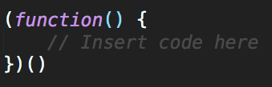
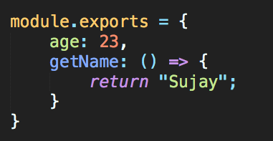
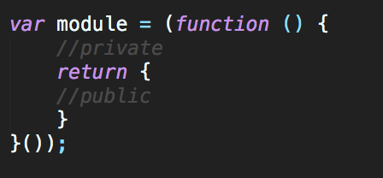

How to not write spaghetti code?
Modularizing code
ES6
ES5

Slide 7
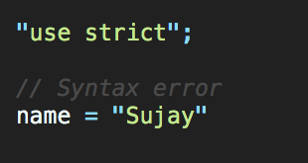
How to not write spaghetti code?
Use strict mode!
Add at the top of your file
Catch code bloopers
Throws errors
Disables deprecated features
https://developer.mozilla.org/en-US/docs/Web/JavaScript/Reference/Strict_mode

Slide 8

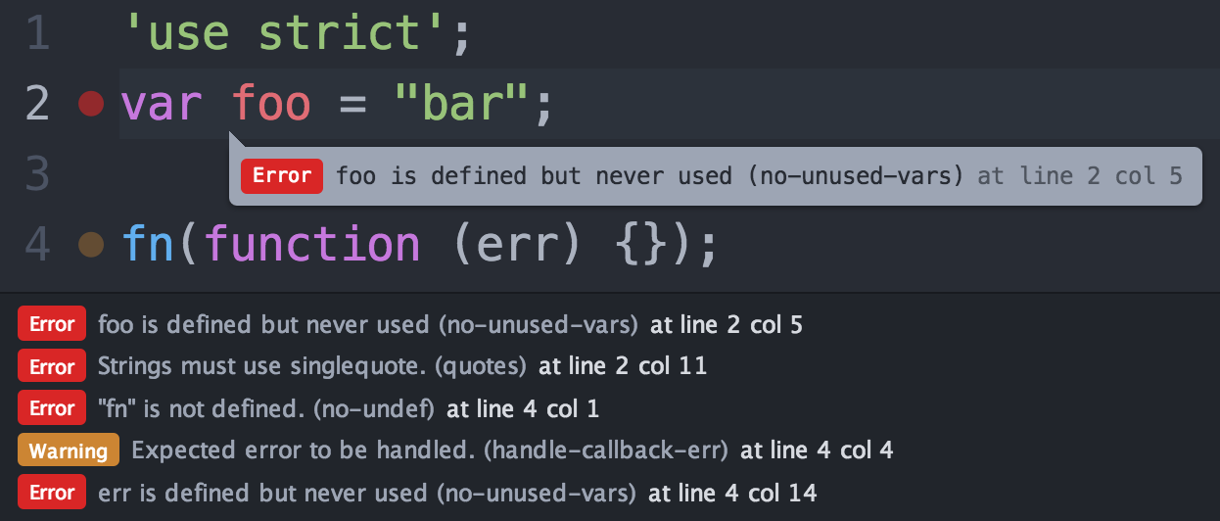
How to not write spaghetti code?
Use a linter!
ESLint, JSLint, JSHint check your code for poor practices!
Built-in Editor Support!

Slide 9
Plain CSS & Javascript still aren’t enough...

Slide 10



Awesome Libraries and Preprocessors

Slide 11

If you want to really learn the power of ES6
https://javascript30.com

Slide 12

Still Plain CSS & Javascript still aren’t enough...

Slide 13
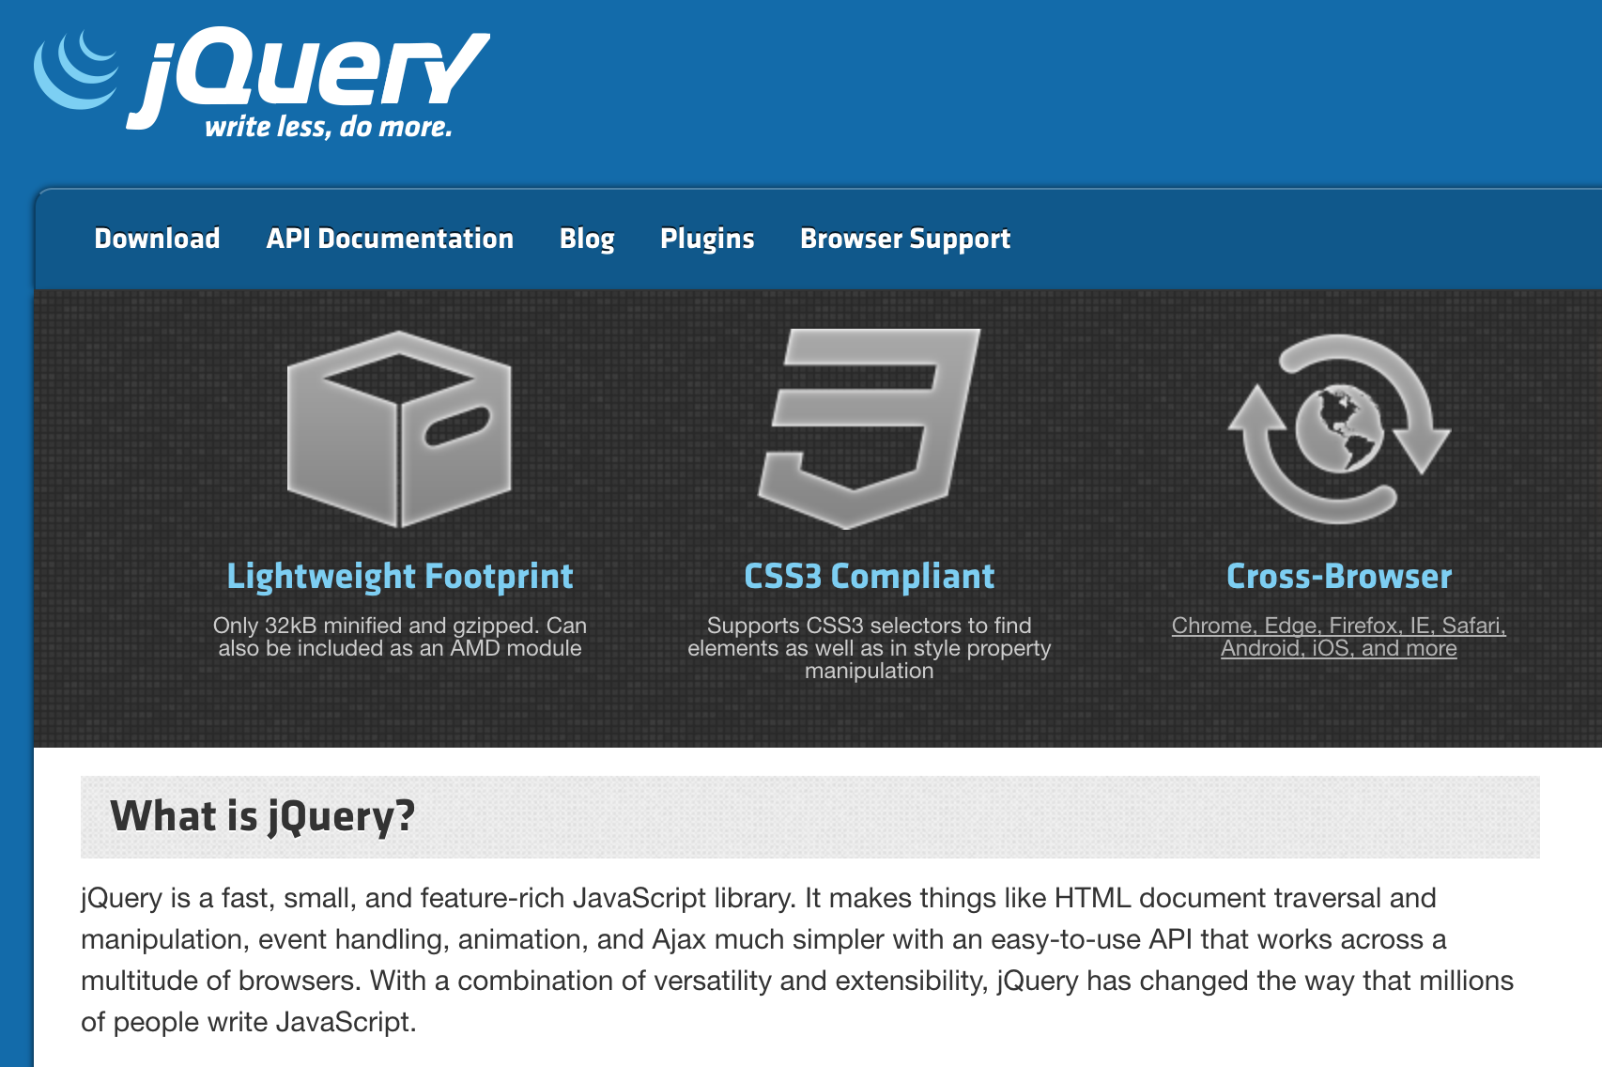
jQuery

Slide 14
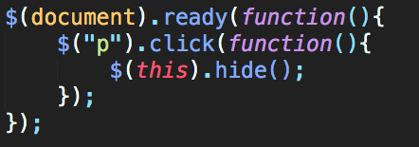
jQuery
Less overhead & simpler functions
Fast, small, rich
Everything is invoked with a “$”
“$” is the name of the function. Seriously.
Widely-used library for DOM Manipulation

Slide 15
Downsides of jQuery
Still possible to write “spaghetti code”
jQuery versioning has become painful
jQuery doesn’t offer a structure, it’s just an API
Growing file size of jQuery can be big overhead on browser load-times
ES6 has faster native functions
jQuery hides a lot of “ugly” parts of Javascript, making learning Javascript much more difficult in the long run (http://youmightnotneedjquery.com/)

Slide 16
jQuery has still moved the web forward!

Slide 17
Modern Frameworks & Libraries

Slide 18

https://hackernoon.com/how-it-feels-to-learn-javascript-in-2016-d3a717dd577f

Slide 19
What do we want?
More boilerplate
Access to native functions
Quick DOM Manipulation
Enforced Guidelines & Structure
Build Powerful Web Applications

Slide 20

Angular
Backed by Google
Popularized Single-Page Web Applications
Dynamic Web Application Views
Services, Factories, Controllers allowed for more modularity
Directives let you invent your own HTML syntax!

Slide 21

Angular Concepts
Model-View-Controller Paradigm
Model
The data model
Controller
The logic handler
View
Renders the data

Slide 22
Angular Concepts
Two Way Data-binding
Automatic synchronization between the model and the view
Checks for changes in the model or view and does “dirty-checking”
$apply calls $digest in Angular, which keeps checking to see if the value has changed!

Slide 23
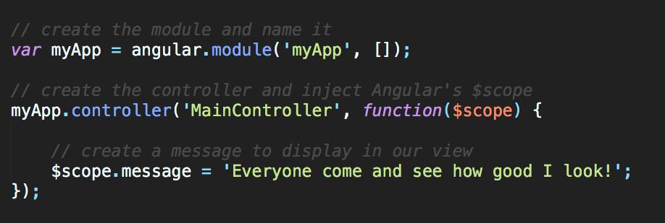
MVC in Angular

Slide 24
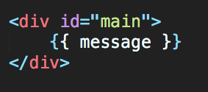
MVC in Angular
{{ }} allows for automatic databinding

Slide 25
Why’d we switch?
Angular 2.0 was completely different from Angular 1.0
MVC doesn’t scale, according to Facebook
You end up with a lot of controllers and views to maintain
React has better performance
Angular uses digest cycles & dirty checking
React leaned more towards ES6 functions rather than custom “directives”
Angular introduced ng-*, which was useful, but specific to Angular
Industry shift towards React
Unidirectional data flow > two-way data binding

Slide 26

React
Backed by Facebook
Library, not Framework
For the bigger architecture, look into Flux
Unidirectional data flow
Declarative
Every component has a state with data injected into it
Component-based
Each module manages its data and views
Extendability
Used with React Native, Electron, etc

Slide 27
“React is a library for building composable user interfaces. It encourages the creation of reusable UI components which present data that changes over time.”
https://facebook.github.io/react/blog/2013/06/05/why-react.html

Slide 28
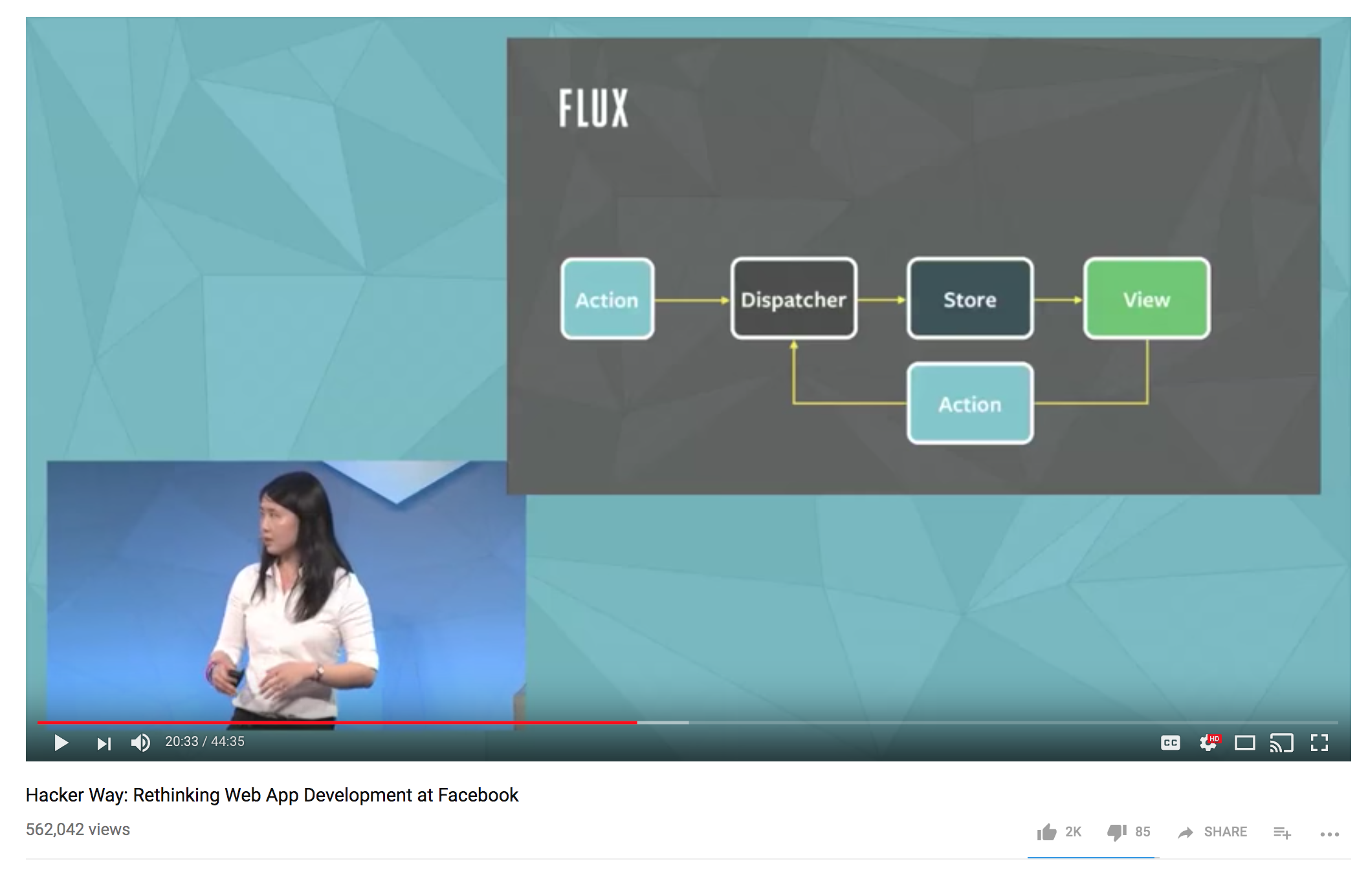
Unidirectional Flow
https://www.youtube.com/watch?v=nYkdrAPrdcw

Slide 29
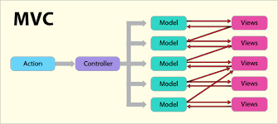
MVC is too complicated
https://medium.com/@cabot_solutions/flux-the-react-js-application-architecture-a-comprehensive-study-fd2585d06483

Slide 30

Why did Facebook think of this?
0 Notifications
1 Notification
Our data has been changed!
React has noticed this data change and will update the view to reflect this change in data
How can we display this change without re-rendering the entire page?

Slide 31

A Background on Painting
The DOM tree is converted into pixels that are laid out onto the page to create the render tree
“Painting”
Reflows cause the DOM Tree to be repainted into a newly updated render tree
Reflow occur due to changes in the DOM tree
Updating a DOM Node, adding a DOM node, etc
Behind-the-scenes computation creates new visual representations
This can be expensive and slow for our webpage!
If only there was a better way!
The Joy of (DOM) Painting

Slide 32
Virtual DOM
In-memory, lightweight clone of the DOM, represented as a single JS Object
Repaint the DOM with the less amount of changes possibles
First, React notices that the data has changed
React will execute the change within the lightweight Virtual DOM
React compares the Virtual DOM with the real DOM by using “diff”
React immediately patches changes from the Virtual DOM to the real DOM
This avoids expensive traversing of the DOM tree
Makes React very fast with DOM changes

Slide 33
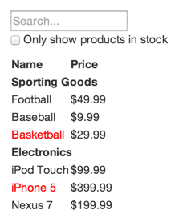
Thinking in React
https://facebook.github.io/react/docs/thinking-in-react.html

Slide 34
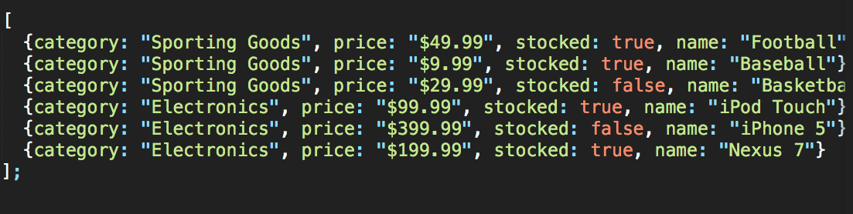
Thinking in React
Our Data!
https://facebook.github.io/react/docs/thinking-in-react.html

Slide 35
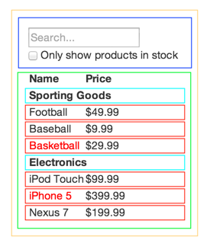
Thinking in React
FilterableProductTable (orange): contains the entirety of the example
SearchBar (blue): receives all user input
ProductTable (green): displays and filters the data collection based on user input
ProductCategoryRow (turquoise): displays a heading for each category
ProductRow (red): displays a row for each product
https://facebook.github.io/react/docs/thinking-in-react.html

Slide 36
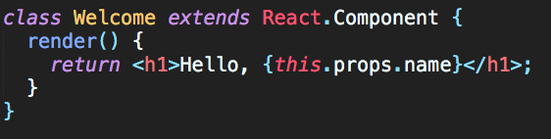
A Simple Example
React Component needs a render method!
Render returns JSX
“this.props” is referring to the passed in “props” of the component

Slide 37
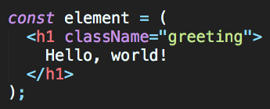
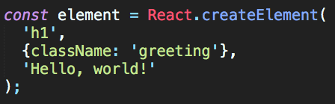
JSX
React’s fancy syntax extension to Javascript that looks a lot like HTML
Creates React “Elements” which allows for injection of Javascript variables and expressions
Some differences with HTML
E.g. “className” vs “class-name”

Slide 38
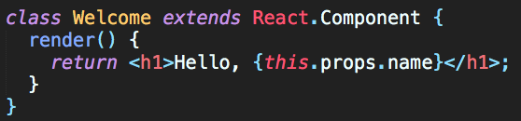

Props
All valid React components accept a single “props” object with data and returns a React element
Props are passed into the React Component & are read-only
https://codepen.io/gaearon/pen/VKQwEo?editors=0010

Slide 39
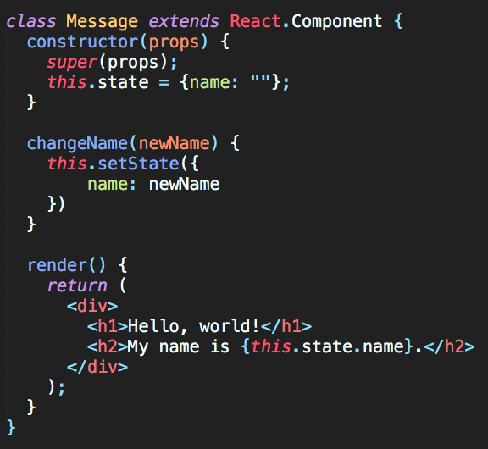
State
A component’s state, or internal data
In the example, name is added to the state. State is an object.
IMPORTANT: State cannot be reassigned, it can only be changed using “this.setState(...)”
this.setState triggers the render function to run again!
http://codepen.io/gaearon/pen/dpdoYR?editors=0010

Slide 40
Lifecycle methods
componentWillMount() - called before the DOM tree has been rendered
componentWillReceiveProps() - called when new props are passed into the component
componentDidMount() - code that will be executed after the component output has been rendered to the DOM
componentWillUnmount() - code that will be run before the webpage is destroyed

Slide 41
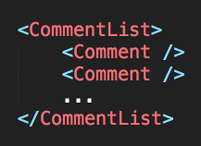
React Composable Views

Slide 42
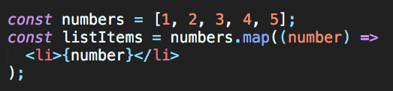
Rendering Multiple Items
Use regular ES5 and ES6 functions to render JSX or Javascript objects!
JSX elements are just Javascript objects so you can store them in arrays too!

Slide 43
Demo

Slide 44
Side Note: Use Classes
The web is littered with examples of React in ES5. Use Classes!
You can convert a functional component to a class in five steps:
Create an ES6 class with the same name that extends React.Component.
Add a single empty method to it called render().
Move the body of the function into the render() method.
Replace props with this.props in the render() body.
Delete the remaining empty function declaration.
https://facebook.github.io/react/docs/state-and-lifecycle.html

Slide 45
Further Readings
https://facebook.github.io/react/
https://facebook.github.io/react/blog/2013/06/05/why-react.html
https://facebook.github.io/react/docs/introducing-jsx.html
https://facebook.github.io/react/docs/jsx-in-depth.html

