Slide 1
Binder

Slide 2
libbinder/link death
Stub/Proxy
message/handler/looper
hwbinder
/dev/binder todo/wait list mmap memory / free ? BINDER_TYPE_HANDLE

Slide 3
ProcessState::self()
->startThreadPool()
IPCThreadState::self()->
transact()
IPCThreadState::talkWithDriver()
将IPCThreadState.mOut发送给对端,
IPCThreadState.mIn为收到的数据

Slide 4
input

Slide 5
NativeInputManager
sp<InputManager> mInputManager
InputManager
sp<InputReaderInterface> mReader
sp<InputReaderThread> mReaderThread
sp<InputDispatcherInterface> mDispatcher
sp<InputDispatcherThread> mDispatcherThread
EventHubInterface
EventHub
KeyedVector<int32_t, Device*> mDevices
int32_t mNextDeviceId
Device
const String8 path
int fd
InputListenerInterface
InputReaderInterface
InputDispatcherInterface
InputReader
sp<EventHubInterface> mEventHub
InputDispatcher
Queue<EventEntry> mInboundQueue

Slide 6
在“InputReader”线程中调用InputReader::loopOnce()
InputReader
KeyedVector<int32_t, InputDevice*> mDevices
ContextImpl mContext
sp<QueuedInputListener> mQueuedListener
InputDevice
Vector<InputMapper*> mMappers
SingleTouchInputMapper/
MultiTouchInputMapper
TouchInputMapper
CursorInputMapper
InputMapper
process()
InputDevice* mDevice
InputReaderContext* mContext

Slide 7
NativeInputWindowHandle
在“InputDispatcher”线程中InputDispatcher::dispatchOnce()
InputDispatcher
notifyKey()
notifyMotion()
injectInputEvent()
registerInputChannel()
Connection
sp<InputChannel> inputChannel
Queue<DispatchEntry> outboundQueue

Slide 8
ViewRootImpl
WindowInputEventReceiver
WindowInputEventReceiver
InputChannel mInputChannel
addWindow()
dispatchInputEvent()
WindowManagerService
registerInputChannel()
LooperCallback
InputManagerService
NativeInputEventReceiver
handleEvent()
consumeEvents()
InputConsumer mInputConsumer
InputChannel::openInputChannelPai()调用socketpair()返回读写fd分别给两个InputChannel持有
1 读端的InputChannel被ViewRootImpl封装成
WindowInputEventReceiver, 在Looper中poll
数据给view
2 写端InputChannel通过registerInputChannel()
在InputDispatcher种以Connection保存, 并在
确认对应window状态后调用InputPublisher::
publishKeyEvent()写入input数据

Slide 9
abstract InputStage
deliver()
forward()
finish()
apply()
onProcess()
abstract AsyncInputStage
NativePreImeInputStage/
ImeInputStage/
ViewPreImeInputStage/
EarlyPostImeInputStage/
...
ViewGroup
dispatchTouchEvent()
dispatchKeyEvent()

Slide 10
display

Slide 11
ViewRootImpl
View.AttachInfo mAttachInfo.mHardwareRenderer
enableHardwareAcceleration()
HardwareRenderer.create()
ThreadedRenderer
RenderNode mRootNode
long mNativeProxy
JNI
nCreateRootRenderNode
JNI
RenderNode
RenderProxy
RenderThread& mRenderThread
CanvasContext* mContext
RootRenderNode
大部分函数都调用到RenderProxy, 而proxy里是把运行函数作为RenderTask去queue到RenderThread运行：
1 RenderProxy.xxx()使用SETUP_TASK(xxx), 然后post
2 CREATE_BRIDGEx(xxx, ...)为后面真正会run的接口
CanvasContext
OpenGLRenderer* mCanvas

Slide 12
View
RenderNode mRenderNode
start()返回Canvas, draw完成后end()告知native
RenderNode
create()
DisplayListCanvas start()
void end(DisplayListCanvas canvas)
Canvas
DisplayListCanvas
drawRenderNode(RenderNode renderNode)
drawHardwareLayer(HardwareLayer layer,...)
JNI
Canvas
DisplayListCanvas

Slide 13
ViewParent
ViewManager
ViewRootImpl.draw()
View
View mView
ThreadedRenderer.draw()
ViewGroup
mRootNode.start()
DisplayListCanvas canvas.drawRenderNode(view.updateDisplayListIfDirty())
mRootNode.end()
FrameLayout
mRootNode
View.updateDisplayListIfDirty()
renderNode.start()
draw(canvas)
enderNode.end(canvas)
canvas
View.onDraw()
ViewGroup.dispatchDraw()
mChildren
View.draw(Canvas canvas,...)
当drawingWithDrawingCache标志为真,则该
child也updateDisplayListIfDirty(), 然后 在传递来的canvas上调用drawRenderNode()

Slide 14
DisplayListCanvas
DisplayListData* finishRecording()
DisplayListData* mDisplayListData
DisplayListData
Vector<DrawRenderNodeOp*> mChildren
Vector<DisplayListOp*> displayListOps
Vector<Chunk> chunks
struct Chunk {
size_t beginOpIndex;
size_t endOpIndex;
size_t beginChildIndex;
size_t endChildIndex;
bool reorderChildren;
};
RenderNode
setStagingDisplayList(DisplayListData* )
DisplayListData* mStagingDisplayListData
DisplayListData* mDisplayListData
framework里当调用RenderNode.end
(DisplayListCanvas canvas)时，就会把对应canvas的ops放到native RenderNode中

Slide 15
CanvasContext::draw()
nDrawRenderNode()
OpenGLRenderer::drawRenderNode()
DisplayListCanvas::drawRenderNode()
RenderState
Caches* mCaches
Program* mProgram
TextureState* mTextureState
renderthread::RenderThread& mRenderThread
TextureState
activateTexture(GLuint textureUnit)
bindTexture(GLuint texture)
TextureState是对gl的texture相关方法的封装

Slide 16
Texture
GLuint id
get()接口将会把bitmap内数据传到Texture.id对应的gl纹理，generateTexture()为实现细节，调用关键接口glTexSubImage2D()
TextureCache
Texture* get(const SkBitmap* bitmap)
Glop
struct Fill {
Program* program;
struct TextureData {
Texture* texture;
GLenum target;
...
} texture;
...
} fill;
GlopBuilder
setFillPaint()
setFillTexturePaint()
setFillLayer()
build()
Glop* mOutGlop
ProgramDescription mDescription
ProgramCache
Program* get(const ProgramDescription& )
get()接口向外提供description来描述绘图
的细节, 然后在ProgramCache构建vertext和
fragment的两个sharder string:
generateVertexShader()
generateFragmentShader()
然后再构造Program对象, Program中通过标
准gl函数glAttachShader, etc来完成
Program
GLuint mProgramId
GLuint mVertexShader
GLuint mFragmentShader

Slide 17
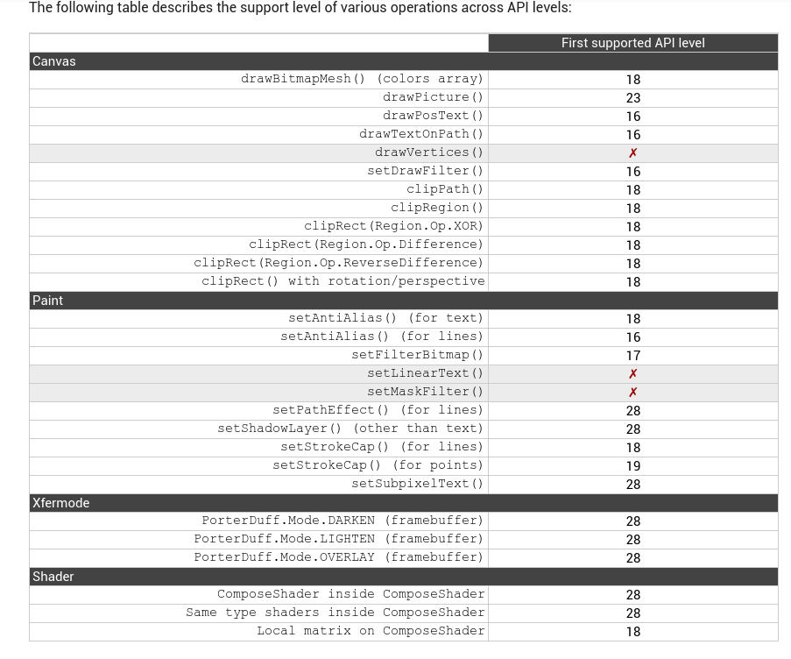
CanvasContext
OpenGLRenderer* mCanvas
OpenGLRenderer
Notes:
https://developer.android.com/guide/topics/graphics/hardware-accel.html

Slide 18
START UP

Slide 19
zygote
init.zygote64_32.rc
service zygote /system/bin/app_process64
-Xzygote /system/bin --zygote --start-system-server --socket-name=zygote
service zygote_secondary /system/bin/app_process32
-Xzygote /system/bin --zygote --socket-name=zygote_secondary
app_main.cpp
1 当参数有--zygote， start()调用
"com.android.internal.os.ZygoteInit"
的main方法
2 或调用"com.android.internal.os.RuntimeInit"
的main方法
AndroidRuntime
start(char *classname,Vector<String8>& , bool zygote)
startVm()
AppRuntime
onStarted()

Slide 20
ZygoteInit
main()
registerZygoteSocket()
创建LocalServerSocket sServerSocket,
将会根据socket name调用bind&listen
startSystemServer()
Zygote.forkSystemServer()然后在
子进程handleSystemServerProcess()
runSelectLoop()
对sServerSocket的fd进行poll, 有连接
请求时创建ZygoteConnection并把连接
fd加入poll, 有对应的消息时, 调用runOnce()

Slide 21
Activity

