Slide 1
struct binder_write_read
BR_XXX(binder_driver_return_protocol)
cmd
read_buffer
struct binder_transaction_data
BC_XXX(binder_driver_command_protocol)
write_buffer
cmd
struct binder_transaction_data
transaction command
code
target descriptor
target.handle
flat_binder_object
data_size
type
offsets_size
type
type
handle
data.buffer
handle
handle
cookie
cookie
data.offsets
cookie
....
....
....
....

Slide 2
proc
proc
wait
todo
todo
wait
thread
thread
todo
todo
wait
wait
thread
thread
todo
todo
wait
wait

Slide 3
add to servicemanager
XService
interface_cast ->
INTERFACE::asInterface
BnXXX
BpXXX
BnInterface
BpInterface
IXXX
BpRefBase
IBinder* const mRemote
IInterface
BBinder
BpBinder
transact()
in ProcessState::
getStrongProxyForHandle() ->
new BpBinder(handle)
onTransact()
mHandle
IBinder

Slide 4
MemoryBase
MemoryHeapBase
sp<IMemoryHeap> mHeap
int mFD
void* mBase
BnMemory
BnMemoryHeap
IMemory
IMemoryHeap
sp<IMemoryHeap> getMemory
void* base()

Slide 5
libhwbinder
IInterface
asBinder()
onAsBinder() = 0
IXXX
BHwBinder
BpHwBinder
onTransact()
int32_t mHandle
IBinder
transact()
BpHwBinder* remoteBinder()
BHwBinder* localBinder()

Slide 6
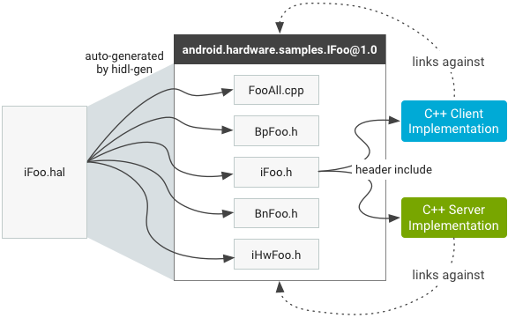
./hardware/interfaces/media/omx/1.0/IOmx.hal
HIDL - 1
hidl-gen
system/tools/hidl
android/hardware/media/omx/1.0/IOmx.h
android/hardware/media/omx/1.0/IHwOmx.h
android/hardware/media/omx/1.0/BnHwOmx.h
android/hardware/media/omx/1.0/BpHwOmx.h
android/hardware/media/omx/1.0/BsOmx.h
android/hardware/media/omx/1.0/OmxAll.cpp

Slide 7
HIDL - 2
hwservicemanager

