Slide 1
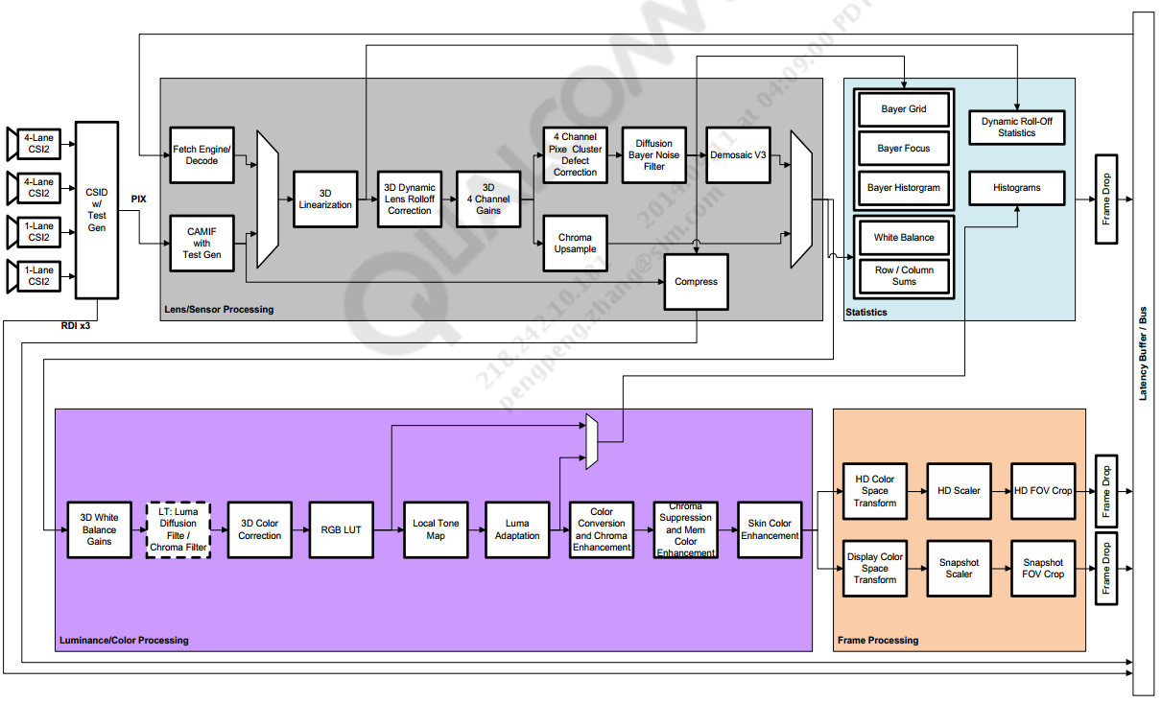

Slide 2
CAM_STREAM_TYPE_PREVIEW
char *preview_bayer_mod[][MAX_STREAM_MODULES] = {
{sensor","iface","isp","pproc","imglib"},
{ "isp", "stats"},
{},
};

Slide 3
msm_isp.h
struct msm_vfe_irq_ops {
...
void (*process_reg_update)(struct vfe_device *vfe_dev,
uint32_t irq_status0, uint32_t irq_status1,
struct msm_isp_timestamp *ts);
void (*process_halt_irq)(struct vfe_device *vfe_dev,
uint32_t irq_status0, uint32_t irq_status1);
void (*process_camif_irq)(struct vfe_device *vfe_dev,
uint32_t irq_status0, uint32_t irq_status1,
struct msm_isp_timestamp *ts);
void (*process_axi_irq)(struct vfe_device *vfe_dev,
uint32_t irq_status0, uint32_t irq_status1,
uint32_t pingpong_status,
struct msm_isp_timestamp *ts);
void (*process_stats_irq)(struct vfe_device *vfe_dev,
uint32_t irq_status0, uint32_t irq_status1,
uint32_t pingpong_status,
struct msm_isp_timestamp *ts);
void (*config_irq)(struct vfe_device *vfe_dev,
uint32_t irq_status0, uint32_t irq_status1,
enum msm_isp_irq_operation);
void (*preprocess_camif_irq)(struct vfe_device *vfe_dev,
uint32_t irq_status0);
};
ISP_EVENT_SOF
ISP_EVENT_FE_READ_DONE
ISP_EVENT_BUF_DIVERT/
ISP_EVENT_BUF_DONE
ISP_EVENT_STATS_NOTIFY

Slide 4
msm_cpp.c
static irqreturn_t msm_cpp_irq(int irq_num, void *data)
msm_cpp_notify_frame_done()

