Slide 1
包含功能
kam_vid_jpegd_xxx
kam_vid_dec_xxx
kam_vid_jpege_xxx
kam_vid_enc_xxx
1 jpeg的编码和解码：
jpeg编码主要用于类似 拍照场景;
jpeg解码场景目前使用于USB摄像头采集
到的jpeg数据先解码成YUV格式然后做avc/
hevc编码
2 avc/hevc的编码和解码

Slide 2
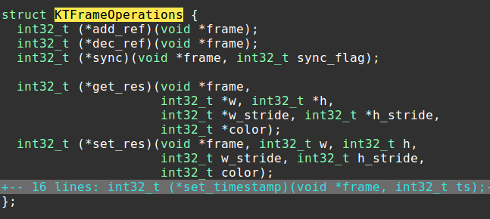
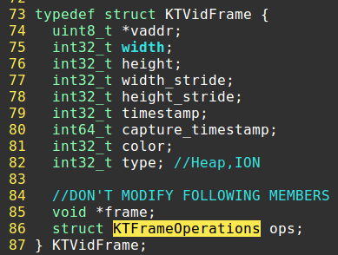
内部buffer介绍
kam_vid_base_create_fq()
kam_vid_base_fq_acquire(KVID_BASE_FQ_HANDLE fq_hndl, KTVidFrame *frame)

Slide 3
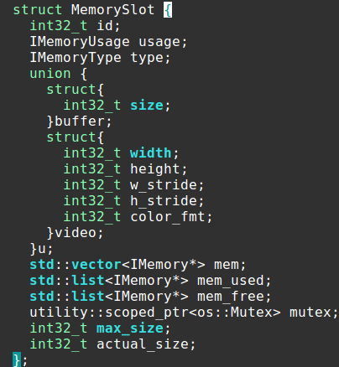
内部buffer实现
kam_vid_base_fq_xx
TVidBaseFQInstance.slot
MemoryPoolImpl
std::map<int32_t, MemorySlot*> _slots
……
MemorySlot

Slide 4
eVidFrameTypeHeap
eVidFrameTypeION
1 Heap类型时分配时为new []返回的堆上buffer
2 Gralloc时是调用ION的接口分配的可以各个模块共享buffer
eMemoryTypeHeap
eMemoryTypeGralloc
create_slot()
get()
put()
MemorySlot
usage
eMemoryUsageBuffer -> IMemory
eMemoryUsageVideoFrame -> VideoMemory
MemorySlot
std::list<IMemory*> mem_used
std::list<IMemory*> mem_free

Slide 5
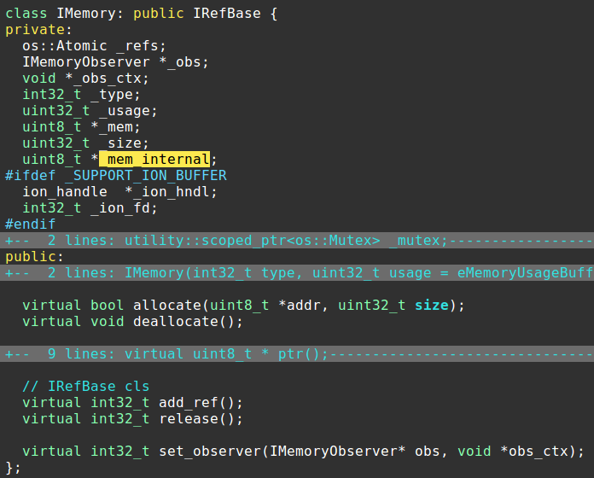
每个Imemory维护一个_refs, 用于确定是否放置到
MemorySlot.mem_free中循环使用

Slide 6
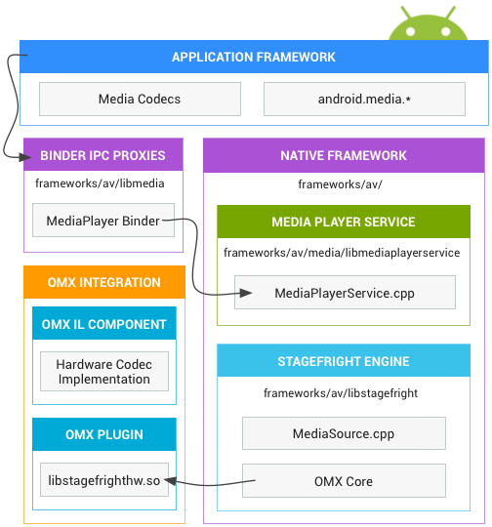
Android编解码框架
Notes:
https://source.android.com/devices/media

Slide 7
libstagefright
MediaCodec
sp<CodecBase> mCodec
CodecBase
Acodec
sp<IOMX> mOMX
CodecObserver
media.codec
OMX
OMXNodeInstance
MX_HANDLETYPE mHandl
OMXNodeInstance
MX_HANDLETYPE mHandl
OMXMaster
libstagefrighthw
dlsym createOMXPlugin

Slide 8
MediaRecorder
BnMediaRecorderClient
libmedia
MediaRecorder
sp<IMediaRecorder> mMediaRecorder
setListener
BnMediaRecorder
MediaRecorderClient
MediaRecorderBase *mRecorder
libmediaplayerservice
StagefrightRecorder
MediaCodecSource
sp<MediaCodec> mEncoder
libstagefright

Slide 9
StagefrightRecorder
sp<hardware::ICamera> mCamera
sp<IGraphicBufferProducer> mPreviewSurface
sp<IGraphicBufferConsumer> mPersistentSurface
sp<CameraSource> mCameraSource
sp<IGraphicBufferProducer> mGraphicBufferProducer
createInputSurface()
setInputSurface()
MediaCodecSource::Puller()
MediaCodecSource
sp<MediaCodec> mEncoder
queueInputBuffer()
MediaCodec

Slide 10
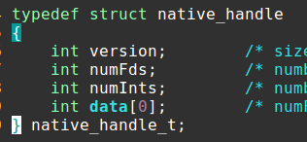
Android媒体Buffer
ANativeWindowBuffer
native_handle_t* handle
GraphicBuffer
GraphicBufferMapper/
GraphicBufferMapper
gralloc_open
alloc_device_t
gpu_context_t
IAllocController* mAllocCtrl
IonController

Slide 11
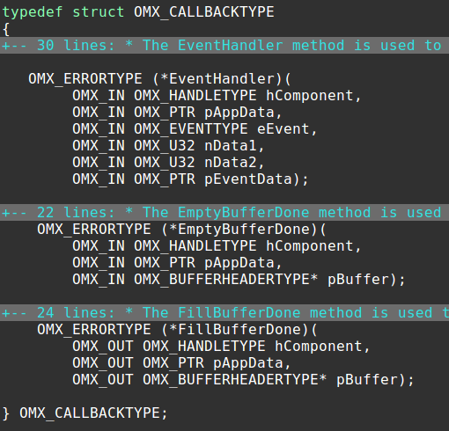
openMAX IL接口
OMX_Core.h
OMX_API OMX_ERRORTYPE OMX_APIENTRY OMX_Init(void)
OMX_API OMX_ERRORTYPE OMX_APIENTRY OMX_GetHandle(
OMX_OUT OMX_HANDLETYPE* pHandle,
OMX_IN OMX_STRING cComponentName,
OMX_IN OMX_PTR pAppData,
OMX_IN OMX_CALLBACKTYPE* pCallBacks)
…

Slide 12
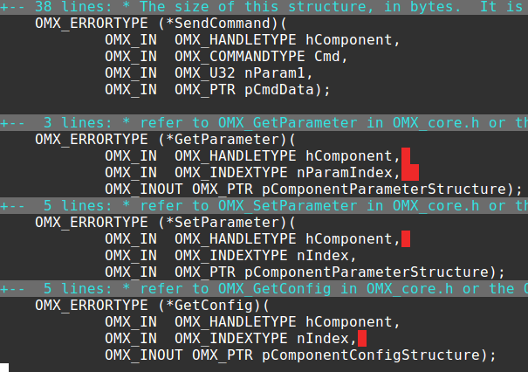
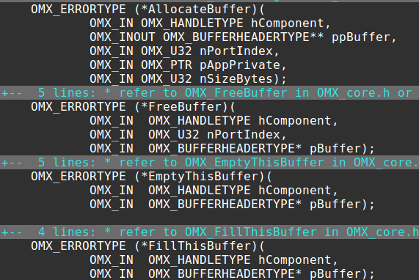
OMX_Component.h
typedef struct OMX_COMPONENTTYPE {
…
}

Slide 13
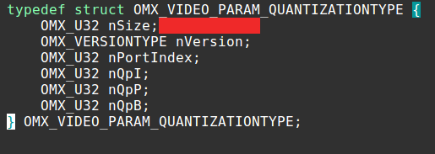
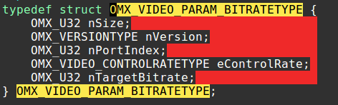
GetParameter/ SetParameter传参时的
OMX_INDEXTYPE和OMX_PTR分别位于
OMX_Index.h和OMX_Video.h中, 如：
OMX_IndexParamVideoQuantization
OMX_IndexParamVideoBitrate

Slide 14
jpeg功能
eVidJpegSW
eVidJpegSW
eVidJpegKeda
eVidJpegHW
kam_vid_jpegd_create
kam_vid_jpege_create
VidJpegSWDecoder
VidJpegSWEncoder
VidJpegHWEncoder

Slide 15
VidJpegSWDecoder
_write_idx
scoped_array<JDecMsg> _data_done
_done_idx
std::list<JDecMsg> _fillbuffer
Decode()
PopBuf()
std::list<JDecBuffer> _jbuf
通过_write_idx循环计数找到
下一个_data_done中JDecMsg.status
为kKeyEmpty位置，放置到_fillbuffer
中
GetNextSlot()
多解码线程
kam_jpg_dec_xx
取出_fillbuffer中JDecMsg, 解码并
更新JDecMsg.status
kam_jpg_dec_xx
通过done_idx循环计数找到下一
个JDecMsg.status为kKeyProcessed
然后回调上层
更新JDecMsg.status
PushBuf()
回调线程
kam_jpg_dec

Slide 16
1 VidJpegSWEncoder实现分为eVidJpegKeda和eVidJpegSW
分别调用算法组的jpeg库和libjpeg的开源实现
2 VidJpegHWEncoder通过WebRTCAPI返回的跨版本RTCJpegCodec_调用
高通平台的硬件jpeg编码器
原生实现
libmmjpeg_interface
mm_jpeg_xx()
libqomx_core
OMX_GetHandle()
libqomx_jpegenc
qomx_core_helper.a
create_component_fns()

Slide 17
QOMXImageCodec
OMXImageEncoder
OMXJpegEncoder
OMXJpegEncoder::encodeImage()
QImageCodecFactory.
CreateEncoder()
QImageEncoderInterface
QImageHW10Encoder
QImageHW10Encoder::Load()
QImageHW10Encoder::Encode()
QJpegeLib_t
libjpegehw
jpege_lib_init
操作/dev/jpeg设备节点

Slide 18
hw_jpeg.cpp实现
1 基于libqomx_core的OMX_GetHandle直接拿到
OMX_HANDLETYPE
或基于libqomx_jpegenc的create_component_fns()
拿到OMX_HANDLETYPE
2 基于标准的OMX接口流程编程，同时参考libmmjpeg_interface
中的具体实现

Slide 19
avc/hevc编解码功能
eVidCodecUsageNDK
eVidCodecUsageSDK
eVidCodecUsageOMX
eVidCodecUsageNDK
eVidCodecUsageSDK
eVidCodecUsageSW
kam_vid_enc_create
kam_vid_dec_create
VidNdkDecoderH264/ VidNdkDecoderH265
VidSdkDecoder
VidKdcDecoderH264/ VidKdcDecoderH265
VidNdkEncoderH264/VidNdkEncoderH265
VidSdkEncoder
VidOmxEncoderH264/VidOmxEncoderH265

Slide 20
ndk接口编解码
VidNdkDecoderH264/ VidNdkDecoderH265
VidNdkEncoderH264/VidNdkEncoderH265
NdkCodec
AMediaCodec_createDecoderByType/
AMediaCodec_createEncoderByType
AMediaCodec_dequeueOutputBuffer/
AMediaCodec_dequeueInputBuffer
libmediandk
AMediaCodec
libstagefright
MediaCodec

Slide 21
SDK接口编解码
VidSdkDecoder/VidSdkDecoder
SdkCodec
createEncoderByType/createDecoderByType
queueInputBuffer/dequeueOutputBuffer
android.media.MediaCodec
libmedia_jni
JMediaCodec
libstagefright
MediaCodec

Slide 22
算法组解码
VidKdcDecoderH264/
VidKdcDecoderH264
KdcCodec
ibh265dec_android_linux.a/
libh264dec_android_linux.a
VideoUnitDecoderProcess
公司算法提供的接口，接口使用、行为和问题都可以向算法组沟通

Slide 23
OMX接口编码
VidOmxEncoderH264/VidOmxEncoderH265
OmxCodec
CCStone::OMXCore *_omx_core
OMXCore
OMX_GetHandle
OMXAndroid_StoreMetaDataInBuffers
OpenMAXLibs. Dlopen() & dlsym
IOMX_Init
IOMXContext
sp<IOMX> iomx
OMXPluginBase *omx
当有权限(system/root)时会直接拿到OMXPluginBase , 或者拿到IOMX来跨进程调用
libvendor_sdk

Slide 24
OmxCodec
cirq_handle _cq_ebd
cirq_handle _cq_ebd
cirq_handle _cq_pre_ebd
cirq_handle _cq_pre_fbd
enqueue()
dequeue from cq_ebd
1 eOmxCodecMetaBuffer时，
通过Ion->conf_media_buffer()填充meta
2 非meta时，拷贝
OMX_EmptyThisBuffer
dequeue from _cq_fbd
OMX_FillThisBuffer
alloc_buffer_on_port()后
所有i/o都在_cq_ebd/_cq_ebd
1 OmxCodec::FillBufferDone() queue _cq_pre_fbd
2 OmxCodec::EmptyBufferDone() queue _cq_pre_ebd
回调线程kam_omx_cb
1 dequeue from _cq_pre_fbd，回调后queue _cq_fbd
2 deque from _cq_pre_ebd, 有值则queue _cq_ebd
Notes:
kMetadataBufferTypeANWBuffer
kMetadataBufferTypeNativeHandleSource

Slide 25
其他调用方式
MediaRecorder/MediaCode
createPersistentInputSurface()
setInputSurface()
setVideoSource(MediaRecorder.VideoSource.SURFACE)
getSurface()
让OMX创建BufferQueue, 拿到对应的producer后送GraphicBuffer编码
createInputSurface(…,
sp<IGraphicBufferProducer> *bufferProducer)
createPersistentInputSurface(
sp<IGraphicBufferProducer> *bufferProducer,
sp<IGraphicBufferConsumer> *bufferConsumer)
setInputSurface(
const sp<IGraphicBufferConsumer> &bufferConsumer)
显示创建producer和consumer再通过setInputSurface传递consumer
BufferQueue::ConsumerListener
GraphicBufferSource
emptyGraphicBuffer()
OMXNodeInstance
Notes:
MediaRecorderTest.java
Camera2VideoFragment.java

