Slide 1
组件内实现
eVidRenderTypeSurfaceView/
eVidRenderTypeNativeWinow/
eVidRenderTypeNativeWinowQcom
kam_vid_render_xxx
VidRenderJava
VidRenderNativeWindowNDK
VidRenderNativeWindowQcom

Slide 2
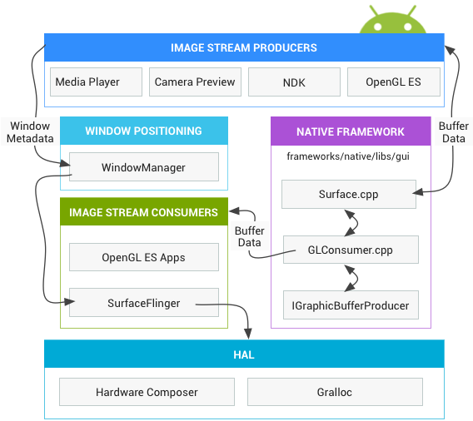
Android图形框架
Notes:
https://source.android.com/devices/graphics

Slide 3
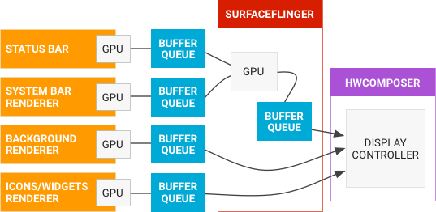
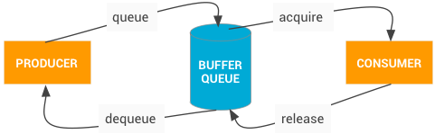
Notes:
https://source.android.com/devices/graphics

Slide 4
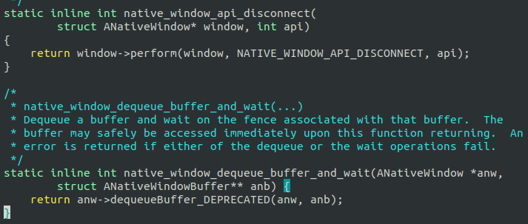
Surface对象
ANativeWindow
int (*perform)(struct ANativeWindow* ,
int operation, ... );
...
Surface
sp<IGraphicBufferProducer> mGraphicBufferProducer
BufferQueueProducer

Slide 5
BufferQueue
createBufferQueue()
consumerConnect()
acquireBuffer(BufferItem* outBuffer,...)
releaseBuffer(...,EGLSyncKHR fence)
native_window_api_connect()
requestBuffer(int slot, sp<GraphicBuffer>*)
dequeueBuffer(int *outSlot, …)
queueBuffer(int slot,…)
ConsumerListener
onFrameAvailable(
const BufferItem& item)
BufferQueue
BnGraphicBufferConsumer
BnGraphicBufferProducer
BufferQueueConsumer
connect()
sp<BufferQueueCore> mCore
BufferQueueProducer
connect()
sp<BufferQueueCore> mCore
BufferQueueCore
sp<IGraphicBufferAlloc> mAllocator
BufferQueueDefs::SlotsType mSlots

Slide 6
dequeue()
queue()
1 update mSlots[] state
2 push back a BufferItem to mQueue
BufferQueueCore
Fifo mQueue
BufferQueueDefs::SlotsType mSlots
std::list<int> mFreeBuffers
std::set<int> mActiveBuffers
typedef BufferSlot SlotsType[NUM_BUFFER_SLOTS]
typedef Vector<BufferItem>
Fifo
BufferItem
sp<GraphicBuffer> mGraphicBuffer
sp<Fence> mFence
bool mAcquireCalled
bool mQueuedBuffer
BufferSlot
sp<GraphicBuffer> mGraphicBuffer
BufferState mBufferState
FREE
DEQUEUED
QUEUED
ACQUIRED
SHARED
release()
acquire()

Slide 7
ConsumerListener
ConsumerBase
sp<IGraphicBufferConsumer> mConsumer
CpuConsumer
GLConsumer
sp<EglImage> mCurrentTextureImage
uint32_t mTexTarget
提供 lockNextBuffer(LockedBuffer *)
从mConsumer中acquire出buffer,并对
对应的GraphicBuffer进行lock拿到虚拟
地址至LockedBuffer.data
EglImage
GLImageKHR mEglImage
sp<GraphicBuffer> mGraphicBuffer
bindToTextureTarget()
libGLESv2_adreno.so
glEGLImageTargetTexture2DOES()
GLConsumer在收到onFrameAvailable()后，使用者
updateTexImage()将会让GLConsumer从bufferqueue
获取到对应的buffer, 并创建eglimage, 用glBindTexture()
来对mTexTarget操作, bindToTextureTarget()更新
eglimage到该texture上面，其他使用gles编程则可以使
用更新的texture

Slide 8
常见BufferQueue场景
SurfaceTexture
long mProducer
long mSurfaceTexture
ImageReader
Surface mSurface
acquireLatestImage()
JNISurfaceTextureContext
JNIImageReaderContext
sp<IGraphicBufferProducer> mProducer
sp<CpuConsumer> mConsumer
创建BufferQueue, procuder送给生产者, consumer为GLConsumer, update后可以作为其他gl surface的texture
创建BufferQueue, procuder送给生产者, consumer为ImageReader持有者
GraphicBufferSource
sp<IGraphicBufferProducer> mProducer
sp<IGraphicBufferConsumer> mConsumer
DisplayDevice
sp<ANativeWindow> mNativeWindow
创建BufferQueue, procuder送给生产者, consumer为编码器
FramebufferSurface
Layer
sp<SurfaceFlingerConsumer> mConsumer
sp<IGraphicBufferProducer> mProducer
创建BufferQueue, procuder返回给SurfaceView等, consumer为SurfaceFlinger

Slide 9
VidRenderJava
VidRenderJava::
RenderFrame()
std::list<KTVidFrame> _render_frames
异步处理线程
kam_render_java
DoRender()拿出_render_frames
数据拷贝到java层byteBuffer
ViESurfaceRenderer
ByteBuffer byteBuffer
Bitmap bitmap
1. 先将byteBuffer拷贝到bitmap
2. 再通过Canvas.drawBitmap()把bitmap中数据拷贝到Surace对应的buffer queue

Slide 10
VidRenderNativeWindowNDK
VidRenderNativeWindowQcom
VidRenderNativeWindowNDK::RenderFrame()
VidRenderNativeWindowQcom::
RenderFrame()
std::list<KTVidFrame> _render_frames
异步处理线程
kam_render_nw/
kam_render_nw_ndk
1 ANativeWindow_lock()
2 copy to ANativeWindow_Buffer
3 ANativeWindow_unlockAndPost()
1 RTCRenderHandle_t拿到ANativeWindow*
2 ANativeWindow->dequeue()
3 use c2d convert to GraphicBuffer
4 ANativeWindow->queueBuffer()

Slide 11
其他方案
GLSurfaceView
camera
EGLContext
SurfaceTexture
onDrawFrame()
SurfaceView
glDrawElements()
在SurfaceTexutre收到回调后,
把SurfaceTexture作为一个texture通过GLES画到SurfaceView对应的EGLSurface上, 参考grafika

Slide 12
常用显示控件
GLSurfaceView
SurfaceView
1 通过eglCreateWindowSurface()从Surface
创建EGLSurface
2 通过glMakeCurrent()将所有gl动作渲染
目的绑定为EGLSurface
3 在GL的上下文回调onDrawFrame()
中操作
relayoutWindow(…,
Surface outSurface)
WindowManagerService
SurfaceControl
createSurface(…,
sp<IGraphicBufferProducer>*)
BnSurfaceComposerClient
Client
Notes:
https://source.android.com/devices/graphics/arch-st

Slide 13
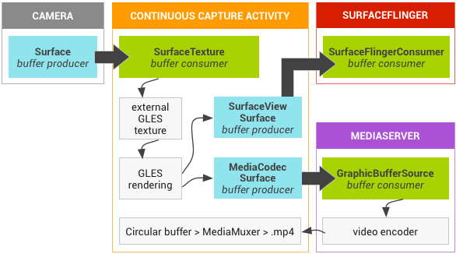
SurfaceTexture
long mProducer
1 BufferQueue::createBufferQueue()
2 构造GLConsumer
3 设置producer到mProducer，设置 GLConsumer
的回调为JNISurfaceTextureContext
根据SurfaceTexture构造的int texName, 后续可以作为GLES的texture画到其他的EGLSurface上

Slide 14
TextureView

Slide 15
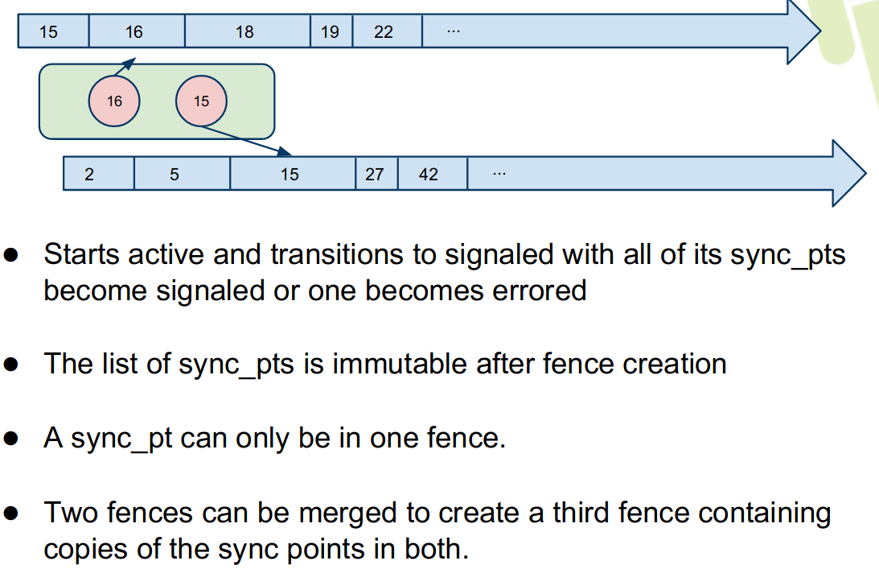
同步方案
libsync
USER
sync_wait()
sync_merge()
sync_fence_info_data()
KERNEL
SYNC_IOC_WAIT
SYNC_IOC_MERGE
SYNC_IOC_FENCE_INFO
Notes:
https://blog.linuxplumbersconf.org/2014/ocw/system/presentations/2355/original/03%20-%20sync%20&%20dma-fence.pdf

Slide 16
从libagl看gl接口
EGL10.eglCreateWindowSurface()
.eglCreateContext()
.eglMakeCurrent()
.eglSwapBuffers()
.eglCreateWindowSurface()
...
SurfaceFlinger::renderScreenImplLocked()
SurfaceFlinger::captureScreenImplLocked()

