Slide 1
Introduction to Cryptocurrency
Understanding basic concepts of peer-peer value exchange, why it’s important and how to get started

Slide 2
HOW DO I KNOW IF ITS A SCAM?
Steer clear of exchanges until you’ve done your research and hold most elsewhere.
Anyone gotten swindled?

Slide 3
Blackmail
Blackmail attempts in which strangers threaten you in exchange for bitcoin as a means of extortion. Commonly by email, where-in the sender transmits a message claiming that he/she has hacked into your computer and is operating it via remote desktop protocol (RDP).
The sender will often say it accessed webcam/personal info and provides two options - send bitcoin to suppress the material, or send nothing and see the content sent to your email contacts and spread across your social networks. Scammers use stolen email lists and other leaked user information to run this scheme across thousands of people en masse.

Slide 4
Fake Exchanges
As bitcoin has become more popular, more people have sought to acquire it. Unfortunately, nefarious people have taken advantage of this and have been known to set up fake bitcoin exchanges. These fake exchanges may trick users by offering extremely competitive market prices that lull them into thinking they're getting a steal, with quick and easy access to some cheap bitcoin. Be sure to use a reputable exchange when buying or selling bitcoin.

Slide 5
Free Giveaways
Due to the viral nature of how information spreads across on the internet, scammers seek to take advantage of people by offering free giveaways of bitcoin or other digital currencies in exchange for sending a small amount to register, or by providing some personal information. When you see this on a website or social network, it's best to immediately report the content as fraudulent, so that others don't fall victim.

Slide 6
Impersonation
Unfortunately it's very easy for con-artists to create social media accounts and impersonate people. Often times they lie in wait, until the person they're trying to impersonate publishes content. The impersonator then replies to it with a follow-up message or call to action - like a free giveaway - using an account that looks almost identical to the original poster or author. This makes it seem like the original person is saying it. Alternatively, impersonators may also try to use these same fake accounts to trick others via private or direct message into taking some kind of action in an attempt to defraud or compromise. Never participate in free giveaways, and if you receive an odd request via someone in your network, it's best to double check to confirm the authenticity via multiple mediums of communication.

Slide 7
Malware
Hackers have become very creative at finding ways to steal from people. When sending bitcoin, always be sure to double or triple check the address you're sending to. Some malware programs, once installed, will change bitcoin addresses when they're pasted from a user's clipboard, so that all of the bitcoin unknowingly gets sent to the hacker's address instead. Since there is little chance of reversing a bitcoin transaction once it's confirmed by the network, noticing this after the fact means it's too late and most likely can't be recovered. It's a good idea to be super-cautious about what programs you allow to have administrator access on your devices. An up-to-date, reputable virus scanner can also help but is not foolproof.

Slide 8
Meeting in Person
When buying or selling bitcoin locally, a counterparty may ask you to meet in person to conduct the exchange. If it isn't a trusted party that you already know, this is a very risky proposition that could result in you getting robbed or injured. Con-artists have also been known to exchange counterfeit fiat currency in exchange for bitcoin. Consider using a peer-to-peer platform to escrow the funds in place of meeting in person.

Slide 9
Money Transfer Fraud
Do not reply to emails or inbound communications from strangers telling you they need help moving some money, whereafter in exchange for your services, you'll get a portion of the funds.

Slide 10
Phishing Emails
Beware of emails purported to be from services you use soliciting you for action, such as resetting your password, or clicking through to provide some sort of interaction with regard to your account. It can be very difficult to spot the difference in a fake email that's trying to entice you to compromise your account, and a legitimate one sent on behalf of a product or service that you use. When in doubt, considering triple-checking the authenticity of the communication by forwarding it to the company, using the contact email address on their website, calling them on the telephone, and/or reaching out to them via their official social media accounts.

Slide 11
Phishing Websites
Phishing websites often go hand-in-hand with phishing emails. Phishing emails can link to a replica website designed to steal login credentials or prompt one to install malware. Do not install software or log in to a website unless you are 100% sure it isn't a fake one. Phishing websites may also appear as sponsored results on search engines or in app marketplaces used by mobile devices. Be wary that you aren't downloading a fake app or clicking a sponsored link to a fake website.

Slide 12
Ponzi and Pyramid Schemes
Do not participate in offerings where one or more people offer you a guaranteed return in exchange for an upfront deposit. This is known as a ponzi scheme, where-in future depositors' principals are used to pay previous investors. The end result is usually a lot of people losing a lot of money.
A pyramid scheme promises returns to participants based on the number of people they invite to join. This enables the scheme to grow virally and rapidly, however, it most often doesn't result in any kind of meaningful return. Never invite your personal network under the sole goal of accumulating rewards or returns from a product or service, and do not contribute your own capital at the behest of others to accelerate the process.

Slide 13
Prize Giveaways
Similarly to free giveaways, prize giveaway scams trick people into taking action or supplying information about themselves. For example, supplying a name, address, email and phone number in order to claim a prize. This can allow a hacker to attempt to use the information to gain access to accounts by impersonating you.

Slide 14
Pump and Dump
Do not trust people who entice you or others to invest because they claim that they know what the bitcoin price is going to be. In a pump and dump scheme, a person (or persons) try to artificially drive up or pump the price so that they can dump their holdings for a profit.

Slide 15
Ransomware
This is a type of malware that partially or completely blocks access to a device unless you pay a ransom in bitcoin. It's best to consult the advice of a trusted computer professional for removal assistance, rather than paying the ransom. Be careful about what programs you install on your devices, especially those that request administrator access. Also be sure to double-check that the application you are downloading isn't a fake one that's impersonating a legitimate one you've used in the past.

Slide 16
Scam Coins
Be careful when investing in alternative coins (altcoins). Amongst altcoins there may be scam coins, enticing users to invest via private sales, or with presale discounts. Scam coins may feature a flashy website and/or boast a large community to create a fear of missing out effect on people who discover it. This helps early holders pump and dump. Scam coins without large communities may do airdrops - offering free coins (or tokens) to people in exchange for joining their communities. This enables scam coins to present their initiatives with inflated traction metrics to make investors feel like they're missing out when it comes time for them to decide if they'd like to buy-in. Scam coins may also use the word Bitcoin in them in an effort to trick or mislead people into thinking there is a legitimate relationship.

Slide 17
All About Trust
If you’re not positive about putting your money there, don’t.
Don’t risk anything you can’t afford to lose at the casino

Slide 18
What today is not about….
Getting rich with cryptocurrency. Long term benefit is having an asset that can’t be taken.
Trading and becoming an expert on exchanges. This is about basic fundamentals of understanding it’s use and getting started.
This is in no way financial advice. It is rather alerting you to the practical applications of peer-peer exchange.

Slide 19
The 5 W’s of Cryptocurrency

Slide 20
The 5 W’s- What, Who/When, Where, Why, How
Today we discuss the basics of cryptocurrency so you can better understand the digital future we face globally.
My journey in crypto began in 2014 and I’ve had my share of learning experiences. I am not an expert by any means, but rather want to share some best practices.

Slide 21
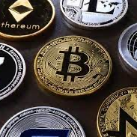
Crypto is a tool
Store of value
Means of exchange
Unit of account

Slide 22
WHAT is cryptocurrency?
It is a string of letters and numbers that cannot be counterfeited. Like a serial number on cash essentially.
These secret codes can be exchanged with another person through a decentralized ledger.
Miners compete to verify this ledger and create new coins, in essence working together to keep the books up to date and verified; cutting out the govnt/banks from centralizing our value exchange.
Miners also bring new money into existence, some coins are limited and some are limitless.

Slide 23
WHAT is are exchanges and privacy coins?
Privacy coins—ARRR, Monero, Ghost?
Exchanges— Coinbase, Bittru, Wealthsimple—Who has been through the process?
Exchanges do KYC and more regulations will follow.
You must claim earnings when you bring it back to fiat or buy gold/silver.
We don’t own crypto—we have a list of numbers to access a code on the blockchain.

Slide 24
WHO came up with it?
Thirteen years ago a person or group using the name Satoshi Nakamoto released a paper describing a new software system called bitcoin.
Nobody knows who this entity was, but this gift of technology has taken the shackles off humanity.
The bigger hurdle is to convince people they don’t need the shackles.

Slide 25
8.95 Trillion
US Debt **BETTER STAT
A devaluing dollar supports new need for CBDC, mass adoption of decentralized currency will combat this.
I’m not a tech person and see value in more than crypto, however our best chance against incoming inflation is to understand our options.

Slide 26
WHY should I start using it?
Understanding how it works and being comfortable will open up options during this digital transformation
Understanding decentralization will be tool to combatting CBDC
It can hedge against inflation
…
REMEMBER COOL CASH? Visual

Slide 27
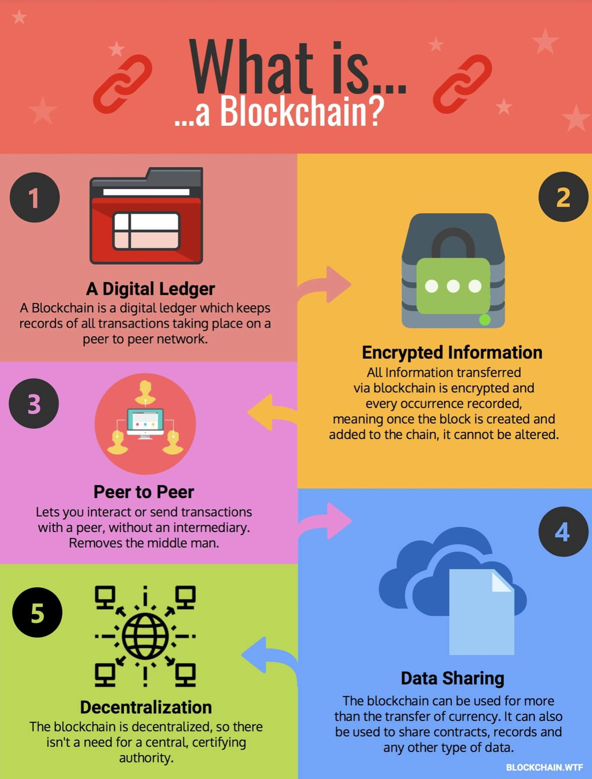
WHERE does it exist?
The blockchain

Slide 28
HOW do I get started safely?
Avoiding scams (and even exchanges—for now)
Use a simple onboard into a private wallet— hardware &/or software
Keep your eggs in many baskets

Slide 29
HOW DO I KNOW IF ITS A SCAM?
Steer clear of exchanges until you’ve done your research and hold most elsewhere.
Anyone gotten swindled?

Slide 30
Blackmail
Blackmail attempts in which strangers threaten you in exchange for bitcoin as a means of extortion. Commonly by email, where-in the sender transmits a message claiming that he/she has hacked into your computer and is operating it via remote desktop protocol (RDP).
The sender will often say it accessed webcam/personal info and provides two options - send bitcoin to suppress the material, or send nothing and see the content sent to your email contacts and spread across your social networks. Scammers use stolen email lists and other leaked user information to run this scheme across thousands of people en masse.

Slide 31
Fake Exchanges
As bitcoin has become more popular, more people have sought to acquire it. Unfortunately, nefarious people have taken advantage of this and have been known to set up fake bitcoin exchanges. These fake exchanges may trick users by offering extremely competitive market prices that lull them into thinking they're getting a steal, with quick and easy access to some cheap bitcoin. Be sure to use a reputable exchange when buying or selling bitcoin.

Slide 32
Free Giveaways
Due to the viral nature of how information spreads across on the internet, scammers seek to take advantage of people by offering free giveaways of bitcoin or other digital currencies in exchange for sending a small amount to register, or by providing some personal information. When you see this on a website or social network, it's best to immediately report the content as fraudulent, so that others don't fall victim.

Slide 33
Impersonation
Unfortunately it's very easy for con-artists to create social media accounts and impersonate people. Often times they lie in wait, until the person they're trying to impersonate publishes content. The impersonator then replies to it with a follow-up message or call to action - like a free giveaway - using an account that looks almost identical to the original poster or author. This makes it seem like the original person is saying it. Alternatively, impersonators may also try to use these same fake accounts to trick others via private or direct message into taking some kind of action in an attempt to defraud or compromise. Never participate in free giveaways, and if you receive an odd request via someone in your network, it's best to double check to confirm the authenticity via multiple mediums of communication.

Slide 34
Malware
Hackers have become very creative at finding ways to steal from people. When sending bitcoin, always be sure to double or triple check the address you're sending to. Some malware programs, once installed, will change bitcoin addresses when they're pasted from a user's clipboard, so that all of the bitcoin unknowingly gets sent to the hacker's address instead. Since there is little chance of reversing a bitcoin transaction once it's confirmed by the network, noticing this after the fact means it's too late and most likely can't be recovered. It's a good idea to be super-cautious about what programs you allow to have administrator access on your devices. An up-to-date, reputable virus scanner can also help but is not foolproof.

Slide 35
Meeting in Person
When buying or selling bitcoin locally, a counterparty may ask you to meet in person to conduct the exchange. If it isn't a trusted party that you already know, this is a very risky proposition that could result in you getting robbed or injured. Con-artists have also been known to exchange counterfeit fiat currency in exchange for bitcoin. Consider using a peer-to-peer platform to escrow the funds in place of meeting in person.

Slide 36
Money Transfer Fraud
Do not reply to emails or inbound communications from strangers telling you they need help moving some money, whereafter in exchange for your services, you'll get a portion of the funds.

Slide 37
Phishing Emails
Beware of emails purported to be from services you use soliciting you for action, such as resetting your password, or clicking through to provide some sort of interaction with regard to your account. It can be very difficult to spot the difference in a fake email that's trying to entice you to compromise your account, and a legitimate one sent on behalf of a product or service that you use. When in doubt, considering triple-checking the authenticity of the communication by forwarding it to the company, using the contact email address on their website, calling them on the telephone, and/or reaching out to them via their official social media accounts.

Slide 38
Phishing Websites
Phishing websites often go hand-in-hand with phishing emails. Phishing emails can link to a replica website designed to steal login credentials or prompt one to install malware. Do not install software or log in to a website unless you are 100% sure it isn't a fake one. Phishing websites may also appear as sponsored results on search engines or in app marketplaces used by mobile devices. Be wary that you aren't downloading a fake app or clicking a sponsored link to a fake website.

Slide 39
Ponzi and Pyramid Schemes
Do not participate in offerings where one or more people offer you a guaranteed return in exchange for an upfront deposit. This is known as a ponzi scheme, where-in future depositors' principals are used to pay previous investors. The end result is usually a lot of people losing a lot of money.
A pyramid scheme promises returns to participants based on the number of people they invite to join. This enables the scheme to grow virally and rapidly, however, it most often doesn't result in any kind of meaningful return. Never invite your personal network under the sole goal of accumulating rewards or returns from a product or service, and do not contribute your own capital at the behest of others to accelerate the process.

Slide 40
Prize Giveaways
Similarly to free giveaways, prize giveaway scams trick people into taking action or supplying information about themselves. For example, supplying a name, address, email and phone number in order to claim a prize. This can allow a hacker to attempt to use the information to gain access to accounts by impersonating you.

Slide 41
Pump and Dump
Do not trust people who entice you or others to invest because they claim that they know what the bitcoin price is going to be. In a pump and dump scheme, a person (or persons) try to artificially drive up or pump the price so that they can dump their holdings for a profit.

Slide 42
Ransomware
This is a type of malware that partially or completely blocks access to a device unless you pay a ransom in bitcoin. It's best to consult the advice of a trusted computer professional for removal assistance, rather than paying the ransom. Be careful about what programs you install on your devices, especially those that request administrator access. Also be sure to double-check that the application you are downloading isn't a fake one that's impersonating a legitimate one you've used in the past.

Slide 43
Scam Coins
Be careful when investing in alternative coins (altcoins). Amongst altcoins there may be scam coins, enticing users to invest via private sales, or with presale discounts. Scam coins may feature a flashy website and/or boast a large community to create a fear of missing out effect on people who discover it. This helps early holders pump and dump. Scam coins without large communities may do airdrops - offering free coins (or tokens) to people in exchange for joining their communities. This enables scam coins to present their initiatives with inflated traction metrics to make investors feel like they're missing out when it comes time for them to decide if they'd like to buy-in. Scam coins may also use the word Bitcoin in them in an effort to trick or mislead people into thinking there is a legitimate relationship.

Slide 44
All About Trust
If you’re not positive about putting your money there, don’t.
Don’t risk anything you can’t afford to lose at the casino

Slide 45
How to get money onto the blockchain?
Shakepay as an onboard—
EMT
AVOID EXCHANGES
SEND TO PRIVATE WALLET
OTHERS CANT EMT TO IT UNFORTUNATELY—WOULD BE A WAY TO AVOID BANKS ENTIRELY.

Slide 46
Shakepay as an onboard—
EMT
SEND TO PRIVATE WALLET
OTHERS CANT EMT TO IT UNFORTUNATELY—WOULD BE A WAY TO AVOID BANKS ENTIRELY.

Slide 47
SOFTWARE VS HARDWARE
SOFTWARE
HARDWARE

Slide 48
Keep your eggs in many baskets
Convenient and portable but dependent on electricity.
Adoption is a battle but it’s a sound means of exchange for self-sufficient communities.
More difficult to confiscate but likely to be vilified.
Advantages and disadvantages
crypto
vs
gold/silver
vs
assets/commodities

Slide 49
“Our fear of technology is really a fear of empowerment. We now have the ability to design the reality we live in and we have to step up to that occasion.”
- Douglas Rushkoff
Author of Life inc., influential thinker

Slide 50
Not your keys;
Not your crypto.

Slide 51
Now let’s watch some clips to hammer it in
Contact us:
Parrs Jars
60 Princess St
Dryden, ON
Parrsjars@gmail.com
Parrsjars.ca
Setting up a hardware wallet

