Slide 1



Purdue
AgHack 2026
ProMaize

Slide 2
Team Intro/Logo
Team ProMaize, Bayer Genomic Prediction track
Alexander Baena
Sofia Gerena
Alen Lizarazo
Live demo: promaize.stipe.app

Slide 3
Intro to the problem
January 2008: the plot budget is cut. 15,962 new lines are waiting.
They come from 157 biparental families that have never been in a field; 24 of those families have neither parent on record.
The field test measures GCA: each line crossed to a tester from the other cluster, ~7 locations.
Every line we cannot test is a line we can never advance. Which ones get the ground?
- Users: pipeline managers (the budget), population development (which families), field testing (the list).

Slide 4
Analysis Goal
Rank lines nobody has grown by what they are worth, with an honest error bar.
Predict broad-acre GCA: trial- and tester-adjusted testcross yield, moisture, maturity, lodging.
Turn it into $/acre (yield x price - drying - lodging loss) at prices the breeder sets.
Choose the plots: how many, which families, which siblings, and what that costs in breadth.
Prove it the only honest way: predict each year's new families from earlier years only.

Slide 5
Tech Stack
Python: numpy, pandas, scikit-learn. The model trains from sufficient statistics.
- Full dataset (1.07M plots, 153k genotyped lines x 2,911 markers): about 3 minutes on a laptop.
- Anvil (RCAC) for the heavy runs; a synthetic judge-mode program runs end to end in about a minute.
React + TypeScript + Vite, installable web app: the demo works with no network.
Hosted at promaize.stipe.app; every state is a URL (budget, family limit, prices).

Slide 6
Technical Approach
Two questions, two models
Family mean <- the parents' genotypes (ridge on the midparent, recent years weighted up).
Sibling differences <- which parental segments each line inherited (ridge on within-family deviations).
Tester effect removed as a BLUP: advance lines, not testers.
Baselines: environmental means, pedigree BLUP, standard GBLUP.

Slide 7
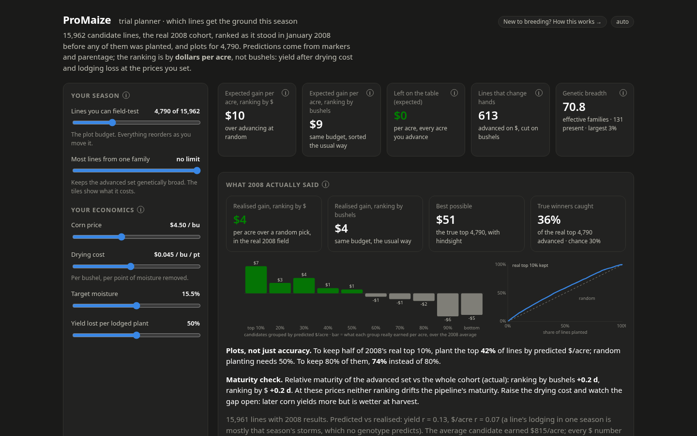
Demo/Prototype
Live: promaize.stipe.app

Slide 8
Business Value
Same plots (30% of lines), six ways, scored on what the field paid, 2003-2008
Rule | Realised $/acre over random (6-year mean) | in 2008 | Real top 10% kept
ProMaize, rank by $/acre | $8.4 | $4.3 | 40%
ProMaize, rank by bushels | $8.1 | $3.9 | 40%
ProMaize, same share of every family | $5.5 | $5.0 | 37%
standard GBLUP, rank by bushels | $5.5 | $1.2 | 36%
ProMaize, $/acre, max 50 per family | $5.2 | $4.4 | 37%
random | $0.0 | $0.0 | 30%
Honest error bars: the 90% bands held 90% of real 2008 results.
2008 was the hardest year to call families (lowest between-family r of the six), and ProMaize still doubled standard GBLUP (r 0.13 vs 0.07).

Slide 9
Future Development
Location-specific placement once lines have multi-year records (today each line is tested once).
Choose crosses, not only lines: predict each family's mean and spread before it is made.
The program's own costs: plot, drying, and discount schedules in place of our defaults.
Multi-trait economic index with test weight and maturity windows per market.

Slide 10

THANK YOU, LEADERSHIP!

Slide 11

THANK YOU!
AND HAVE FUN!!!!!!!!!!

