Slide 1

1. the difference between a POST request and a GET request.
Core concept and multiple pattern for security
2) Sanitization: neutralizing any harmful encoding (<script>)
3) Protect yourself against XSS vulnerabilities.
3) Protect yourself against XSS vulnerabilities.
4) Protect yourself against SSTI attacks.

Slide 2
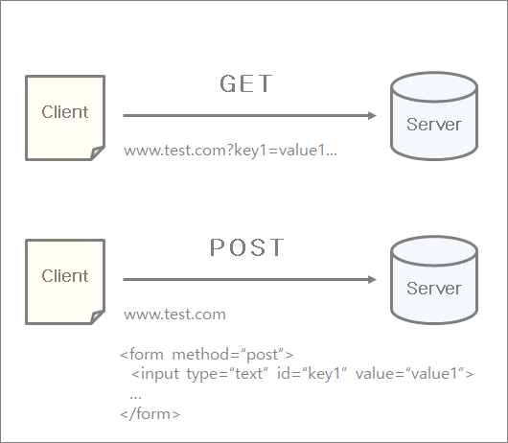
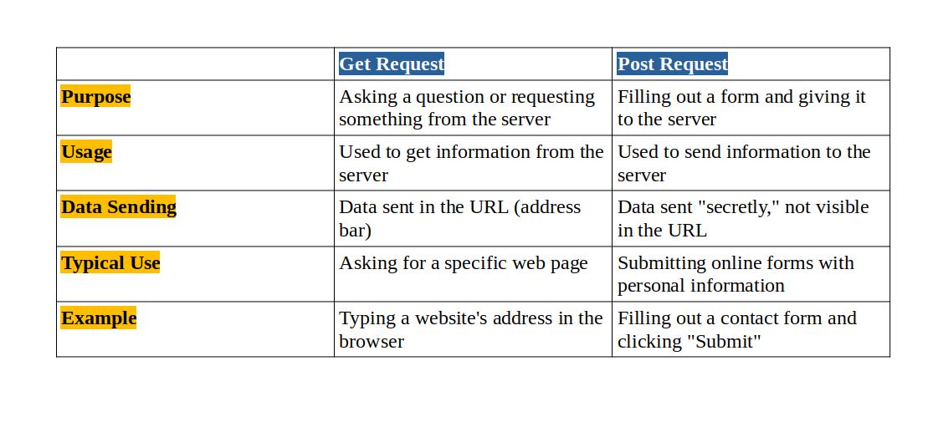
POST and GET

Slide 3
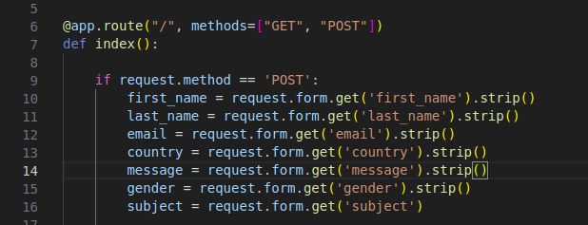
POST and GET

Slide 4
Sanitazation
Sanitazation == Validation ?

Slide 5
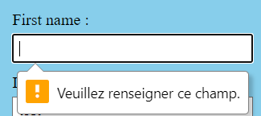
Sanitazation
Validation

Slide 6



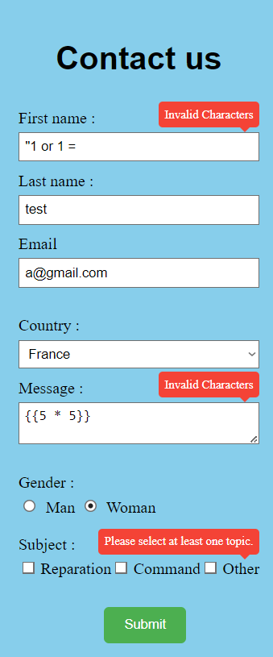

Sanitazation
Validation

Slide 7

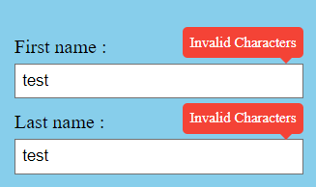
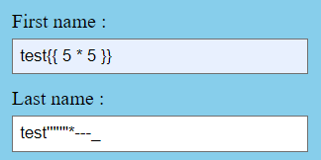


Sanitazation
Sanitazation

Slide 8
Sanitazation

Slide 9
XSS
Cross Site Scripting is an is an attack where the attacker injects malicious executable scripts into the code of a trusted application or website.
The end user's browser has no way to know that the script is malicious and could not be trusted. Thus execute the script.
Through the script there could be access to any cookies, session tokens, other sensitive info retained by that site or rewrite content of the html page.

Slide 10
XSS
2 types

Slide 11


XSS
Stored XSS: The malicious script is permanently stored on the server, and every time a user visits the infected page, the script is served to them.
Example: In a web application is the possiblity to post comment and they are NOT properly sanitized:
User A post this comment:
User B views the comment and trigger the script:

Slide 12
XSS
2. Reflected XSS: The injected script is reflected off a web server, often by exploiting a vulnerable search field or URL parameter. The user is typically tricked into clicking a malicious link containing the script
Search:
URL will shows this

Slide 13
XSS
Prevention:
Input Validation:
Output Encoding
Use Content Security Policy (CSP)
HTTPOnly and Secure Flags
Regular Security Audits:

Slide 14
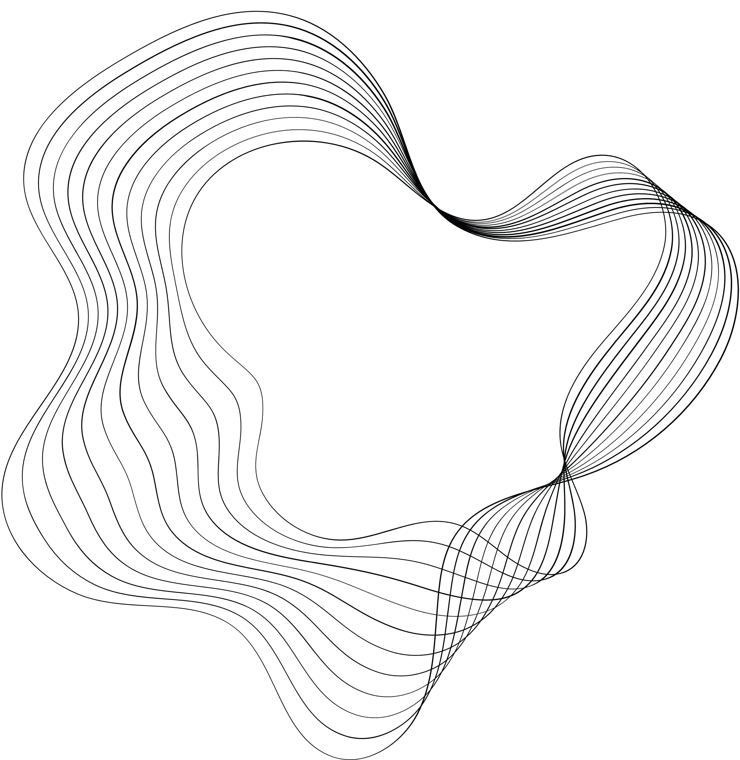
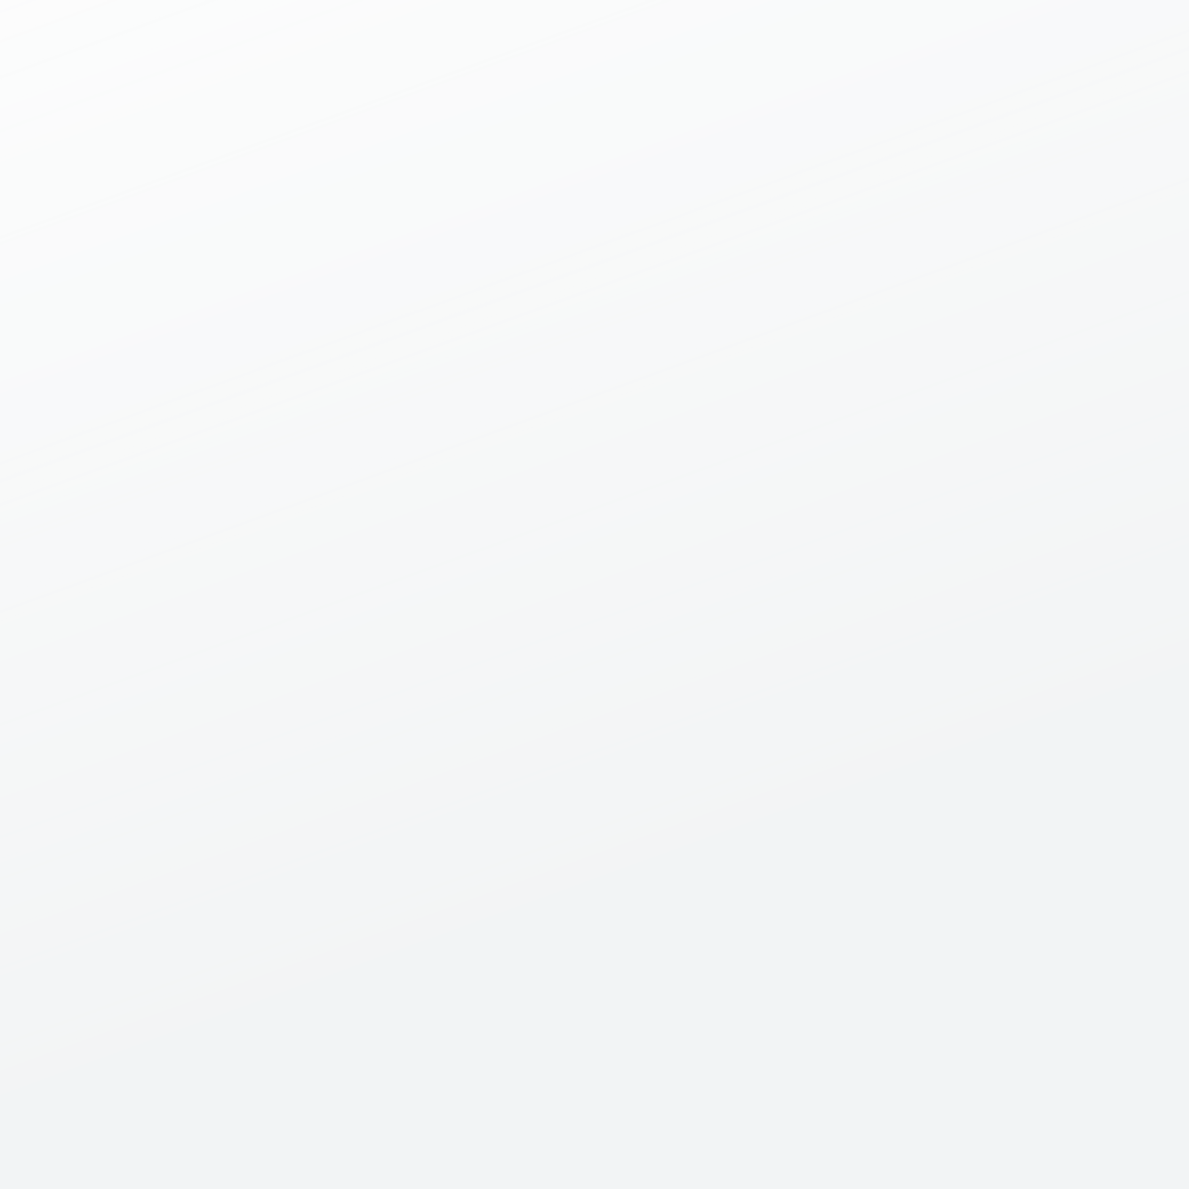
SERVER SIDE TEMPLATE INJECTION
SSTI

Slide 15

WEB APPLICATION VULNERABILITY
Execute payload trought template

Slide 16

TEMPLATE
A lot of application use template and jinja is one of them.

Slide 17
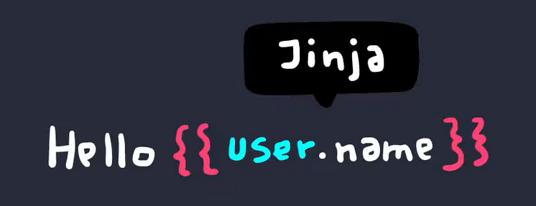
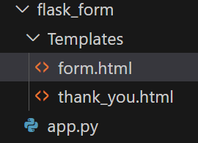
TEMPLATE ?
Bracket
When the content of a web page have some dynamic content
generaly there's template.
The dynamic content is surrender by specific character, that depend on the application use. Here for jinja it's {{ }}
Vision
Templates are a way to separate the presentation (HTML, CSS) from the application logic (Python code in Flask, for example)
A template engine makes designing HTML pages easier by using static template files which at runtime replaces variables/placeholders with actual values in the HTML pages

Slide 18
THE INJECTION
It's when user input is mixed up with the content of the template

Slide 19
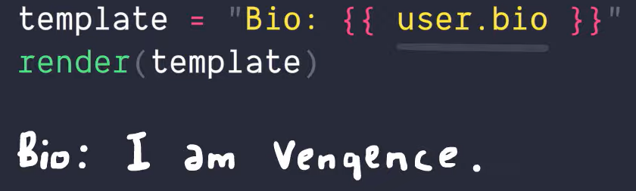
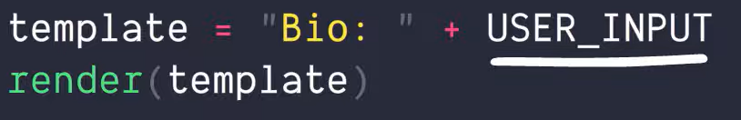


Because it's getting information from the database and send it back
Here the input user become a part of the template, and the template can evaluate arbritary code

Slide 20
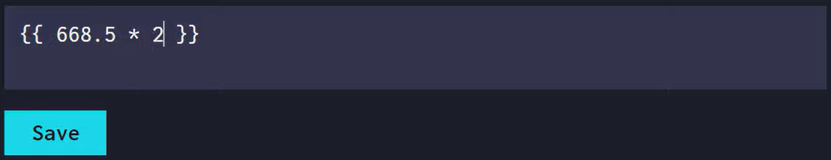
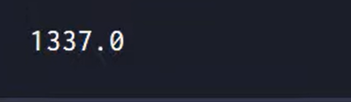
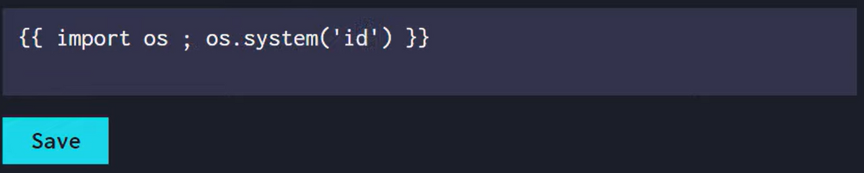

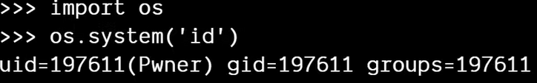
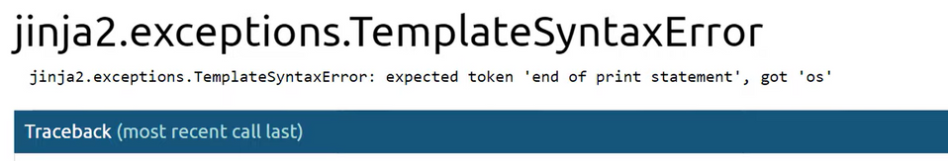
EXAMPLE
Basic operation
Try to get a shell
Jinja does not support import statment

Slide 21
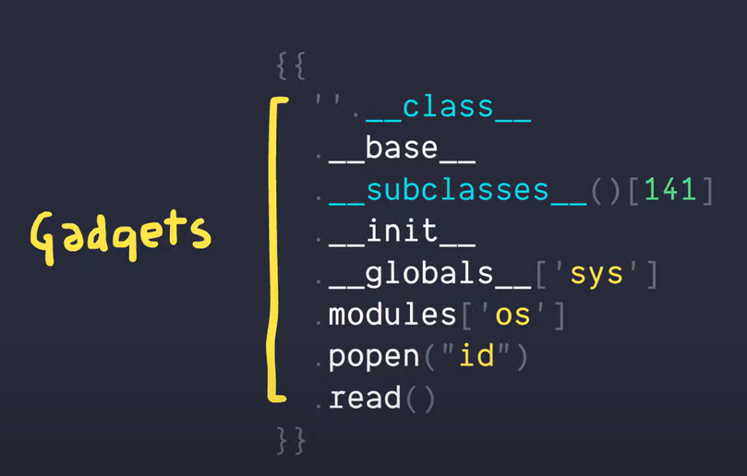

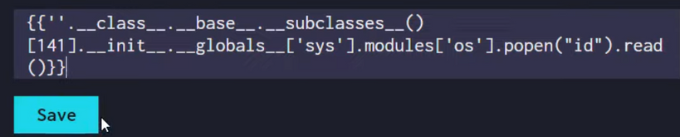
We can't import with jinja but we can have acces to it with python
for that we have to use "Gadgets"

Slide 22
SOLUTIONS
SANITIZATION
Templates should not be created from user-controlled input. User input should be passed to the template using template parameters.
Sanitize the input before passing it into the templates by removing unwanted and risky characters before parsing the data. This minimizes the vulnerabilities for any malicious probing of your templates
SANDBOX
Use docker to sandbox template in a secure environnement.
But i don't know what i'm talking about

Slide 23
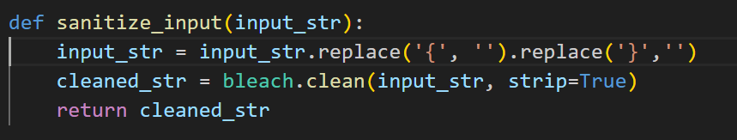
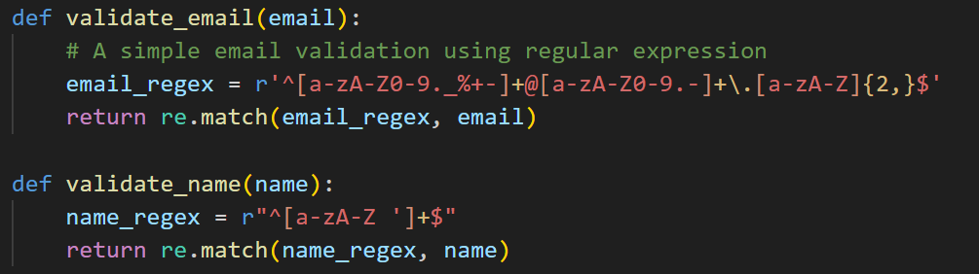

Slide 24

POCE BLEU

