Slide 1
How javascript objects work
Helen Emerson
http://helephant.com
@helephant
Notes:
If you are a web developer, javascript is pretty hard to get away from. It is the default choice in the browser and node.js means it has a following on the server side as well.
Helen Emerson
Currently technical architect for Totaljobs
Web developer for the past 10 years, have developed an interest in front end technlogy

Slide 2
What this session is about
YES
How the javascript language works
Language features you can use to create objects
Plain old javascript
NO
OO design
How to structure your code
Frameworks or libraries
Best practice
Using javascript in a browser
Notes:
I won't be offended if this is not for you. If this isn't what you were expecting and you don't think you're interested, please feel free to go to Sebastian's talk. He's going to be talking about REST and SPA.

Slide 3
What this session is about
Creating objects
The object type, object literal, dot and subscript notation, constructors
Public methods
Function as objects, function declarations and expression, hoisting, anonymous functions
Private methods
Nested functions, closures, scope
Method context
Properties
Object prototype and prototype chaining
Notes:
My goals are:
I'm hoping this will be useful to any programmer who uses javascript.
If you don't know javascript well, I hope you come away with an understanding of what the language is about, how it works and how the language features relate to each other
Everyone, even Dylan Beattie, will learn something new

Slide 4
Please code along!
http://github.com/helephant/JavascriptObject
git clone git://github.com/helephant/JavascriptObjects.git
OR
http://helephant.com/javascript-objects.zip
Notes:
Mostly coding – examples and labs
Please ask questions as we go along.

Slide 5
Creating objects
Objects are just hashes
Dot vs subscript notation
Object literal
Objects are dynamic
Constructor functions
Notes:
Javascript objects are just collections of key/value pairs like a hashtable. Methods are just properties that contain a function.
The Object type
DEMO: declare object and assign properties
TODO: object based, not class based.
Dynamic and weakly typed.
TODO: what does the dynamic nature of javascript really mean?
DEMO: for..in example
Dot syntax vs subscript syntax
Demo
Object literal
TODO: what does the object literal really mean?
Exactly the same as using the Object type, just more consise
JSON
Can use object literal and then assign properties
One off objects like this are really useful
Pass around group of related variables
Constructor functions
Object literal is great for one off objects but sometimes you want to mass produce objects with the same properties and methods
Constructor functions are just functions that set up objects. They aren't special language constructs like classes are in C#.
The logic is pretty much the same as setting up a single object, the only difference is the new keyword automatically does things like creating the object and returning it.
If you called the constructor function without the new operator, the this object wouldn't get set up and your
DEMO: constructors without the new operator
Objects created with constructor functions maintain a link back to the function that created them
Constructor functions are not classes. No guarantee about object structure

Slide 6
Public methods
Adding methods to objects
Functions as first class objects
Function declaration vs function expression
Anonymous functions
Notes:
Methods are just properties that point to a function
There are three javascript language features that make this possible: the fact that functions are objects, that you can create them at runtime using the function operator and that they can be anonymous.
Functions as first class objects
Functions in javascript are just a type of object
Can do all the normal things you can do with an object
A method in an object is just a reference to a function object
Functions can be declared using the function declaration or the function operator
Function declaration – javascript 101 way to create a function
Hoisted to the top of the function when the function is created so the order doesn't matter
Is automatically bound to a variable in the current scope with the function's name
Functions created with the function declaration must have a name, they can not be anonymous
Function expression
The function expression is evaluated when the code inside the function is run. It is not affected by hoisting.
This means the function expression can be affected by surrounding code – for example you can put it in an if statement
The function expression doesn’t automatically add the function object into the current scope. Instead it returns it and it is up to the code to do something with it.
If you don't do anything with the return value of the function expression, there's no way to invoke it.
Since they're not added to the scope, they don't have to have a name. They can be anonymous.
The function expression is most useful because it can be used anywhere it is valid to put an expression.
Also very useful for single use functions like event handlers
Anonymous functions
Anonymous functions are functions that don't have a name.
The name is different from the variable that has a reference to the function
Name can be useful for recursion and stack traces, but you don't usually really need it

Slide 7
Private methods
You can simulate private methods inside a constructor by creating a nested function that your object uses.
This works through the magic of closures.
Notes:
In javascript you can nest functions inside other functions
The inner function can access variables in the parent function.
A closure is the mechanism that javascript uses to give you access to the parent scope, if it is run after the parent function has exited.
Closures happen when the outer function is executed and when the inner function is created.
This is important, because the inner function might run after the outer function has exited.
This could be because the child function is being used as an event handler or callback.
Or it could be because the child function is being used as an object's method.
This can be used to create private state inside your object
The closure is created when the parent function exits, which means that the value of the variables are the values from when the function exited.
The child function can update the values in the parent function
Every time the parent function runs, it creates a new closure.
Warning: memory consumption
Large outer functions
Outer functions called many times

Slide 8
Method context and this
Notes:
In C# you never need to give any thought about what the this keyword will refer to. It always refers to the object which your currently executing method belongs to.
Javascript is more complicated because
the link between objects and methods is more of an incidental one
functions are objects and may be invoked outside of the object they belong to - callbacks are the best example of this
Every time you call a function, it will have a value assigned to this.
Default context is the global object – window in the browser
When you call a method from an object, it will be the object
If you want to, you can set it to anything you like using function.call or function.apply
This is why "this" is set to the global context whenever you call a constructor without the new operator

Slide 9
Object prototype
Object prototype
Prototype chaining
Notes:
Object prototypes are javascript's way of sharing implementation across similar objects, much like classes in C#.
Although they look a bit like classes, constructor functions are not classes. Javascript has only objects and no classes.
In a class based languages there is a clear distinction between the idea of a class and an object.
Classes are templates for making objects.
An object is created from a class.
You can not have an object without a class. All objects are created from a class.
You can not change an object after it has been instantiated.
In prototype-based languages (there are others, but javascript is the most widely used) there are no classes.
Objects are created by creating an empty object or by cloning an existing one.
It is called prototypical inheritance, because an existing object can be used as the starting point to build a new one.
Prototypical inheritance is implemented in javascript by adding properties or methods to a constructor's prototype method.
Any object that is created by the constructor will automatically inherit the properties or methods added to the prototype.
In that way, the prototype is the starting point for any object created by the constructor and the object is customized by adding properties and methods directly to the object itself.
The prototype is not a type system. All objects created by a constructor can be customized so there is no guarantee they will conform to the structure in the prototype.
Prototypes start off as an empty Object – which is how every object ends up with a toString() method
Prototypical inheritance works because the object maintains a link back to the constructor function that created it. We've seen that before when we've looked at the constructor property of objects.
How javascript reads properties from objects
Check the object itself, check the constructor's prototype

Slide 10
Properties

Slide 11
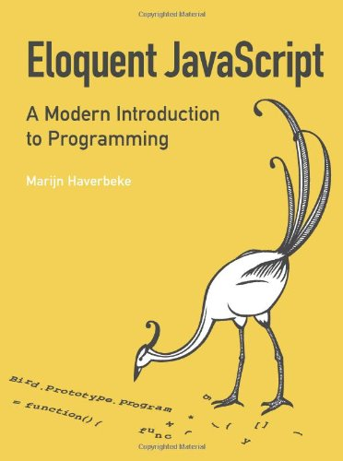
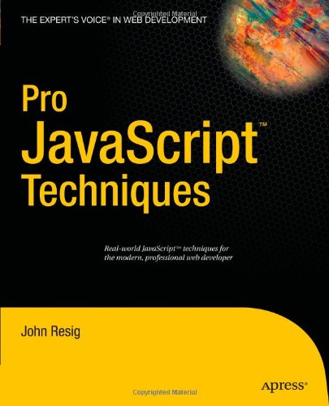
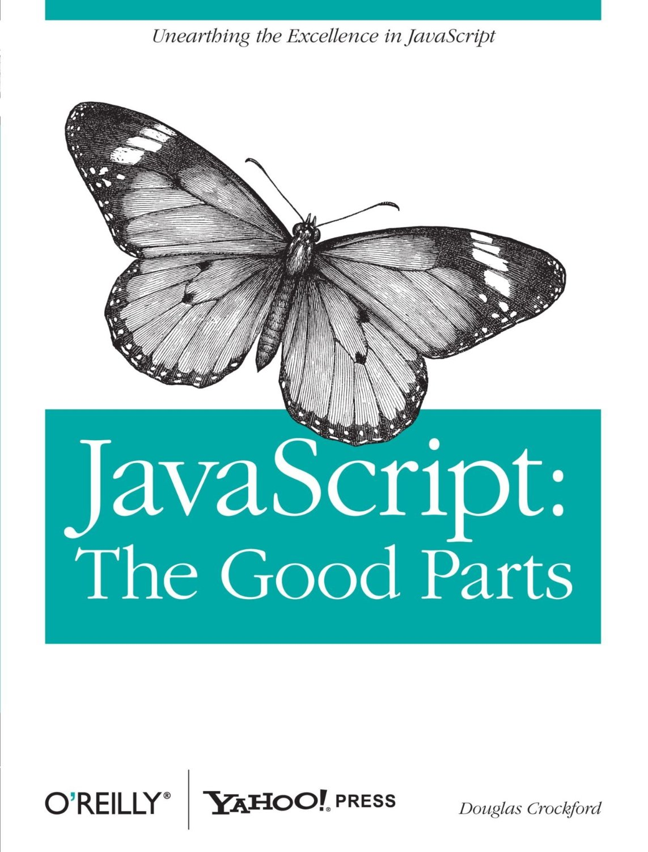
Further reading

