Slide 1
XGBoost Performance

Slide 2
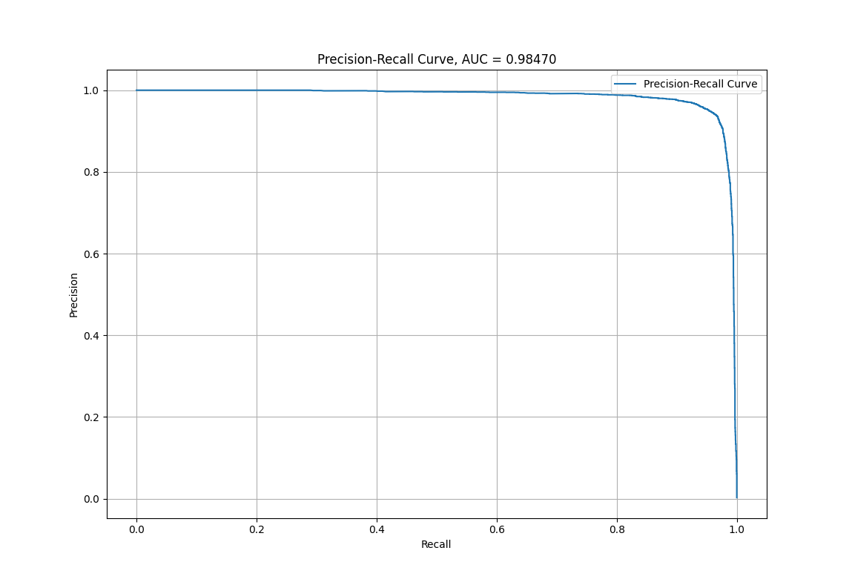
Precision Recall Curve

Slide 3
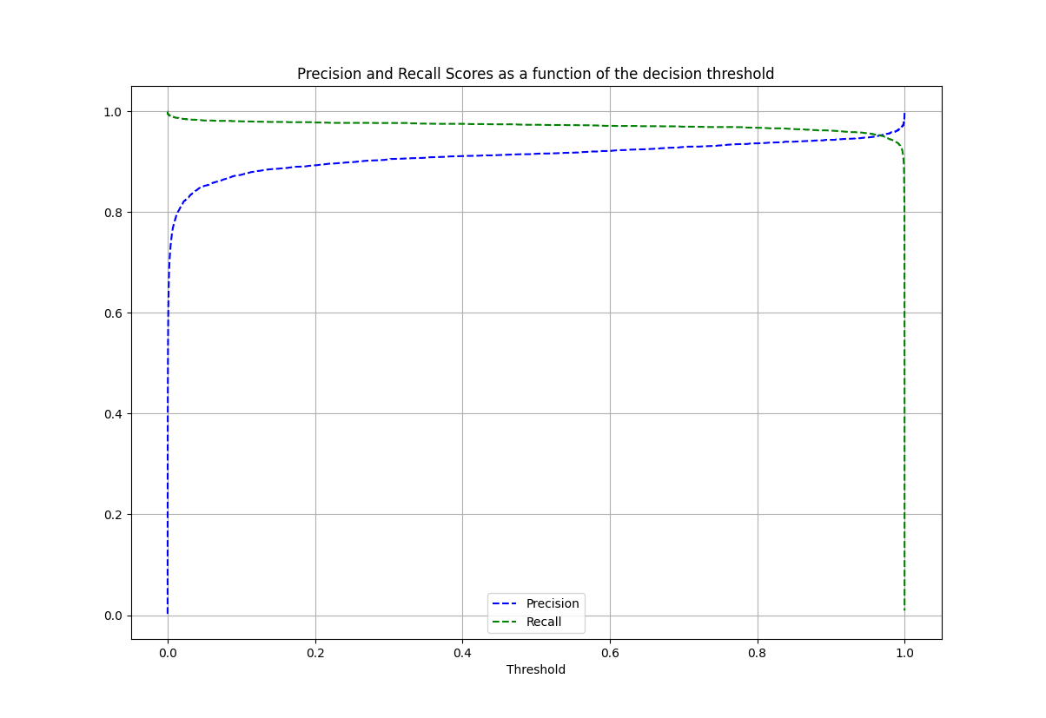
For a given threshold the precision and recall
precision recall thresholds
504084 0.998776 0.383189 0.999994
504085 0.998767 0.380371 0.999994
504086 0.998758 0.377553 0.999994
504087 0.998748 0.374501 0.999995
504088 0.998732 0.369805 0.999995
504089 0.998718 0.365814 0.999995
504090 0.998708 0.362996 0.999995
504091 0.998692 0.358535 0.999995
504092 0.998682 0.355717 0.999995
504093 0.998661 0.350317 0.999995
504094 0.998643 0.345621 0.999995
504095 0.998628 0.341864 0.999995
504096 0.998617 0.339047 0.999996
504097 0.998595 0.333646 0.999996
504098 0.998573 0.328716 0.999996
504099 0.998547 0.322611 0.999996
Decided on a threshold of 0.9999969, but probably by tweaking a bit could find one with same purity but higher recall.

Slide 4
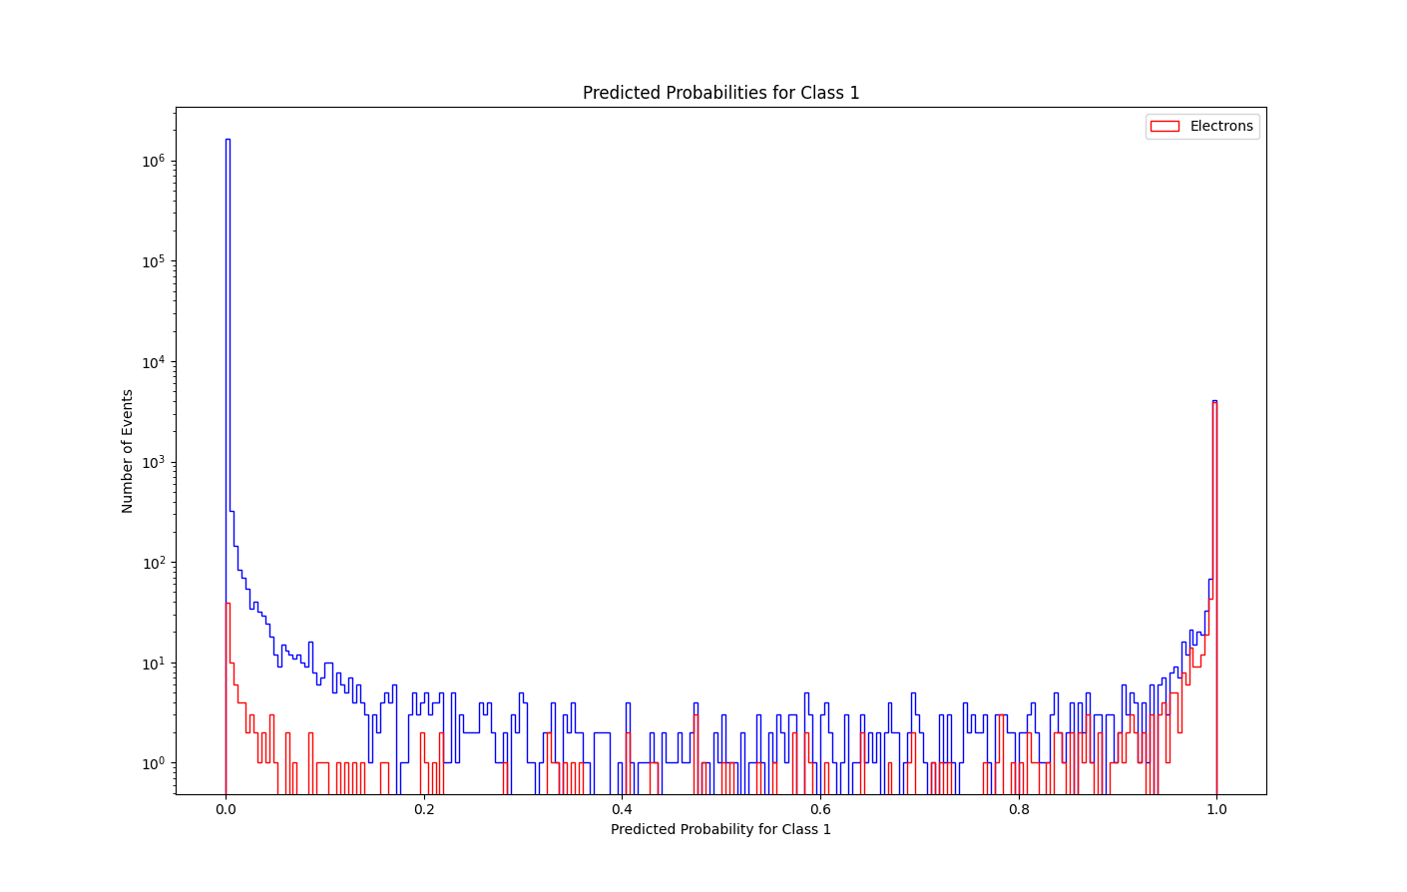
Predicted probabilities for class 1 (electrons) plt.yscale(‘log’)

Slide 5
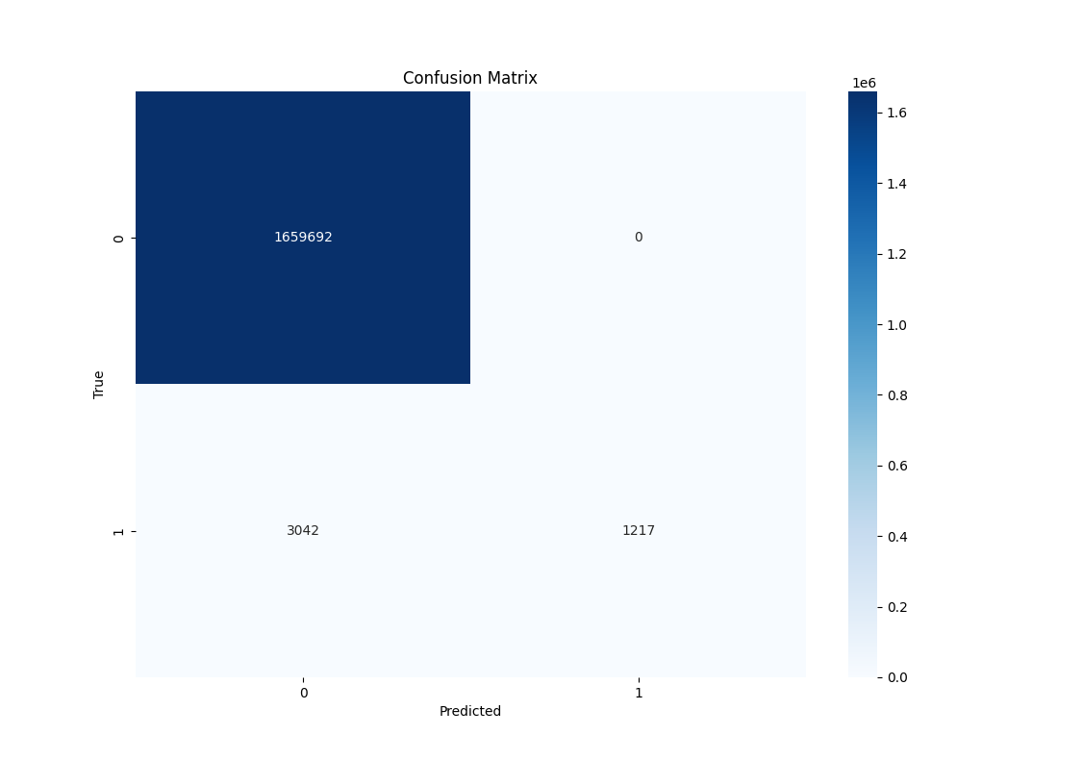
Confusion Matrix (Actual values)

Slide 6
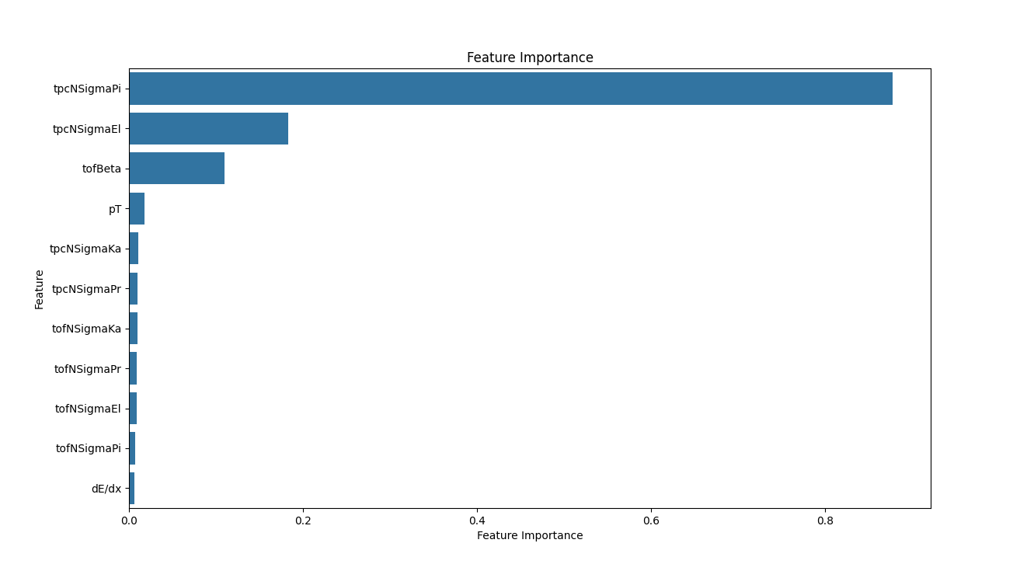
Feature Importance

Slide 7
A study on the outputs

Slide 8
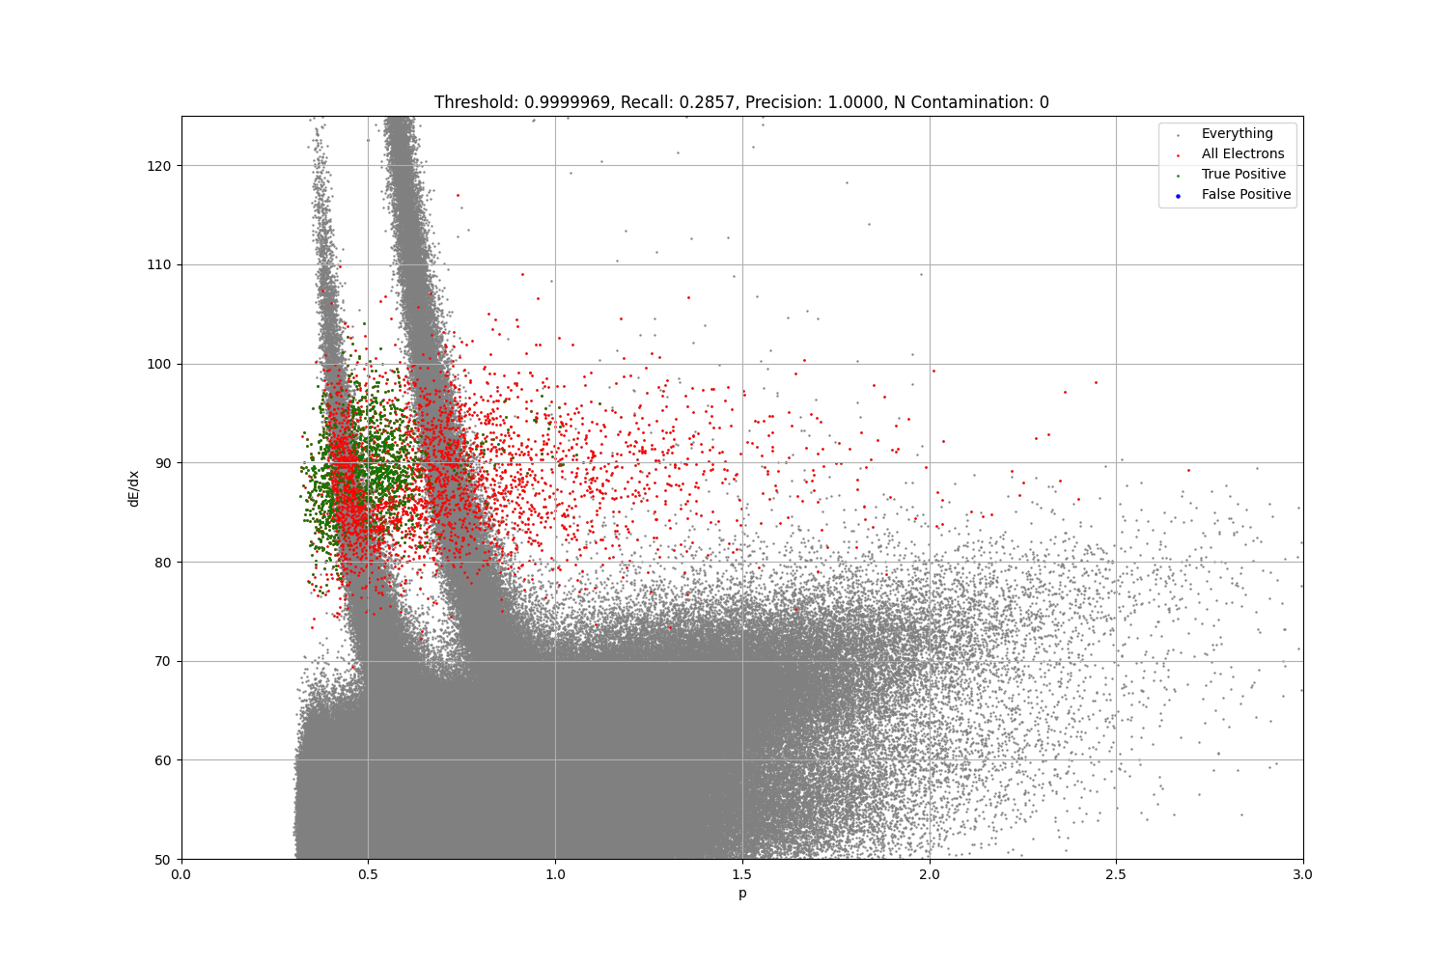

Slide 9


Slide 10
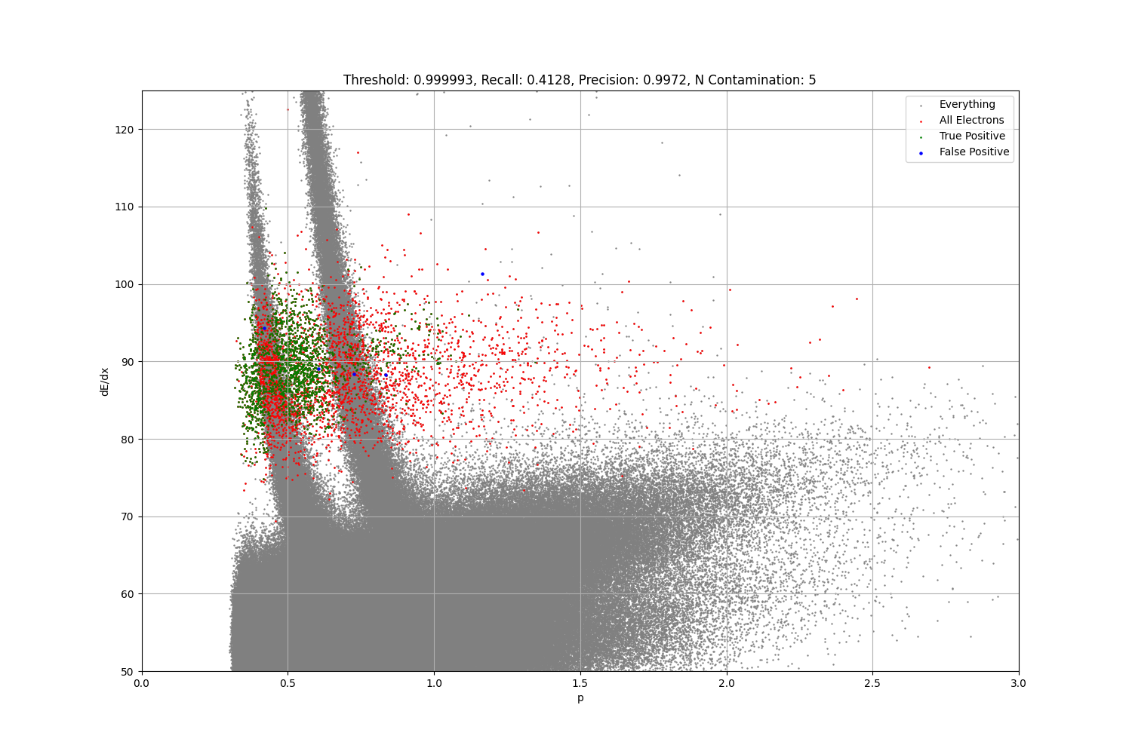

Slide 11
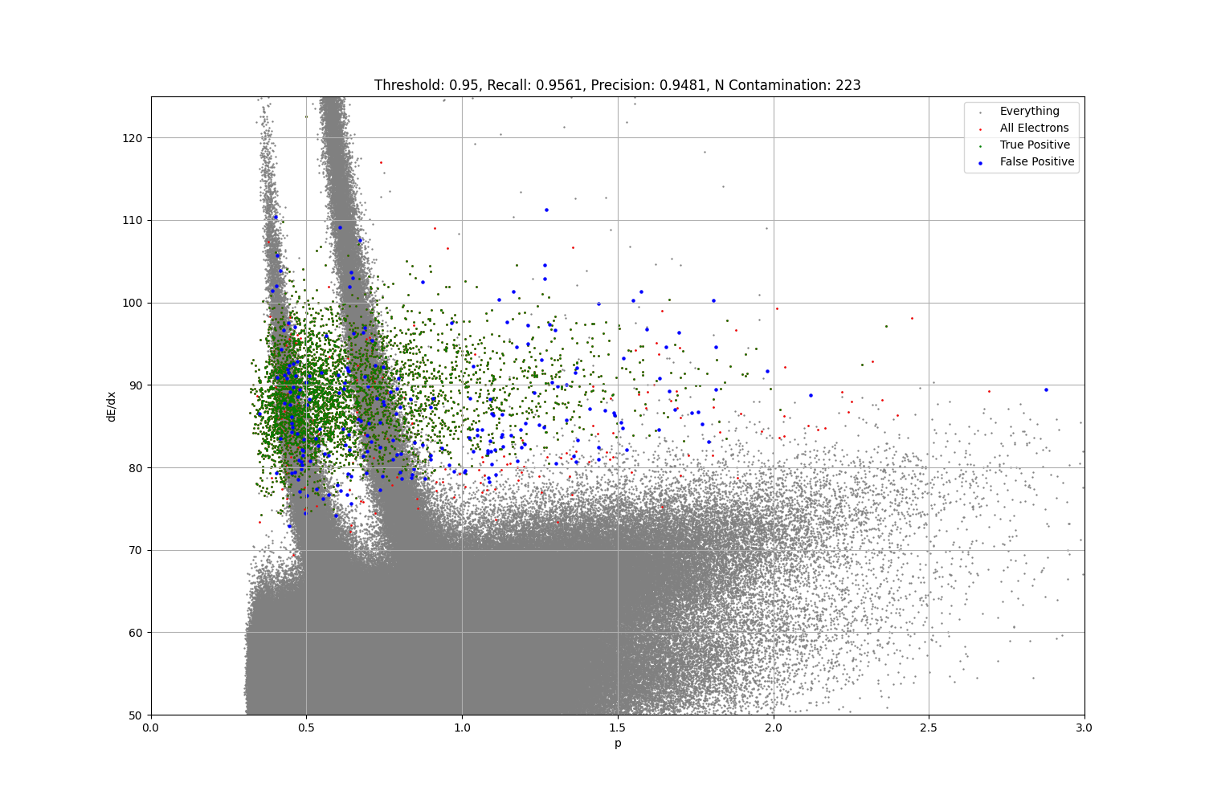

Slide 12
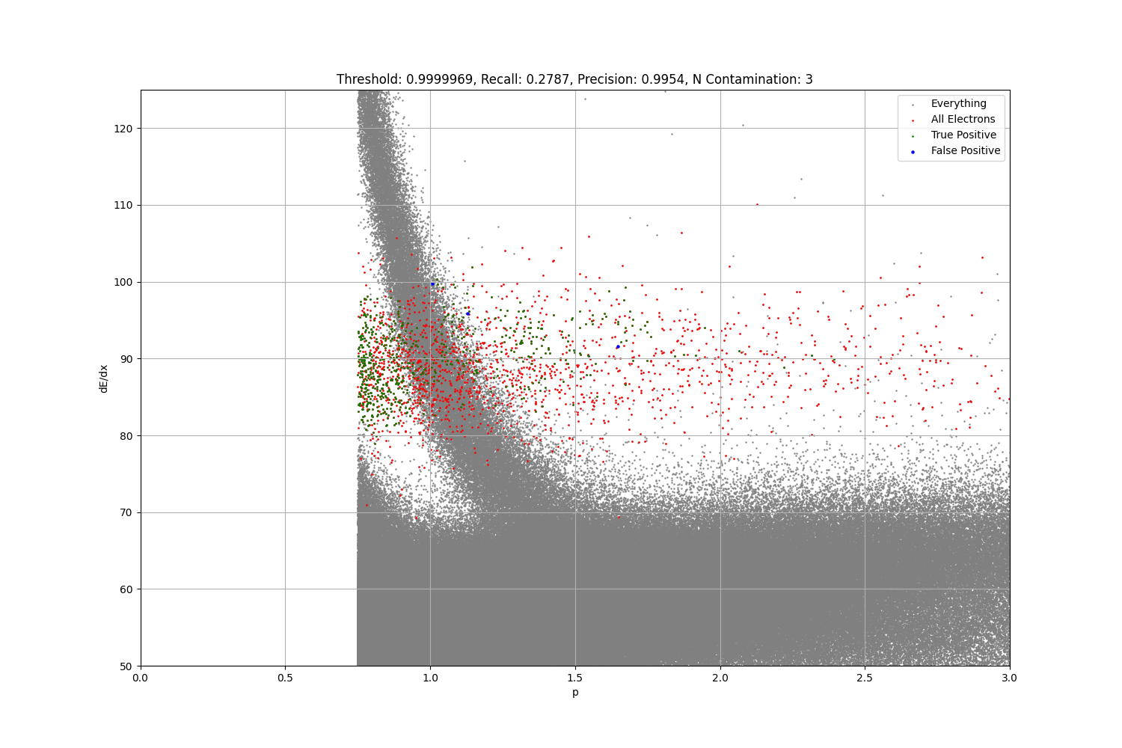
CUT AT P > 0.75

Slide 13
Multi-Class Model

Slide 14
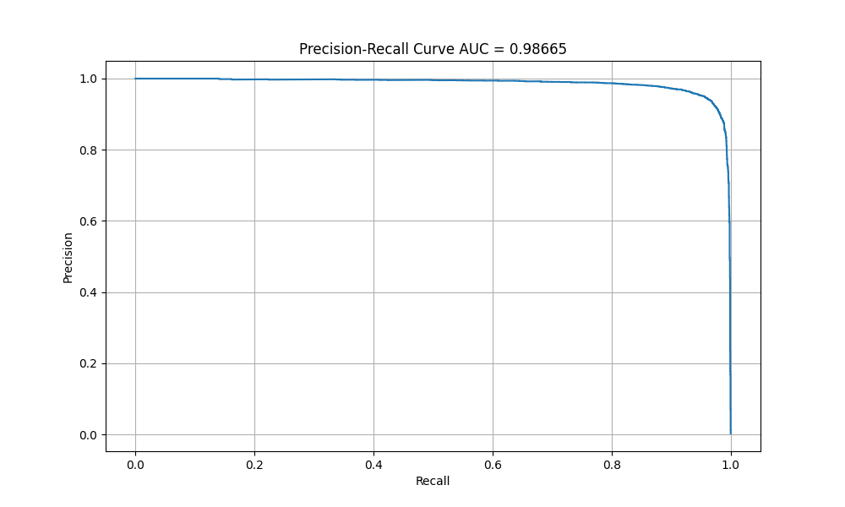
Precision Recall Curve

Slide 15
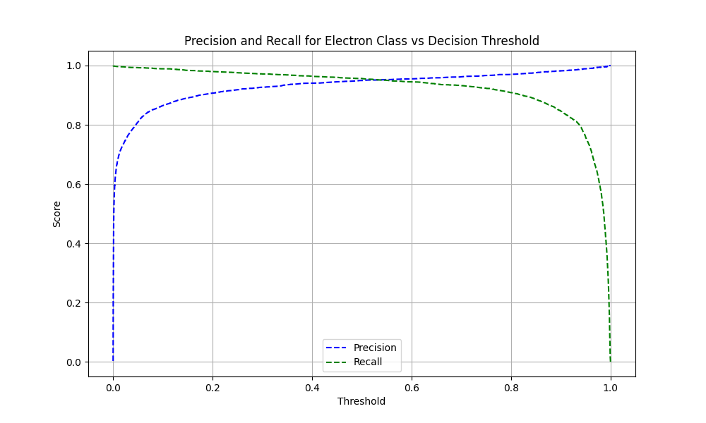
Prec Recall Threshold

Slide 16
