Slide 1
Spinderella: NMR spectra on a quantum computer
HQS challenge • Qiskit Fall Fest 2026 • Team Spinderella • 10/11/2026

Slide 2
Overview
Matching task + noise tolerance + optimised circuits + real IBM hardware
• Completed the initial-state TODO: all 2^N X-basis states, weights N − 2w
• Matched A → spectrum_3, B → spectrum_2, C → spectrum_1 (all 6 assignments scored)
• Max tolerable noise_strength: A 19.97, B 22.85, C 23.22 s⁻¹ (10 % dip rule)
• Circuits: 5,382 → 19 CNOTs per circuit (exact), half the circuits by symmetry
• All three molecules run on ibm_kingston: hardware reproduces the spectra and the matching

Slide 3
Matching Molecules to NMR Spectra with Qiskit
What we simulate
• Liquid-state ¹H NMR: chemical shifts δ and J couplings
• Signal Tr(I_x(t) I_x(0)) from all 2^N X-basis states, Trotterised in Qiskit, Fourier-transformed
The TODO we solved
• H then RZ(0 or π) per qubit → |+⟩ or |−⟩; 8 states (A, B), 4 (C)
• Weight = ΣX eigenvalue N − 2w; check C_xx(0) = N·2^N (24, 24, 8) exactly

Slide 4
From Spin Hamiltonian to NMR Spectrum
Pipeline
• Rotating frame (exact: [H, ΣZ] = 0) → Pauli operator
• Lie–Trotter 300 × 2.5 ms → ⟨ΣX⟩, ⟨ΣY⟩ → C_xx, C_yx → e^(−Γt) → FFT → ppm
Checks
• Gate angles exact; circuit = product of exponentials (3e-16)
• Code's +Im sign correct
• 99 tests pass; notebook reruns cleanly

Slide 5
The Matching Result: A→3, B→2, C→1
Result
• A → spectrum_3, B → spectrum_2, C → spectrum_1
• Cosine 0.80 / 0.87 / 0.84 matched, ≤ 0.005 otherwise
• Best total 2.52 vs 0.87 runner-up
Robust
• Same answer for 27 + 126 metric / noise / resampling choices
• Confirmed by exact diagonalisation
• File-name hints not used to decide

Slide 6
Separating Frequency-Axis and Trotter Errors
Two error sources
• Frequency labels 0.4–0.9 Hz low (fftfreq vs fft_causal points)
• Trotter: line shifts ≤ 0.72 Hz (A), heights ≤ 19 %
Fixes measured
• Corrected axis: C peak error 0.67 → 0.12 Hz
• 1.25 ms steps: A shift 0.72 → 0.14 Hz at 2× CNOTs
• Higher-order Suzuki not worth it

Slide 7
Signal Length Sets Frequency Resolution
Resolution limit
• 0.75 s → 1.33 Hz grid: 0.9 Hz (A) and 0.5 Hz (B) never resolved
• Need ≥ 224 (A), 239 (B), 34 (C) time points (aliasing)
Longer signal
• 3 s resolves A's 0.9 Hz doublets (Γ ≲ 3 s⁻¹)
• Shape match 0.80 → 0.97 with 1.25 ms steps and 3 s

Slide 8
Noise Broadens Peaks and Hides Multiplets
Noise tolerance (10 % dip)
• A 19.97 · B 22.85 · C 23.22 s⁻¹
• Fails when line width Γ/π ≈ closest-peak gap
Is it J?
• Not J's strength — the smallest line gap
• A: J12 − J02 = 6.1 Hz · B: J01 − J12 = 7.0 · C: J = 7.9
• A: J02 9.5 → 14 Hz lowers limit 28.3 → 12.8

Slide 9
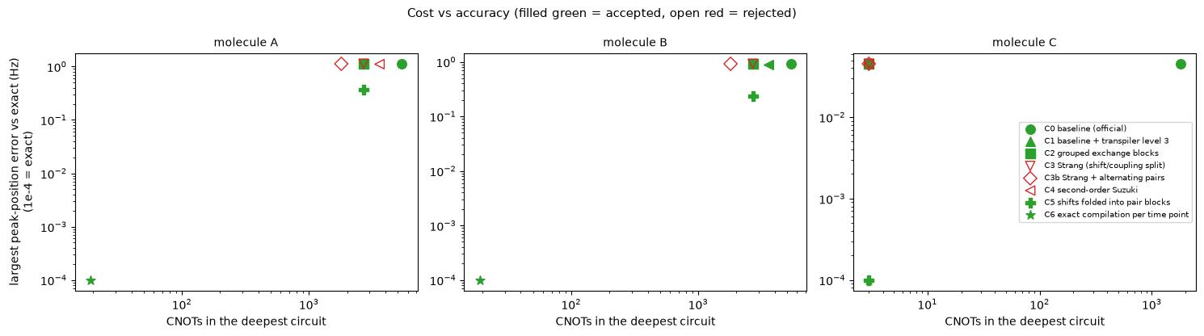
Circuit reduction: 5,382 → 19 CNOTs, exact
Exact compilation of e^(−iHt) per time point: 19 CNOTs (A, B), 3 (C), no Trotter error; ΠZ symmetry halves the circuits.

Slide 10
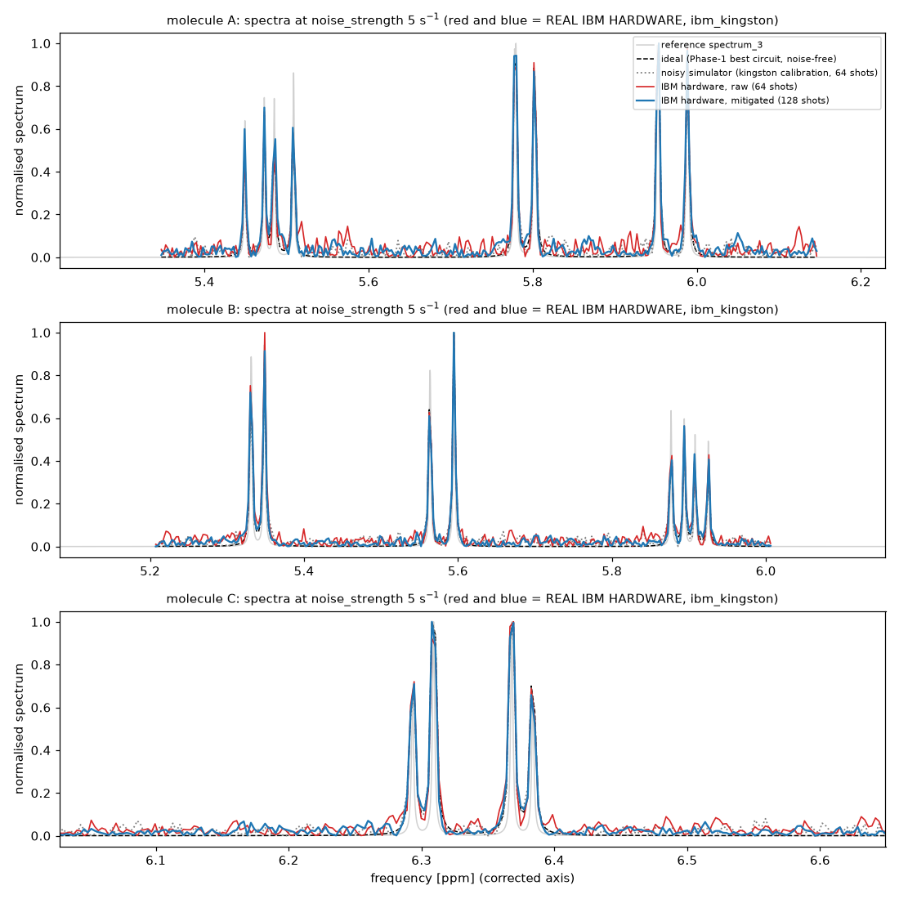
Real IBM hardware (ibm_kingston): spectra reproduced
Mitigated vs ideal: cosine 0.978 / 0.988 / 0.984, all peaks found, shifts ≤ 0.19 Hz; matching from hardware alone A→3, B→2, C→1.

Slide 11
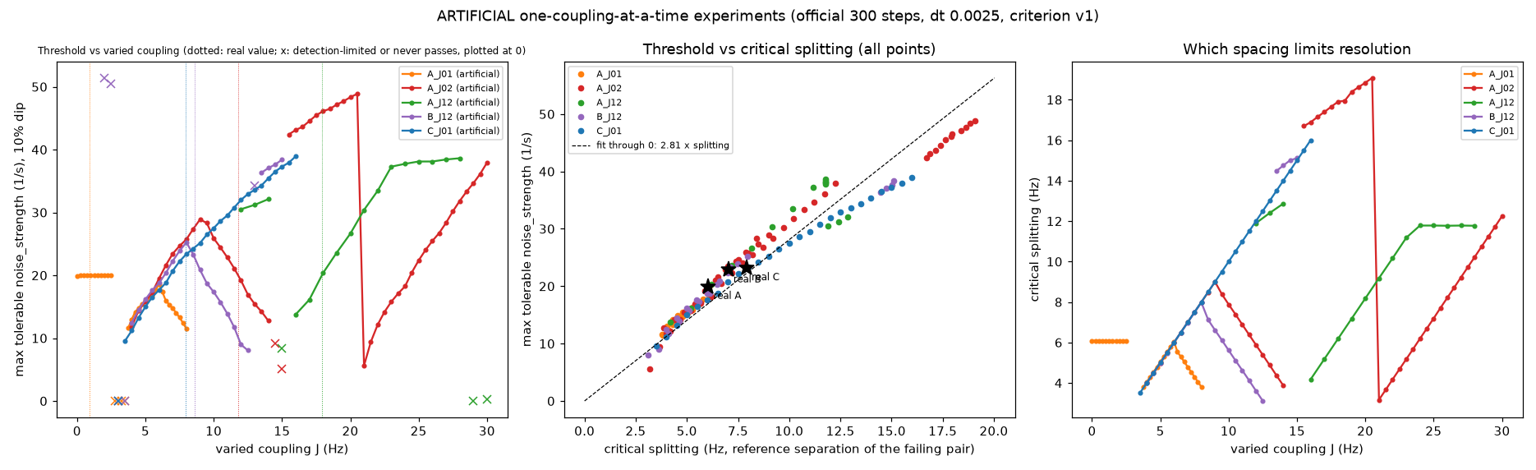
Noise limit follows the smallest line gap, not J
One coupling changed at a time: the limit vs J goes up or down; vs the closest-peak gap it lies on one curve.

Slide 12
What We Learned—and What the Model Leaves Out

Slide 13
Conclusions and limitations
• Matching and noise limits solved and independently verified (agents + reviewer + audit)
• Exact compilation suits 2–3 spins (classical e^(−iHt)); larger molecules: folded-shift product formula (3× more accurate)
• Noise limits depend on the dip criterion; B vs C not ranked
• Hardware: 390 of 600 s, 18 jobs; raw + mitigated data, circuits, noise model archived — reruns without credentials

