Slide 1
TEAM ZOLLERQU
Splitting a simulation mesh
between a CPU and a GPU
12 qubits
one per mesh region
One qubit per mesh region. Run on IonQ's noisy
simulator and graded against the exact best split.
1,000 shots
IonQ Forte 1 noise model
Oussama Turki · Tushar Pandey
Qollab x IonQ Hackathon, October 2026
27.8 %
are the exact best split
This effort is supported by Qollab & IonQ
IonQ Forte 1 noise model (Qollab), 11 Oct 2026
ZollerQu - Qollab x IonQ Hackathon 2026
1
Notes:
Hi, we are team ZollerQu: Oussama Turki and Tushar Pandey. We split a simulation mesh between two computers, a CPU and a GPU, with a quantum circuit on IonQ's noisy simulator.

Slide 2
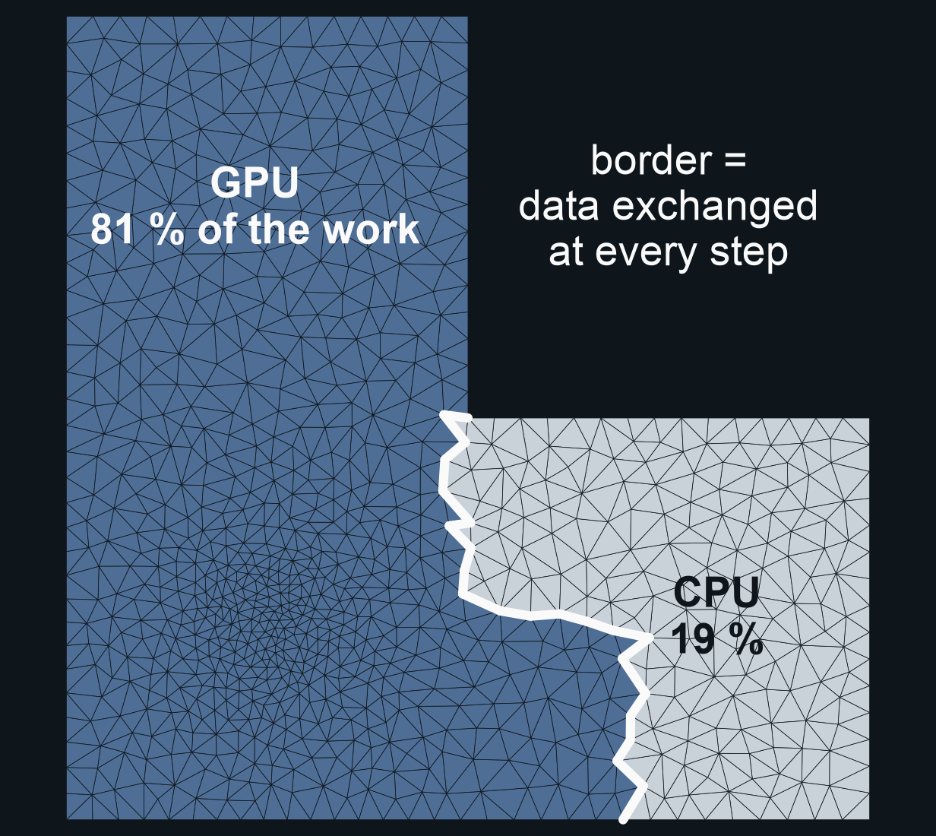
THE PROBLEM
One mesh, two devices: who computes what?
80 %
of the work should go
to a GPU that is 4x
faster than the CPU
assumed device speeds (model)
Who: engineers who run large simulations
(heat, stress, crash) on CPU + GPU clusters.
Why: a bad split leaves one device idle,
or makes the devices exchange more data.
our mesh (1,670 triangles), the exact best split
for CPU + GPU (classical)
ZollerQu - Qollab x IonQ Hackathon 2026
2
Notes:
Big simulations, like crash tests, cut their mesh into parts. A good split gives each device a fair share of work and keeps the border short, because data crosses it at every step. A GPU four times faster should get eighty percent.

Slide 3
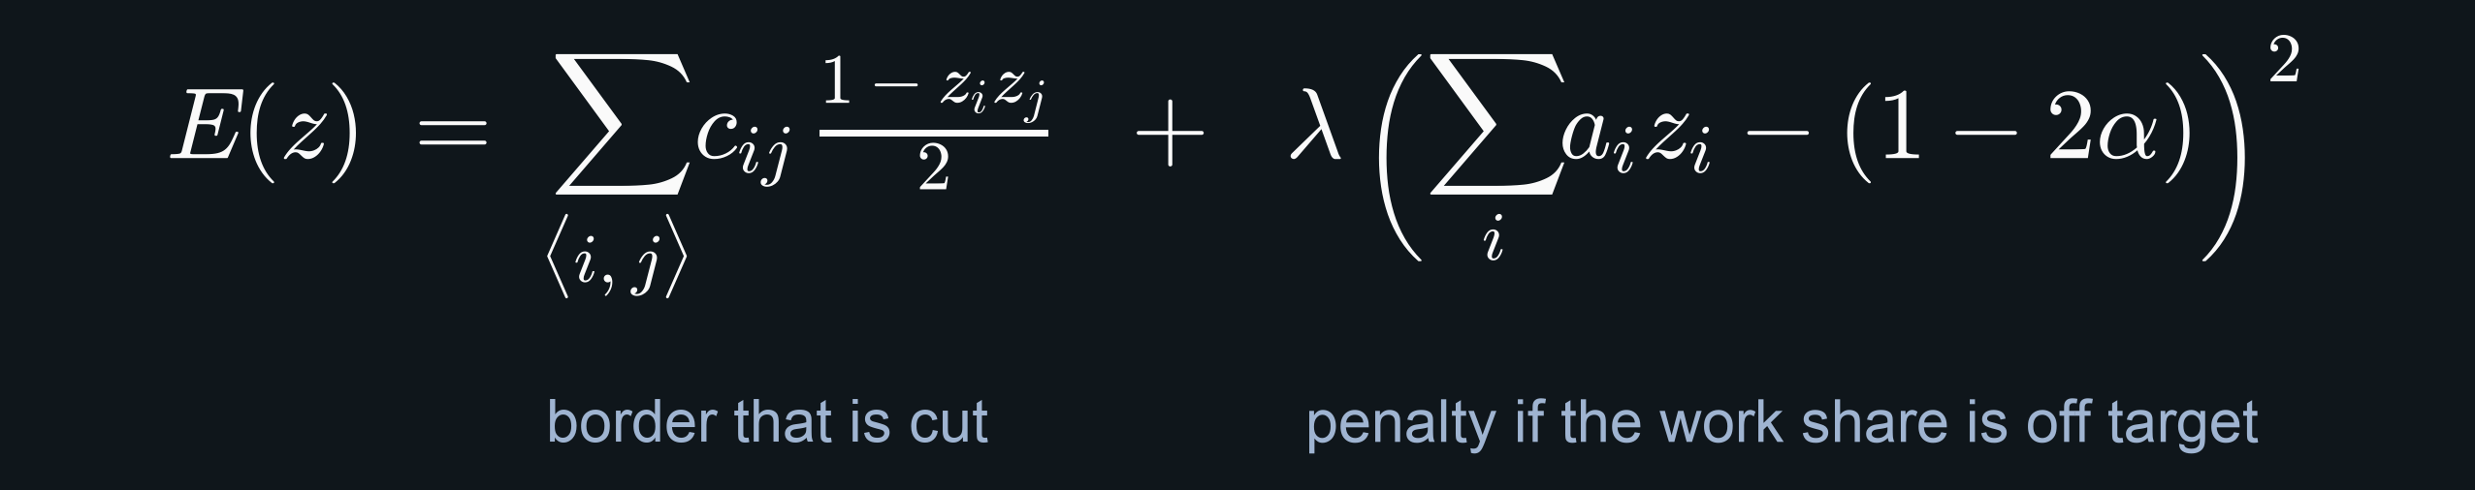
FORMULATION
From mesh to Ising energy
1 qubit =
1 mesh region
12 regions =
4,096 splits
alpha =
target work share
0: device A 1: device B
all checked: the best is known
0.5 equal, 0.8 CPU + GPU
exact best split: classical check of all splits
ZollerQu - Qollab x IonQ Hackathon 2026
3
Notes:
We group the mesh into twelve regions, one qubit each: zero means device A, one means device B. The energy adds the border that is cut and a penalty when the work share misses its target. Twelve qubits let us check every split and know the exact best one.

Slide 4
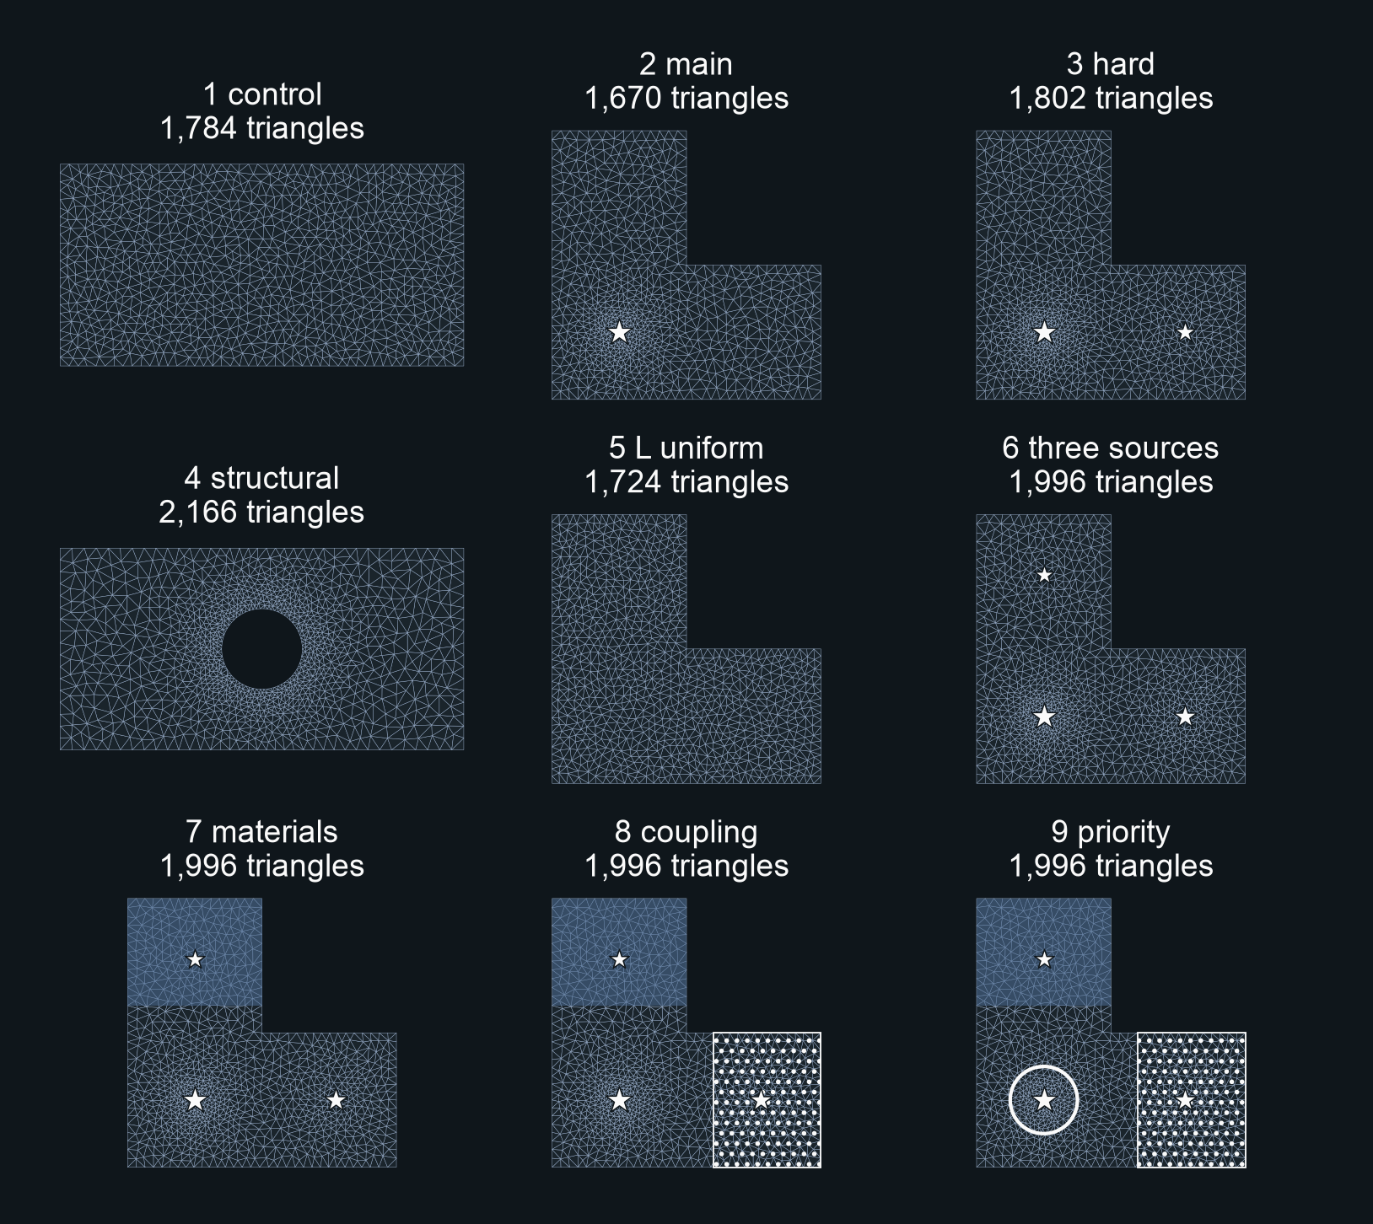
BENCHMARK
9 mesh objects, one method
9
objects, built from 6 different
meshes (1,670 to 2,166 triangles)
Shapes: a plate, L-shaped plates and a plate
with a hole
What changes the work: heat sources, heavy
material, strongly coupled zones, a priority zone
Every object: both device scenarios, grouped
into 12 to 29 regions (one qubit each)
frozen meshes in data/frozen_meshes (identical on every machine)
ZollerQu - Qollab x IonQ Hackathon 2026
4
Notes:
We tested nine mesh objects: a plate, L-shaped plates and a plate with a hole, with heat sources, heavy materials, strong coupling and a priority zone.

Slide 5
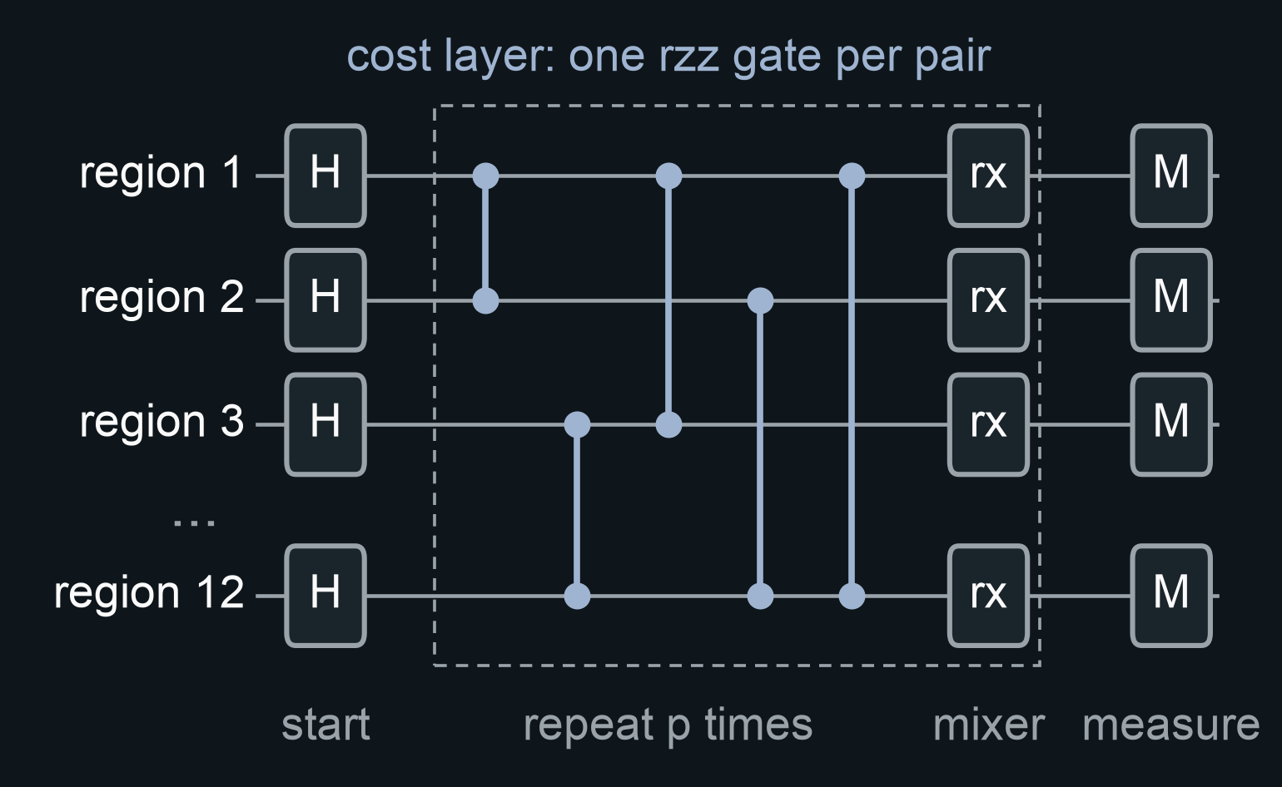
QUANTUM METHOD
Fixed circuits, trained offline
104
circuits compared
at 12 qubits
LR-QAOA, optimised QAOA, CVaR-QAOA,
warm starts, varQITE (IonQ's method)
Trained on a noiseless simulator
ONE fixed circuit per IonQ job
noiseless simulation (results/ionq_selection)
sketch of the QAOA circuit; varQITE uses the same start and measurement
ZollerQu - Qollab x IonQ Hackathon 2026
5
Notes:
The circuit starts from all splits, applies a cost layer with one two-qubit gate per pair of regions, then a mixer. We compared one hundred and four circuits, including IonQ's varQITE. Training is offline and noiseless. On Qollab we send one fixed circuit per job.

Slide 6
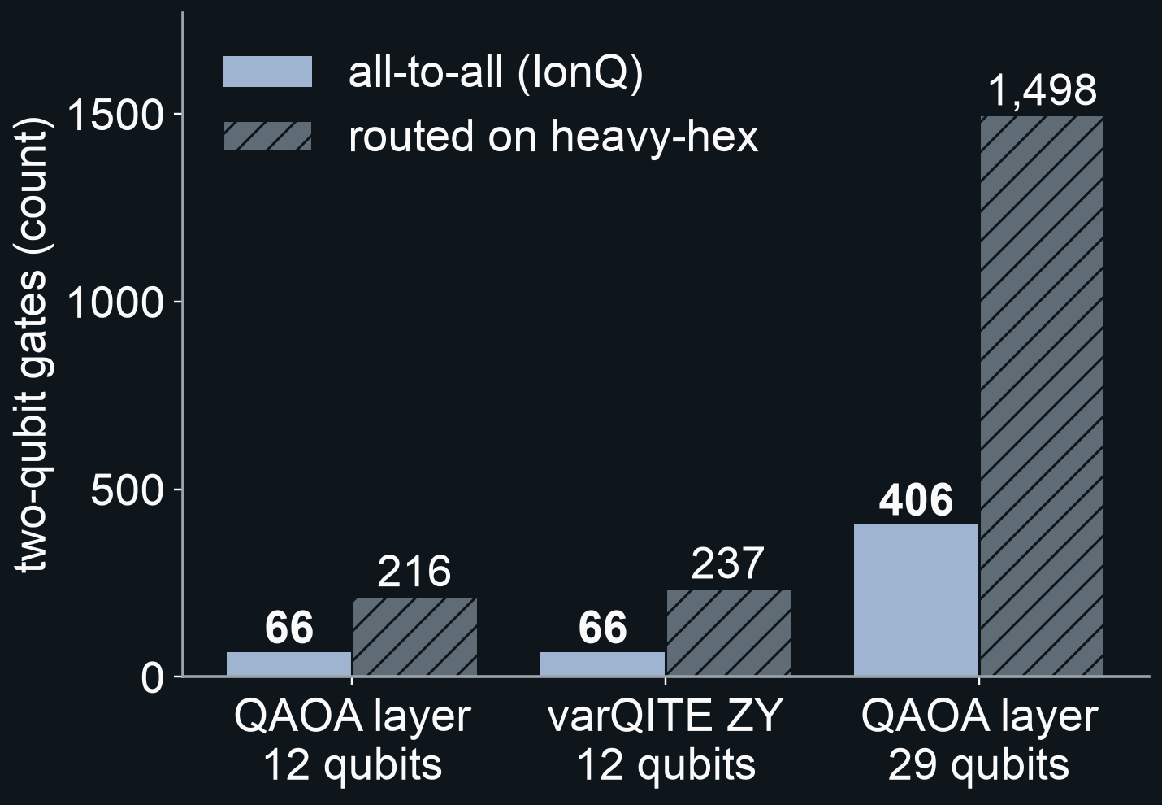
WHY IONQ
Every region pairs with every other
66
two-qubit gates for one
layer at 12 qubits,
all-to-all connectivity
216 after routing on a heavy-hex
layout: 3.3x more
At 29 qubits: 406 against 1,498
(3.7x more)
counted with the Qiskit transpiler only
(no simulation, no hardware run)
ZollerQu - Qollab x IonQ Hackathon 2026
6
Notes:
Our balance term couples every pair of regions. IonQ connects every pair of qubits, so one layer needs sixty-six two-qubit gates. Routed on a heavy-hex layout it needs about three times more, counted with the transpiler only.

Slide 7
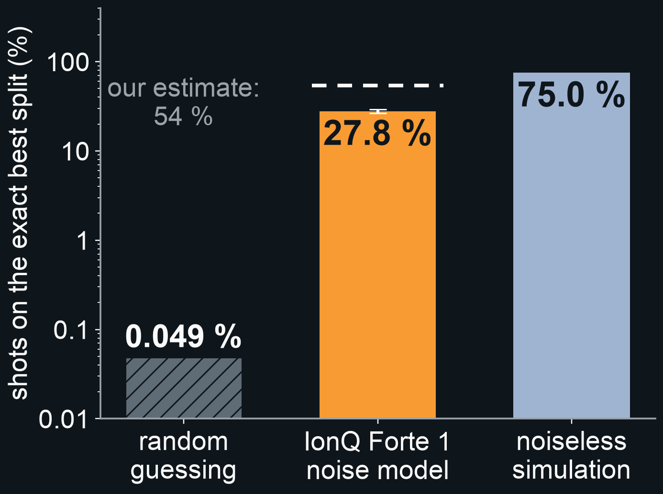
MAIN RESULT · 2 EQUAL DEVICES
28 % of shots are the exact best split
27.8 %
of 1,000 shots, about 570x random guessing
Most frequent answer: the exact optimum
IonQ Forte 1 noise model (Qollab), 11 Oct 2026:
varQITE ZY, 12 qubits, 66 two-qubit gates
Noiseless: 75.0 %. Noise costs 47 points,
about 2x what we estimated.
Classical, same 1,000 tries: annealing finds it
in 50 % of runs, local search in 51 %.
random and noiseless: noiseless simulation; classical: classical
ZollerQu - Qollab x IonQ Hackathon 2026
7
Notes:
The main result, for two equal devices. On the IonQ Forte 1 noise model, twenty-eight percent of one thousand shots were the exact best split, and it was the most frequent answer. Random guessing gives five hundredths of a percent. Without noise we reach seventy-five percent: noise costs twice what we estimated.

Slide 8
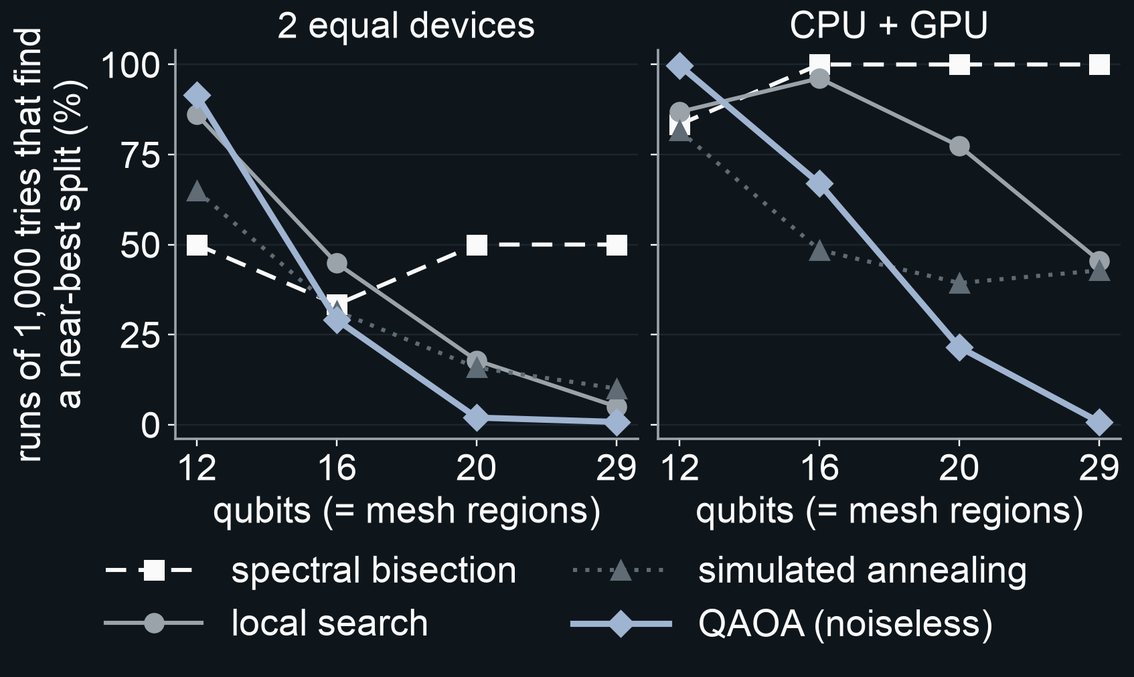
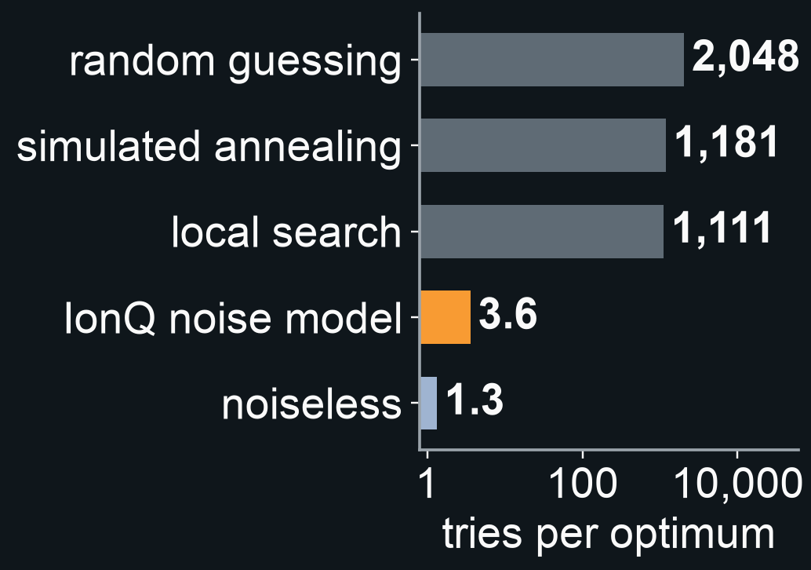
SCALING · HONEST COMPARISON
Bigger meshes: classical methods win
12 qubits: IonQ Forte 1 noise model (Qollab),
classical
Caveats: varQITE first needed 7,581
noiseless training circuits. A shot is not
the same work as a classical evaluation.
server simulation, noiseless, 10 Oct 2026 (cases 2 and 9, seeds 7-9);
QAOA = our best setting per size; the other lines are classical
ZollerQu - Qollab x IonQ Hackathon 2026
8
Notes:
Now the honest part. As the mesh grows, classical methods win: at twenty-nine regions, simulated without noise, our best circuit finds a near-best split in under one percent of runs, spectral bisection in half or more. On IonQ's simulator we needed four shots per optimum against eleven hundred classical evaluations. But varQITE first needed seven thousand six hundred training circuits, and a shot is not the same work as a classical evaluation.

Slide 9
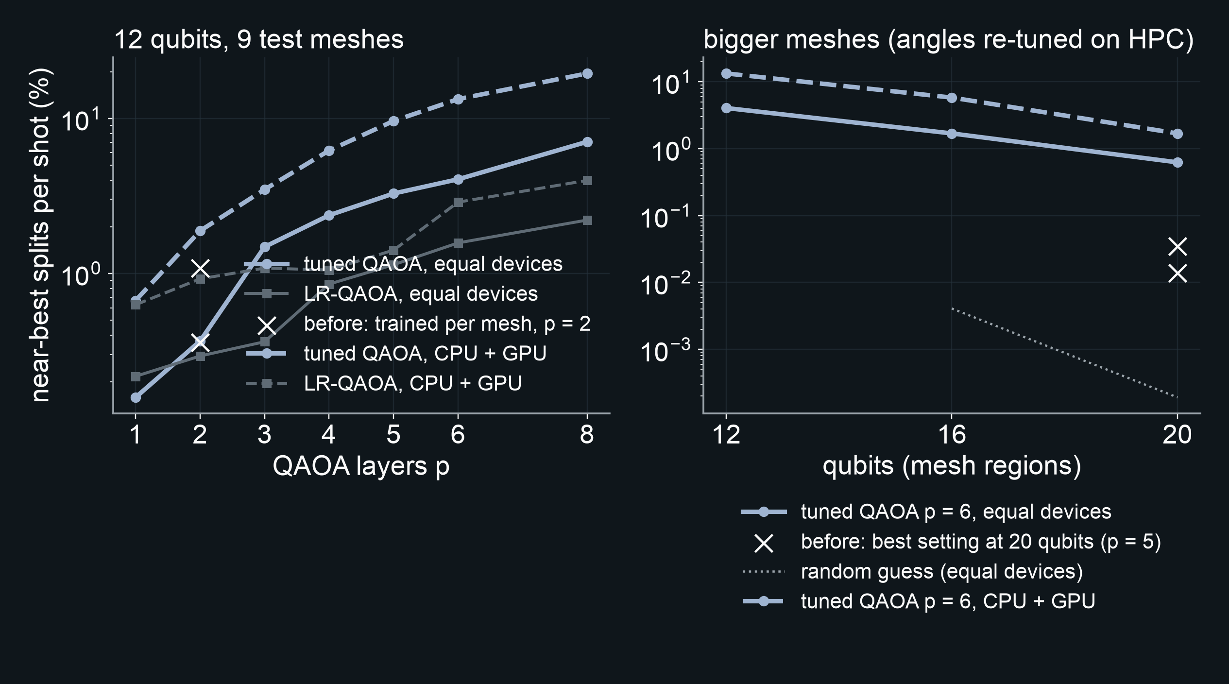
IMPROVING QAOA · HPC
Tuning QAOA itself: about 20x more near-best answers
QAOA types we built
standard QAOA, all angles tuned
(5 optimisers: COBYLA, Nelder-Mead,
Powell, L-BFGS-B, SPSA)
LR-QAOA (linear ramp)
warm-start QAOA (spectral split)
CVaR-QAOA
symmetry-reduced QAOA
Iceberg-protected QAOA (error detection)
device-choice QAOA (many devices)
12 qubits, 8 layers: 7.1 % / 19.5 % near-best (before 0.36 % / 1.08 %)
20 qubits, 6 layers: 0.62 % / 1.69 % (before 0.014 % / 0.035 %)
29 qubits, 8 layers, found in 1,000 tries: 88 % / 100 % (spectral 50 % / 100 %)
settings chosen on 18 separate calibration
meshes, then frozen; scored on unseen meshes
per shot, equal devices / CPU + GPU; noiseless simulation, HPC server, 11 Oct 2026;
deeper circuits lose more under noise (0.5 % per gate estimate: best at 5 layers)
ZollerQu - Qollab x IonQ Hackathon 2026
9
Notes:
Then we tuned QAOA on separate calibration meshes, comparing seven QAOA types. At twelve qubits the best setting gives about twenty times more near-best answers per shot, and it still helps at twenty qubits.

Slide 10
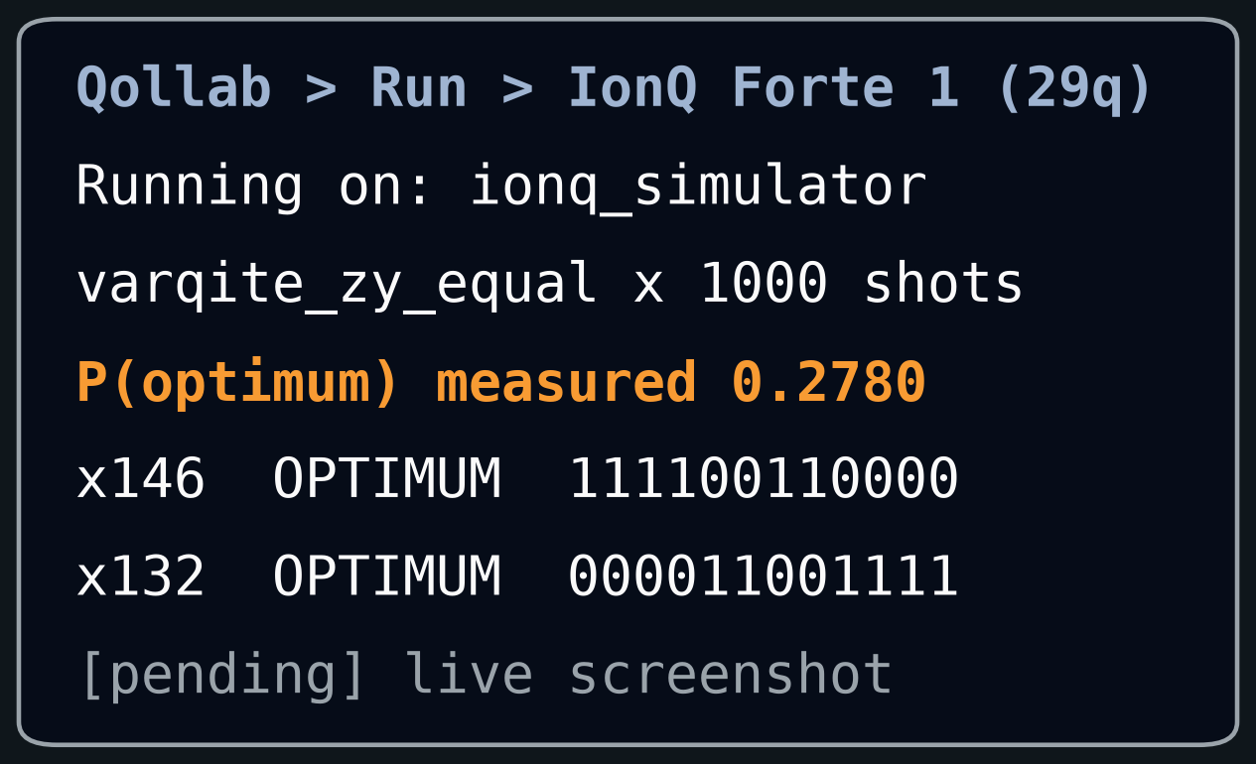
DEMO · LIMITS · NEXT STEPS
Run it on Qollab
Limits
1. A noisy simulator, not hardware.
2. CPU + GPU: the varQITE circuit fails. One
qubit stays 50/50, and we proved why.
3. Beyond 12 qubits, classical methods win.
Next steps
1. Run the other circuits on the noise model.
2. Repair the circuit for unequal shares.
3. Split between more than two devices.
Qollab project: [pending] Video: [pending]
GitHub: Oussema-t/zollerqu-qollab (branch mesh)
This effort is supported by Qollab & IonQ
ZollerQu - Qollab x IonQ Hackathon 2026
10
Notes:
[CUT TO THE LIVE QOLLAB DEMO] On Qollab we press Run and choose IonQ Forte 1. Limits: a noisy simulator, not hardware. For a CPU plus a GPU the varQITE circuit fails, and we proved why. Beyond twelve qubits classical methods win. Next, we repair that circuit. Thank you. This effort is supported by Qollab and IonQ.

Slide 11
APPENDIX
Both device scenarios at 12 qubits
Scenario
Circuit (two-qubit gates)
Random
Noiseless
IonQ noise model
2 equal devices
varQITE ZY (66)
0.049 %
75.0 %
27.8 %
CPU + GPU
CVaR-QAOA, p = 2 (132)
0.024 %
0.58 %
[pending]
CPU + GPU
varQITE ZY (66)
0.024 %
0.00 % (cap proved)
[pending]
Share of shots that are the exact best split. The noisy runs for CPU + GPU are still to be made.
random, noiseless: noiseless simulation; last column: IonQ Forte 1 noise model (Qollab), 11 Oct 2026
ZollerQu - Qollab x IonQ Hackathon 2026
11
Notes:
Appendix, not spoken: the two device scenarios side by side. For CPU plus GPU the published varQITE circuit is capped by a qubit that stays fifty-fifty; the best other circuit reaches about half a percent without noise.

