Slide 1
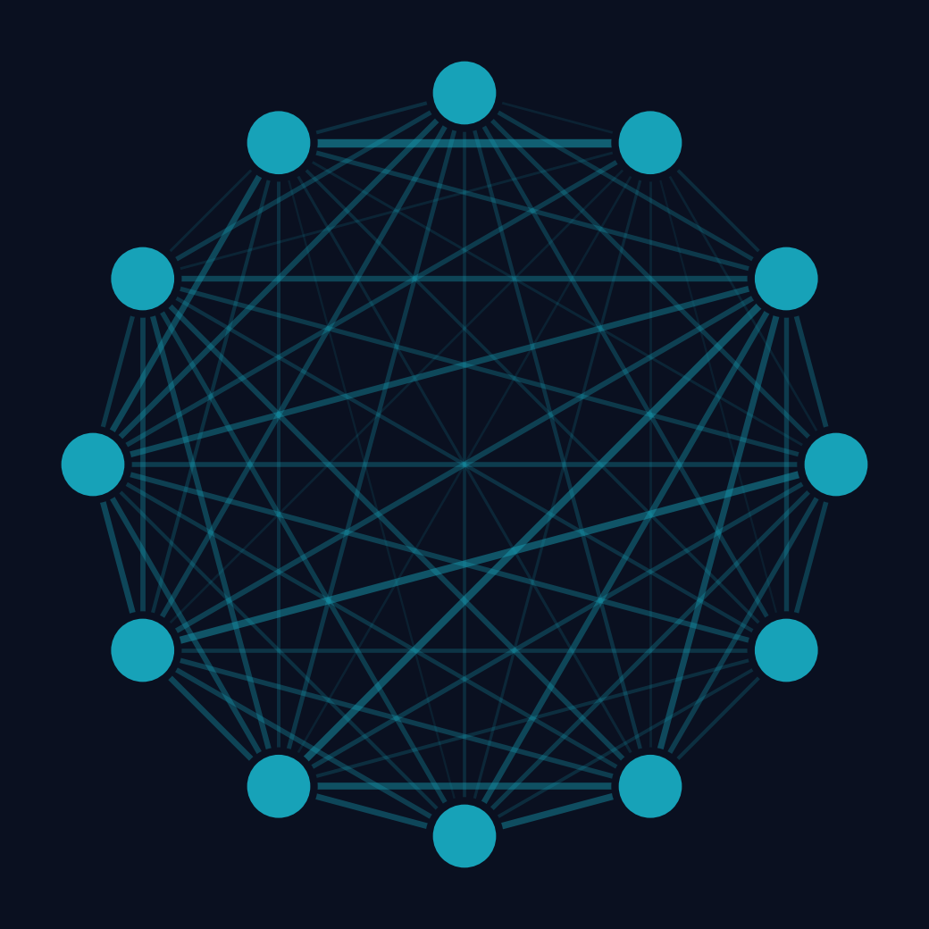
Portfolio Selection
with QAOA
TEAM ZOLLERQU
Which stocks to buy? One qubit per asset,
sampled on the IonQ Forte 1 noise model.
Oussama Turki · Tushar Pandey
This effort is supported by Qollab & IonQ
ZollerQu - Qollab x IonQ Hackathon 2026
1
Notes:
Hi, we are team ZollerQu. We pick stocks with QAOA on the IonQ noise model.

Slide 2
Which assets should a fund buy?
PROBLEM
Banks and funds build
portfolios every day
AAPL
Apple
GLD
gold
XOM
oil
JPM
bank
They want low risk
and a good return
TLT
US bonds
JNJ
health
PG
consumer
XLU
utilities
Risk comes from assets
that fall together
VNQ
real estate
FCX
copper
MSFT
Microsoft
SLV
silver
Every extra asset
doubles the choices
4,096
536,870,912
portfolios, 12 assets
portfolios, 29 assets
Data: weekly prices of 12 US stocks and funds, 2006-2014 (Kaggle Huge Stock Market Dataset, CC0)
ZollerQu - Qollab x IonQ Hackathon 2026
2
Notes:
Funds want low risk and good return. Risk comes from assets that fall together. Twelve assets give four thousand portfolios, twenty-nine give half a billion.

Slide 3
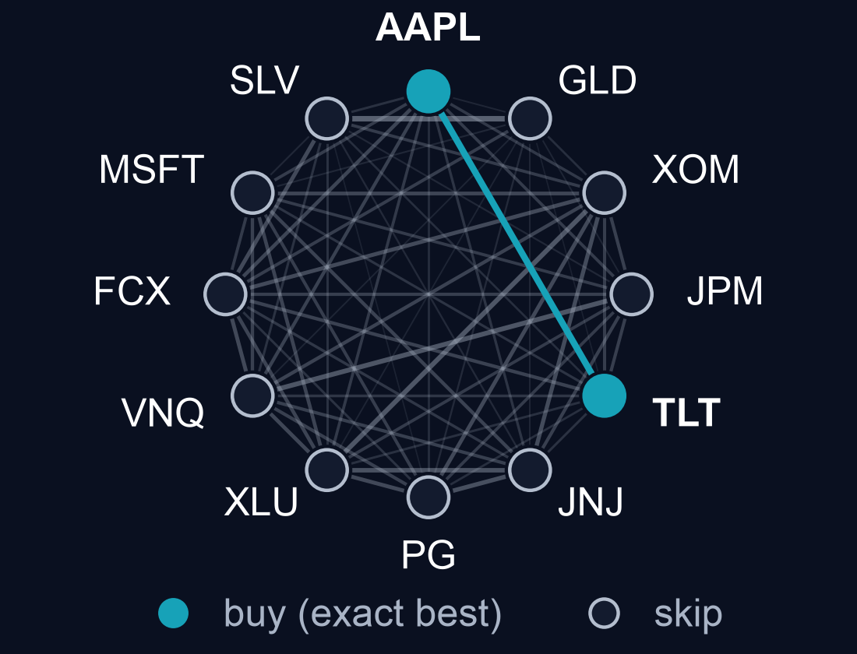
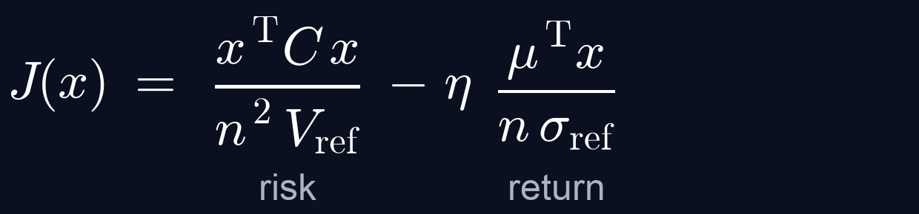
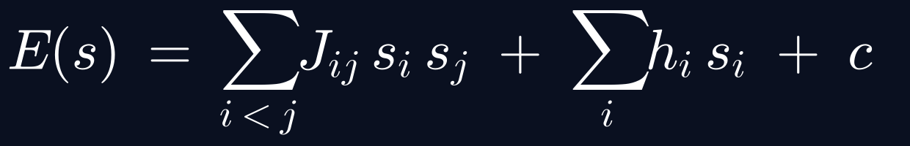
One qubit per asset, one Ising energy
FORMULATION
Score to minimise: risk minus return
The same score as an Ising energy
1 qubit = 1 asset: |0> buy, |1> skip
12 qubits · 66 couplings · 4,096 states
Exact best portfolio found by checking all 4,096 portfolios (classical); risk and return from 2006-2014 data
ZollerQu - Qollab x IonQ Hackathon 2026
3
Notes:
Each asset is one qubit: zero means buy, one means skip. Risk minus return becomes an Ising energy. The exact best: Apple plus US bonds.

Slide 4
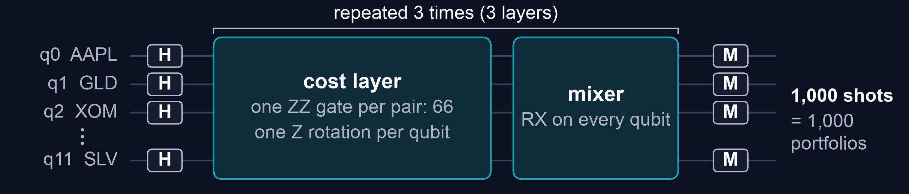
QAOA circuits, trained offline, one IonQ job
QUANTUM METHOD
COMPARED
BEST AT 12 QUBITS
AT 16, 20, 29 QUBITS
8 circuit types
CVaR-QAOA
Linear-ramp QAOA
58 circuits, trained offline
on a classical simulator
3 layers, 198 two-qubit gates,
sent to IonQ as one job
Angles reused from 12 qubits,
no new training
12 qubits: 58 circuits + a random-guess control, noiseless simulation · 16-29 qubits: server simulation
ZollerQu - Qollab x IonQ Hackathon 2026
4
Notes:
We trained fifty-eight circuits offline. Best at twelve qubits: CVaR-QAOA, three layers. At twenty-nine qubits: linear-ramp QAOA, with the angles reused.

Slide 5
8 circuit types, 5 settings that mattered
WHAT WE TRIED
Settings we changed (noiseless)
58 circuits tested
Mixer sign (12 assets)
as written → opposite sign: 0.004 % → 1.8 % per shot
6 kinds of QAOA
Linear-ramp QAOA
Free-angle QAOA, 5 optimisers
Objective (12 assets)
mean energy → CVaR 0.1: 1.8 % → 5.8 % per shot
CVaR-QAOA (α = 0.1, 0.25)
Multi-angle QAOA
Layers (29 assets)
3 → 16: 6.6 % → 90 % of runs (noiseless)
Counterdiabatic QAOA
XY-mixer QAOA (keeps balance)
Ramp range (29 assets)
up to 1.5 → 3.0: 45 % → 90 % of runs at 16 layers
2 imaginary-time methods
VarQITE on the QAOA angles
Angle choice (29 assets, 3 layers)
by energy → by CVaR: 9.9 % → 17.9 % of runs
varQITE ansatz (IonQ + ORNL)
12 assets: noiseless simulation, 10 Oct 2026 · 29 assets: noiseless server simulation, 11 Oct 2026
per shot = chance that one shot is the best portfolio · runs = 1,000-shot runs that contain it
ZollerQu - Qollab x IonQ Hackathon 2026
5
Notes:
We compared eight circuit types. The mixer sign, the CVaR objective and more layers mattered most.

Slide 6
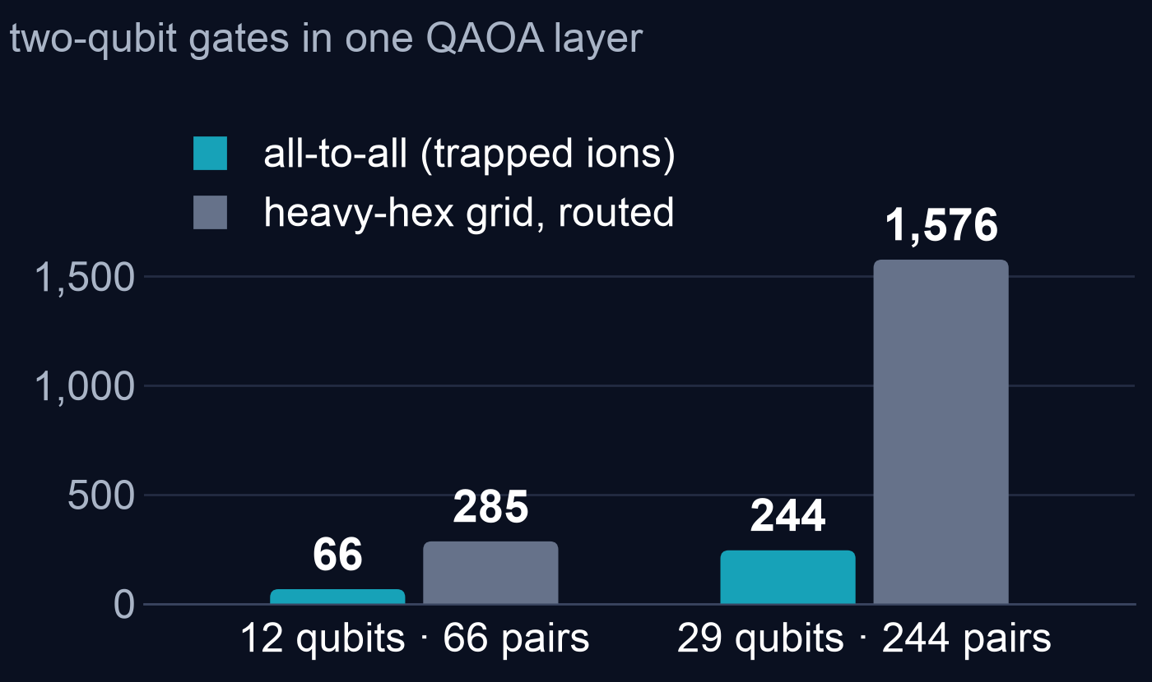
All-to-all links: 4.3× fewer two-qubit gates
WHY IONQ
4.3×
fewer two-qubit gates
at 12 qubits (66 vs 285)
6.5×
fewer at 29 qubits (244 vs 1,576)
66 pairs = 66 gates, no SWAPs
Gate counts from transpiling only (Qiskit 2.5.2, level 1); heavy-hex = median of 5 routing seeds
on a generic heavy-hex map. No circuit was run on a heavy-hex device.
ZollerQu - Qollab x IonQ Hackathon 2026
6
Notes:
Trapped ions connect every pair of qubits, so one layer needs sixty-six two-qubit gates. A heavy-hex chip needs two hundred eighty-five.

Slide 7
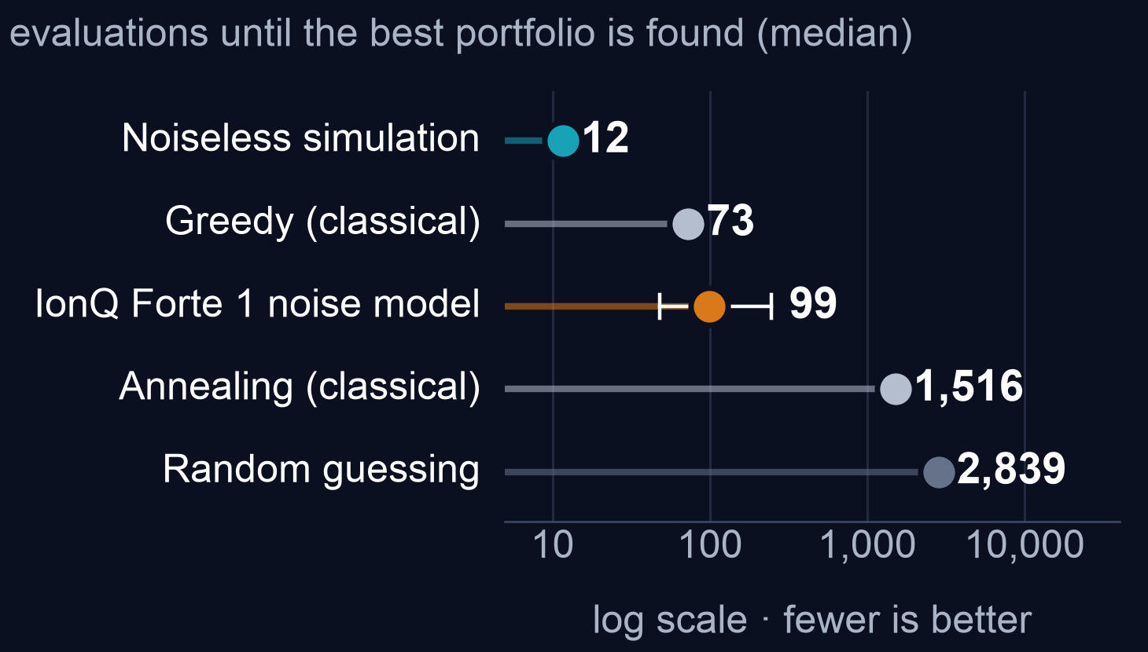
IonQ noise model: 29× random guessing
MAIN RESULT
IonQ Forte 1 noise model
7 / 1,000
shots are the exact best
of 4,096 portfolios
29× random guessing
58 / 1,000 noiseless
95 % interval: 3-14 per 1,000
IonQ Forte 1 noise model (Qollab): 1 job, 1,000 shots, 11 Oct 2026 · noiseless simulation
Classical: median of 50 runs. Sampler medians come from the hit rate per shot. Training not counted.
ZollerQu - Qollab x IonQ Hackathon 2026
7
Notes:
Main result: on the IonQ noise model, seven in a thousand shots were the exact best portfolio, twenty-nine times better than random. Without noise it is fifty-eight.

Slide 8
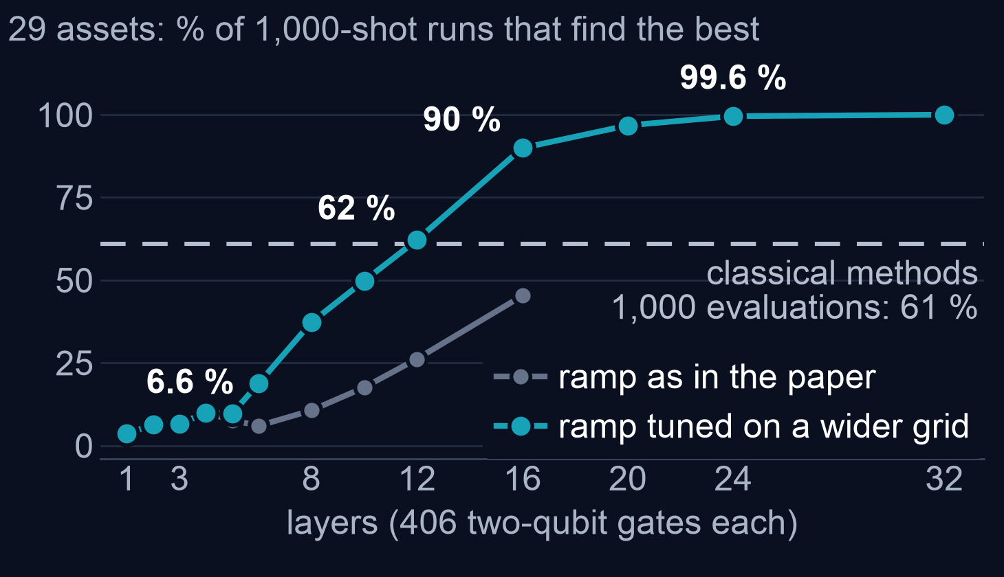
29 qubits: more layers help, only without noise
SCALING AND HONEST COMPARISON
Read with care
Noiseless simulation only
16 layers = 6,496 two-qubit
gates; our 198-gate IonQ run
lost a factor 8 to noise
Classical: 100 % with 10,000
evaluations
A shot is not the same work
as a classical evaluation
Server simulation of all 536,870,912 states, 11 Oct 2026; ramp tuned at 12 assets, no tuning at 29
Classical: greedy descent and annealing, 200 runs, the same 1,000 evaluations
ZollerQu - Qollab x IonQ Hackathon 2026
8
Notes:
With twenty-nine assets, three layers find the best in seven percent of runs, classical search in sixty-one. Sixteen layers reach ninety percent, but only without noise. No quantum advantage is claimed.

Slide 9
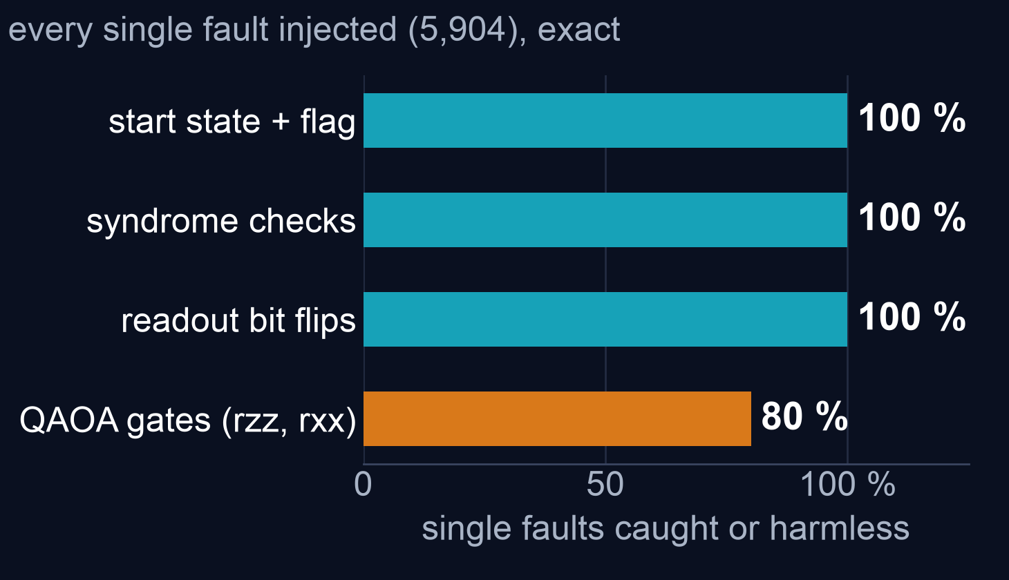
Iceberg catches errors, but doubles the gates
ERROR DETECTION
17 qubits
12 logical on 14, + 1 flag
+ 2 helpers per check
25 % kept
IonQ Forte 1 noise model,
1 layer: 3 in 4 shots flagged
Best portfolio: 2 of 246 kept
shots; plain 5-11 per 1,000
133 vs 66 two-qubit gates
Faults: exact simulation of every single fault (1, 2 layers) · Run: IonQ Forte 1 noise model, 1,000 shots
Detection, not correction: shots that fail a check are discarded (Qollab, 11 Oct 2026)
ZollerQu - Qollab x IonQ Hackathon 2026
9
Notes:
We also tried Iceberg error detection. On the IonQ noise model it flagged three in four shots. The kept shots were not clearly better, because the code doubles the gates.

Slide 10
Try it on Qollab: one click, one IonQ job
DEMO, LIMITS, NEXT STEPS
Honest limits
Live demo on Qollab
A noisy simulator: one job of 1,000 shots
Open the project:
the code is in main.py
Noise cuts the hits from 58 to 7 per 1,000
1
Classical heuristics match or beat it
Run → Select QPU →
IonQ Forte 1 (29q) noise model
Next steps
2
Iceberg at more layers and checks
Each job returns counts,
a table and plots
Shorter circuits: 66 instead of 198 gates
3
Find how many layers the noise allows
ZollerQu - Qollab x IonQ Hackathon 2026
10
Notes:
[SWITCH TO QOLLAB] This is our project. The code is in main.py. We press Run, pick the IonQ Forte 1 noise model, and get results and plots. [BACK TO SLIDES] Classical methods still match us. Next: more Iceberg layers and shorter circuits.

Slide 11
Thank you for
your attention
TEAM ZOLLERQU
Oussama Turki · Tushar Pandey
Portfolio Selection with QAOA
This effort is supported by Qollab & IonQ
ZollerQu - Qollab x IonQ Hackathon 2026
11
Notes:
Thank you for your attention. This effort is supported by Qollab and IonQ.

