Slide 1
Web fundamentals Checkpoint project
How does the web works ?
What do you need to be a web developer ?
What’s the role of a web developer ?

Slide 2
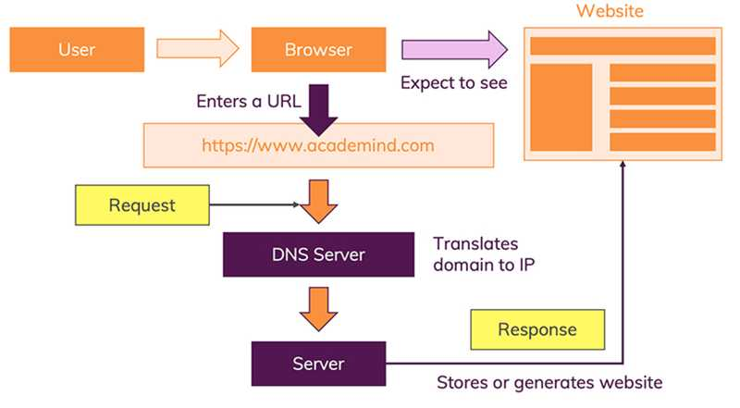
How Websites Work?
Let’s start with the most obvious way of using the internet: You visit a website like www.google.com
The moment you enter this address in your browser and you hit ENTER, a lot of different things happen:
The URL gets resolved
A Request is sent to the server of the website
The response of the server is parsed
The page is rendered and displayed

Slide 3
Actually, every single step could be split up in multiple other steps, but for a good overview of how it all works, that’s something we can ignore here. Let’s have a look at all four steps.
Step 1 - URL Gets Resolved
The website code is obviously not stored on your machine and hence needs to be fetched from another computer where it is stored. This “other computer” is called a “server”. Because it serves some purpose, in our case, it serves the website.
You enter “academind.com” (that is called “a domain”) but actually, the server which hosts the source code of a website, is identified via IP (= Internet Protocol) addresses. The browser sends a “request” (see step 2) to the server with the IP address you entered (indirectly - you of course entered “academind.com”).
In reality, you also often enter "academind.com/learn" or anything like that. « google.com" is the domain, "/learn" is the so-called path. Together, they make up the “URL” (“Uniform Resource Locator”).
In addition, you can visit most websites via "www.google.com" or just « google.com". Technically, "www" is a subdomain but most websites simply redirect traffic to "www" to the main page.
An IP address typically looks like this: 172.56.180.5 (though there also is a more “modern” form called IPv6 - but let’s ignore that for now).
How is the domain “google.com” translated to its IP address?
There’s a special type of server out there in the internet - not just one but many servers of that type. A so called “name server” or “DNS server” (where DNS = “Domain Name System”).
The job of these DNS servers is to translate domains to IP addresses. You can imagine those servers as huge dictionaries that store translation tables: Domain => IP address.
When you enter “google.com”, the browser therefore first fetches the IP address from such a DNS server.

Slide 4
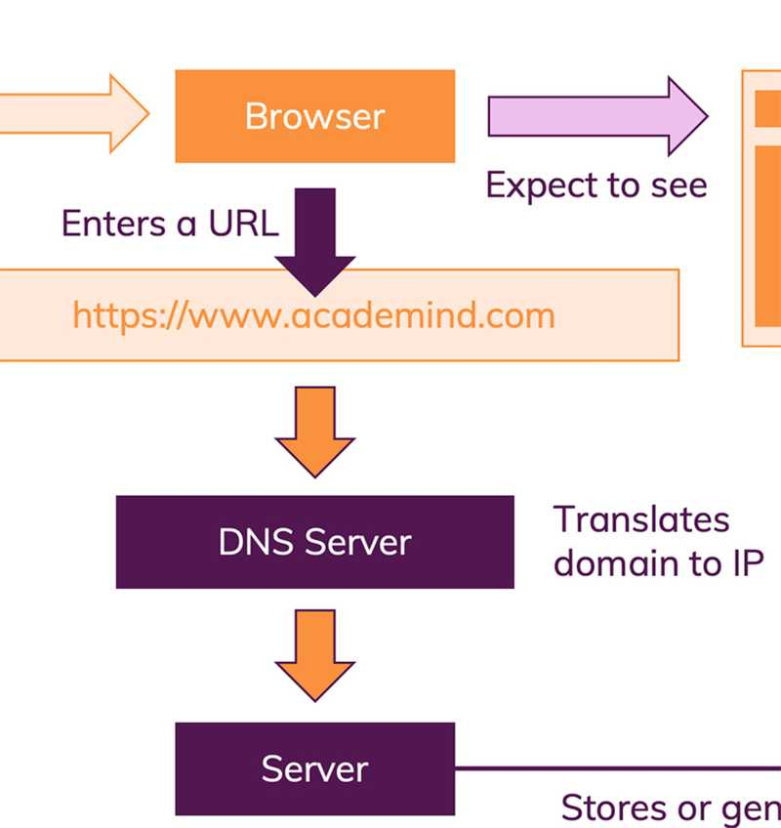
In case you’re wondering: The browser knows the addresses of these domain servers by heart, they’re programmed into the browser so to say.
Once the IP address is known, we advanced to step 2.
Step 2 - Request Is Sent
With the IP address resolved, the browser goes ahead and makes a request to the server with that IP address.
“A request” is not just a term. It really is a technical thing that happens behind the scenes.
The browser bundles up a bunch of information (What’s the exact URL? Which kind of request should be made? Should metadata be attached) and sends that data package to the IP address.
The data is sent via the “HyperText Transfer Protocol” (known as “HTTP”) - a standardized protocol which defines what a request (and response) has to look like, which data may be included (and in which form) and how the request will be submitted

Slide 5
Since the whole process and format is standardized, there is no guessing about how that request has to be read by the server.
The server then handles the request appropriately and returns a so called “response”. Again, a “response” is a technical thing and kind of similar to a “request”. You could say it’s basically a “request” in the opposite direction.
What happens on the server?
That’s defined by web developers. In the end, a response has to be sent. That response doesn’t have to contain “a website”. It can contain any data - including files or images.
Some servers are programmed to generate websites dynamically based on the request (e.g. a profile page that contains your personal data), other servers return pre-generated HTML pages (e.g. a news page). Or both is done - for different parts of a webpage. There also is a third alternative: Websites that are pre-generated but that change their appearance and data in the browser.
For our simple case we have a server that returns the code to display a website. So let’s continue with step 3.
Step 3 - Response Is Parsed
The browser receives the response sent by the server. This alone, doesn’t display anything on the screen though.
Instead, the next step is that the browser parses the response. Just as the server did it with the request. Again, the standardization enforced by HTTP helps of course.
The browser checks the data and metadata that’s enclosed in the response. And based on that, it decides what to do.

Slide 6
You might’ve had cases where a PDF opened in your browser. That happened because the response informed the browser that the data is not a website but a PDF document instead. And the browser tries to pick the best handling mechanism for any data type it detects.
Back to our website scenario.
In that case, the response would contain a specific piece of metadata, that tells the browser that the response data is of type text/html.
Step 4 - Page Is Displayed
As mentioned, the browser goes through the HTML data returned by the server and builds a website based on that.
Though it is important to know, that HTML does not include any instructions regarding what the site should look like (i.e. how it should be styled). It really only defines the structure and tells the browser which content is a heading, which content is an image, which content is a paragraph etc. This is especially important for accessibility - screen readers get all the useful information out of the HTML structure.

Slide 7
What do you need to be a web developer?
1. Who Can Become A Web Developer?
Anyone can become a web developer. You don’t need to be a tech wizard or possess a never-ending list of formal qualifications; as long as you’re passionate about the field and willing to learn, a career in web development is well within your reach.
Don’t believe me? Just look at my friend Aziz, He originally trained as a musician, before swapping chords for code and enrolling on the Web Development course. With no prior knowledge or experience, he dove head-first into the industry and has never looked back.
That isn’t to say that forging a successful career in web development is easy. Learning the necessary skills takes time and dedication, and there’ll be times when your brain will hurt. But the point is, web development isn’t reserved for one type of person —nor is there a clear-cut route into the field. Anyone who wants to do it, can.

Slide 8
2. What Are The Key Skills That I’ll Need To Learn To Become A Web Developer?
Before you can call yourself a web developer and start applying for jobs, you’ll need to master the following skills:
Languages: HTML, CSS and JavaScript It’s impossible to go into a career in web development if you’re not fluent in these three core languages. HTML is the language used to create websites and apps, you’ll use it to describe the structure of the page. CSS is used to describe the visual presentation of these pages, determining things like layout, colours and fonts. JavaScript is used to make these pages interactive. These aren’t the only programming languages but they are the most useful for beginners.
Libraries and Frameworks: Bootstrap and jQuery Once you’ve mastered the basic languages, you can start exploring libraries and frameworks—which have essentially been created to simplify and speed-up the way you work with HTML, CSS and JavaScript. There are tons of libraries and frameworks out there, but Bootstrap and jQuery are the most popular, so knowing these two will give you a huge advantage. A free, open-source front-end library containing HTML and CSS-based design templates, Bootstrap will enable you to create responsive, mobile-friendly websites that display flawlessly on any device. Now remember the programming language JavaScript? Well, jQuery is simply a JavaScript library. In very basic terms, jQuery condenses common JavaScript tasks into fewer lines of code.

Slide 9
Git and GitHub Git is a version control system that enables you to keep track of all changes made to your code. GitHub is a hosting service for your Git repository, enabling teamwork and collaborative projects.
Optional: Design Software Sketch and Photoshop When working in web development, it’s not strictly necessary to be familiar with programmes like Sketch and Photoshop—but it doesn’t hurt. Many designers use these tools to present website mockups and prototypes, and if you ever plan on working as a freelance allrounder, this will certainly give you an advantage.
Of course, this is just the tip of the iceberg—there are loads more languages, tools and platforms that web developers use in their day-to-day work. However, it’s important to start with the basics and walk before you can run!

Slide 10
What’s the role of a web developer?
A Web Developer is responsible for the coding, design and layout of a website according to a company’s specifications.
As the role takes into consideration user experience and function, a certain level of both graphic design and computer programming is necessary. Once a website has been created, a Web Developer will generally assist with the maintenance and the upkeep of the website.
Web Developer duties and responsibilities of the job:
A Web Developer must have experience in the planning and the delivery of web applications across multiple platforms.
A typical Web Developer job description should cover:
Writing efficient code
Creating websites/a website using standard HTML/CSS practices
Working closely with web designers and programmers to produce the website
Constant communication with other colleagues in the business to develop and deploy their content – and ensuring there is a clear establishment of what can be created within what timeframe
Researching different software programs, maintaining software documentation
Implementing contingency plans in case the website goes down

Slide 11
Maintaining and expanding/enhancing the website once built
Managing a team might also be part of the job role
Web Developer job qualifications and requirements:
Although there are no formal educational requirements to become a Web Developer, experience in the field will be expected.
Knowledge in the following is a requirement:
HTML/XHTML, CSS, JavaScript
Server architecture
Experience with server-side frameworks such as python, ruby, php, Java, ASP, ASP.NET
Experience with database systems such as SQL and Oracle
Ability to multitask with strict time constraints, budgets and business goals
Strong communication skills
Management experience or examples that show ability to manage a team, should this role involve team management

