Slide 1
Out-Of-Memory
Final Presentation

Slide 2
Vision
Project Management
Team (RUP)
Tools
Agile Development
Architecture & Design
Use-Case Diagram
Architecture (MVC)
Testing
Demo
CI/CD
Time Estimation
Risk Management
Metrics
Agenda

Slide 3
Vision
Online Flashcard Application
Prevent exmatriculation
Create, Edit, Show and Delete decks with flashcards
User Login
Form groups with friends
Share your decks
Compete with others (Gamification)

Slide 4
Project Management

Slide 5
Project Management - Team
Luca Adams (Frontend / Backend) – Designer & Implementer
Leonhard Stengel (Frontend / Backend) – Business Designer & Requirements Specifier
Franz Nitz (Frontend / Backend) – Test Designer & Tech Writer
Justin Gottfried (Backend) – Project Manager & Configuration Manager

Slide 6
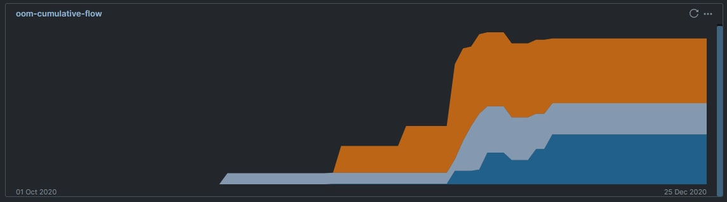
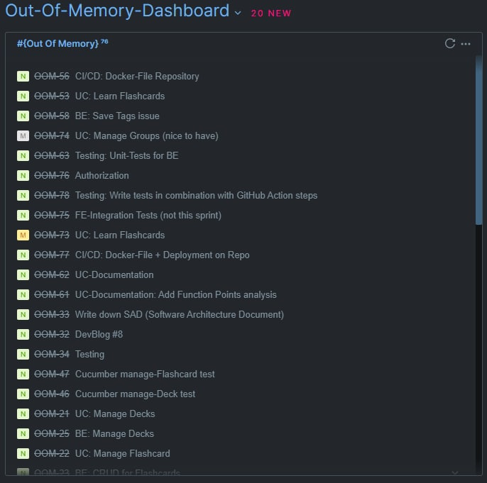
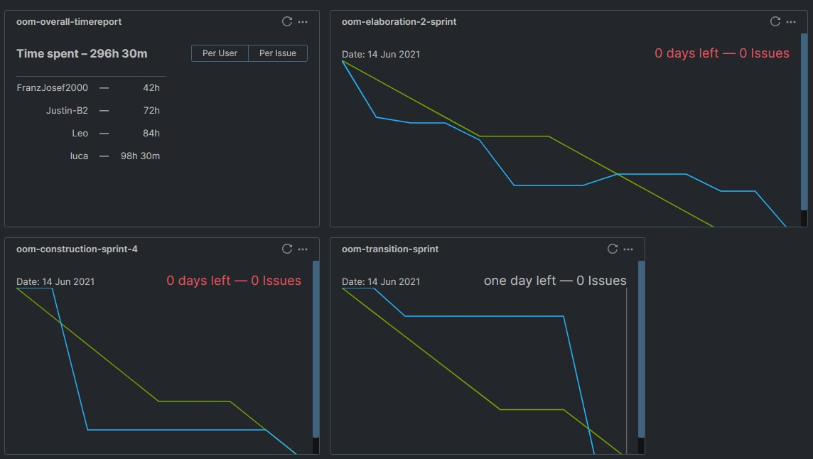
Project Management – Tools Youtrack

Slide 7
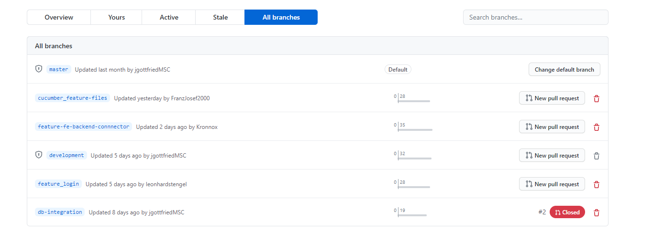
Project Management – Tools GitHub
Version Control System
Quality Assurance – Code Reviews

Slide 8
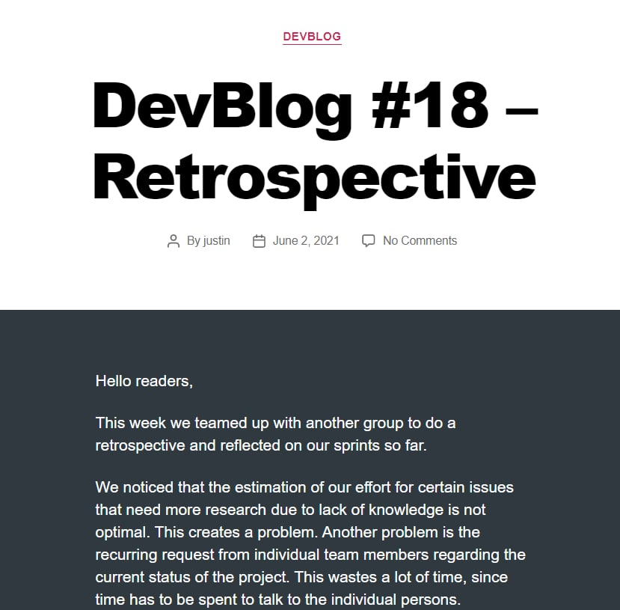
Project Management – Tools Wordpress
Blogposts
Showing latest progress
Knowledge Base (like Confluence)

Slide 9
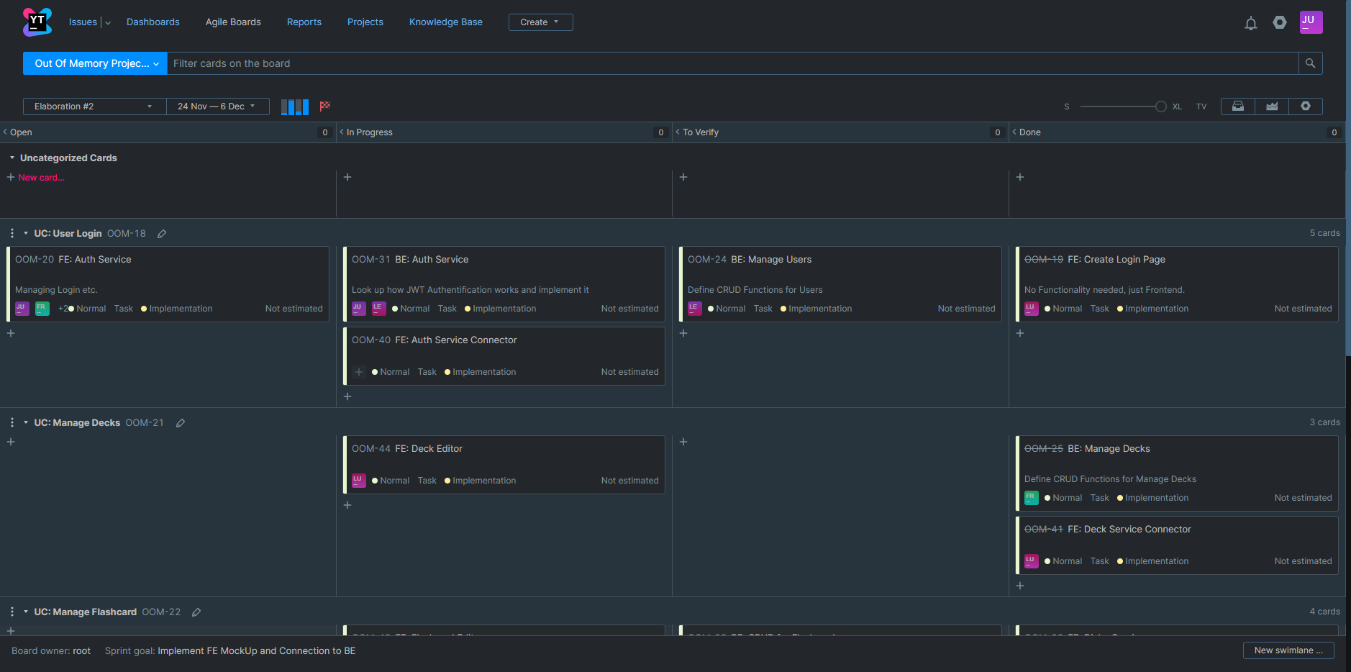
Agile Development - SCRUM

Slide 10
Time Estimation
Use-Case | Estimated time (hours) | Spent time (hours) | Function points
Manage Flashcards | 58 | 44 | 35,7
Manage Decks | 38 | 20 | 38,76
Manage Groups | 25 | 57,5 | 44,88
Gamification | 70 | 98 | 76,5
Manage Users | 20 | 65,35 | 51
Learn Flashcards | 30 | 26,14 → 16 | 20,4

Slide 11
RISK Management
Risk Name | Risk Probability of Occurence | Risk Impact | Risk Factor | Risk Mitigation | Person in Charge of Tracking
Lack of Estimation Skills | 90% | 6 | 5,4 | Regularly conducting sprints | Justin Gottfried
Code quality sucks | 50% | 5 | 2,5 | Uniform coding conventions and code reviews | Leonhard Stengel
Lack of Technical Skills | 25% | 8 | 2 | Use technology that is familiar | Luca Adams
Incorrect prioritization of use cases | 20% | 9 | 1,8 | Frequent recap of implemented functions and regular review of the overall system | Franz Josef Nitz
Team member failure | 5% | 5 | 0,25 | Better distribution of work | Justin Gottfried

Slide 12
Architecture & Design

Slide 13
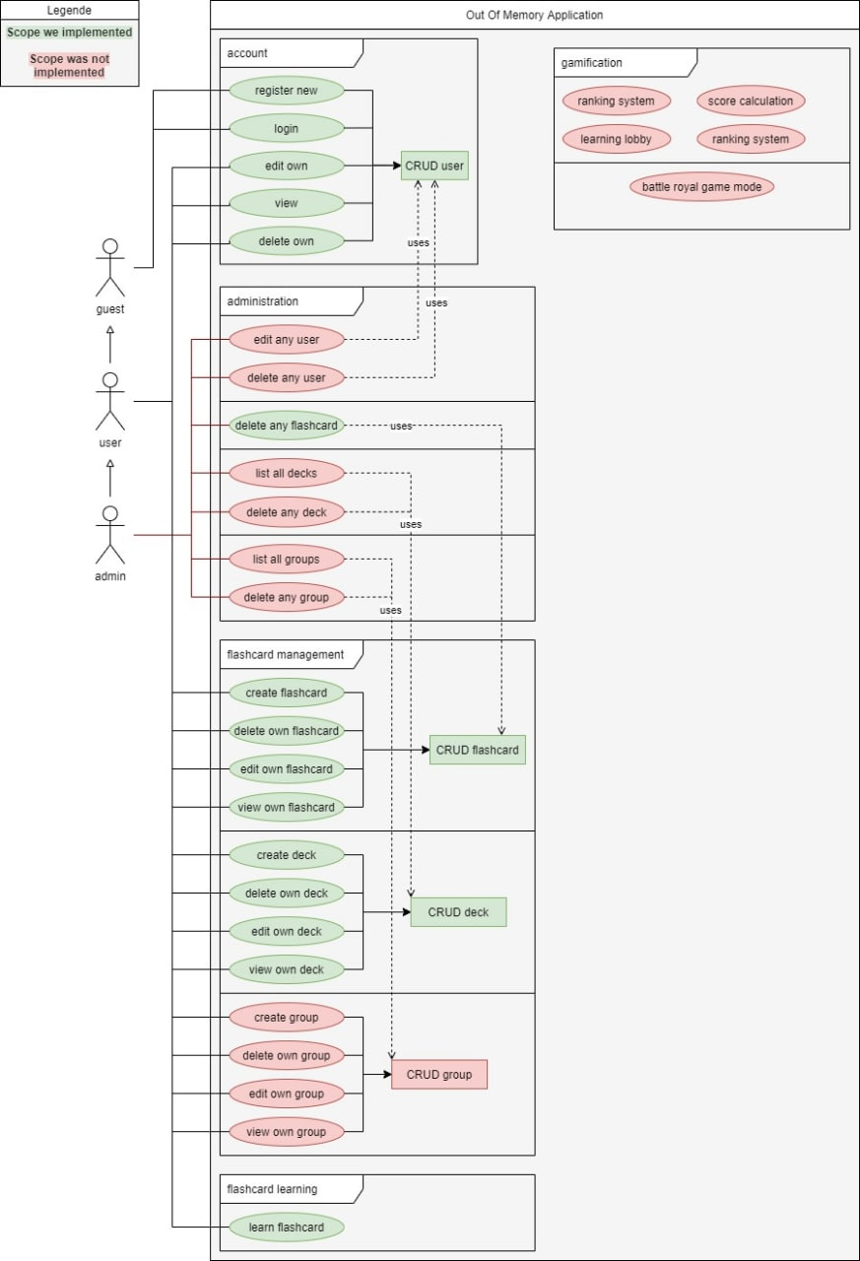
Architecture & Design – Use-Case-Diagram

Slide 14
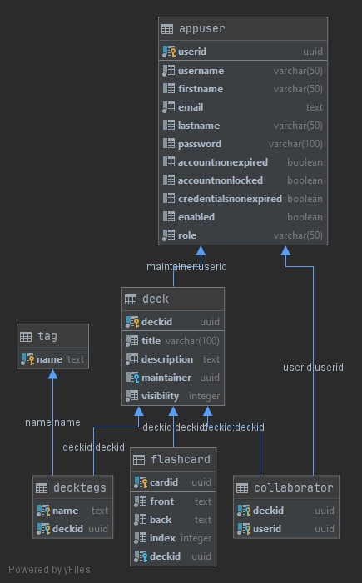
Architecture & Design – Database Diagram

Slide 15
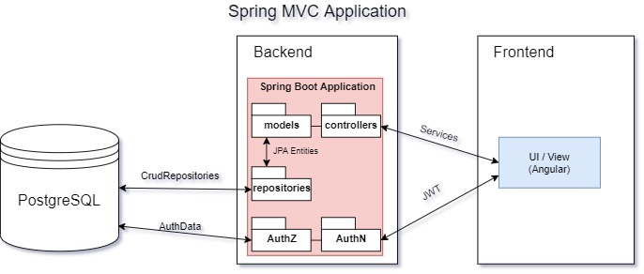
Architecture & Design – MVC Patterns

Slide 16
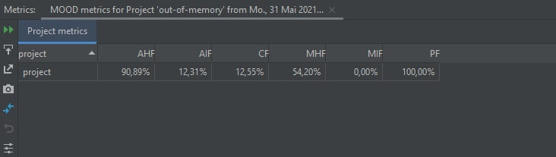
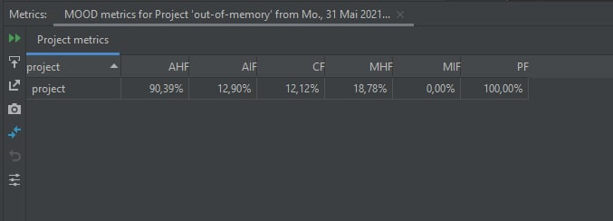

Metrics
MOOD Metrics
Cyclomatic Complexity

Slide 17



Testing
Unit Testing
Backend
Feature Files
Use-Case Testing
Integration Testing
Frontend

Slide 18
CI/CD

Slide 19





CI/CD

Slide 20

Demo

