Slide 1
Out-Of-Memory
Mid-Term Presentation

Slide 2
Agenda
Vision
Project Management
Team (RUP)
Tools
Agile Development
Architecture & Design
Use-Case Diagram
Architecture (MVC)
Testing
Demo

Slide 3
Vision
Online Flashcard Application
  Prevent exmatriculation
  Create, Edit, Show and Delete decks with flashcards
  User Login
  Form groups with friends
  Share your decks
  Compete with others (Gamification)

Slide 4
Project Management - Team
Luca Adams (Frontend / Backend) – Designer & Implementer
Leonhard Stengel (Backend) – Business Designer & Requirements Specifier
Franz Nitz (Frontend / Backend) – Test Designer & Tech Writer
Justin Gottfried (Backend) – Project Manager & Configuration Manager

Slide 5
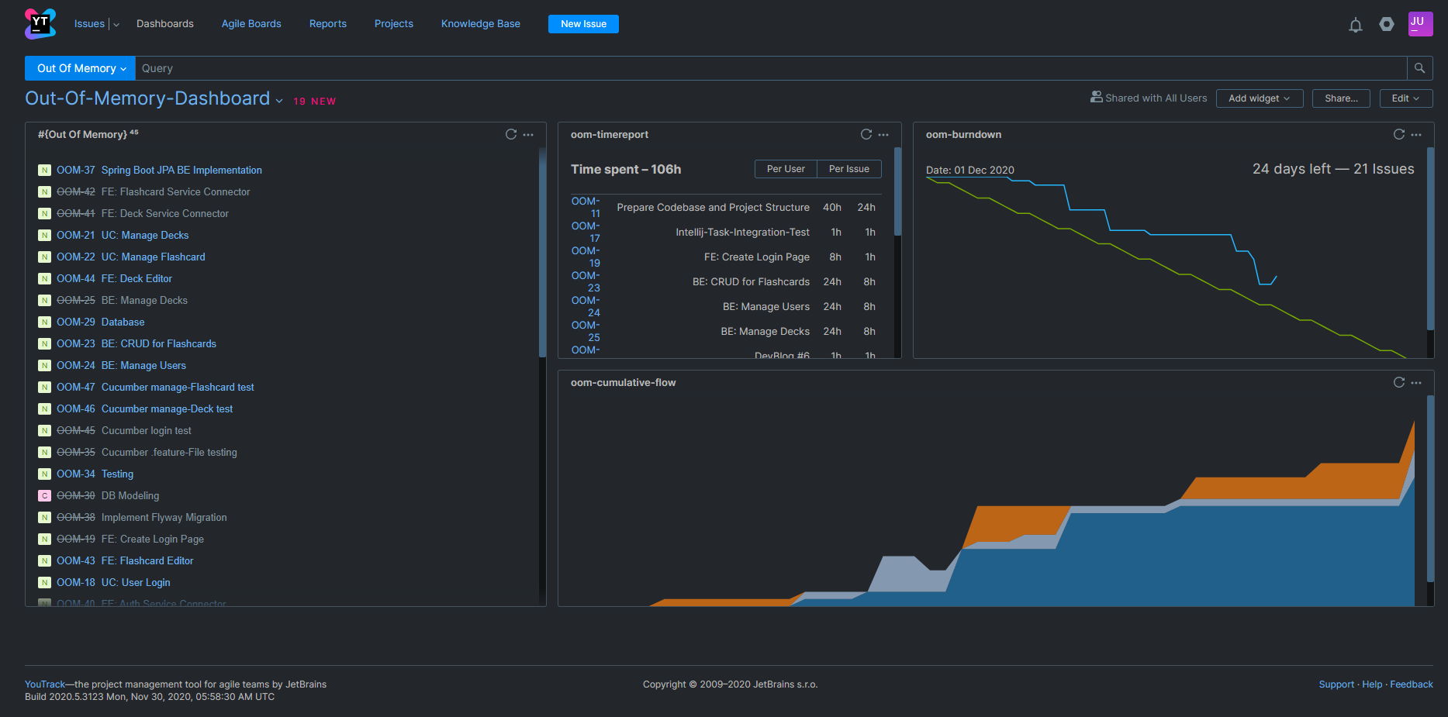
Project Management – Tools
Youtrack

Slide 6
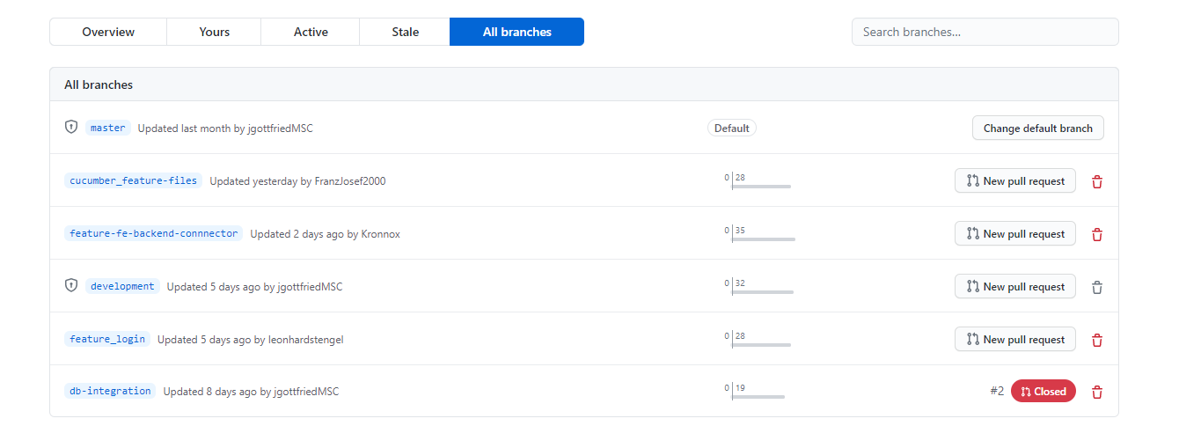
Project Management – Tools
GitHub
Version Control System
Quality Assurance – Code Reviews

Slide 7
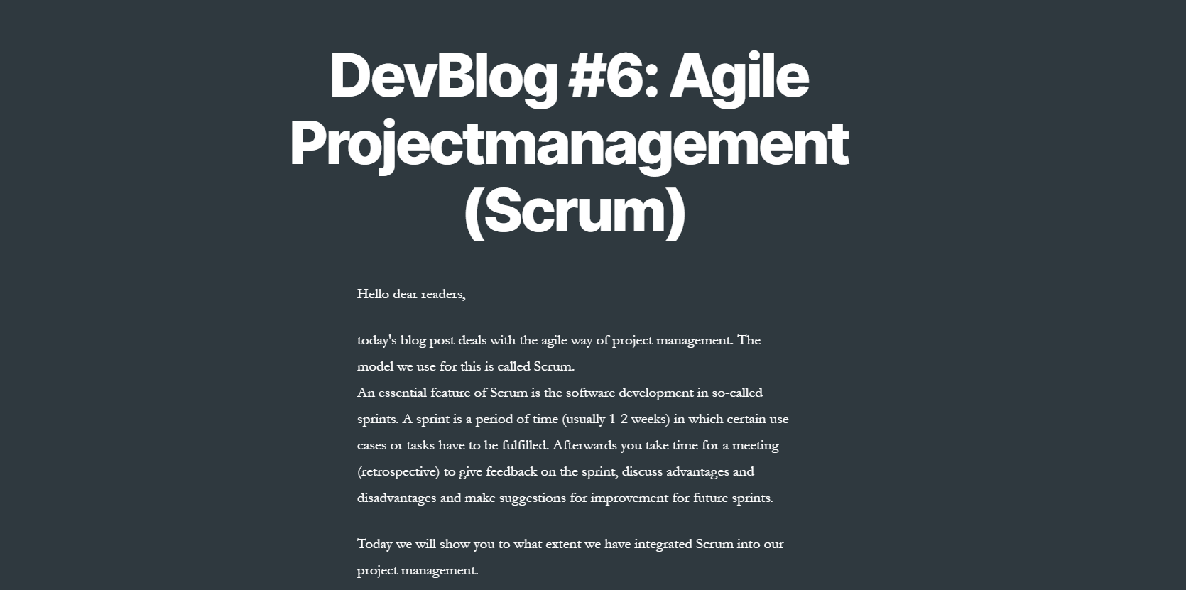
Project Management – Tools
Wordpress
Blogposts
Showing latest progress
Knowledge Base (like Confluence)

Slide 8
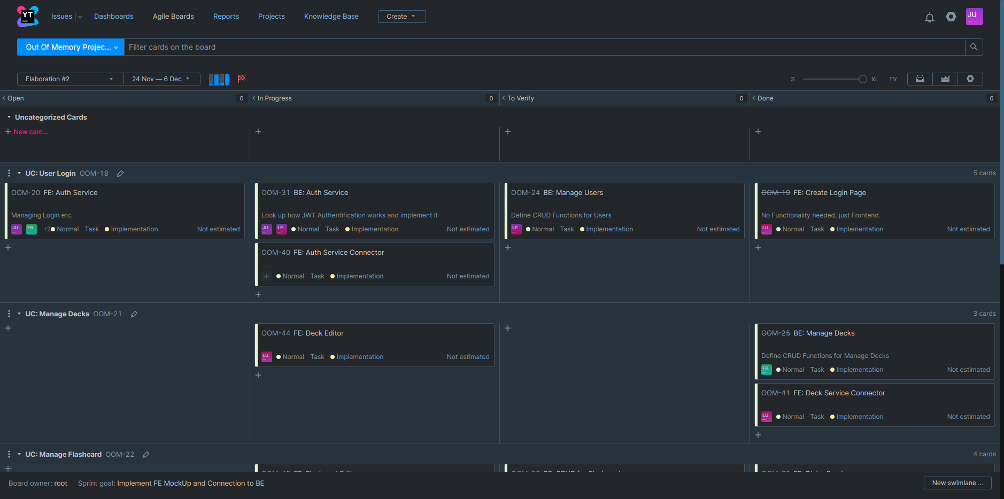
Agile Development - SCRUM

Slide 9
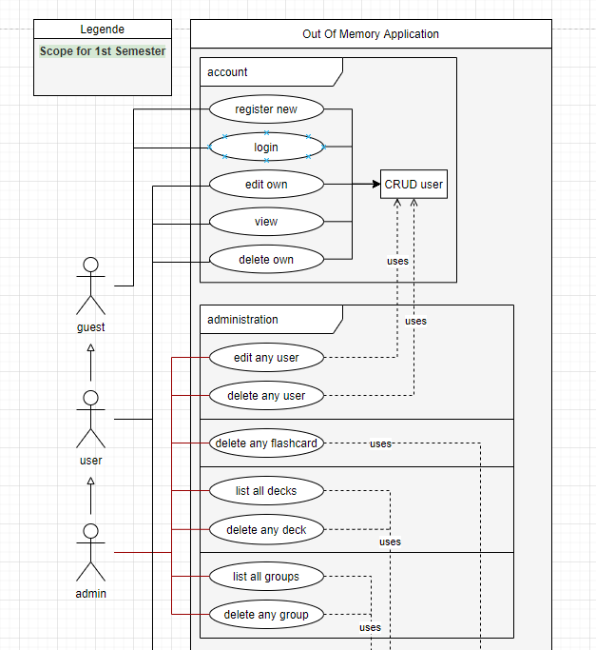
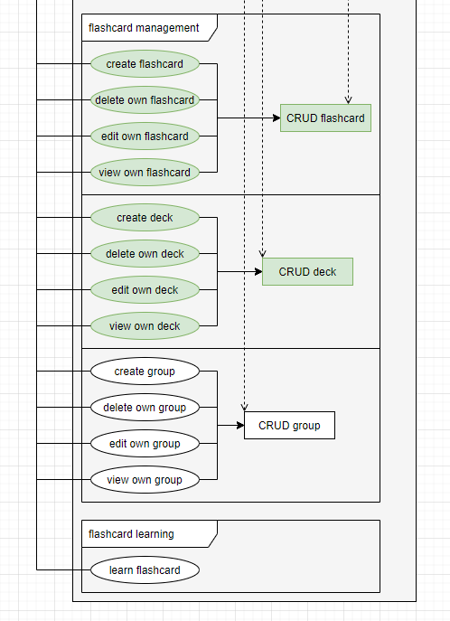
Architecture & Design – Use-Case-Diagram

Slide 10
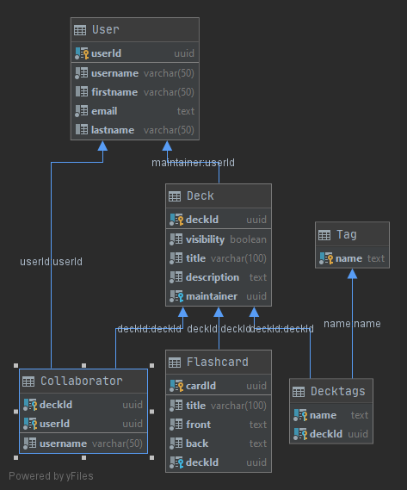
Architecture & Design – Database Diagram

Slide 11
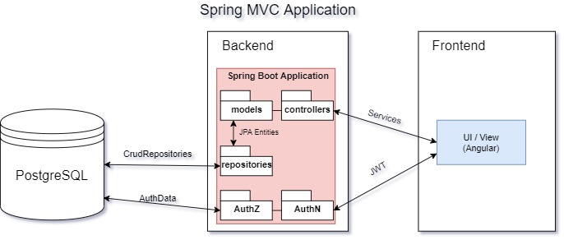
Architecture & Design – MVC

Slide 12
Testing
Demo

Slide 13

Demo

