Slide 1
DEMO 1
HelpMeApp
Oleksandr Petrov
Stanislav Budzyn
Oleksandra Naumenko

Slide 2
Passed topics
Web Design / UI / WEB-Application Architecture
UML
Development tools
Source Control
Soft Skills: Methodology and teamwork

Slide 3

AGENDA —
Practical skills | . . . . . . . . . . . . . . . . . . . . . . . . . . . . . . . . . . . . . . | 03
Demo Time | . . . . . . . . . . . . . . . . . . . . . . . . . . . . . . . . . . . . . . | 12

Slide 4
Practical skills

Slide 5
Goals
Understanding the software development cycle and Agile methodologies
Improve our knowledge and hardskills
Practice work in team
Get experience working with a real project

Slide 6
Product Vision
Vision
In our difficult time there are many people all over Ukraine who need help or who would like to help. That’s why we decided to create a project which is aimed to help these people to find each other and help them to communicate more easily and conveniently. People, who need help, will be able to create an advert and some other person who is able and willing to help can easily and conveniently contact that person.
Target Group
Any person who is in a difficult life situation and who is looking for help is our target group.
Any person who feels that they can help and has the desire and ability to help their fellow compatriots
Business Goals
Create a platform that will facilitate communication and help connect all Ukrainians who are in a difficult situation and need help with people who would like to help

Slide 7
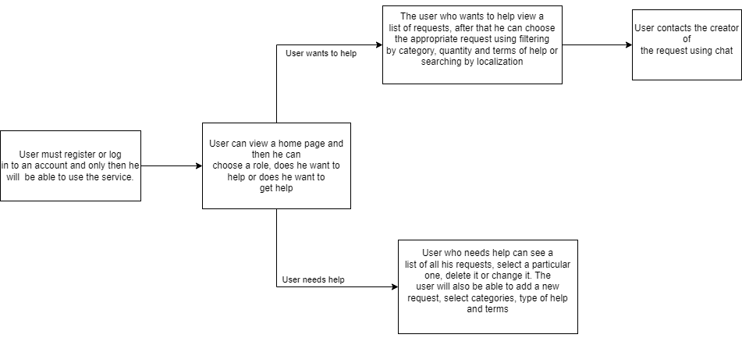
Functionality Diagram

Slide 8

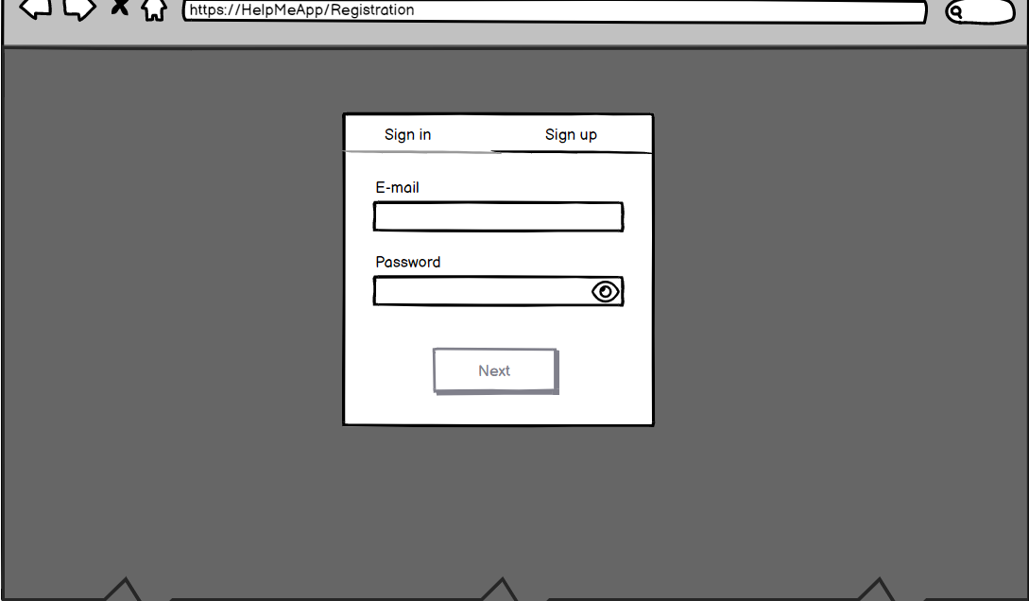
Mockup: Sign in form

Slide 9
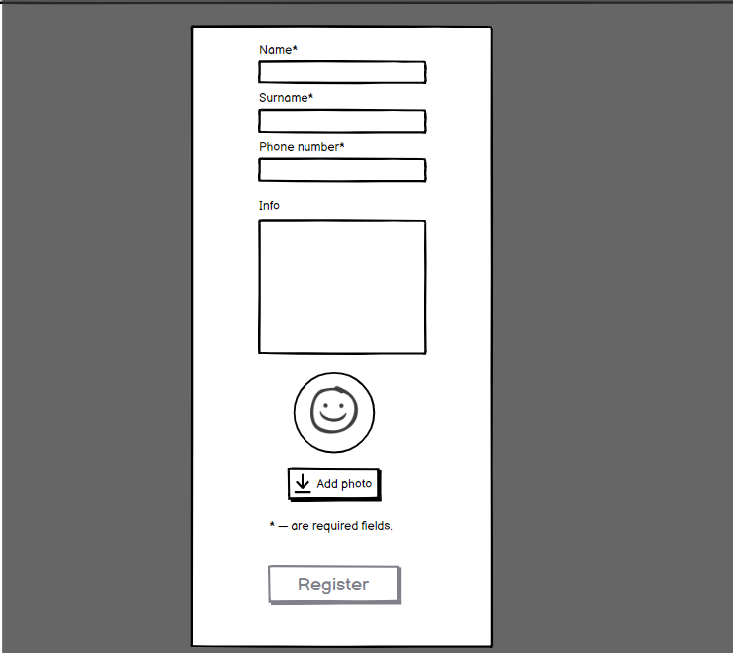
Mockup: Sign Up form

Slide 10
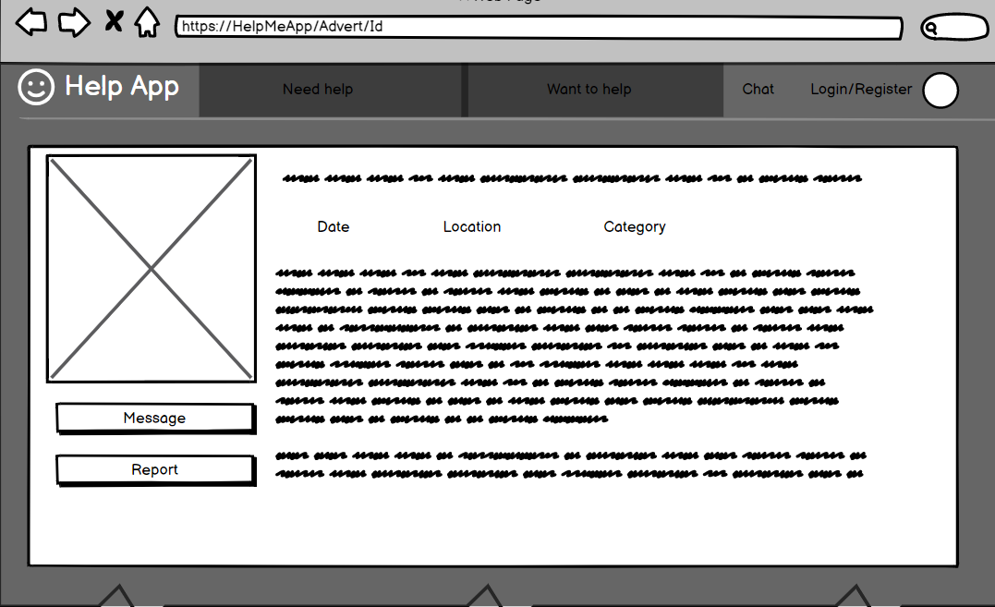
Mockup: Avert Page

Slide 11
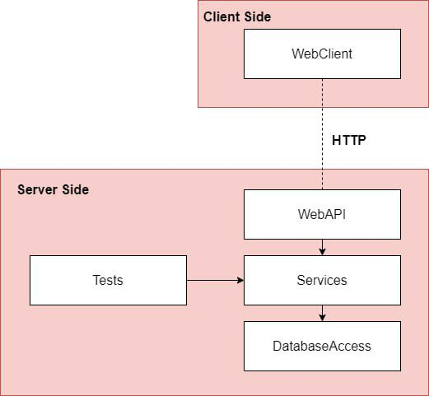
PROJECT DESIGN: ARCHITECTURE
Communication between the Client Side and the Server Side is established via HTTP.
Project has the n-tier architecture.
WebAPI contains API Controllers.
Services contain the business logic of the project.
DatabaseAccess provides classes to work with the database.

Slide 12
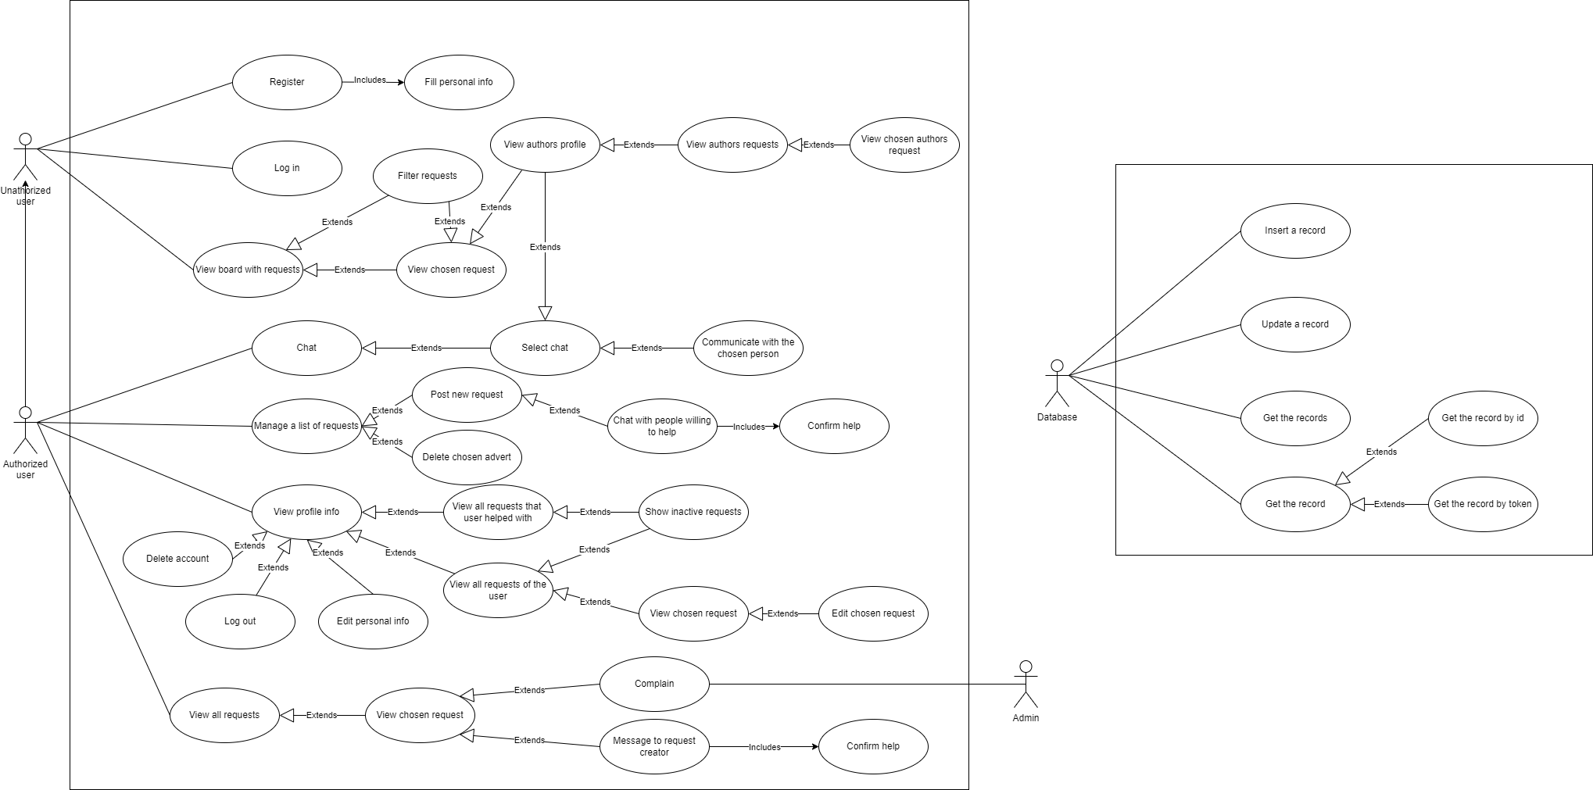
PROJECT DESIGN: USE-CASE DIAGRAM

Slide 13
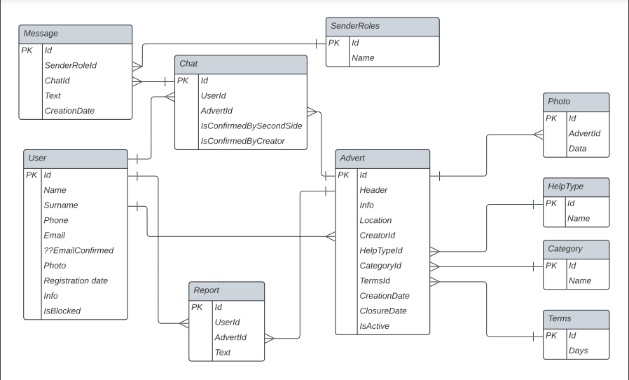
PROJECT DESIGN: DB DIAGRAM

Slide 14





TECHNOLOGIES
FRONT-END
BACK-END
React
React Bootstrap
CSS
Formik
Yup
React Router
Axios
Bootstrap
C#
ASP.NET Core
ASP.NET Identity
Entity Framework Core
JWT
Automapper
Bogus
VC SYSTEM
PM SYSTEM
Git
Azure DevOps

Slide 15
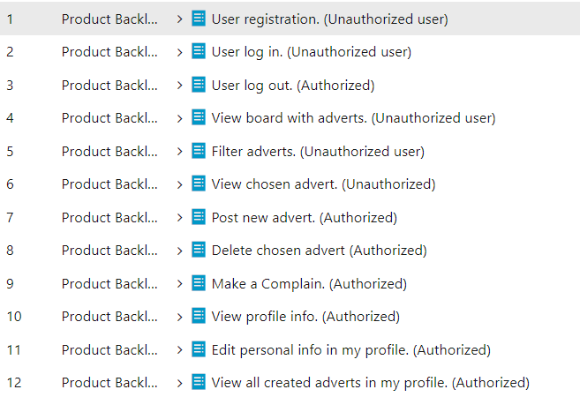
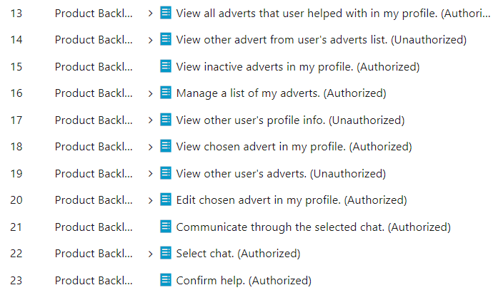

PROCESS: AGILE

Slide 16
DEMO TIME!

Slide 17
Thank you!
Questions?

