Slide 1
Lesson 7: AI and LLM
Chat Smart, Stay Safe

Slide 2
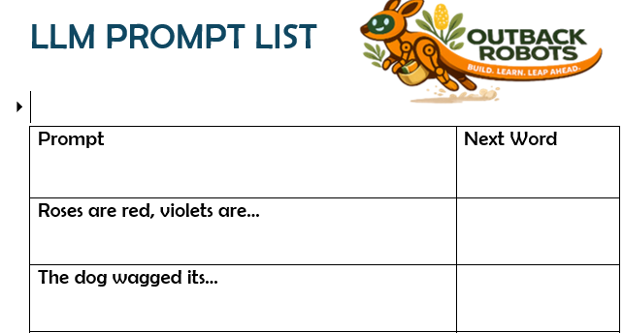
Lesson Preparation
Print off AI prompts to give to groups of students

Slide 3
Lesson 7 - Overview
Lesson 6 Recap - 5 min
Introduction to LLMs – 5 min
3. LLM sentence finisher – 15 min
4. Prompt engineering activity - 15 min
5. Interacting with Blossom and Ultrasonic sensor - 40 min
6. Survey - 5 min
7. Summary - 5 min
Total: 90 min

Slide 4
Lesson 7 – Learning objectives
After this lesson, students will be able to:
Explain that LLMs work by predicting the next word based on patterns in data
Define AI and LLM in their own words
Identify at least two examples of AI they encounter in everyday life
Make and compare predictions the way an LLM does
Evaluate an AI's output critically rather than accepting it at face value
Students can explain how the wording of a prompt affects the quality of an LLM's response
Students can identify the elements of an effective prompt: role, audience, task, constraints
Students can compare outputs from different prompts and evaluate which is more useful

Slide 5
Lesson 7 -
Student success criteria
I can explain what AI is and give two examples from my everyday life
I can describe what LLM stands for and what it does
I can explain that LLMs learn by finding patterns in huge amounts of text
I can explain why AI can sometimes get things wrong or make things up
I can explain the difference between an AI predicting something and actually understanding it
I can think of a situation where relying on AI might cause a problem
I can write a prompt that gives an LLM enough information to give a useful answer
I can explain why a vague prompt produces a worse result than a specific one
I can compare two AI responses and identify which prompt produced the better one

Slide 6
Lesson 6 Recap
Sample script: “Ethics is how we decide what is right and wrong when the answer isn't obvious, AI can’t make ethical decisions as it has no feelings, and no understanding on our consequences.
Bias in AI comes from the data it was trained on, if the data doesn’t encapsulate the whole population, it may work unfairly against those that weren’t included or well represented.”

Slide 7
Let’s remember what we learned in Lesson 6!
AI can’t make ethical decisions
Humans must drive this
AI can be unintentionally biased, based on the data we train it on

Slide 8
Introduction to LLM
Sample script: “LLM stands for large language model, it’s a type of AI that is specifically trained on text. It learns by reading billions of books, articles, websites and other pieces of information to recognize patterns. AI constantly predicts what word should logically come next to generate its response! ChatGPT, Claude and Copilot are all commons examples of LLMs. They can sometimes hallucinate, meaning they mix things up…confidently. This is why it's important to educate ourselves on how to use these models safely and still think for ourselves!”

Slide 9
Introduction to LLMs
LLM = Large Language Model
📚 Trained on billions of sentences from books & websites
💬 Predicts the next word — over and over — to “write”
📱 Examples: ChatGPT, Claude, Copilot
⚠ LLMs can hallucinate — always check their answers!

Slide 10
Human LLM Game
Instruction note: Get the children to complete the LLM prompt list themselves and record common answers on the board. To encourage them to give sensible answers, award a point for each time students get matching answers. It’s likely for the first few prompts the students will give very similar answers and less so for the latter prompts. This is because of the predictability.

Slide 11
Human LLM
Let's play a game!
We are going to act as the AI/LLM
In front of you have 10 sentence starters (prompts)
It’s your job to predict what word comes next
Finish all the sentences and compare with your classmates
You’ll get 1 point for every time you have a matching answer with a classmate (e.g. 5 points if 5 others have the same word as you!)

Slide 12
Discussing predictions
Instruction note: Get some common answers up on the board, ask students to raise their hands if they got common answers. Discuss why some prompts had more similar answers than others.
Sample script: “Put you hand up if you said … for sentence starter…
Lots of people came up with the ‘Roses are red, violets are blue’, this is because this is a common saying we have all come across. We are able to recognise the pattern and similarly identify what word comes next. ‘For breakfast the moon ate a bowl of…’ doesn’t really make sense, and certainly isn’t a saying so we got different and creative answers!
LLMs perform similarly, if there's a really predictable pattern it can respond with it will, otherwise it might make something up that doesn’t always make sense!

Slide 13
Discussing predictions
Share your answers!
🤝 Did anyone get the same words?
📊 Which prompts got the most matching answers?
🤔 Why were some prompts more predictable?

Slide 14
Recognising patterns
Instruction note: This lesson is very discussion based, we’d recommend having small group discussions then raising important points with the whole class.
Sample script: “When AI confidently makes things up, this is a hallucination. Not because the AI is dreaming, but because it produces something that sounds completely real but isn't true. It suggests what it recognises as the next best word, even if the sentence makes no sense. Let’s think about if we were using an LLM for our homework, AI might invent a fake quote or statistic because it just sounds plausible based on the information it has. Then you would be the one handing up incorrect information. Important takeaway, always check the information AI gives you.”

Slide 15
Recognising patterns
The LLM gave similar answers — because it recognised patterns!
❓ Even for nonsense sentences — it still answered. Why?
⚠ A confident AI answer is NOT always a correct one!

Slide 16
Prompt vs response
Now we are going to interact with an LLM to discover how the quality of our prompts impact the response
Let’s go back and think about the skins we designed in Lesson 5!
An LLM could be a really good help in choosing a good material, if we prompt it correctly

Slide 17
Prompt vs response
Put the three prompts on the following slides into the LLM, clearing it every time (by starting a new chat or opening a new tab)
HINT: The amount of time and thought we put into our prompts, influence the quality of response we will get back

Slide 18
Prompts
Instruction note: You can directly copy and paste the prompts into ChatGPT or LLM of your choice. The idea is that the more thought we put into the prompt, the better quality the response will be.
Discuss the following questions for each, at your discretion:
“Does the LLM ask us more questions? Will it take us further prompts to get a quality answer?”
“Does the response consider everything we want it to, perception, sustainability, equity?”
“How could we improve this prompt?”
If you have time, add a Prompt 4 designed by the class, it could weigh up the pros and cons of all the materials the groups came up with and give 1 definitive answer of what material it recommends and why.

Slide 19
🟥 VAGUE PROMPT
What would be a good skin for a robot?

Slide 20
🟨 BETTER PROMPT
What material could we use for a skin of our 3D printed robot? We want it to able to be used by every school in Australia.

Slide 21
🟩 BEST PROMPT
What material could we use for a skin of our 3D printed robot? We want it to able to be used by every school in Australia.
The robot has been 3D printed with PLA and PETG, the skin should go over the top and not restrict movement, some ideas we have already considered are recycled shopping bags, old stockings/clothes, silicon
Somethings we need to consider are:
Perception (it’s for Year 5/6 students so we want our robot to look kind and helpful)
Sustainability (we want a material that can be recycled and repurposed)
Equity (every child in Australia should have fair access, it should be cheap and abundant)

Slide 22
Blossom’s Sensor
It’s time to plug in Blossom’s sensor, it will fit into the top hat which can be tied to Blossom’s head
Plug in the wires, RED to VCC/POWER, BLACK to GND, BROWN to TRIG, BLUE to ECHO
Plug the Blossom computer into a power source
Wait for the wi-fi to show up and connect
Head to https://192.168.90.1:8080
Go to Sensor
Can you figure out what Blossom might be coded to do as the sensor value changes?

Slide 23
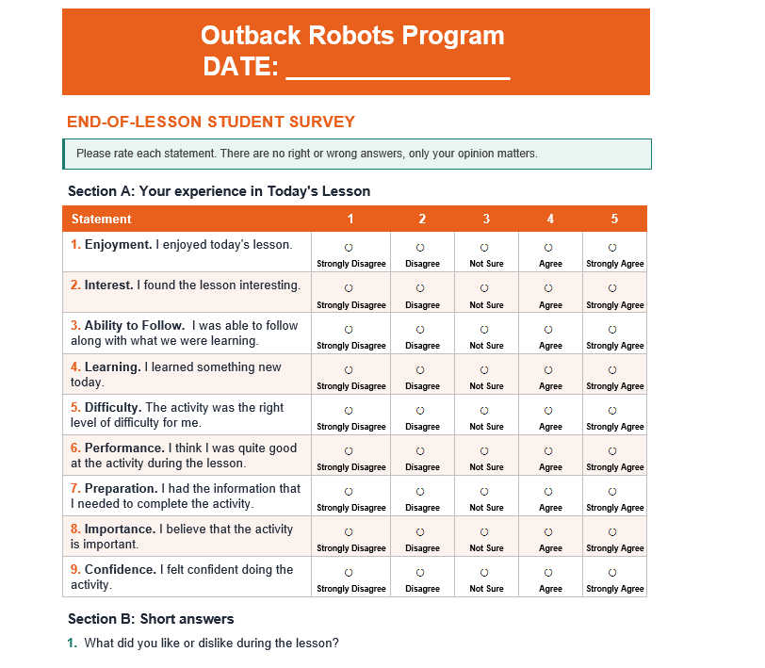
Survey

Slide 24
Summary
AI is a human designed tool which is a computer, designed to generate responses based on patterns
LLMs are AI tools that are trained on reading billions of texts to generate predictable responses
AI can hallucinate, discuss why it’s important that we always check its responses

