Slide 1
Lesson 3 – Coding (with) Blossom:

Slide 2
Lesson Preparation
Before you start:
Have a go at creating the game with Blossom yourself, if you run into any issues, reach out!
Familiarise yourself with the Blossom game, it should be easy to understand and encourage the students to play with each other for a few minutes (great metacognitive opportunities, understanding why they give instructions)
OPTIONAL: run a digital technologies/art class where children build their own Blossom skins in paint, canva or other digital art platform of choice (you are welcome to use the skins we send but children may enjoy creating their own)

Slide 3
Lesson 3 - Overview
Lesson 2 recap (5 minutes)
Introduction: What is coding (5 minutes)
Play the Blossom guessing game with a friend (5 minutes)
Code the game (45 minutes)
If-else statements
loops
Create your own blocks for nod and shake head
Code game the game
Discussion: Why coding?
Building Blossom’s base
Notes:
Make format consistent
Make game one lesson section

Slide 4
Lesson 3 – Learning objectives
After this lesson, students will be able to:
explain what coding is and why/where it is important to know,
design algorithms involving multiple alternatives (branching) and iteration
implement algorithms using visual programming, involving control structures (such as “if/then”)

Slide 5
Lesson 3 -
Student success criteria
I can …
Skip for now!!

Slide 6
Recap Lesson 2

Slide 7
Control processes slide
The following slide should be familiar
Explain to the students today we are focusing on the code part of the diagram

Slide 8
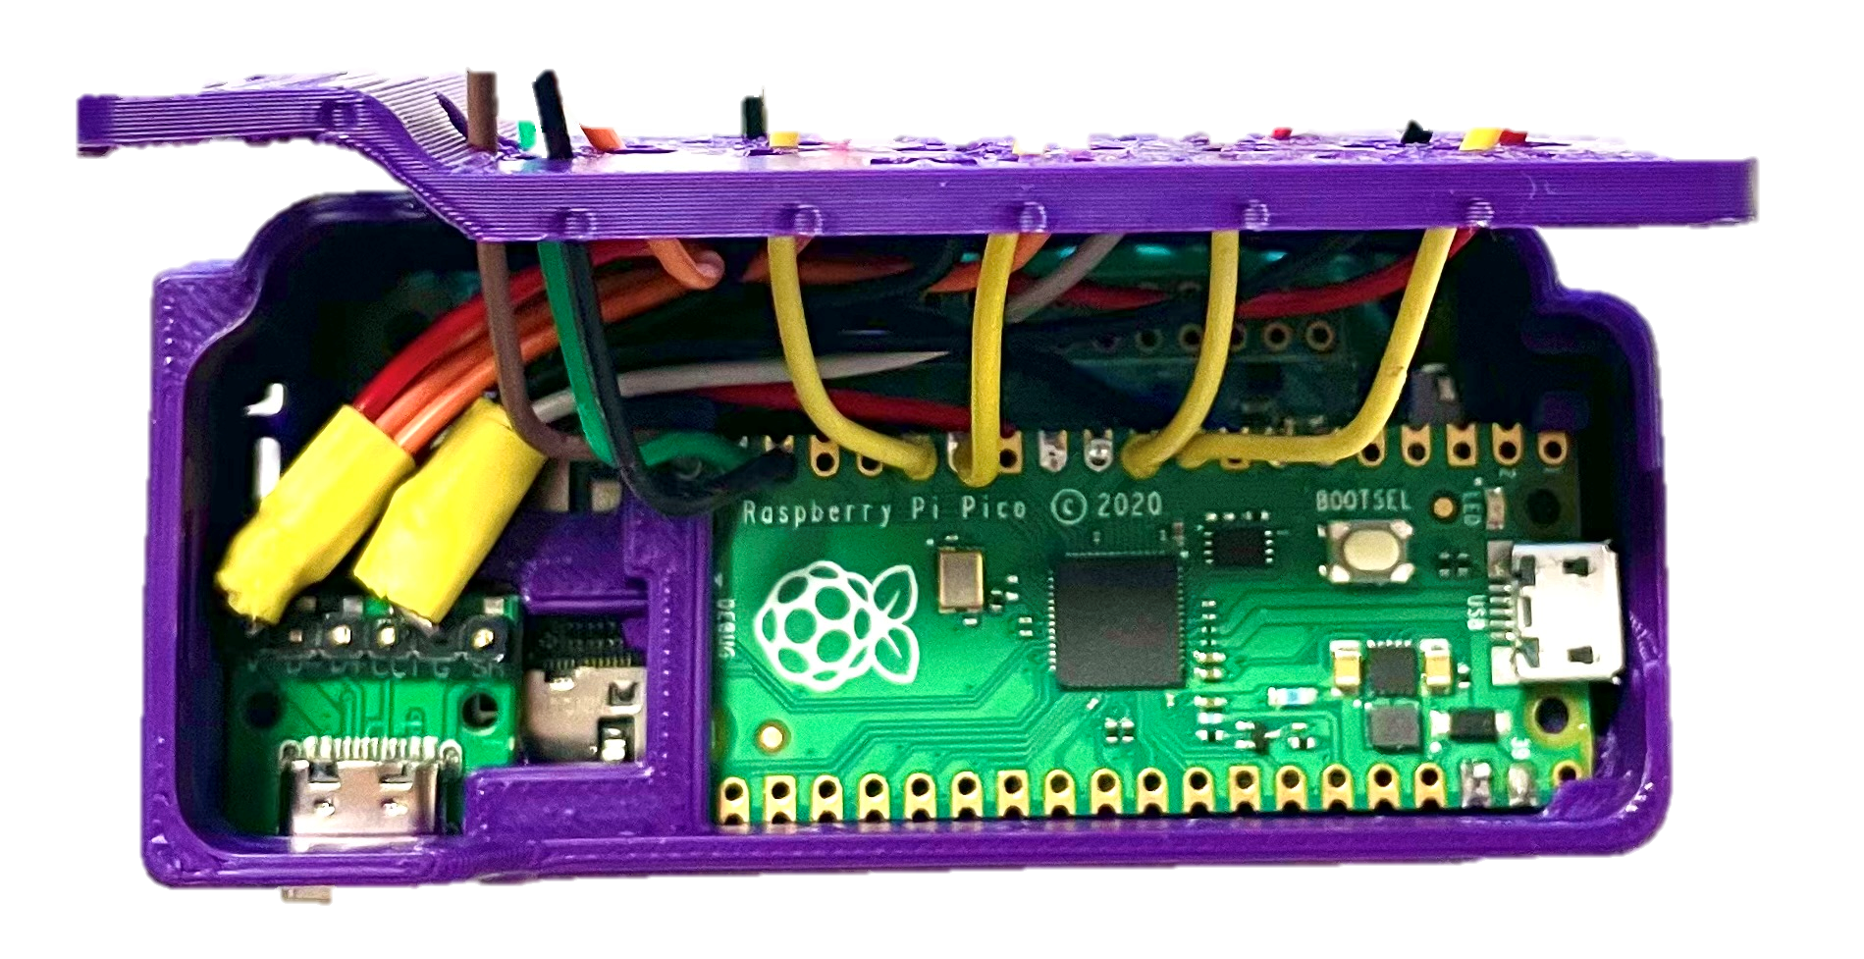
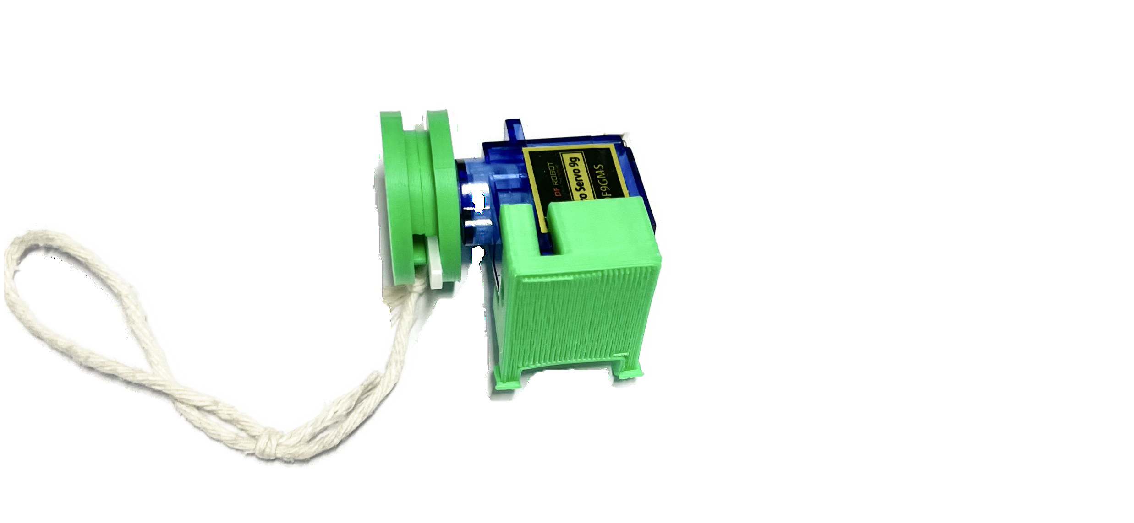
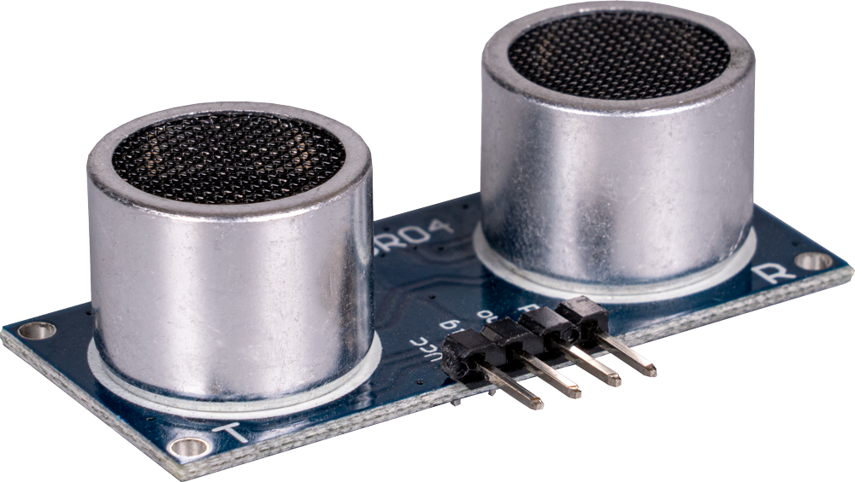

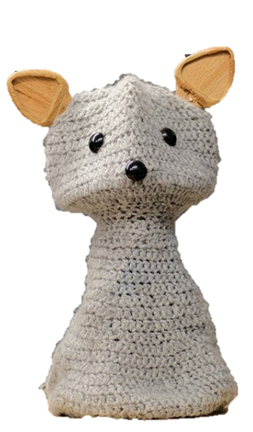

Robot Control Process
set motor position
information from environment
computer
interprets the sensor input and decides how to react
motor
code
ultrasonic sensor
Input . (hand approaching)
Blossom moves

Slide 9
Explaining coding
Coding can seem overwhelming to those that don’t have much exposure to it
Its important to breakdown that barrier and explain coding in a simple way
Explain coding to the students by introducing following concepts:
‘Code is just a language that robots and computers understand!’
‘Like humans, different computers can understand different languages, we will use block coding in these lessons’
‘In the code script we build a procedure we want the computer to follow’
‘Like us, code has its own dictionary, and if a term we use isn’t in their dictionary, we can define it for them’
Explain that block-based coding is a good place to start, because we know the computer understands each block, anything inside white bubbles we can change to achieve what we want out of the code

Slide 10
Introduction to coding
Coding = Computer language
A procedure for the computer (or robot) to follow, telling it EXACTLY what to do
Block-based coding is an easy place to start!
code

Slide 11
Blossom’s Game
Blossom’s game is quite simple
It will think of a random number, say between 1 and 20, and we input guesses until we get it right
We will code Blossom’s animation to speak, nod and shake to interact with the students
We could add competitions for students such as who can get the number in the least guesses etc. to make it fun and competitive

Slide 12
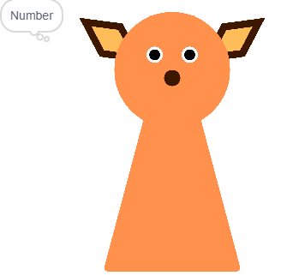
Blossom’s Guessing Game
We are going to code a virtual Blossom (on our screen) to play a game with us
The goal is to create a game where we guess the number Blossom is thinking of
Play the game with a friend - “I’m thinking of a number between..”

Slide 13
Intro to scratch
Now would be a good time to share your screen
Open the link on the following slide
Create a new project
Walk the children through how to upload their Sprites and costumes or use the ones we have provided
“Sprites are the little characters that we get to code, skins are different ways that character may look, they might be doing different things or wearing different clothes.”
Ensure the costumes have meaningful names, this will make it easier to move our Blossom animation
Notes:
Include link, step by step for teachers.
Include definition of sprites, skins etc.

Slide 14
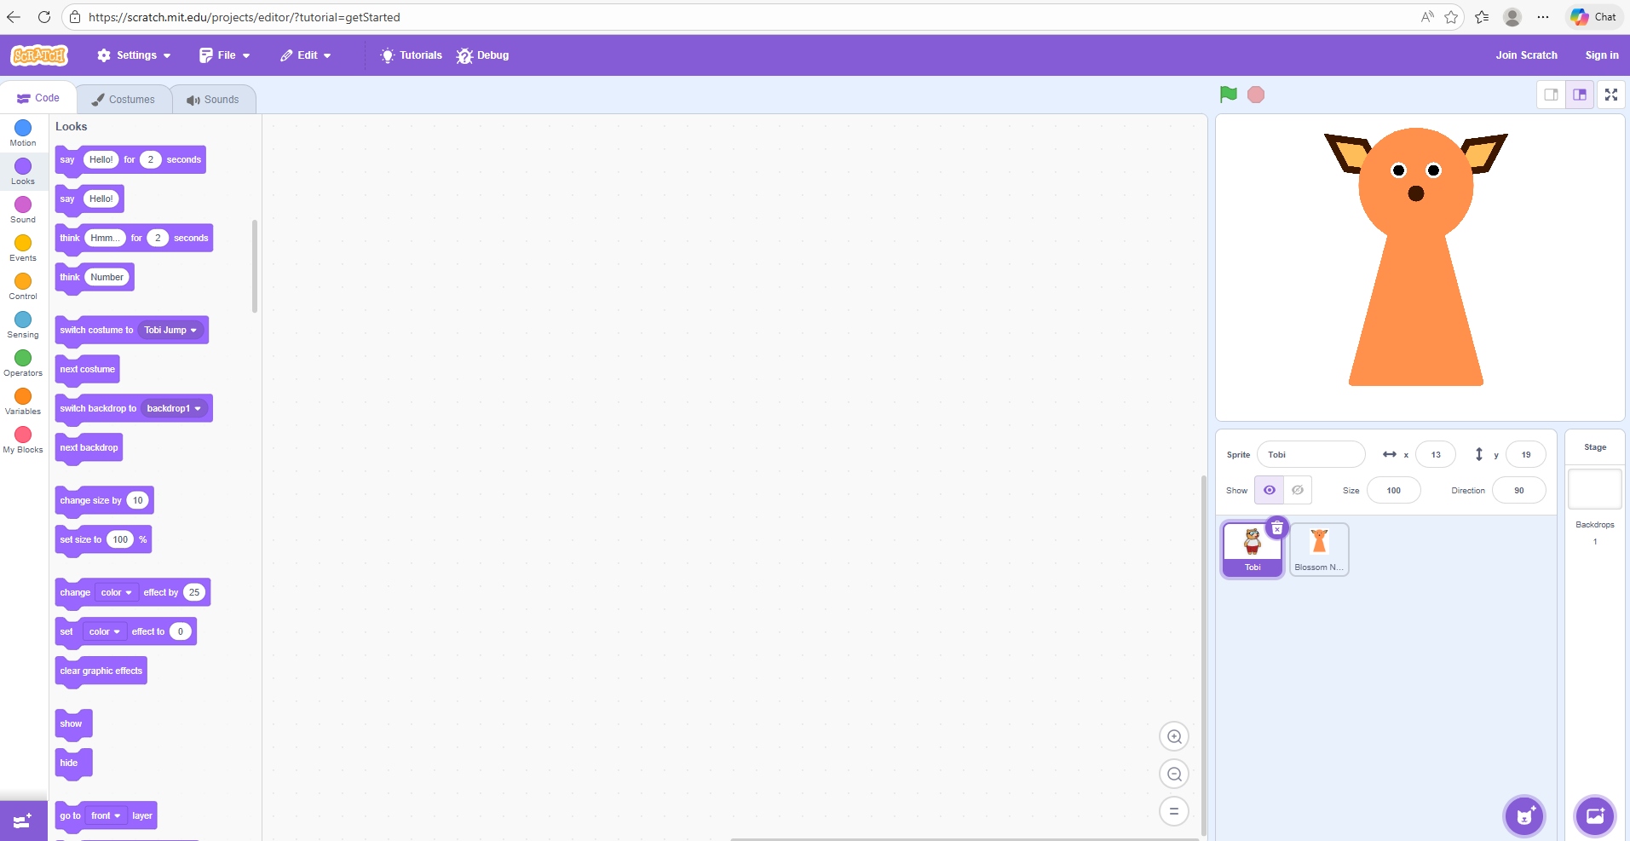
Intro to Scratch
Open Scratch and hit create! Scratch - Imagine, Program, Share
The characters in the top right animation are called our ‘Sprites’
We can upload our own!
We can also give our Blossom different appearances, called costumes

Slide 15
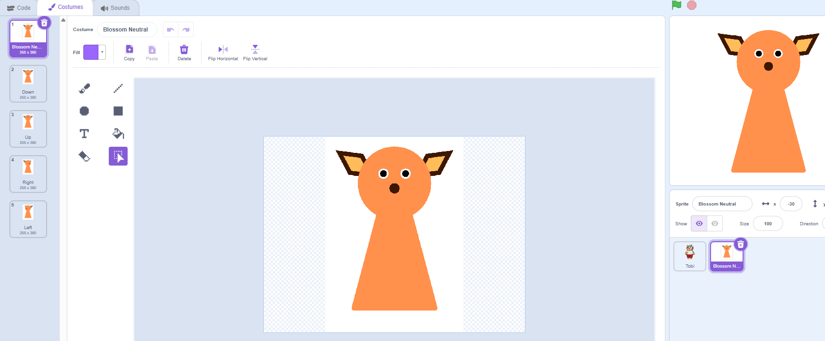
Uploading our costumes
Upload your forward-facing Blossom as the sprite
Add the 4 other directions Blossom is looking as costumes

Slide 16
Introducing IF STATEMENTS
“If statements are exactly as they sound, we can code our computers to do something, only IF another event occurs. In block coding, we but that event inside the hexagon next to if. We then place the instructions on what we want it to do between the top and bottom of the block.”
Notes: Get students to think of IF STATEMENTS they have in every day life…IF we see the fridge open, we might close it! The students will have 3 if statements inside their code, being their guess is greater than, lower than or equal to Blossoms number. They will provide Blossoms response for each within.

Slide 17

Introducing IF STATEMENTS
An IF STATEMENT is exactly as it sounds
In the CONTROL section we will find this block
Within the hexagon we are going to put our ‘EVENTS’, think about the 3 different events that may occur when guessing

Slide 18


Our first IF STATEMENT
Let’s start with our guess being greater than Blossoms number
Clip this inside the hexagon next to IF
Inside the IF block, tell Blossom what you want it to do
Maybe try playing the guessing game with a friend, and think about how you help them with their next guess

Slide 19
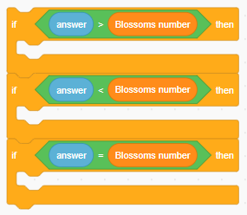
IF STATEMENTS
Repeat this for our guess being less than and equal to Blossoms number

Slide 20
Introducing loops
“Loops are a stack of code that we want to repeat, this could be forever, until an event happens or a certain number of times. Sometimes it’s easier to tell someone to repeat an action 10 times, like throw and catch a ball, rather than telling them to throw the ball, catch the ball, throw the ball, etc.”
Note: encourage to think about loops that may be important for the game, repeat the question until students guess correctly, and head nodding and shaking are great examples of loops we will include.

Slide 21
Introducing Loops
A loop is a stack of code that we want to repeat multiple times, it might be FOREVER, or just until we tell it to
We want to shake or nod Blossom’s head, but how many times?
We want our game to keep going until we get the number right!

Slide 22
Creating our own blocks
“Let’s get [student] up the front to follow these instructions. The instructions were clear but did it take a long time to explain? Could we make our own instruction block that’s a little easier? What would we call it…what was the action [student] just performed?”
Note: Act out the blue block of code, then simply ask the student to walk in a square. What’s easier? Ask children why naming the block something meaningful is important.

Slide 23
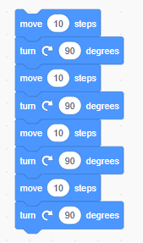
Creating our own blocks
Sometimes we want to instruct our code to do something lots of times – like this
Rather than repeating our code over and over, we can create a ‘block’ so that we can refer to all of its code with just one name
What could we name this block?
Why are good block names important?

Slide 24
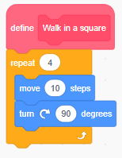
Creating our own blocks
Sometimes we want to instruct our code to do something lots of times
Rather than repeating our code over and over, we can define our own block for next time – like this
Defining a block adds it to the computers dictionary so it remembers for next time

Slide 25

Another loop
When you play the game with your friend, think about when the game stops, and put it into the hexagon!
We will want all of our code inside the repeat until block!

Slide 26
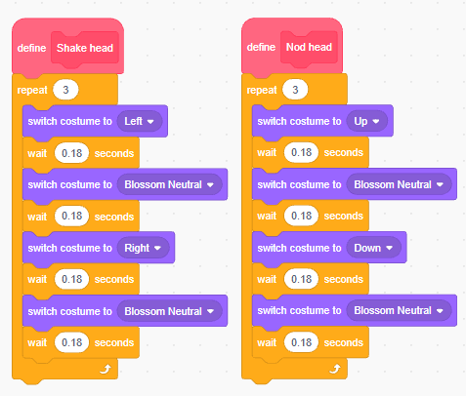
Creating our own blocks - HINT
Example script: “Play around with the numbers inside the white bubbles to make the animations look the most natural (or interesting).”
Instruction Note: Decreasing the wait times will make the animations look more natural, however too fast can also be confusing. The students can find something that looks good to them.

Slide 27

Creating our own blocks
Make a block called ‘Shake head’ and one called ‘Nod head’
Underneath, we need to build exactly what we want blossom to do each time
Think about what you would tell your friend to do if they didn’t know how to nod or shake their head

Slide 28

Creating Blossom Guessing Game
All code needs a place to start!
In the EVENTS section we will see many blocks we can choose to begin our code, pick one and drag it to our script
Underneath, we need to tell the program exactly what to do when your program starts

Slide 29


Creating Blossom Guessing Game
First, we need Blossom to think of a number, in the operators section you will find this block
We can change the numbers to be anything we like
Once Blossom has thought of a random number, we can then ask the question

Slide 30

Creating Blossom Guessing Game
Atwe need Blossom to think of a number, in the operators section you will find this block
We can change the numbers to be anything we like
We can make this number a variable, call it something meaningful for when we use it later

Slide 31
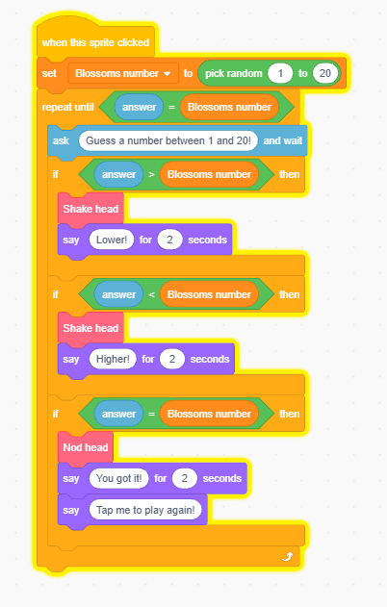
Creating Blossom Guessing Game- HINT
Instruction note: Your code should look something like this. Again, we can play around with all the bubbles in white to better suit our game.
Sample script: “Should Blossom speak for longer or would you prefer it to say different things?”

Slide 32
Coding discussion
Have a discussion with the students about future occupations or daily tasks that may be easier with coding
Coding is like a problem-solving superpower, what problem would you use coding to help solve
Even if you’re job doesn’t need coding skills, it can teach us how to break problems down into smaller steps. When can this be useful?

Slide 33
Summary

Slide 34
Questionnaire

