Slide 1
Lesson 8 – Presentation
Design, Build, Reflect

Slide 2
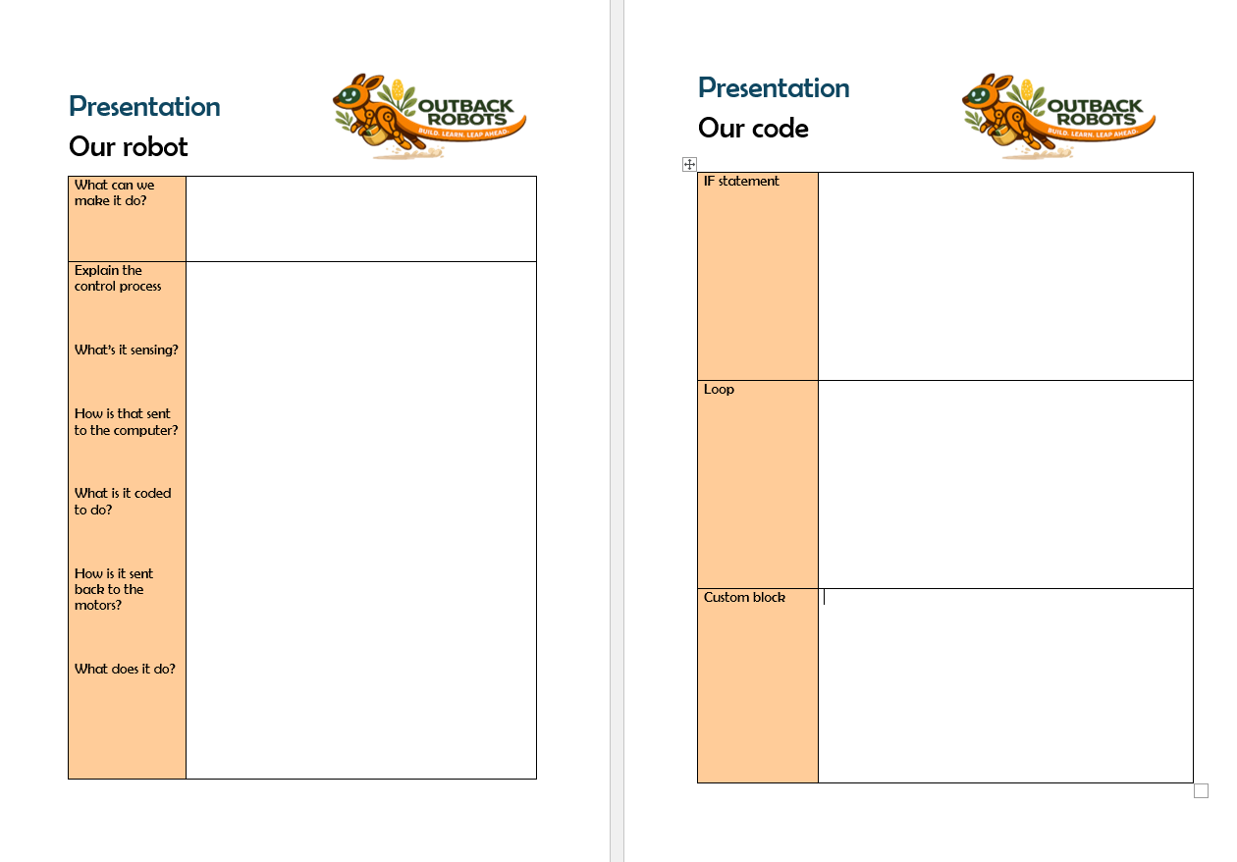
Lesson Preparation
No new content is delivered in this lesson. This is a celebration and synthesis lesson. Ensure all robots and skins are built and ready before the session. Groups should have access to their Design for Good worksheets from Lesson 6 and their Scratch code from Lesson 3. Set up the room so groups can present from their desk or a central display area.
Print off Lesson 8 Worksheet, Presentation Preparation

Slide 3
Lesson 8 - Overview
Lesson 7 Recap - 5 min
Showcase preparation – 25 min
2.1 Instructions
2.2 Student preparation
3. Group presentations – 40 min
4. Class reflection – 10 min
5. Survey - 5 min
6. Summary - 5 min
Total: 90 min

Slide 4
Lesson 8 – Learning objectives
After this lesson, students will be able to:
Explain the key concepts from the program in their own words
Describe the decisions they made across coding and skin design
Reflect on the role of AI in their day-to-day life, ethics of AI and designing tools for real world use
Communicate their learning clearly to a small audience

Slide 5
Lesson 8 -
Student success criteria
I can explain what my robot does and how it works
I can describe the design choices I made for my robot's skin and why
I can connect my design choices back to sustainability, equity and perception
I can explain one thing I learned about AI or coding that surprised me
I can reflect on what I would do differently if I started again

Slide 6
Lesson 7 recap
Sample script: “LLM stands for Large Language Model and they work by predicting what word should come next. Sometimes if our prompt doesn’t make sense, or is a little unpredictable AI can give us incorrect answers, called hallucinations. A good prompt asks the AI to consider the factors we need to when making a decision. The more relevant information we can give it the better!

Slide 7
Let’s remember what we learned in Lesson 7!
What does LLM stand for?
How do they work?
Why can AI sometimes give us wrong or made up answers
What makes a good AI prompt?

Slide 8
Your task
Sample script: “Today is our showcase lesson. Each group will present what they created during the program. You will have about 25 minutes to prepare your presentation together.
Your presentation should cover four main parts:
Your Robot – what it does and how it works
Your Code – the programming ideas you used
Your Skin Design – the materials and design choices you made
Your Reflection – what you learned and what you would improve next time
Your goal is not to be perfect. The goal is to explain your thinking and what you learned during the project.”

Slide 9
Your task
Your task is to make a short presentation with your group that covers the following
🤖 Our Robot — what it does and how it works
💻 Our Code — what coding concepts you used
🎨 Our Skin — what material you chose and why
💡 Our Reflection — what you learned and what you'd change

Slide 10
Our robot
Sample script: “The first part of your presentation should introduce your robot.
Explain the control process and what the sensor, computer, code and motors do to help the robot achieve its function.
If possible, demonstrate the robot performing one action.”

Slide 11
Our robot
Show your robot and demonstrate it doing something (e.g. responding to the ultrasonic sensor, idle state or keyboard control)
Explain the control process when: sensor → computer → code → motor → movement
What does your robot sense? How does it respond?

Slide 12
Our code
Sample script: “In this part, explain some of the coding ideas your group used.
Try to explain at least one example of each:
IF statement — What condition did you check? What action happened when the condition was true?
Loop — What repeated action did your robot perform? Why was repeating that action useful?
Custom block — What custom block did you create? How did it make your code easier to organise?”
Instruction note: Encourage students to describe the idea, not read the code.

Slide 13
Our code
Explain one IF statement you used
What was the event and what was the action?
Explain one loop you used
Why was repeating something useful?
Describe one custom block you created
How was it helpful

Slide 14
Our skin
Sample script: “Now explain the design of your robot’s skin.
Think about both appearance and materials.
Explain:
What material you chose, why you chose it and how you want people to perceive your robot
Also think about sustainability:
Is the material recycled or reused? Was it something you already had at home? How does your design make your robot more interesting or meaningful?”

Slide 15
Our skin
What material did your group use?
How do you want others to perceive your Blossom?
Why is this material a sustainable choice?
Is it recycled or repurposed?
How is this material equitable?
Did you pay for it?
Was it lying around the house?

Slide 16
Our reflection
Sample script: “This part is about reflecting on your learning.
Think about your experience during the program.
You might talk about something that surprised you about robots or AI, an example of AI you use every day, something you found difficult but eventually solved, something you would do differently next time
Reflection is important because it helps us understand how we learn and improve.”

Slide 17
Our reflection
What is one thing about robots that surprised you during the program?
What is one use of AI you come across daily that you didn’t think was AI before the program?
If you could change one thing about the program what would it be?
Learn more or less coding, building, AI, robots?
Change the build or the skin?
What is one way you would use robots or AI to make a positive difference in the world?

Slide 18
Audience task
Instruction note: Try to keep those not presenting involved and encourage students to ask other group questions and take a few comments on things that students found new or interesting about their peers’ presentation.

Slide 19
Audience task
While another group is presenting it’s your job to think about:
One thing you hadn’t thought about
One question you could ask them

Slide 20
Questionnaire

Slide 21
You did it!
Congratulations, Outback Robots graduates!
🤖
You Built
a real robot with sensors, motors and code
💻
You Coded
with loops, IF statements and custom blocks
🎨
You Designed
for good — sustainably and thoughtfully
Build. Learn. Leap Ahead.

