Slide 1
Lesson 3 – Coding
Coding Blossom’s game

Slide 2
Lesson Preparation
Before you start:
Have a go at creating the game with Blossom yourself, if you run into any issues, reach out!
Familiarise yourself with the Blossom game, it should be easy to understand and encourage the students to play with each other for a few minutes (great metacognitive opportunities, understanding why they give instructions)
OPTIONAL: run a digital technologies/art class where children build their own Blossom skins in paint, canva or other digital art platform of choice (you are welcome to use the skins we send but children may enjoy creating their own)

Slide 3
Lesson 3 - Overview
Lesson 2 Recap - 5 min
What is coding– 10 min
2.1 Introduction
2.2 Play the guessing game with friends
3. Code the game in Scratch – 40 min
3.1 In-else statements
3.2 Loops
3.3 Create your own blocks
3.4 Code the game
4. Building Blossom’s base - 25 min
5. Why coding discussion - optional
6. Survey - 5 min
7. Summary - 5 min
Total: 90 min
Notes:
Make format consistent
Make game one lesson section

Slide 4
Lesson 3 – Learning objectives
After this lesson, students will be able to:
explain what coding is and why/where it is important to know,
design algorithms involving multiple alternatives (branching) and iteration
implement algorithms using visual programming, involving control structures (such as “if/then”)

Slide 5
Lesson 3 -
Student success criteria
I can explain what coding is and why it is important.
I can design an algorithm with different outcomes and repeated steps.
I can use IF statements to control what happens in my program.
I can use loops to repeat actions in my code.
I can create and use my own custom blocks with meaningful names.
I can use variables to store information (like a random number) in Scratch.
I can explain how robots use sensors, code, and motors to respond to their environment.
I can describe how computers use binary (0s and 1s) to communicate information.

Slide 6
Recap Lesson 2
What is a robot?
Sensors help robots notice what is happening around them
Computers use electric signals:
ON = 1
OFF = 0
A bit = 1 digit (0 or 1)
A byte = 8 bits

Slide 7
Control processes slide
The following slide should be familiar
Explain to the students today we are focusing on the code part of the diagram

Slide 8
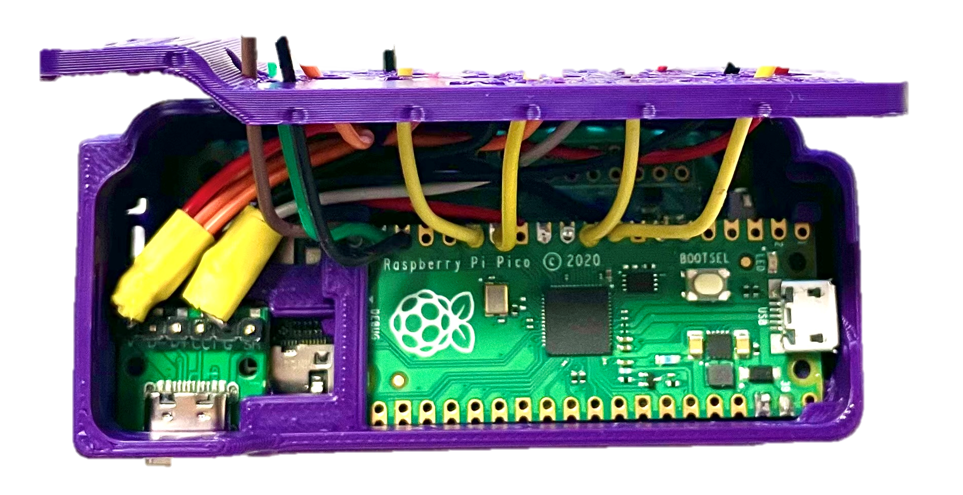
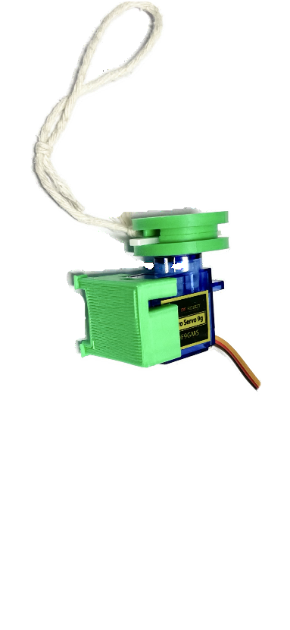
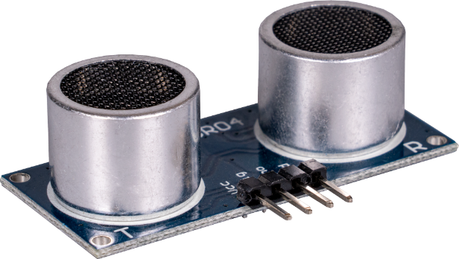

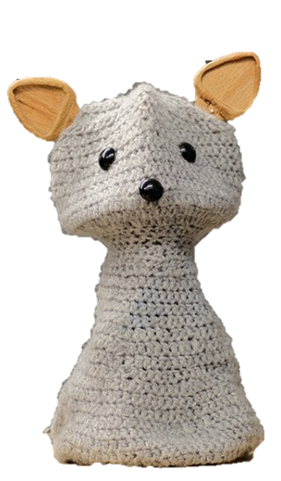

Robot Control Process
set motor position
information from environment
computer
interprets the sensor input and decides how to react
motor
code
ultrasonic sensor
Input . (hand approaching)
Blossom moves

Slide 9
Explaining coding
Coding can seem overwhelming to those that don’t have much exposure to it
Its important to breakdown that barrier and explain coding in a simple way
Explain coding to the students by introducing following concepts:
‘Code is just a language that robots and computers understand!’
‘Like humans, different computers can understand different languages, we will use block coding in these lessons’
‘In the code script we build a procedure we want the computer to follow’
‘Like us, code has its own dictionary, and if a term we use isn’t in their dictionary, we can define it for them’
Explain that block-based coding is a good place to start, because we know the computer understands each block, anything inside white bubbles we can change to achieve what we want out of the code

Slide 10

Introduction to coding
Code = instructions a computer follows exactly
Like a recipe — miss a step and it goes wrong!
Block coding = great starting point 🧩
code

Slide 11
Blossom’s Game
Blossom’s game is quite simple
It will think of a random number, say between 1 and 20, and we input guesses until we get it right
We will code Blossom’s animation to speak, nod and shake to interact with the students
We could add competitions for students such as who can get the number in the least guesses etc. to make it fun and competitive

Slide 12
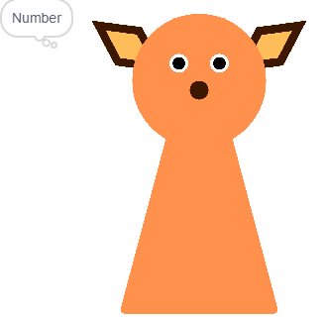
Blossom’s Guessing Game
We are going to code a virtual Blossom (on our screen) to play a game with us
The goal is to create a game where we guess the number Blossom is thinking of
Play the game with a friend - “I’m thinking of a number between..”

Slide 13
Intro to scratch
Now would be a good time to share your screen
Open the link on the following slide
Create a new project
Walk the children through how to upload their Sprites
“Sprites are the little characters that we get to code!

Slide 14
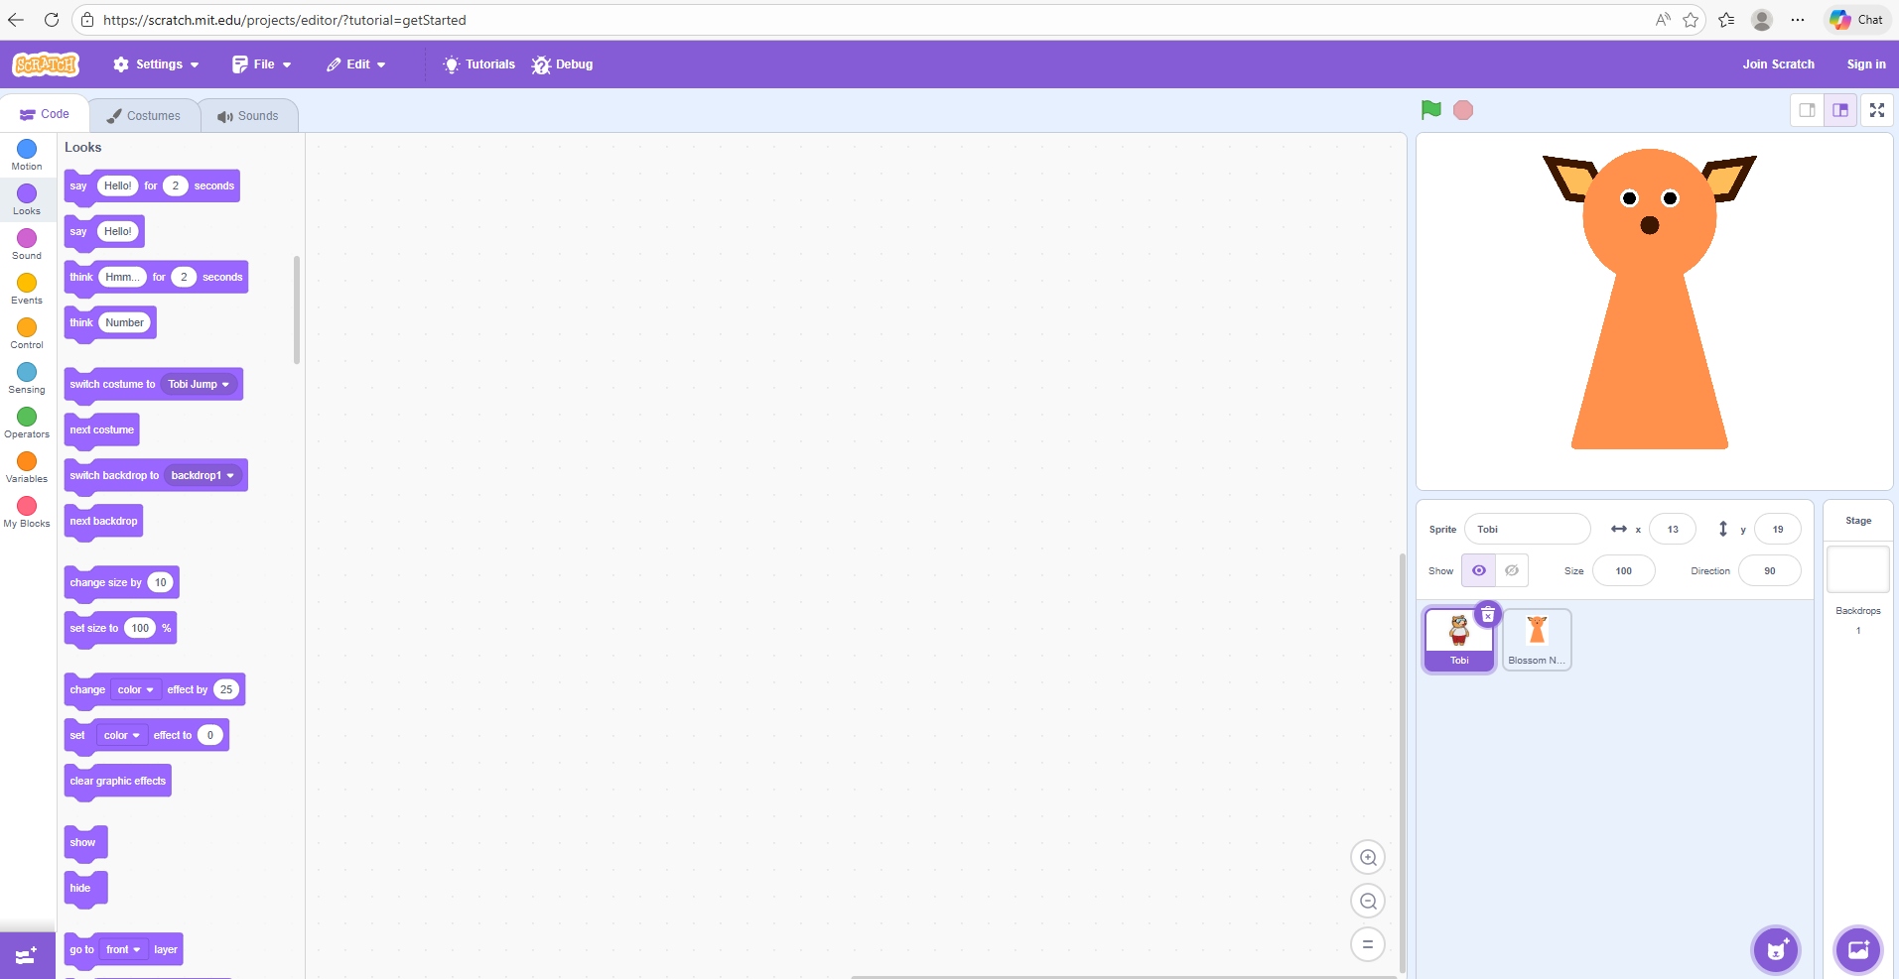
Intro to Scratch
Open Scratch and hit create! Scratch - Imagine, Program, Share
The characters in the top right animation are called our ‘Sprites’
We can upload our own!

Slide 15

Creating Blossom Guessing Game
All code needs a place to start!
In the EVENTS section we will see many blocks we can choose to begin our code, pick one and drag it to our script
Underneath, we need to tell the program exactly what to do when your program starts

Slide 16


Creating Blossom Guessing Game
First, we need Blossom to think of a number, in the operators section you will find this block
We can change the numbers to be anything we like
Once Blossom has thought of a random number, we can then ask the question

Slide 17


Creating Blossom Guessing Game
At the beginning of the game, we need Blossom to think of a number, in the operators section you will find this block
We can change the numbers to be anything we like
We can make this number a variable, call it something meaningful for when we use it later

Slide 18
Introducing IF STATEMENTS
“If statements are exactly as they sound, we can code our computers to do something, only IF another event occurs. In block coding, we but that event inside the hexagon next to if. We then place the instructions on what we want it to do between the top and bottom of the block.”
Notes: Get students to think of IF STATEMENTS they have in every day life…IF we see the fridge open, we might close it! The students will have 3 if statements inside their code, being their guess is greater than, lower than or equal to Blossoms number. They will provide Blossoms response for each within.

Slide 19

Introducing IF statements
IF something happens → THEN do this
🚪 IF the fridge is open → close it
☔ IF it’s raining → bring an umbrella
Find the IF block in the CONTROL section!
Inside the hexagon we put our EVENT or condition
Underneath we put our ACTION (what we want to do)

Slide 20


Our first IF STATEMENT
Let’s start with our first event, if our guess is greater than Blossoms number (you can find the green hexagon inside operators)
Clip this inside the hexagon
Inside the IF block, tell Blossom what you want it to do, this is the ACTION
Inside looks we can make Blossom say something (higher or lower)

Slide 21
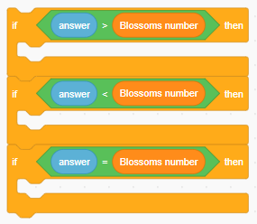
IF STATEMENTS
Repeat this for the 3 different events, our number can be less than, greater than or equal to Blossom’s

Slide 22
Introducing loops
“Loops are a stack of code that we want to repeat, this could be forever, until an event happens or a certain number of times. Sometimes it’s easier to tell someone to repeat an action 10 times, like throw and catch a ball, rather than telling them to throw the ball, catch the ball, throw the ball, etc.”
Note: encourage to think about loops that may be important for the game, repeat the question until students guess correctly, and head nodding and shaking are great examples of loops we will include.

Slide 23
Introducing loops
A loop repeats code — forever, or until told to stop
⚾ Throw, catch, throw, catch… = loop!
🤖 Blossom keeps asking until you guess correctly
Use “repeat until” — what event stops it?

Slide 24

Loops
When you play the game with your friend, think about when the game stops, and put it into the hexagon!
We will want all of our code inside the repeat until block!

Slide 25
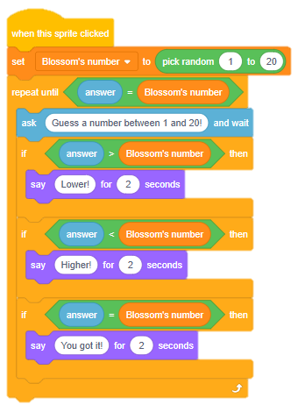
Creating Blossom Guessing Game- HINT
Instruction note: Your code should look something like this. Again, we can play around with all the bubbles in white to better suit our game.
Sample script: “Should Blossom speak for longer or would you prefer it to say different things?”

Slide 26
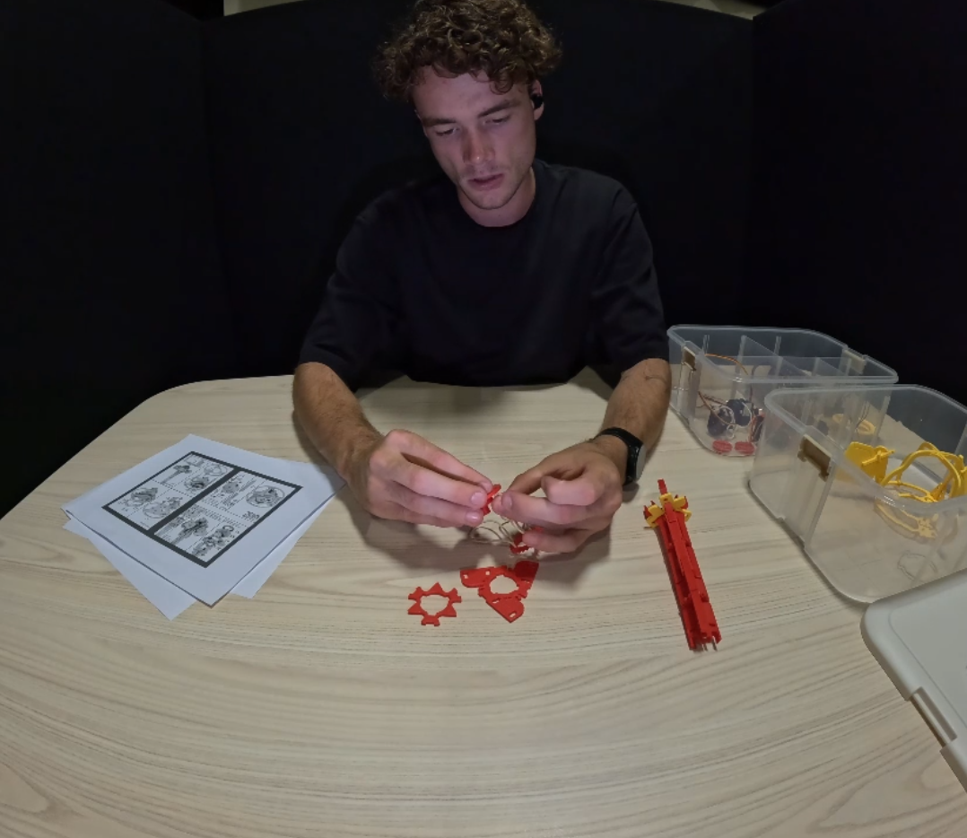
Building Blossom’s Spine

Slide 27
Coding discussion
Have a discussion with the students about future occupations or daily tasks that may be easier with coding
Coding is like a problem-solving superpower, what problem would you use coding to help solve
Even if you’re job doesn’t need coding skills, it can teach us how to break problems down into smaller steps. When can this be useful?

Slide 28
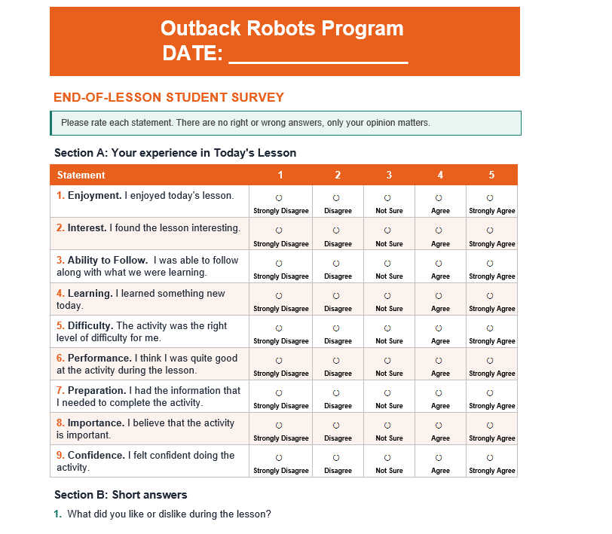
Survey

Slide 29
Summary
Name an example of an IF statement in day-to-day life, what is the EVENT and what is the ACTION
Why do we use loops?
What is an advantage of creating our own blocks?

