Slide 1
Lesson 2 – Sensing the World:
From Signals to Data

Slide 2
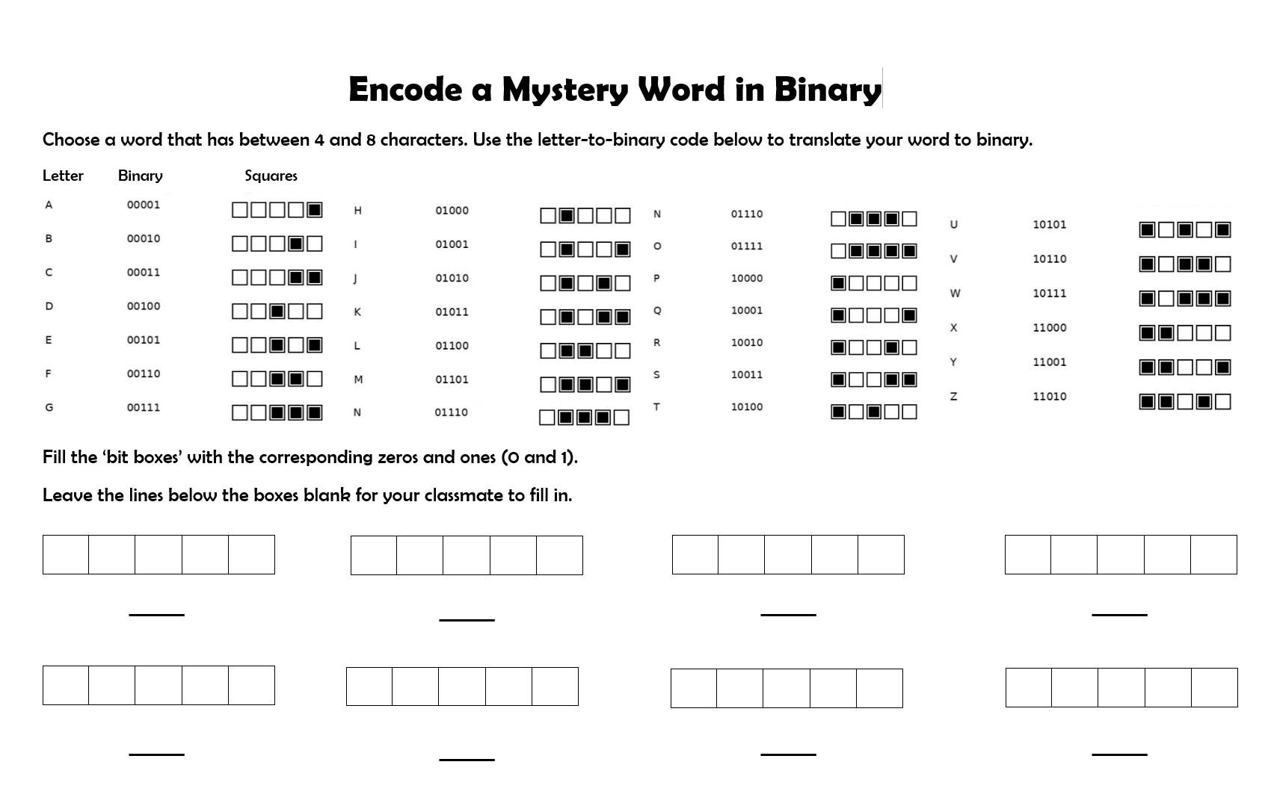
Lesson Preparation
Before you start:
Print of the Worksheet “Encode a Mystery Word in Binary” for every student
Familiarize yourself with the slides and activities in this lesson.
You can print off the teacher slides or add any notes/ parts of the example scripts to the notes on the student slides. This way, you can see them when in presenter mode.
Then hide the teacher slides, so they don’t get shown when you present.
We recommend to go through the slides in presenting mode, so that you also become familiar with the animations and order in which the different items appear.

Slide 3
Lesson 2 - Overview
Lesson 1 Recap - 5 min
Sensors – 15 min
2.1 From Human to Robot Senses
2.2 Types of Sensors
3. Language of Machines – 30 min
3.1 Control Process in Humans and Robots
3.2 Electricity (off/on)
3.3 Bits and Bytes
3.4 (Spelling in) Binary
3.5 Optional extension: Binary beads or Counting in binary – 15-30 min
3.6 Programming Languages
4. Building Blossom’s head - 30 min
5. Survey - 5 min
6. Summary - 5 min
Total: 90 min

Slide 4
Lesson 2 – Learning objectives
After this lesson, students will be able to:
explain the function of sensors in robots and other machines,
identify different types of sensors and what each one senses,
describe the control process sequence in robots and other machines
(sensor input → computer with code → motor → movement)
describe how computers use 0/1 (off/on) to represent information,
encode and decode a short word using a binary code chart,
understand what programming languages are.

Slide 5
Lesson 2 -
Student success criteria
I can explain what sensors are used for inside of robots and other machines.
I can name three different types of sensors and what they measure.
I can outline the order of processing inside the Blossom robot that is needed to turn environmental input into an action. (input → sensor → computer with code → motor position → movement)
I can describe how computers use electricity to communicate information with off- and on-states (0/1).
I can encode and decode a short word in binary using the class chart.
I can explain that programming languages are a human-friendly way to write instructions that computers can understand.

Slide 6
Lesson 1 Recap
Robot types (selection): industrial, medical, entertainment, discovery, educational, domestic, social, humanoid
What is a robot?: A machine that senses (uses sensors to notice things in the world around it), moves (has moving parts that can act in the real world) and is intelligent (uses code to make a decision about the next action from the input)
Robot parts: motor (movement), sensor (notice), computer + software/code (control/process), wires (connect), power source (energy), machinal structure (hold everything together)
Helpful uses: dangerous, dull, precise, labour shortage Harmful uses: replacing humans, befriending humans (emotional dependency, illusion of care but don’t really understand, social isolation, inappropriate responses

Slide 7
Let’s remember what we learned in Lesson 1!
3 robot examples (types or jobs)
What is a robot?
3 robot parts & what they do
2 helpful + 2 harmful uses of robots

Slide 8
Sensors Intro
Example Script:
“You learned in the previous lesson that robots (and other technologies) use sensors to notice what is happening around them. Today we will zoom into this aspect a bit more to identify how sensors can turn information from the world around them into a language that robots (or other computers) can understand.”
Whole-class brainstorm: How do we sense the world? Review the human senses and what the “biological sensors” notice around us, i.e. the sensory organs: eyes (vision), ears (sound), nose (smell), tongue (taste), skin (touch).
Then ask the students: “Which of these senses do you think a machine could also have? Are there any senses a robot can have that we don’t?”

Slide 9
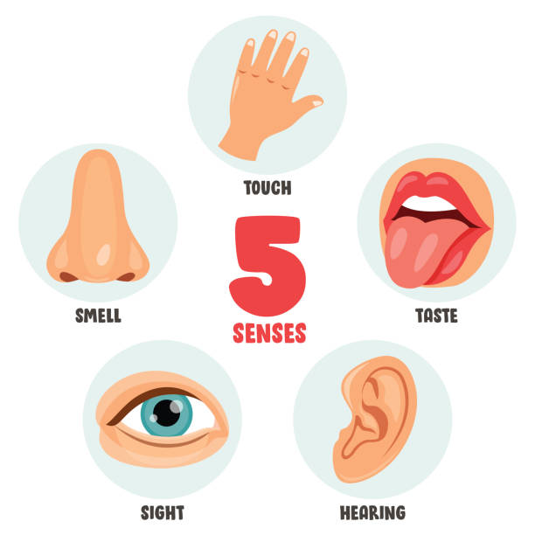
Human Senses
help us notice things in our environment
Which of these senses could a robot also have?

Slide 10
Robots Senses
Example Script:
“Similar to how humans have sensory organs to notice things around them, robots can use sensors to measure different information in their environment.”
“Almost everything that can be measured or captured with a machine could also be used as a sensor for robots. This allows them to sense many things around them. Some robot senses are very similar to human senses, while others can be quite different in terms of the information they receive and how sensitive they are. We will look at some examples now.”

Slide 11
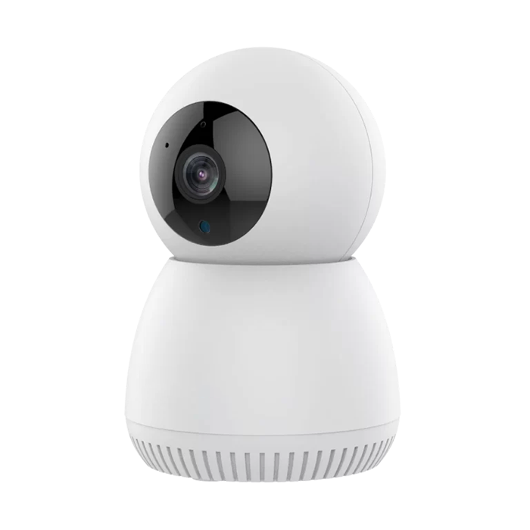
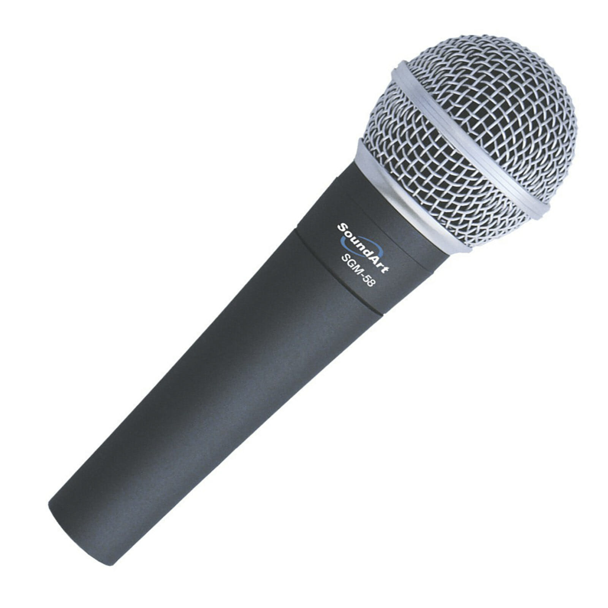

Machine Sensors
help them notice things in the environment
Notes:
Sensory organs: https://media.istockphoto.com/id/1256560323/vector/five-senses-concept-with-human-organs.jpg?s=612x612&w=0&k=20&c=8T7iU0oQAdMrw_CZeNzJ0WJvaHDY9iu6wP8cw87NkOA=
Camera: https://cdn.shopaccino.com/startech/products/2mp-wi-fi-robot-pt-camera-6741-a-157808_l.png?v=591
Microphone: https://www.australiankaraoke.com.au/wp-content/uploads/2021/04/SoundArt-SGM-58.jpg
Touch pad: https://5.imimg.com/data5/SELLER/Default/2023/6/318683739/JT/GN/FQ/83194000/71meeyqptcl.jpg

Slide 12
Robots Senses
Example Script:
“There are many other sensors that can be used inside of a robot to give it the ability to sense further information from its environment”
Instruction Note:
Introduce the sensors on the next slide to give students a sense of what kinds of things sensors can measure.
vision/imaging sensors (similar to our sense of vision): camera, colour sensor (can detect different colours), light sensor (can measure how bright or dark the robot’s surroundings are), ultrasonic sensor (senses how far the next object is away)
Highlight that the ultrasonic sensor (can also be called distance sensor) is the sensor that is used in Blossom now.
tactile sensors (similar to our sense of touch): button (the simplest type of sensor, only detects if it being pushed or not), touch sensor (similar to a laptop’s touchpad
other sensors: sound sensors/microphones, temperature sensor
The sensors on the next slide could all be used inside of Blossom after adjusting the code on its computer accordingly.

Slide 13
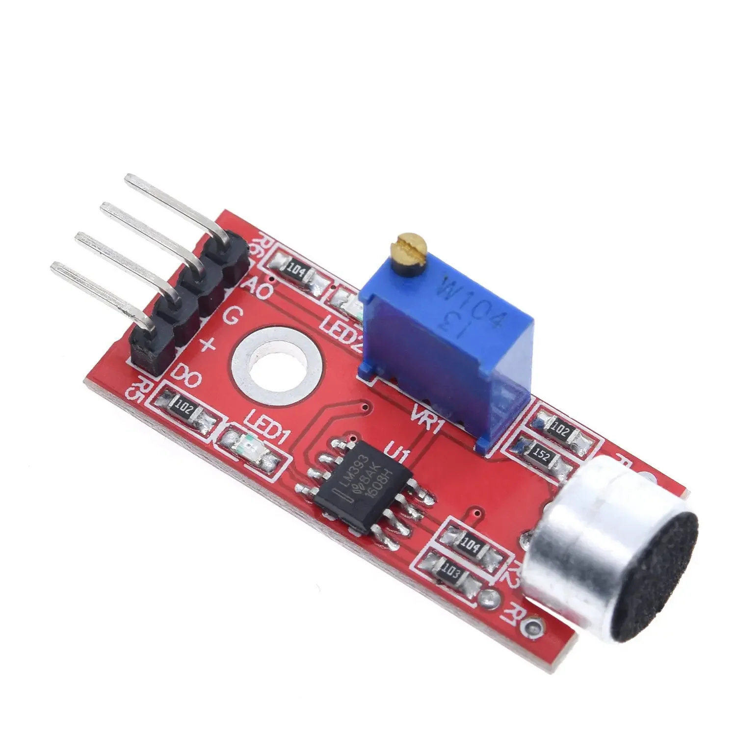
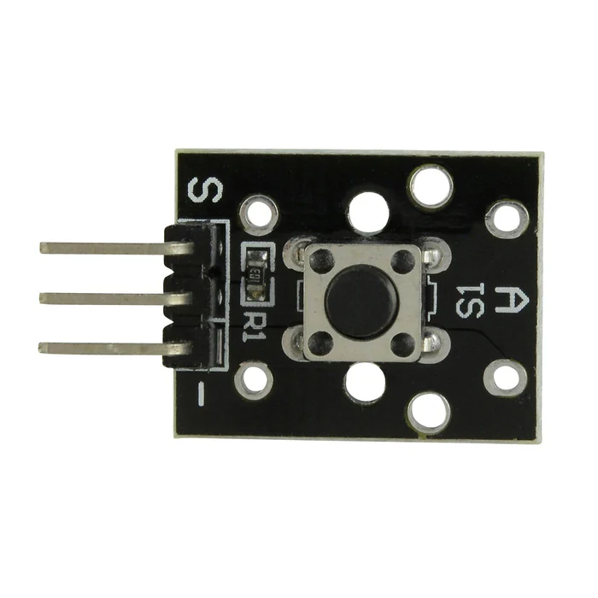
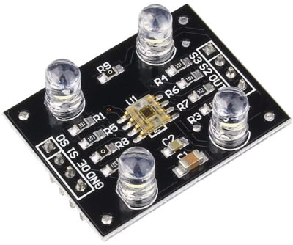
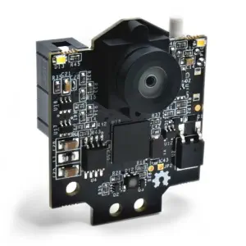
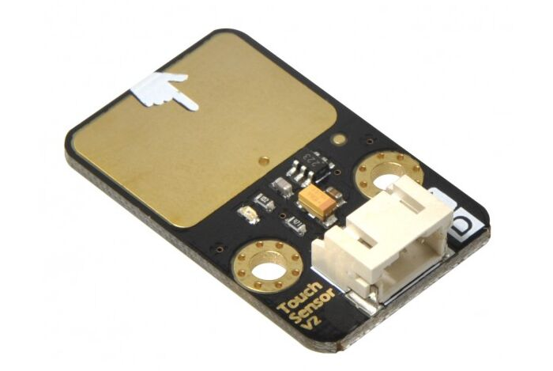
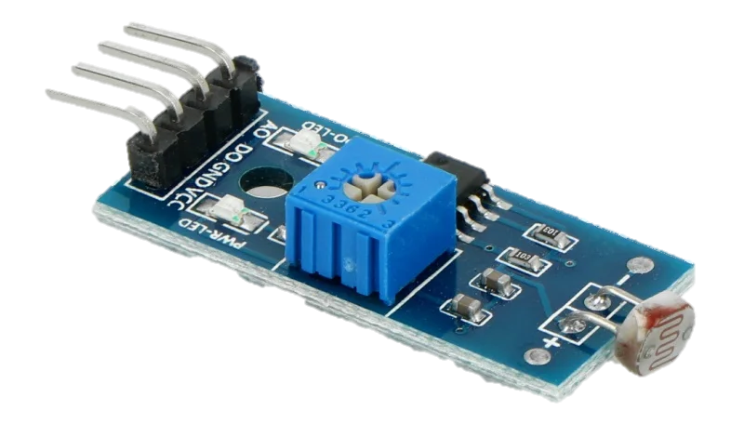
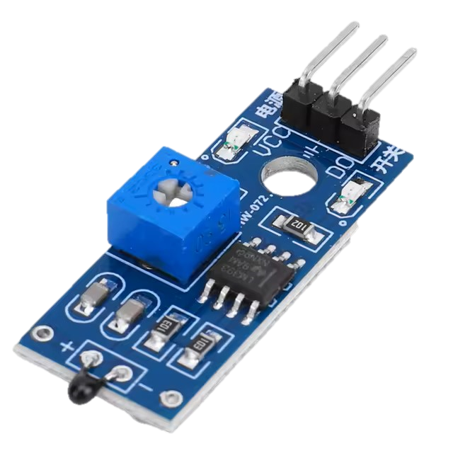
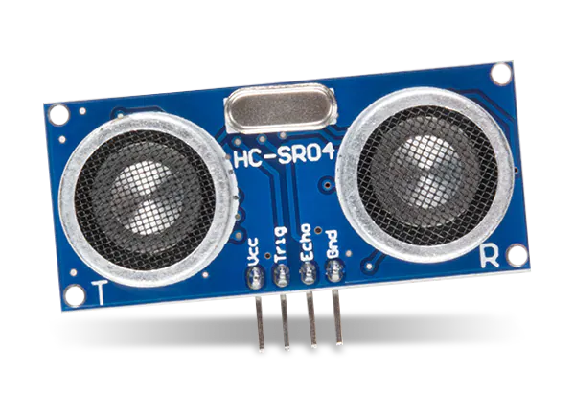
Sensor Types
vision & imaging sensors
tactile sensors
other sensors
button
sound sensor (microphone)
colour sensor
camera
touch sensor
light sensor
temperature sensor
distance sensor (ultrasonic sensor)

Slide 14
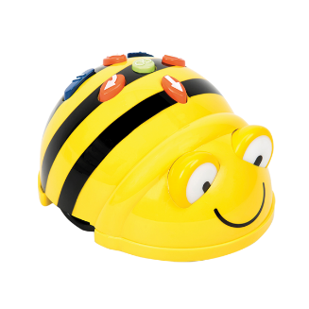
Sensor Types
Instruction Note:
On the next slide, show one robot picture at a time and let students think about which kinds of sensors the depicted robots have and what they sense in the environment.
Note: Some robots (like Nao) have lots of sensors. We have provided a full list for your reference, but you don’t need to work through all examples. We suggest getting students to identify at least 3 .
Bee bot:
buttons (students can tell the bot what to do)
newer versions also come with a microphone (to detect sound) and infrared sensors (to detect other bee bots)
Bee Bot

Slide 15
Sensor Types
Vending machine:
If it is difficult for the students to think of the sensors in a vending machine, you can go through the whole process of buying something from a vending machine and ask them to consider what the machine needs to know to select the correct actions throughout the process):
buttons: input of what item user selects
temperature sensor: determine how much the food/drinks need to be cooled
coin mechanism (combination of optical, mechanical and electromagnetic sensors): identify coin size, weight and metallic composition
additionally, some vending machines have more complex sensors for processing cashless payments
can have security sensors such as camera, tilt sensor (alarm when it falls over), or motion detector

Slide 16
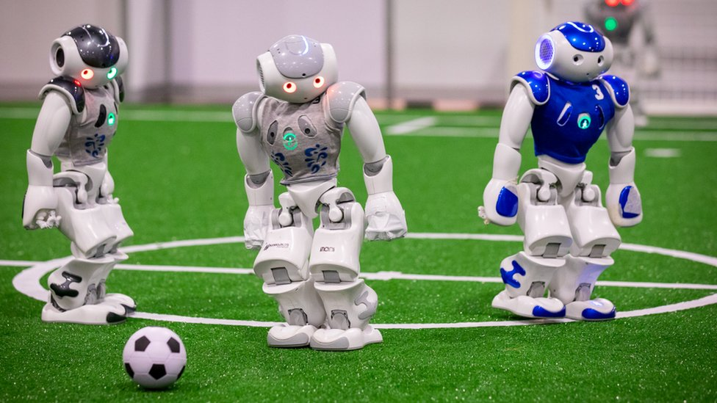
Sensor Types
NAO (football playing robot) has the following sensors:
chest button -> processing simple commands, f.i. to turn on and off,
camera -> images of surrounding, in combination with additional code it can be used to identify objects in the robot’s surrounding,
audio/microphone -> interacting with users through spoken language,
ultrasonic/proximity sensor -> to sense how far away objects/people are,
touch sensor on head -> can be programmed to complete certain action when people pet its head,
temperature/thermal sensor -> can block motors when they are overheating
motor position sensors for every motor -> knows which position it is in (do not mention unless you want to introduce this type of sensor)
gyroscope sensor -> knows when it’s upright and when it falls (do not mention unless you want to introduce this type of sensor)
NAO robot

Slide 17
Sensor Types
There are a lot of different types of sensors that can be used for robots (or other machines) to detect certain information in their surroundings.
Some other examples that were not mentioned on the student slides are:
position sensor: e.g. to know the position of a motor (Blossom’s motors cannot do this but the NAO robot in the photo has these sensors), or fluid level sensors
motion sensor: e.g. tilt sensor (detects tilting of object/device), accelerometer (measuring acceleration), or gyroscope sensor (uses gravity and momentum forces to measure rotation, a robot knows if it’s upright or when it falls)
more: air pressure sensor, humidity sensor, heartbeat sensor, motion sensor (as used when lights turn on when people walk past), gas and chemical sensors (detecting different gases and chemicals, such as alcohol sensor, CO-sensors that set off fire alarms)
Feel free to also introduce some of these to the students when discussing sensors.

Slide 18
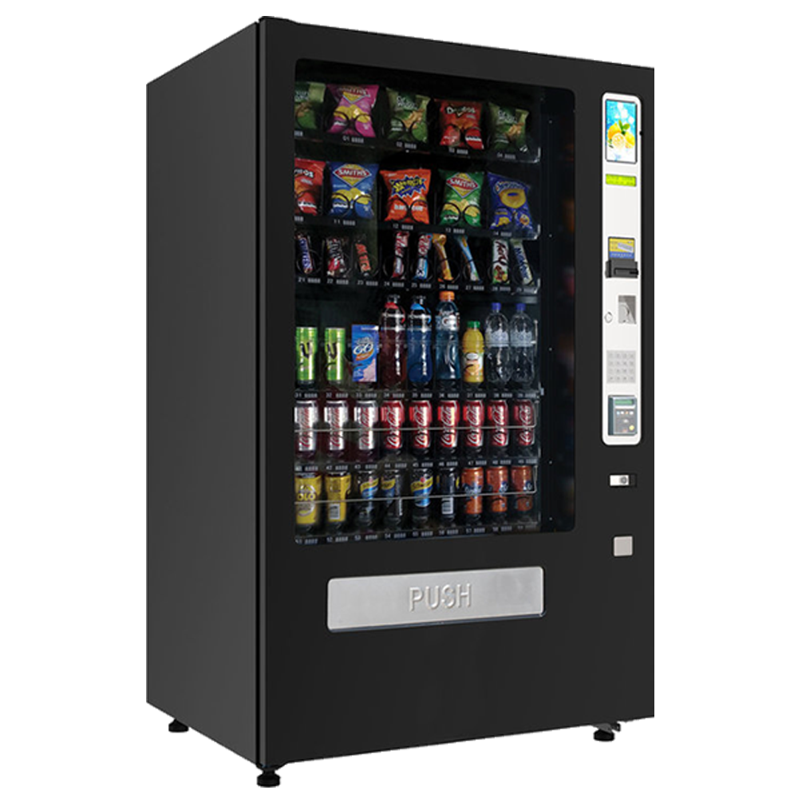
Machine Sensors
What sensors could these robots have? – and what do they sense?
Bee Bot
NAO robots
Vending Machine
Notes:
Sensory organs: https://media.istockphoto.com/id/1256560323/vector/five-senses-concept-with-human-organs.jpg?s=612x612&w=0&k=20&c=8T7iU0oQAdMrw_CZeNzJ0WJvaHDY9iu6wP8cw87NkOA=
Camera: https://cdn.shopaccino.com/startech/products/2mp-wi-fi-robot-pt-camera-6741-a-157808_l.png?v=591
Microphone: https://www.australiankaraoke.com.au/wp-content/uploads/2021/04/SoundArt-SGM-58.jpg
Touch pad: https://5.imimg.com/data5/SELLER/Default/2023/6/318683739/JT/GN/FQ/83194000/71meeyqptcl.jpg

Slide 19
Control Process inside Digital Systems
Example Script:
“Now that we know that both humans and robots use senses/sensors to make sense of the world around them, we will have a look at the control process. This is the sequence of steps needed to turn the environmental input into an action.”
Instruction Note:
On the next slide, the human control process from sensory input (a ball that is coming towards you) to the motor response (you moving to kick the ball) is visualized. Every item appears after each other.
The slides following will one-by-one swap out a part of the visualization to show what the process looks like in the Blossom robot when a hand is approaching the ultrasonic sensor on its head.
You can let students predict what the next swap will be (e.g. ask: “What does Blossom have in place of a brain?”, “What fulfills the same function as a human muscle in a robot?”)

Slide 20
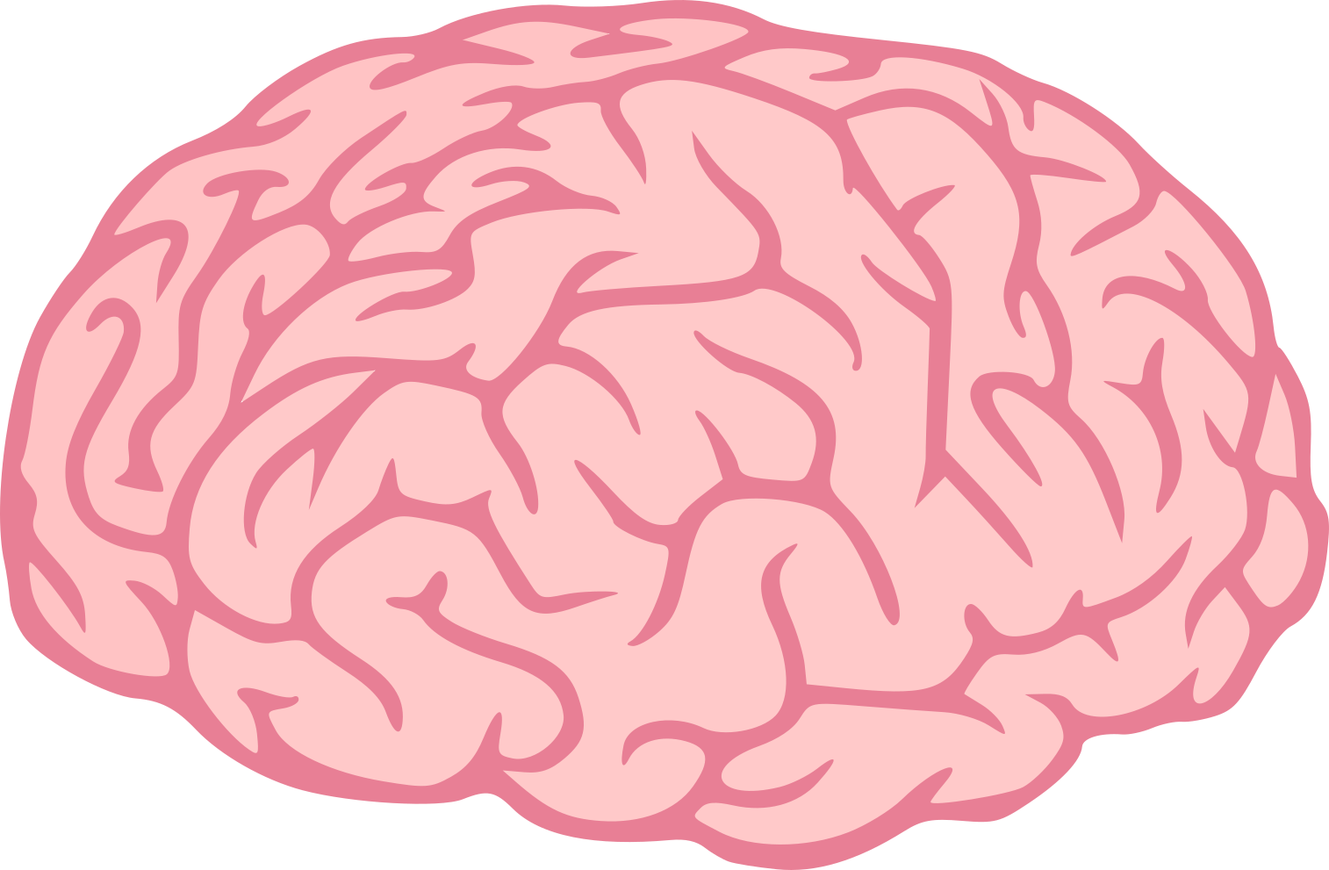
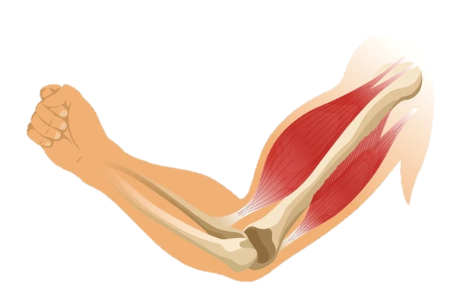



Human Control Process
tells muscles to move
information from environment
brain
interprets the sensory input and decides how to react
sensory organ (eyes)
muscles
Input . (object approaching)
You move

Slide 21
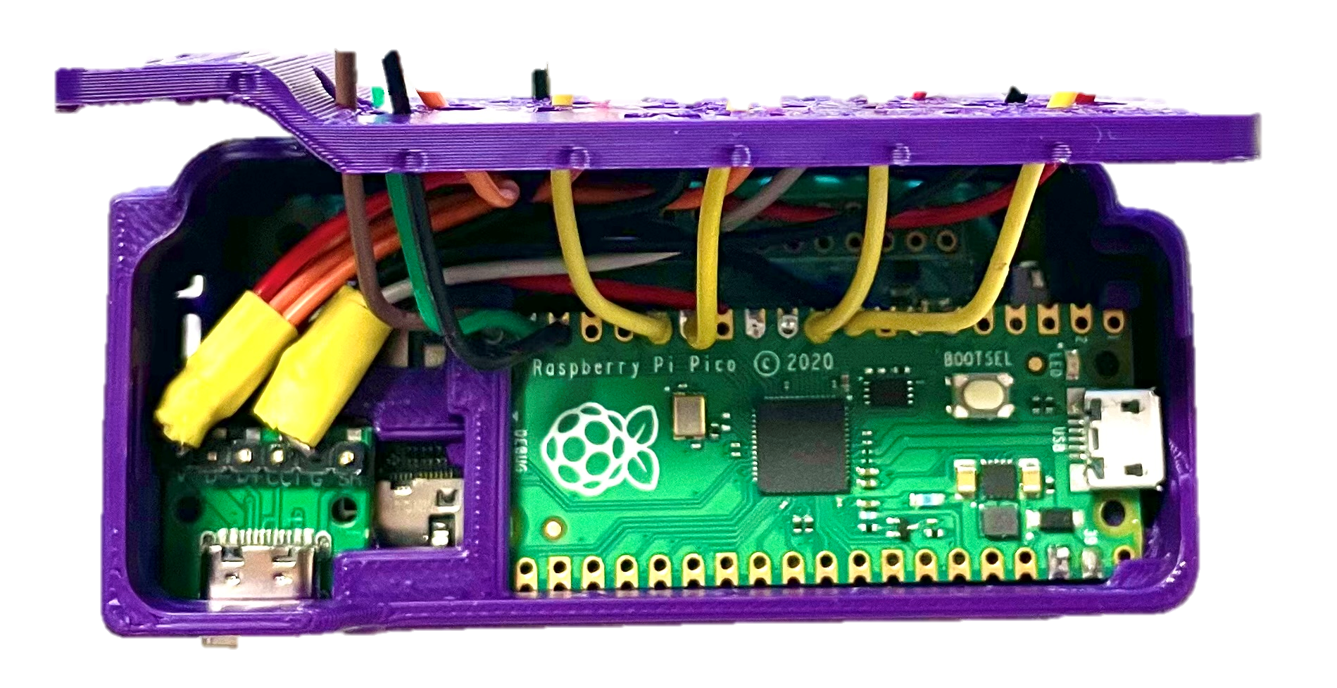
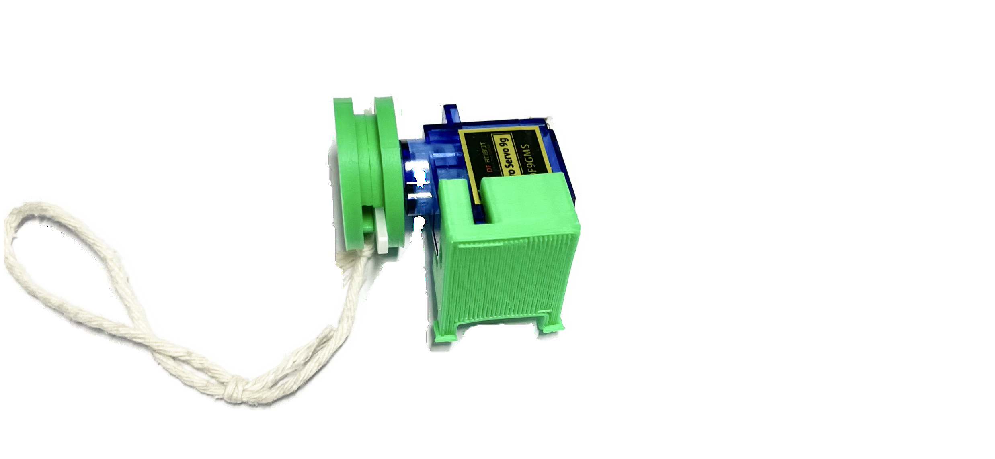
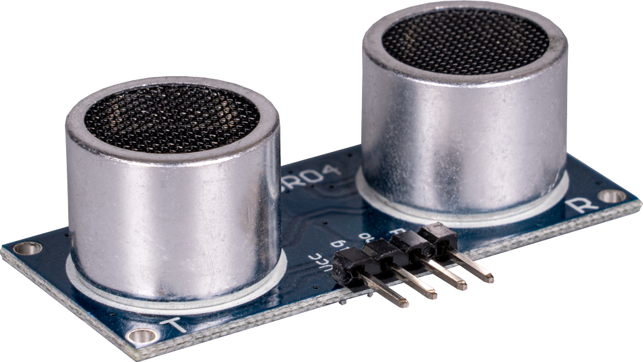

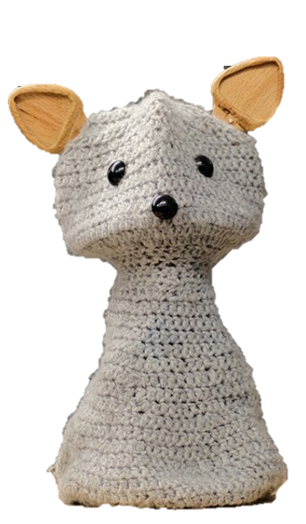

Robot Control Process
tells muscles to move
set motor position
information from environment
computer
brain
interprets the sensor input and decides how to react
interprets the sensory input and decides how to react
sensory organ (eyes)
motor
muscles
code
ultrasonic sensor
Input . (object approaching)
You move
Input . (hand approaching)
Blossom moves

Slide 22
Robot Control Process
tells muscles to move
information from environment
brain
interprets the sensory input and decides how to react
muscles
ultrasonic sensor
Input . (hand approaching)
You move

Slide 23
Robot Control Process
tells muscles to move
information from environment
computer
muscles
ultrasonic sensor
Input . (hand approaching)
You move

Slide 24
Robot Control Process
tells muscles to move
information from environment
computer
interprets the sensor input and decides how to react
muscles
code
ultrasonic sensor
Input . (hand approaching)
You move

Slide 25
Robot Control Process
set motor position
information from environment
computer
interprets the sensor input and decides how to react
motor
code
ultrasonic sensor
Input . (hand approaching)
You move

Slide 26
Robot Control Process
set motor position
information from environment
computer
interprets the sensor input and decides how to react
motor
code
ultrasonic sensor
Input . (hand approaching)
Blossom moves

Slide 27
Binary
Example Script:
“Now we know that sensors help robots gather information (e.g., sound waves, light or press of a button). The different robot parts now need to convert this information into ‘messages’ that its computer can use to make decisions – such as how to respond or move through the environment.
Computers are electrical, so all information that is sent into a computer, processed in a computer or sent out from computer is in the form of electrical signals.
A simple electrical device we all know are light bulbs. They can be either on or off.
Inside of computers, information is processed with lots of tiny micro transistors that work like lightbulbs. They can also either be flipped on or off, depending on whether they receive electrical input or not”
Instruction Note:
When talking about electrical signals being on or off, you can show this using the light switch of the classroom light.
A great video explanation of this: https://www.youtube.com/watch?v=Xpk67YzOn5w

Slide 28
?
?
computer
?
motor
code
ultrasonic sensor
How do the parts communicate?

Slide 29
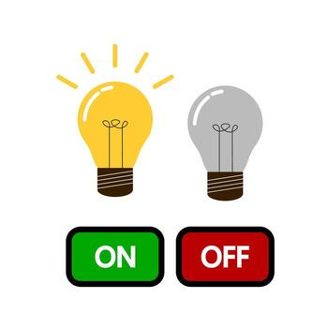
Binary
Computers are electrical, all information is sent in electrical signals
0
1
micro transistor in computers
The on- & off-state can be coded as numbers (zero and one)
Notes:
https://www.youtube.com/watch?v=Xpk67YzOn5w

Slide 30
Binary Sequences
Instruction Note:
Let students find the sequence of zeros and ones from the image of on and off transistors/lights. Every light that is on is a 1, every that is off is a 0.
The numbers will appear after one another in the order of the sequence.

Slide 31
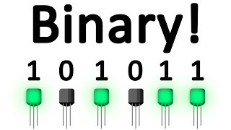
Binary Sequences
Computers are electrical, all information is sent in electrical signals
1
0
1
0
1
1
0
1

Slide 32
Bits and Bytes
Example Script:
“Every digit (0 or 1) in binary is called a Bit (binary digit)
Since a single on/off of a digit cannot express much information, multiple of these bits are combined in computers to express more complex information.”
Instruction Note:
Students might know this word already from MB/mega bytes (1 million bytes) or GB/giga bytes (1 billion bytes). This is used both when talking about storage (how much data is saved inside a computer’s memory) and related to data usage (how many bytes of data did the device download from or upload to the internet).

Slide 33

Bits and Bytes
Every digit (0 or 1) is called a bit.
In most computers, sequences of 8 bits are combined to store or process information
A sequence of 8 bits = 1 byte
byte
bit

Slide 34
Spelling in Binary
Every symbol you can type on a computer is stored as a byte.
Example: “Hi!”
01001000
01101001
00100001
H
i
!

Slide 35
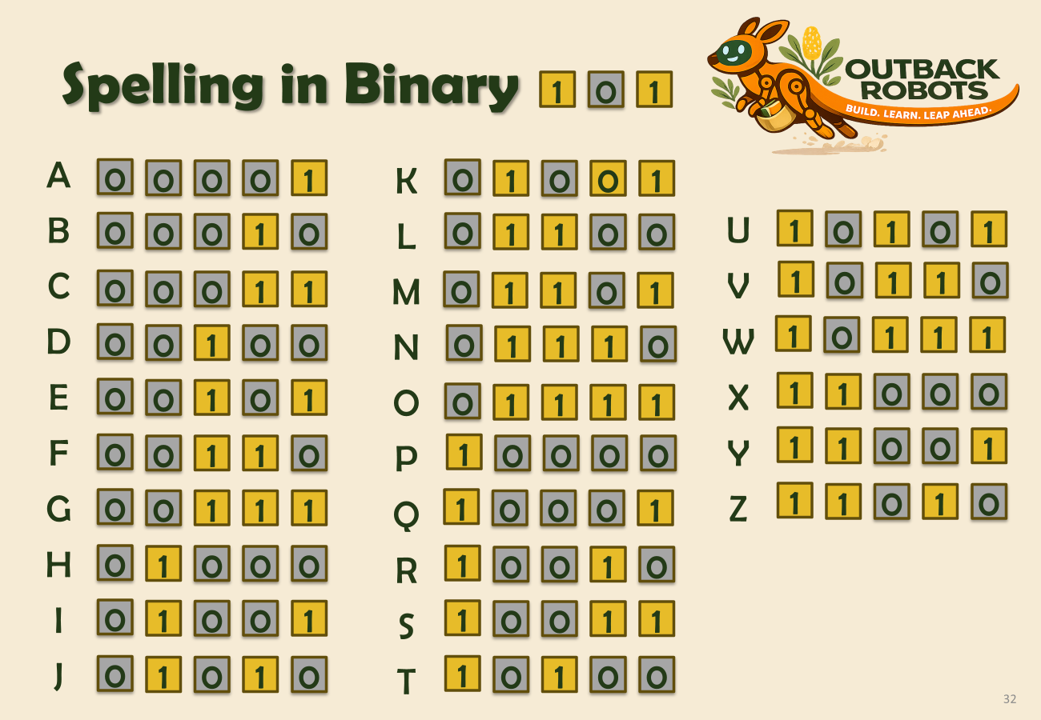
Spelling in Binary Activity
Instruction Note:
Pair the students with one other student (or a group of three, they will then exchange their writing in a circular way).
Hand out the worksheet “Spelling in Binary”
Tell them to:
“Think of a word you want to write to your partner (4-8 characters).”
“Use the worksheet and the binary code reference on the slide to encode it in binary.
You can either write zeros and ones into the ‘bit boxes’, or colour in all that are on / a 1)”
Leave the line underneath the “bit boxes” blank, they are for your partner to decode your word.
worksheet
When both students are done, let them exchange their binary writing with the partner and try to decode what they wrote (also using the reference on the slide).
Note: While students are completing the worksheet, leave the “Spelling in Binary 101” slide up for them to easily refer to the code conversion chart.
slide with conversion chart

Slide 36
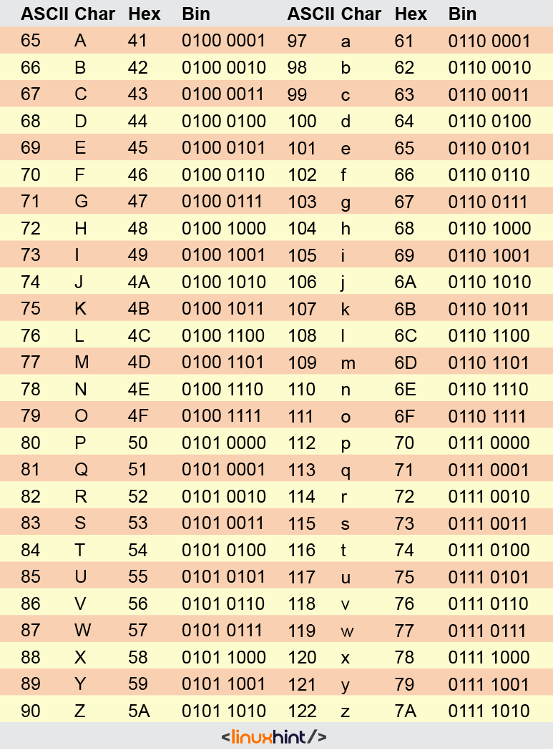
Spelling in Binary Code
The code on the next slide is a simplified version of the common ASCII code (American Standard Code for Information Interchange)
ASCII normally uses 7 or 8 bits to encode a single character, whereas our simplified code only uses 5
If you were to add ‘010’ before the numbers in our simplified code, you would get the ASCII code version for uppercase letters. If you added ‘011’ in front, you would get the lowercase letters.
Notes:
Code table: https://linuxhint.com/wp-content/uploads/2022/02/word-image-536.png

Slide 37
Spelling in Binary
1
0
1
A
0
0
0
0
1
K
0
1
0
0
1
B
0
0
0
1
0
L
0
1
1
0
0
U
1
0
1
0
1
C
0
0
0
1
1
M
0
1
1
0
1
V
1
0
1
1
0
D
0
0
1
0
0
N
0
1
1
1
0
W
1
0
1
1
1
E
0
0
1
0
1
O
0
1
1
1
1
X
1
1
0
0
0
F
0
0
1
1
0
P
1
0
0
0
0
Y
1
1
0
0
1
G
0
0
1
1
1
Q
1
0
0
0
1
Z
1
1
0
1
0
H
0
1
0
0
0
R
1
0
0
1
0
I
0
1
0
0
1
S
1
0
0
1
1
J
0
1
0
1
0
T
1
0
1
0
0

Slide 38
Extension Activity
Binary Bracelets
Start off as in the previously described activity. Instead of having a partner decode the word the students encoded, let them turn it into a bracelet with light and dark coloured beads
You could still let a partner decode it first to check that there are no errors in the encoded bits.

Slide 39
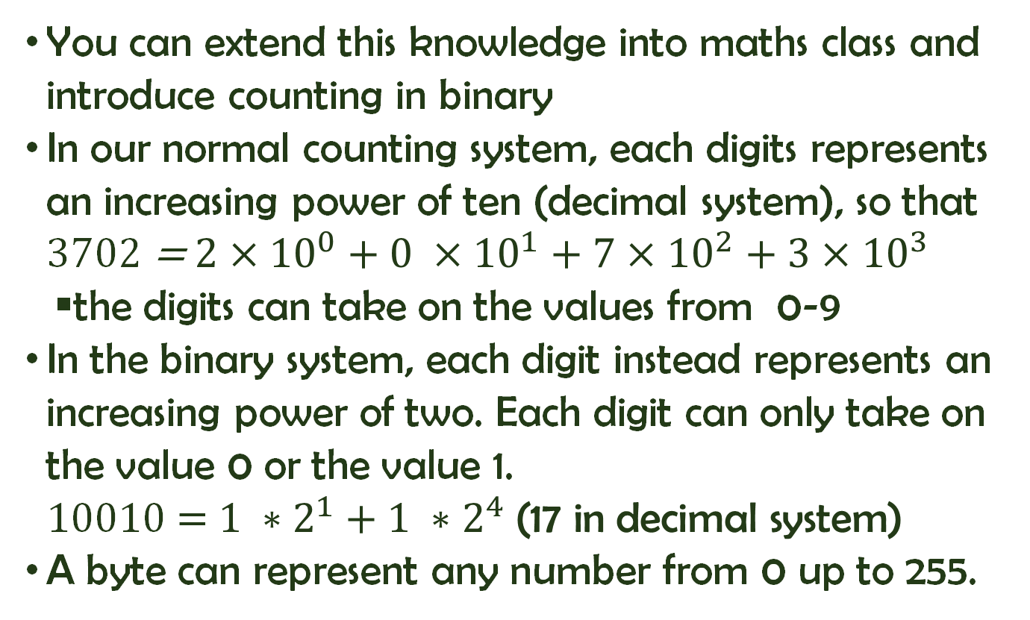
Extension Activity: Counting in Binary
You can extend this knowledge into maths class and introduce counting in binary
In our normal counting system, each digits represents an increasing power of ten (decimal system), so that 3702 = $2×{10}^{0}+0 ×{10}^{1}+7×{10}^{2}+3×{10}^{3}$
the digits can take on the values from 0-9
In the binary system, each digit instead represents an increasing power of two. Each digit can only take on the value 0 or the value 1. 10010 = $1 ∗2^{1}+1 ∗2^{4} \text{(17 }\text{in} \text{decimal} \text{system}\text{)}$
A byte can represent any number from 0 up to 255.

Slide 40
Translating between Computer and Human Language
Example Script to introduce programming languages:
“As you can see in the last activity, writing in binary takes a lot more time and characters than writing in English – or other alphabetical languages”
‘We still want to be able to use computers and communicate what they should do, without having to write a ton of zeros and ones.’
‘For this, people have invented something called programming languages, which act as a kind of translator between human language and computer language.’
‘There are many different programming languages that have been invented. They contain words from natural language but also tell the computer exactly what to do. Some examples are Python, HTML, Java, C#, C++, JavaScript, SQL, R.’
Instruction Note:
Students will get to work with a very simple version of a programming language (block-based coding) in the next lesson, and learn more about some basic concepts in coding (e.g. loops, if-statements).

Slide 41
Programming Languages
Have you heard of programming languages before?

Slide 42
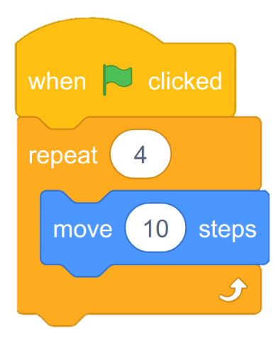

Programming Languages
Programming languages can translate between human and computer language.
programming languages
block-based coding

Slide 43
Building Blossom’s Head

Slide 44
Building Blossom’s Head

Slide 45
Extension: Sensor Input Data
let students go to the sensor input page on Blossom’s interface
let students inspect the data from the ultrasonic sensor and how it changes as they move their hand towards it or further away
sensor data to diagram
let students measure the distance from their hand to the sensor with a ruler and plot it in a diagram (x-axis: distance, y-axis: the number of the sensor input data on the web interface)
Distance from hand to sensor in cm | 5 | 10 | 20 | 50
Sensor input data | X (let students measure) | ~ 2x | ~ 4x | ~ 10x

Slide 46
Questionnaire
same questions as last week, fill out as honestly as you can

Slide 47
Summary – From Signals to Data
What are sensors?
Parts of machines that help them sense things around them (take in information from the environment).
Types of sensors
A lot of different sensors exist, let students name a few (e.g., temperature sensor, camera, microphone,

Slide 48
Lesson 2 -
Student success criteria
I can explain what sensors are used for inside of robots and other machines.
I can name three different types of sensors and what they measure.
I can outline the order of processing inside the Blossom robot that is needed to turn environmental input into an action. (input → sensor → computer with code → motor position → movement)
I can describe how computers use electricity to communicate information with off- and on-states (0/1).
I can tell what a bit and byte are.
I can encode and decode a short word in binary using the class chart.
I can explain that a programming languages are used to translate between human (natural) language and computer (binary) language.

Slide 49
Summary – Sensing the World
What are sensors?
parts of robots (and other machines) that notice things in the world around them
Sensor types
Control Process in Blossom: From environmental input (e.g. approaching hand) to movement
hand -> ultrasonic sensor
How do computers communicate
What is a bit, what is a byte?
What are programming languages?

