Slide 1
Lesson 4 – What Is AI?
Algorithms and Predictions

Slide 2
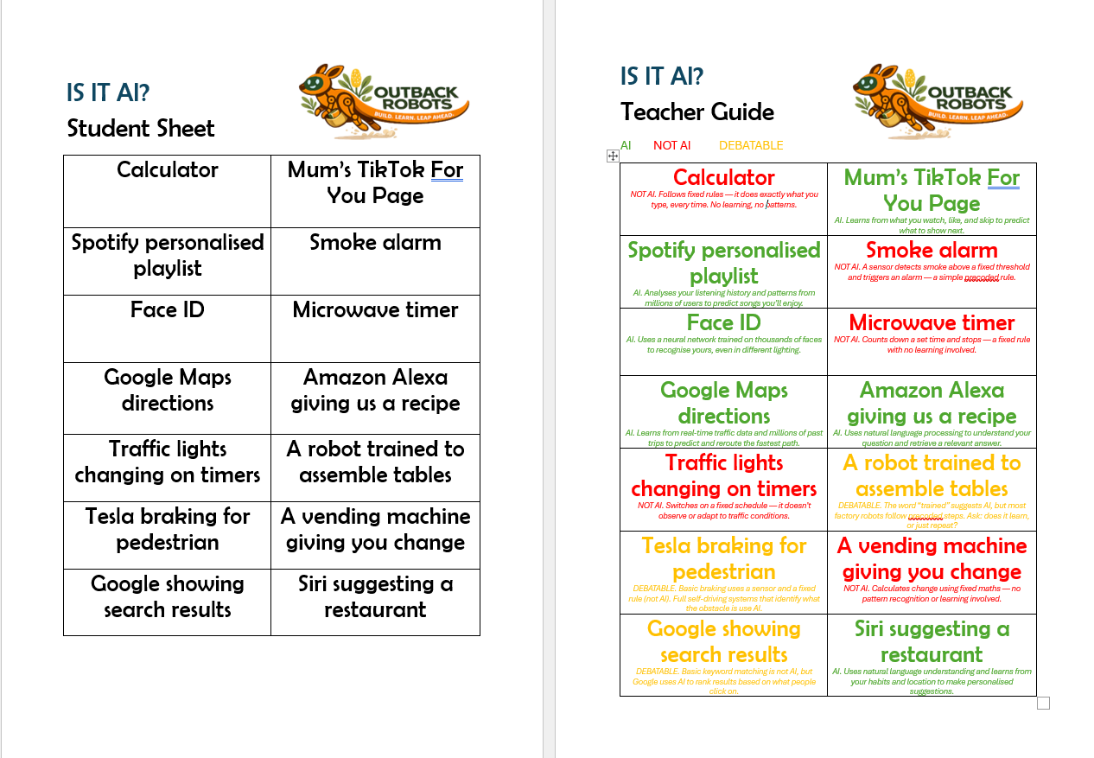
Lesson Preparation
Print off IS IT AI? cards, one set each to a small group is appropriate – and keep the Teacher guide (with answers) for yourself (more details below).

Slide 3
Lesson 4 - Overview
Lesson 3 Recap - 5 min
What is AI – 10 min
2.1 Pattern recognition
2.2 A tool not a mind
3. Is it AI – 25 min
3.1 Students sorting cards
3.2 Class discussion + clarification
4. Building Blossom’s spine - 30 min (+ any catch up 10 min)
5. Survey - 5 min
6. Summary - 5 min
Total: 90 min

Slide 4
Lesson 4 – Learning objectives
After this lesson, students will be able to:
Define AI in their own words
Identify at least three examples of AI they encounter in everyday life
Explain the difference between a programmed rule and AI-driven decision making
Describe AI as pattern recognition rather than human-like thinking or understanding
Distinguish between AI and non-AI technology in a real-world scenario
Reflect critically on the role AI already plays in their daily life

Slide 5
Lesson 4 -
Student success criteria
I can explain what AI is in my own words
I can give at least three examples of AI I use or see every day
I can explain the difference between a programmed rule and AI
I can describe AI as finding patterns rather than actually thinking or understanding
I can look at a piece of technology and decide whether it uses AI or not
I can reflect on how much AI is already part of my daily life

Slide 6
Recap Coding
Instruction note: Cover the following concepts
‘Code is just a language that robots and computers understand!’
‘We use IF STATEMENTS to tell the computer to do something IF an event occurs’
‘We use loops to tell our computer to continue to repeat a stack of code’

Slide 7

Let’s remember what we learned in Lesson 3!
Give an example of a coding language
How does an IF STATEMENT help us automate our code?
How do loops help make our code shorter (or neater)

Slide 8
Introduction to AI
Sample script: “AI stands for artificial intelligence. It’s when computers are programmed to do things that would normally require thinking (like humans do). It learns from patterns in data, just like how we learn from our experiences. We know AI is everywhere already! It helps us with YouTube/Netflix suggestions, Siri in our phones, Google Translate, Maps and autocorrect.
It is made by humans but doesn’t have emotions or feelings like we do. There are many different types of AI and we will learn about them in the next few weeks. You may have heard of:
generative AI: a tool that is able to generate text, images or videos
LLM (large language models) an AI tool that learns from and produces text, based on predictions
machine learning, enables systems to learn from many types of data! ”
Note: Some products like ChatGPT use all of these AI technologies together.

Slide 9
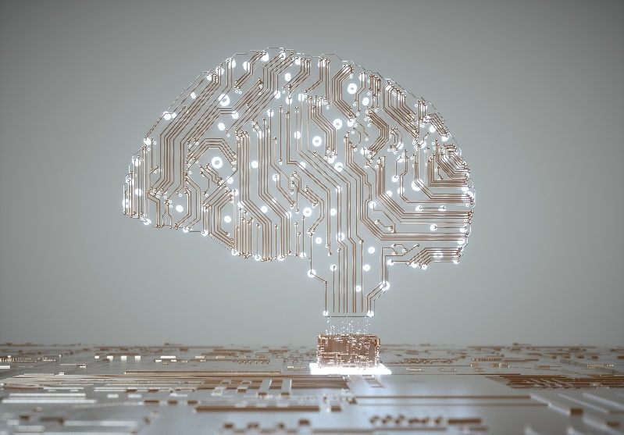
Introduction to AI
AI = Artificial Intelligence
🧠 Learns from patterns in data
🛠 A tool made by humans — not magic!
📱 Generative AI - LLMs - Machine Learning

Slide 10
Learning from patterns
Sample script: “If we went to our YouTube or Netflix recommendations we would see a whole bunch of TV shows, movies and videos to watch. How does the AI suggest we watch these? It doesn’t know us, and it’s definitely never watched TV with us, we might not have ever told it what we do and don’t like. It’s because it can look at data of millions of other people who have watched similar things to us and see what they watched next, it then suggests them as something we might like to watch next!
In other words, it is using data to make a prediction”

Slide 11
Learning from patterns-not thinking
AI finds patterns — it does NOT think like us
📺 Netflix doesn’t know you
It spots what millions of similar people watched next
Pattern → Prediction (not understanding!)

Slide 12
It’s EVERYWHERE!
✅
Autocorrect
fixes typos as you type
🧑
Face ID
recognises your face
📧
Spam filter
blocks junk mail
🤖
ChatGPT
predicts next word
🤔 Can you think of more examples?

Slide 13
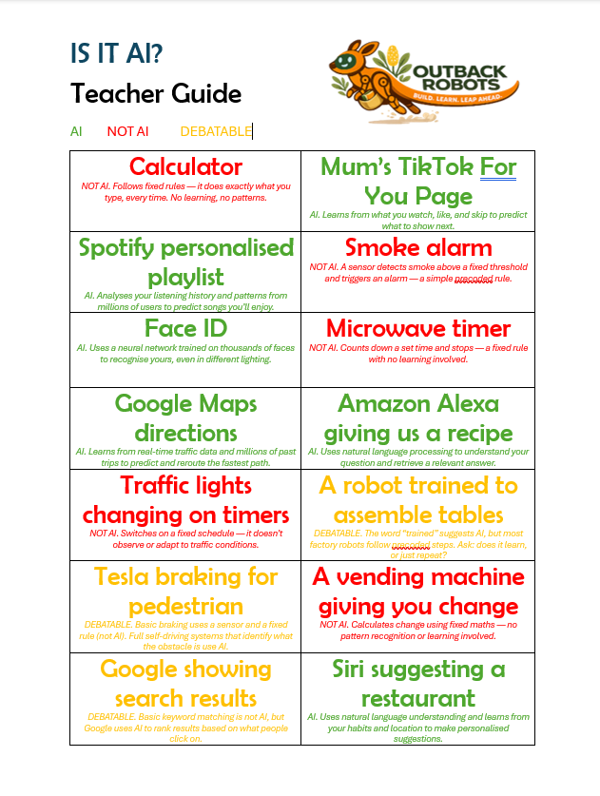
Is It AI?
Instruction note: Some of the cards are debatable. Here are some discussion points to raise with the students:
Teslas – They have precoded rules, if the ultrasonic sensor detects something in front of it at X distance it will brake (this is not AI). However, some newer models predict where the cars or objects in front will go next and brake accordingly (this is AI)
Google search – Google will generate a list of results based on common words which is precoded and doesn’t use AI, however newer models may predict what a person is looking for, based on what links others clicked on and show them first
Assembly robot – Can use prediction models to recognise which pieces are likely to go where, however most are precoded and are not AI

Slide 14
Is it AI?
We are going to do an activity, separating things into whether we think they are AI or not
Remember, AI has access to billions of resources and makes predictions!
Some of the cards may are debatable!
If you think the card is debatable, create an argument for why you think it is or isn’t AI

Slide 15
AI Mistakes and Hallucinations
Sample script: "Imagine you've read every bike review ever written — every magazine, website, and forum post — and you remember all of it. I ask you: 'What type of bike is a Talon?' Easy — it's a Giant mountain bike. You've seen that thousands of times. Confident, correct, done. Now I ask: 'What's better for a 12 year old — a Talon Pro 5000 or a Trek Thunderbolt X?’ You've never seen those exact names. But you've read so much about similar bikes that you piece something together, you even produce a comparison table. Talon Pro 5000 comes out on top.
Sounds great. Except — I made those bikes up. They don't exist. You filled in the gap with something that sounded completely plausible and presented it with total confidence.
That's exactly what AI can do. We call it a hallucination — not because the AI is dreaming, but because it produces something that sounds real but isn't. And the scary part? It doesn't know it's wrong. No alarm goes off. It just gives you the most pattern-consistent answer it can. So whenever AI gives you a confident, detailed answer, ask yourself: is this actually true, or does it just sound true?"

Slide 16
Can it make mistakes?
🚲 You’ve read every bike review ever written…
Easy: “What is a Talon?” → Giant mountain bike ✅
Hard: “Talon Pro 5000 vs Trek Thunderbolt X?”
Neither bike exists — but AI gave a confident answer!
⚠ This is a HALLUCINATION — always check AI answers!

Slide 17
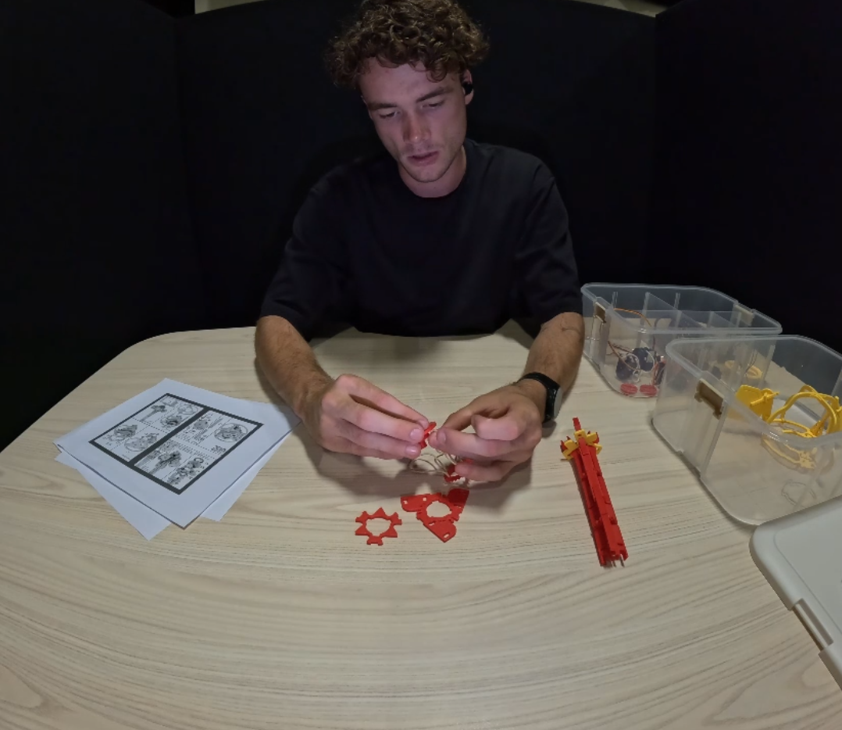
Building Blossom’s Base

Slide 18
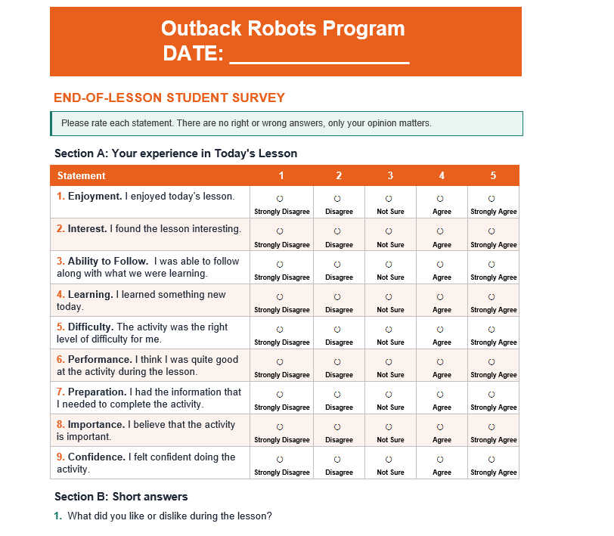
Survey

Slide 19
Questionnaire

Slide 20
Summary
AI – Artificial Intelligence
Come up with 3 different examples of AI in our everyday life
Explain the difference between predicting and understanding
Why is it always important to check the answers AI gives us?

