Slide 1
Lesson 5 – Design for Good
Sustainability, societal impact and equity

Slide 2
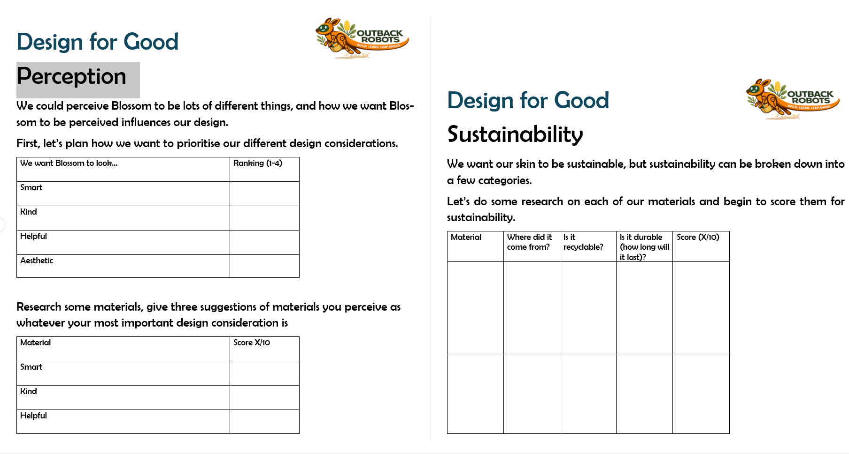
Lesson Preparation
Print off Design for Good Worksheet, one per group of 3-4 is appropriate (total 4 pages)

Slide 3
Important instruction
Students will choose a material to design Blossom’s skin in this lesson. The idea is that they will source that material from home to design next week.
At the end of the lesson get students to plan in their groups who will be sourcing what, if multiple materials. The lesson is designed such that materials are sustainable and equitable, they should be free and repurposed. If any groups run into tubule sourcing materials they are welcome to use the recycled shopping bags we provided.

Slide 4
Lesson 5 - Overview
Lesson 4 Recap - 5 min
Design factors – 15 min
2.1 Perception
2.2 Sustainability
2.3 Equity
3. Desing for Good worksheet – 30 min
4. Blossom’s motor movement - 30 min
5. Survey - 5 min
6. Summary - 5 min
Total: 90 min

Slide 5
Lesson 5 – Learning objectives
After this lesson, students will be able to:
Explain the environmental benefit of using recycled materials in design
Describe what inclusive design means and why it matters
Identify how a robot's appearance influences human perception and trust
Reflect on how design choices affect who can access and benefit from technology
Evaluate whether a design decision is equitable by considering who is included or excluded
Recognise that good design involves values and social responsibility, not just function

Slide 6
Lesson 5 -
Student success criteria
I can explain why using recycled materials is a more sustainable design choice
I can describe what equity means in the context of design and technology
I can give an example of a design that includes some people and excludes others
I can explain how Blossom's appearance might change the way someone feels about it
I can reflect on the design choices I made and explain the values behind them
I can describe what "design for good" means in my own words

Slide 7
Lesson 4 Recap
Instruction note: Get students to come up with some examples of AI again, maybe discussed if they noticed any examples of AI in day to day life since last week.
Sample script: “AI is when computers are programmed to do things that would normally require thinking (like humans do). It learns from patterns in data, just like how we learn from our experiences. AI can make mistakes too, it’s important to check the answers that AI gives us.”

Slide 8
Let’s remember what we learned in Lesson 4!
What is AI?
Give 3 examples of AI we come across everyday
Why do we need to check the answers AI gives us?
AI predicts based on patterns, it doesn’t think or understand things like we do!

Slide 9
What is perception?
Sample script: “Perception is how we view things, or how we feel about things when we see them. Our perception of Blossom can change based on how we design the skin and what Blossom looks like. On the next slide we are going to see four different skins Outback Robots team dressed Blossom in.”

Slide 10
What is perception?
Perception = how we view things
👀 How something LOOKS changes how we feel about it
🤖 Blossom’s skin changes how we perceive it
Same robot — different skin — different reaction!

Slide 11
Skins
Instruction note: Play an interactive voting game, for each question get the students to move to a corner of the room for which skin they perceive as the smartest, best and which they would treat the most carefully. Maybe get a student to discuss why each time.

Slide 12
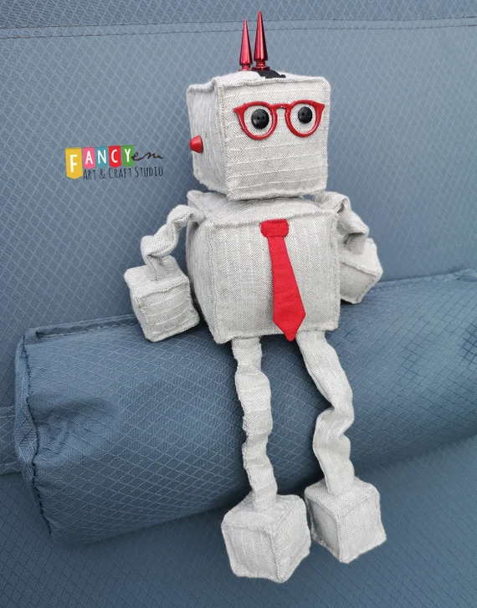
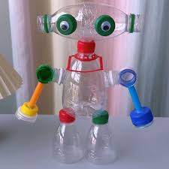
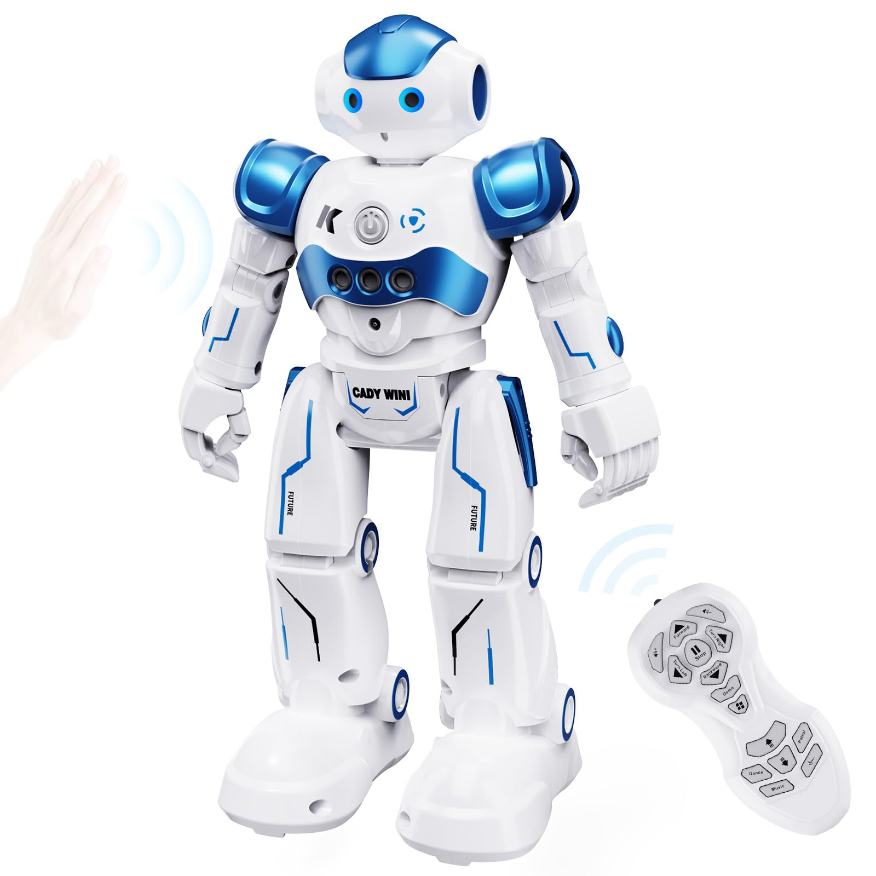
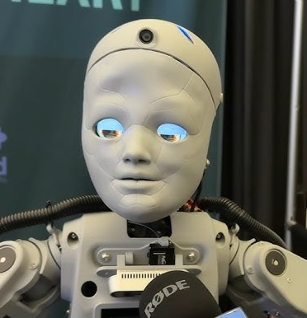
Skins
Skin A
Skin B
Skin C
Skin D
🤔 Think about…
🧠 Which robot seems the smartest? ✨ Which looks the best? 🤝 Which would you treat most carefully?

Slide 13
Perception changes
Instruction note: This can be more of an ‘informal chat’. Discuss with he students who changed their view and why. Was anyone’s vote influenced by peers. Notice our perception of which Blossom was ‘best’ depends on what the question is, smart, best looking or the one we’d treat most carefully.

Slide 14
Perception changes
Our perceptions change!
👥 Not everyone agrees — and that’s ok!
🔁 Peers can even change our minds
Same Blossom — same function — materials matter!

Slide 15
Sustainability
Sample script: "Sustainability is about how we take care of our world, making sure the choices we make today don't cause problems for the future. Sustainable materials are usually spoken about as materials we can recycle, are durable and easy to get.
When we design Blossom's skin, we need to think about where the materials come from, how they're made, and what happens to them when we're done."

Slide 16
Sustainability
Sustainability = caring for the world’s future
♻
Recyclable
can it be used again?
💪
Durable
will it last?
🌍
Easy to get
available everywhere?

Slide 17
Sustainability
Consider the skins we looked at earlier
What is each made out of?
Is this new or reused material?
Are the materials recyclable?
How durable are they?
Could the material be used again?

Slide 18
Equity
Sample script: “Equity is providing everyone with equal opportunities to access something. Think about things that are low cost, available in all locations (abundant) and easy to work with.
If we asked every student in this class to bring in their own material from home, would that be fair? Would everyone be able to? Remember to be equitable it has to cover all of the points, cost, availability and easy to use"

Slide 19
Equity
Equity = equal access for everyone
Every Australian school must be able to use the material!
💰
Cost
gold sheets vs plastic bags
📍
Availability
old t-shirts vs specialty fabric
✂
Ease of use
cut & staple vs knitting

Slide 20
Why materials matter
Sample script: “For this activity we are going to pretend we are engineers for Outback Robots. We are going to design a skin for Blossom that can be used by every school in Australia. We need to think about the three big questions on the slide.”
First , perception. How will people feel when they see Blossom for the first time? Will it look friendly? Smart? Professional? The way something looks affects how people react to it.
Second, sustainability. If every school in Australia builds this skin, that's a LOT of material. We need to ask: is it kind to the environment? Can it be recycled or reused?
Equity. Can a school in remote areas get the same materials as a school in Adelaide? Our design has to work for everyone, not just schools with big budgets and fancy equipment."

Slide 21
Your turn
You are the head engineer for Outback Robots!
Design a skin for every school in Australia
Consider:
👀 Perception
♻ Sustainability
🤝 Equity

Slide 22
Design for Good Worksheet
Instruction note: Get students to work in small groups choosing a material for Blossom’s skin. Encourage them to do their own research on three different materials they might see as appropriate to design a skin for Blossom. There are no right or wrong answers.
Get each group to do a brief presentation/discuss their findings and suggest which material they would use to design Blossom’s skin, remembering it’s thinking about the use being every Australian school!

Slide 23
Your turn
Split into groups and design a solution
Remember your solution needs to be
Well perceived (for your intended use)
Sustainable
Equitable
Let’s use the Design for Good worksheets to help us plan

Slide 24
Moving Blossom’s Motors
Plug the Blossom computer into a power source
Wait for the wi-fi to show up and connect
Head to https://192.168.90.1:8080
Go to Calibration, drag the sliders, what can we make Blossom do?

Slide 25
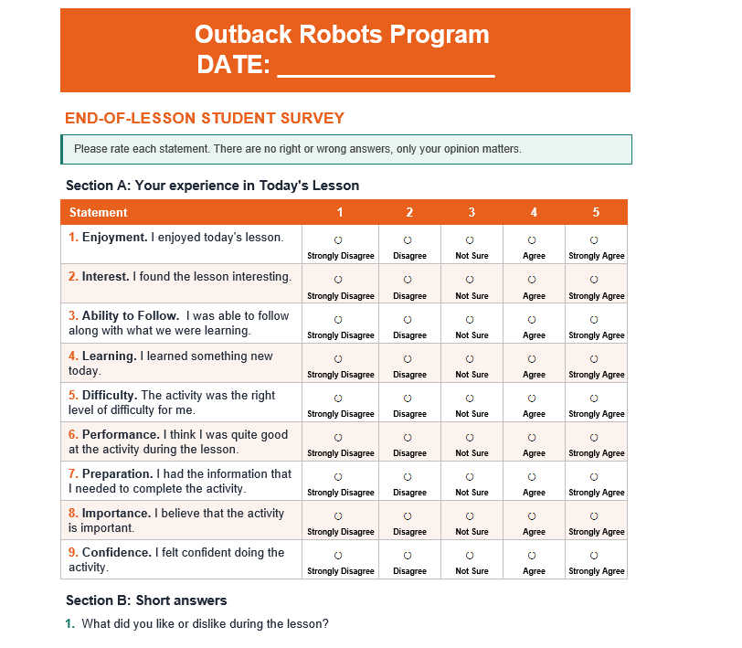
Survey

Slide 26
Summary
Give a brief presentation on what material you chose and why!

