Slide 1
Lesson 6: Ethics of AI
Fairness, Bias and Impact

Slide 2
Lesson Preparation
Before you start:
Students will make their Blossom skin in this lesson. Ensure all students have bought in their materials from home, or have access to the shopping bags we provided
Have LLM of choice ready to go, if using ChatGPT it may be best that you are already logged in etc., to ensure lesson flows smoothly

Slide 3
Lesson 6 - Overview
Lesson 5 Recap - 5 min
Intro to ethics – 15 min
2.1 Introduction
2.2 Why AI can’t do ethics
3. Spot the bias – 20 min
3.1 Scenario 1
3.2 Scenario 2
4. Making Blossom’s skin - 40 min
5. Survey - 5 min
6. Summary - 5 min
Total: 90 min

Slide 4
Lesson 6 – Learning objectives
After this lesson, students will be able to:
Give a brief definition of the concept of ethics
Articulate why AI can’t understand ethics
Understand positive and negative uses of AI, and how AI can be trained to avoid bias
Give a brief definition of anthropomorphism

Slide 5
Lesson 6 -
Student success criteria
I can explain what ethics means in my own words
I can give an example of a decision that needs ethical thinking, not just rules
I can explain why AI can't make ethical decisions on its own
I can describe what bias in AI means and where it comes from
I can explain what anthropomorphism is and why it matters with AI
I can describe what could go wrong if we treat AI like a human

Slide 6
Lesson 5 Recap
Instruction note: Get students to reflect on what material they chose as suitable for Blossom’s skin
Sample script: “Perception is how we look at things, and changes based on what the purpose is. Our perception of Blossom may change with different skins, and a good material might be different for different purposes. Sustainability is the ability to use the material over and over while minimizing our environmental impact. Equity is about ensuring everyone has access to the material, there its lots of it (abundant) and its cheap!”

Slide 7
Let’s remember what we learned in Lesson 5!
What is perception?
Depending on what Blossom will do!
What is sustainability?
Can we use recyclable or repurposed materials
What is equity?
Does everyone have access
What made a good skin?

Slide 8
Introduction to ethics
Instruction note: Open up a general conversation over the next few slides about ethics. This concept won’t be completely foreign to them, but important to bring up before we discuss the ethics of AI.

Slide 9
💵 SCENARIO: You find $20 on the ground in the classroom
Discuss in your group:
❓ What do you do?
💬 Why?

Slide 10
What if…
For those that left it/returned it…
What if you found out the note was dropped by someone visiting for the day and won’t be back to collect it? Who should keep it?
For those that kept it…
What if someone comes into class upset the next day that they had lost money and couldn’t buy a snack on the way home? What should you do?

Slide 11
Introduction to ethics
Sample script: “Even for us the answer isn’t always clear! AI doesn’t have feelings and it can’t predict the future or further consequences. It is important when considering ethics that humans make the calls! We know AI can be a great assistance to us but its important we keep making key decisions when considering ethics!”

Slide 12
Introduction to ethics
The answer isn’t always clear!
🧠 AI can’t predict future consequences
❤ AI has no feelings — no understanding of right and wrong
Humans must make the ethical calls!

Slide 13
Why ethics are important
Sample script: “AI can do lots of great things, but now knowing it can’t make ethical choices for us we need to consider why this could be a problem if we relied on AI to make big decisions for us. What are a few tasks that AI would NOT be good at helping us do?”

Slide 14
What is AI good for?
AI can do many great things, but it can’t do ethics
What jobs would AI NOT be good at?
Judge? 👨‍⚖️
Doctor? 👨‍⚕️
Teacher? 🧑‍🏫
Counsellor?

Slide 15
Bias
Sample script: “Bias is when we favour some things, people or ideas over others, sometimes without even realising. Everyone has bias, it comes from our experiences! The food you like, your opinion friends and family are all slightly biased, and its not always a bad thing. AI has bias too, and it depends on the data it was trained on. The next few slides show scenarios where AI tools were developed but weren’t exposed to the whole population, so they have bias.”

Slide 16
What is bias?
Bias = favouring some things over others, often without realising
📊 AI bias comes from its training data
If training data skips some groups → AI is unfair to them
⚠ Not deliberate — but still harmful!

Slide 17
Scenarios
Instruction note: The next few slides cover two scenarios where AI tools were trained inappropriately and produced a biased output. Get students to discuss why the bias may be damaging. No right or wrong answers for these!

Slide 18
SCENARIO 1 – Face recognition
You build an AI tool that is trained to recognise faces when they walk past a security camera
Input from the data (1 million faces) | The camera didn’t identify these people as well (Bias)
90% had light skin | People with darker skin
75% were male | Females
3% wore glasses | People wearing glasses

Slide 19
SCENARIO 1
The AI recognised what it was trained on — those patterns!
Discuss:
❓ Is the AI deliberately ignoring people?
🔧 Is there an easy fix?
🌏 Why does this matter?

Slide 20
SCENARIO 2 – Dinner recommendations
You build an AI tool that recommends dinner recipes for people
Input from the data (1000 recipes) | The tool didn’t consider these factors (Bias)
All recipes were made by people living in big cities | People living in rural communities don’t have access to some ingredients
The recipes were all taken from recent articles written in February | Some ingredients are seasonal! The tool was recommending ‘Summer salads’ in winter and people could not buy them!

Slide 21
SCENARIO 2
The tool worked for some people — but not everyone!
Discuss:
❓ Is the AI deliberately excluding people?
🤔 Is this a good use of AI?
🔧 How could we train the AI better?

Slide 22
Making Blossom’s Skin
Using your research from Lesson 5 and provided templates, design a skin for Blossom
You can stick it together by sewing it, using staples or gluing it together
Do you perceive your Blossom how you wanted to?

Slide 23
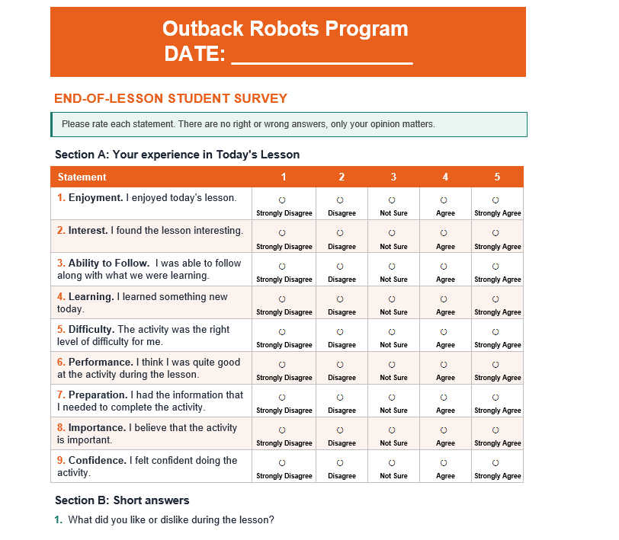
Survey

Slide 24
Summary
Sample script: “Ethics is how we decide what is right and wrong when the answer isn't obvious — it requires judgment, values, and empathy
AI cannot make ethical decisions on its own because it has no feelings, no judgment, and no understanding of consequences
Bias in AI comes from the data it was trained on — if that data is unrepresentative, the AI will reproduce that unfairness at scale
The AI is not being deliberately unfair — it simply reflects the limitations and gaps in what it was taught
Humans must remain responsible for the ethical consequences of AI decisions — including the people who build it, use it, and deploy it”

Slide 25
Summary
What is ethics?
AI can’t make ethical decisions
Bias comes form the data the tool was trained on
We need to be the ones responsible for ensuring AI use and decisions are ethical!

