Slide 1
ECOMMERCE
ADMIN
USER

Slide 2
BEGINNER LEVEL DISCUSSION
ADMIN & USER:
Single server:
1) Categories
2) Products
3) Add to cart
4) Orders
5) Profile(both User & Admin)
6) API calls (both User & Admin)

Slide 3
BEGINNER LEVEL DISCUSSION
Client Side:[Different Port]
ADMIN:
1) Register
2) Login
3) Manage
i) User roles
ii) Users
iii) Categories
iv) Products
v) Profile
4) Individual port
User:
1) Register
2) Login
3) Forgot Password
4) Search Products according to available categories and sub categories
5) Manage Add to cart
6) View Order and its status
7) Track order
8) Profile
9) Individual Port

Slide 4
BEGINNER LEVEL DISCUSSION
ADMIN:
Manage Categories
Manage Main Category
List
View
Create
Update
Delete(Active/Inactive)
Manage Sub Category
List
View
Create
Update
Delete(Active/Inactive)
Manage Products
List
View
Create
Update
Delete(Available/Out of stock)
Manage Orders
List
View
Update(date of delivery and status)
Track Order

Slide 5
BEGINNER LEVEL DISCUSSION
ADMIN:
Manage Roles:
List
View
Create
Update
Delete(Active/Inactive)
Manage Profile
Update
View
Dashboard Activities
View:
Total Orders
Pending Orders
Total Customers
Total Products
Manage Users
List
View
Create
Update
Delete(Active/Inactive)

Slide 6
BEGINNER LEVEL DISCUSSION
ADMIN/USER (SERVER SIDE):
• Shared Server: Admin and User backends run on the same server and port.
• Admin Controls: Full access to manage products, users, categories, and orders.
• Admin-Specific Operations:
• User Management: Admin can add, view, edit, or deactivate User accounts.
• Product Management: Admin can add, edit, and deactivate products.
• Category/Subcategory Management: Admin can create, edit, and deactivate categories and subcategories. • Order Management: Admin can view, confirm, and update order statuses (e.g., Confirmed, Shipped, Delivered).
• Admin's changes (e.g., product availability, order status) are reflected immediately for users.
• User-Specific Operations:
• Registration/Login/Forgot Password: Users can create accounts, login, and reset passwords. • Product Browsing: Users can view categories, subcategories, and individual products.
• Cart Management: Users can add or remove items from the cart.
• Order Placement: Users can proceed to checkout and place orders for items in their cart.
• Order Tracking: Users can track the status of their orders (e.g., Pending, Shipped, Delivered). • Real-Time Sync: Changes made by the Admin (order status) are instantly updated on the User’s side.

Slide 7
BEGINNER LEVEL DISCUSSION
ADMIN (CLIENT):
• Separate Port: Admin’s frontend runs on a different port.
• Admin UI: User interface for managing products, users, categories, and orders.
• Updates: Any change made by the Admin (order status, product availability) is instantly reflected on the User side.
• Admin Dashboard: Real-time metrics for total orders, total customers, total pending Orders, total products.
USER(CLIENT):
• Separate Port: User's frontend runs on a different port.
• User Interface (UI): A dynamic and engaging interface for browsing products, adding to cart, and managing orders.
• Product Availability: Users can view real-time product availability (e.g., In Stock, Out of Stock).
• Real-Time Updates: When Admin updates product status or order status, users can see the changes reflected in real time.
Example: If Admin marks an order as "Shipped," the user sees the updated status instantly.
• Order Placement: Users can proceed to checkout and place orders.
• Order Tracking: Users can track the status of their orders and see expected delivery dates.
Cart Management: Users can add products to their cart and remove them as needed.

Slide 8
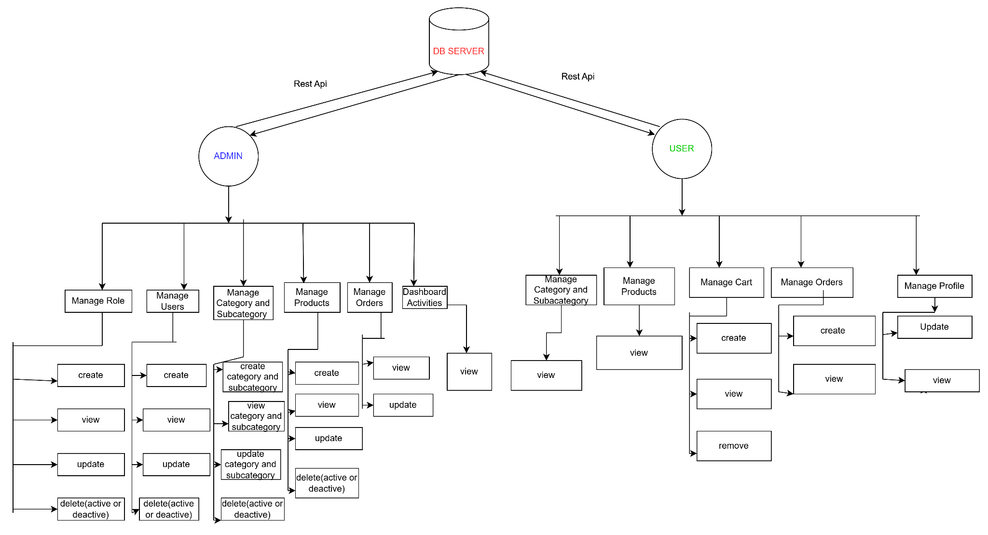
ARCHITECTURE:

Slide 9
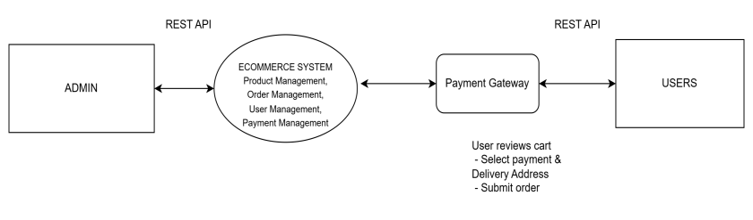
LEVEL- 0 -DFD
• ECOMMERCE SYSTEM: An online shopping platform where users can browse products, add them to the cart, make secure payments, track their orders.
• Admin: Manages products, orders, users, and finances and updating the users order status.
• User: Browses products, adds items to the cart, places orders, and tracks order status

Slide 10
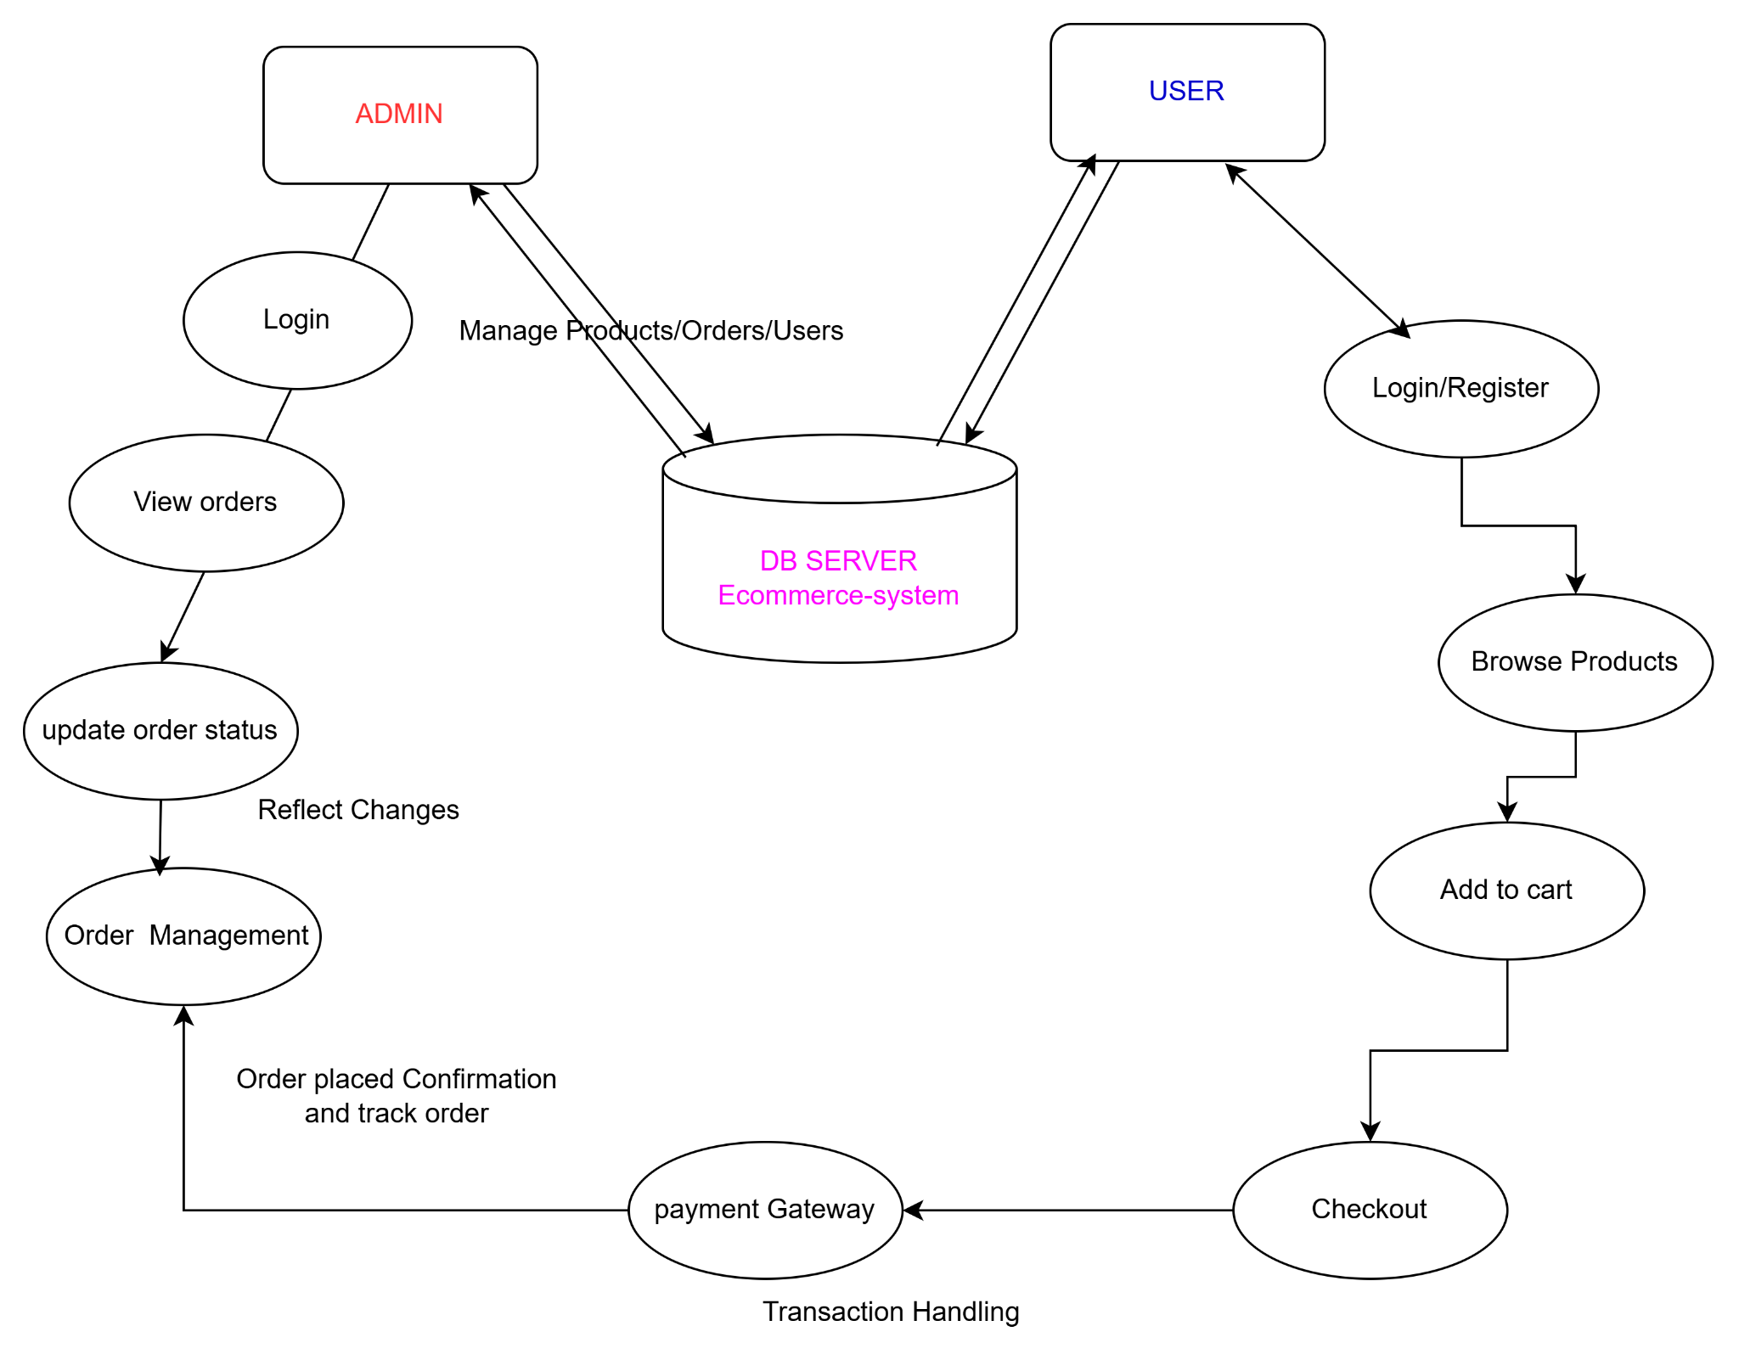
LEVEL-1-DFD

Slide 11
LEVEL-1-DFD
1. User Login (JWT Authentication)
• User logs in with credentials.
• Server validates and generates a JWT token.
• The token is stored and used for accessing protected routes.
• 2. Browse Products
• User selects categories and subcategories.
• Products are displayed .
• User can view product details (images, price, description).
• 3. Add to Cart
• User adds desired products to the cart.
• Cart is updated with product details (quantity, price).
• 4. Manage Cart
• User views cart items.
• 5. Review Cart & Place Order
• User reviews the cart.
• User adds delivery address and confirms order.

Slide 12
LEVEL-1-DFD
• 6. Make Payment
• User selects a payment method.
• User enters payment details and confirms the transaction.
• 7. Admin Order Management
• Admin views all orders placed by users.
• Admin can update the order status (e.g., processing, shipped). • Admin can set or update the expected delivery date.
• 8. User Order Tracking
• User tracks the status of their order.
• Real-time updates are provided on order progress and delivery status.
• User can remove or update quantities of items in the cart.

Slide 13
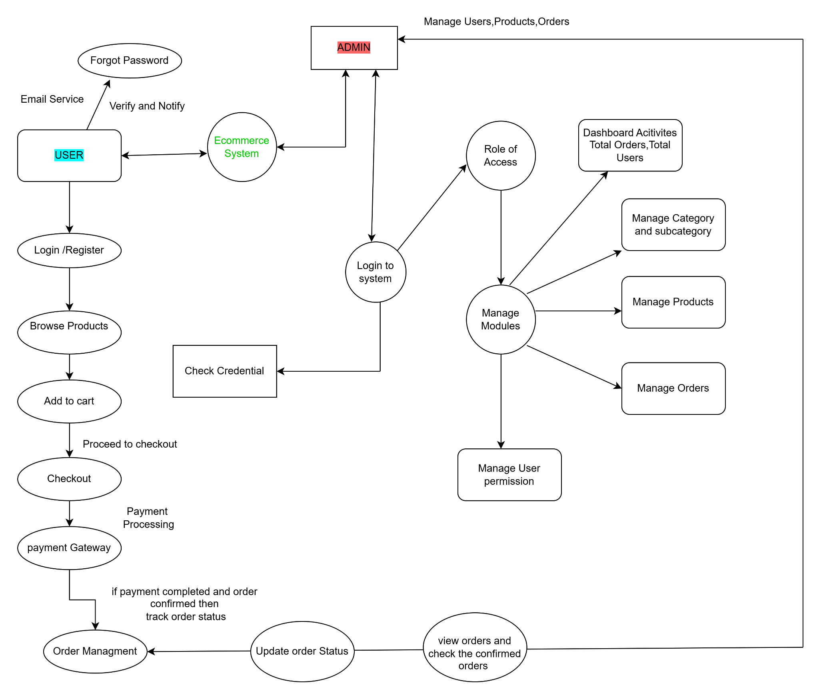
LEVEL-2-DFD

Slide 14
LEVEL-2-DFD
1. Admin Login & Role Management
• Admin logs in using credentials (username/password).
• The server validates the credentials and generates a JWT token for authentication.
• Admin manages user roles (add/deactivate roles) and sets access permissions for different users. 2. Admin Product Management
• Admin adds products with detailed information (name, description, price, images, etc.).
• Admin can edit, activate, or deactivate products, including managing product stock availability. • Admin sets exchange and refund policies for products.
3. Admin Category/Subcategory Management
• Admin can add, edit, or deactivate product categories and subcategories.
4. Admin User Management
• Admin adds new users, sets roles, and can deactivate users as needed.

Slide 15
LEVEL-2-DFD
5. User Login (JWT Authentication)
• User logs in using their credentials (username/password).
• The server validates the credentials and generates a JWT token for accessing protected routes in the web application.
• User Browse Products(Products are displayed with details (name, description, price, images, etc.). • User selects categories and subcategories to browse available products.
6. User Add to Cart
• User adds desired products to the cart.
• The cart updates with selected items, displaying quantity and price.
7.User Review Cart & Place Order
• User reviews the items in the cart and confirms the order.
• User adds a delivery address and proceeds to place the order.

Slide 16
LEVEL-2-DFD
8. User Make Payment
• User selects a payment method (credit card, debit card, etc.).
• Payment details are entered, and the user confirms the transaction.
9. Admin Order Management
• Admin views all orders placed by users.
• Admin updates order status (e.g., processing, shipped, delivered).
• Admin sets the expected delivery date.
10.User Order Tracking
• User tracks the status of their order (pending, shipped, delivered).
• Real-time updates on the order progress and expected delivery are provided.

