Slide 1

Course Project: Maximal Non-Branching Paths Course: 19BIO201-Intelligence of Biological Systems 3
Team Members
Apoorva M – BL.EN.U4AIE19007
Bhuvanashree M – BL.EN.U4AIE19010
Sai Nikhilesh Reddy – BL.EN.U4AIE19027
Mentor
Dr. S. Santhanalakshmi
Asst. Professor
Computer Science Engineering
ASE-Bangalore
Mentor
Dr. Amrita Thakur
Asst. Professor
Department of Chemistry
ASE-Bangalore

Slide 2
What are Maximal Non-Branching Paths?
A node in a directed Graph is called a 1-in-1-out node if its indegree andoutdegree are both equal to 1.
A path whose internal nodes are 1-in-1-out nodes and whose initial and final nodes are not 1-in-1-out nodes.
In our implementation, we account for isolated cycles where all nodes are 1-in-1-out nodes

Slide 3
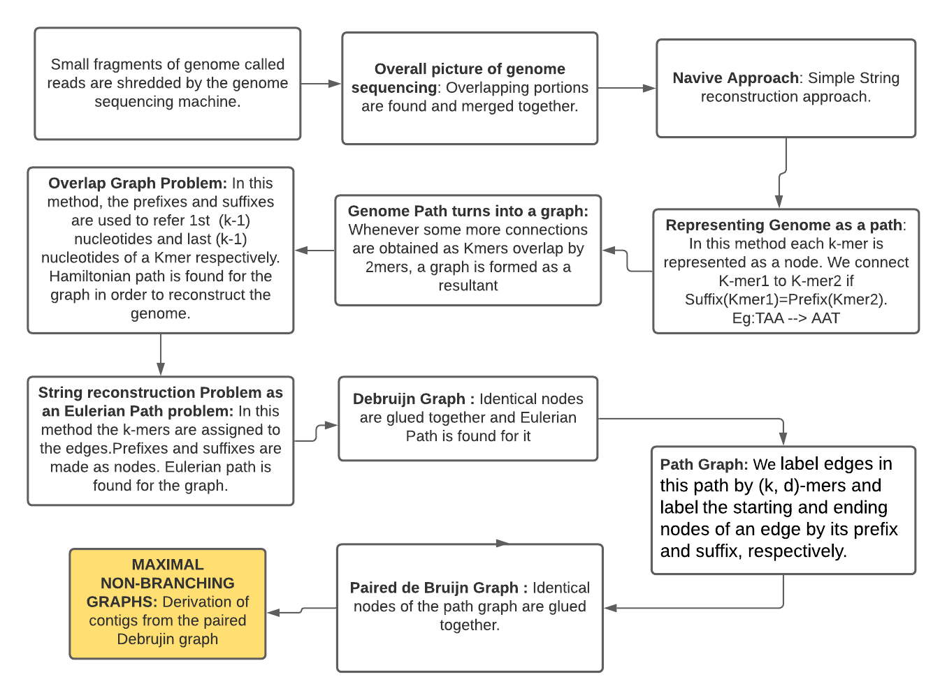
Flowchart

Slide 4
Flowchart

Slide 5
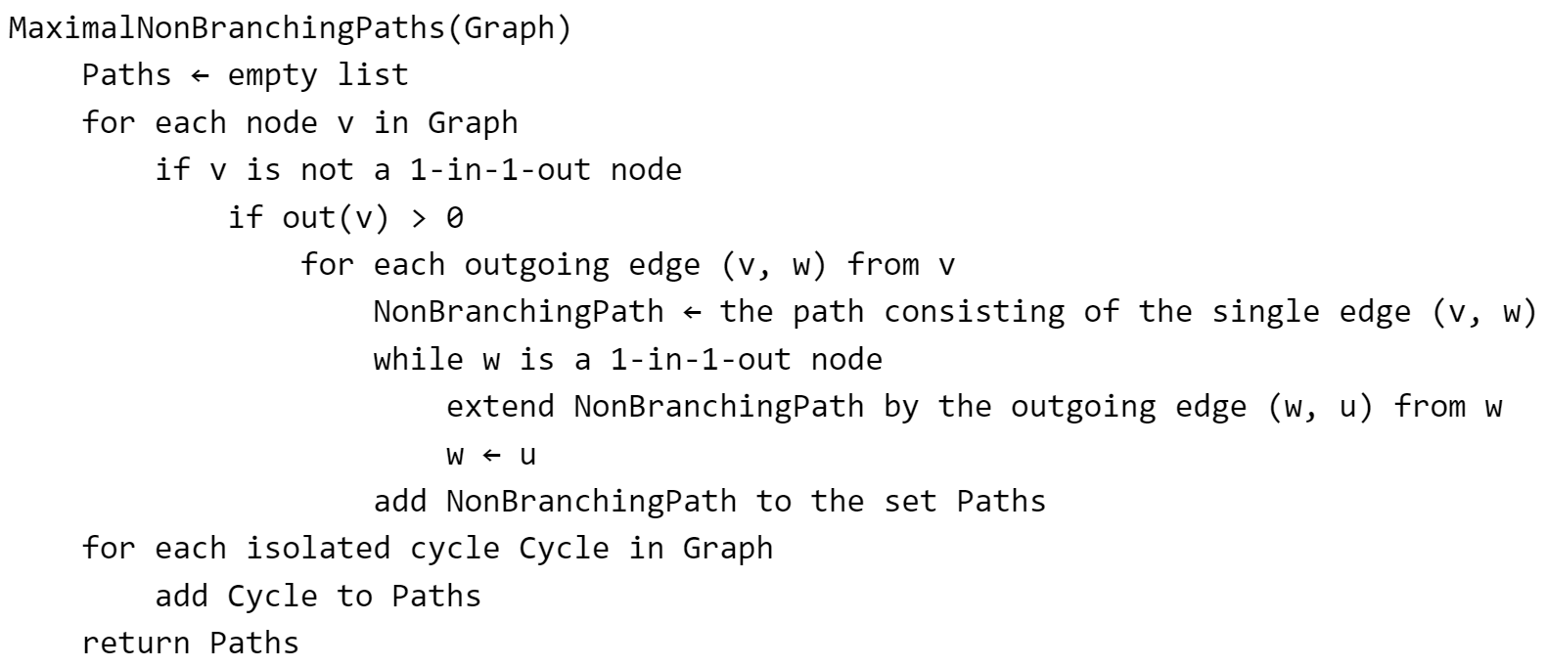
Pseudocode

