Slide 1

Course Project: Position, Velocity and Static Force Analysis of Koppelrastgetriebe Mechanism Course: 19PHY113/Computational Engineering Mechanics - 2
Mentor:
Mr. Rajeevlochana G. Chittawadigi
Dept. of Mech. Engg.
ASE-Bengaluru
Team 11: Members
Bhuvanashree Murugadoss BL.EN.U4AIE19010
Karna Sai Nikhilesh Reddy BL.EN.U4AIE19027
Kode Jai Surya BL.EN.U4AIE19030

Slide 2
Introduction
The course Computational Engineering Mechanics laid the foundation for engineering mechanics by providing a connection between mechanics and computational thinking.
Robotics is one of the major areas where AI is applied, hence understanding the fundamentals of Robotics becomes crucial for us, the students of the branch – Artificial Intelligence Engineering.
Hence, mechanisms, which are the fundamental building blocks of robots/machines, need to be studied in detail.
Through this project we aim to assess the knowledge we have gained through the course of our year-long study of Computational Engineering Mechanics.
We will be applying the knowledge we gained, to perfom Position, Velocity and Static Force Analysis of Koppelrastgetriebe Mechanism

Slide 3
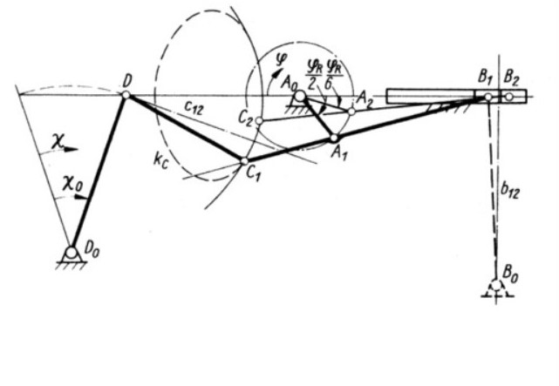
Description of the Mechanism
Mechanism consists of 6 links and 7 joints:
There are total of 6 rotatory joints and 1 prismatic joint.
Rotatory joints are present at R_{12,} R_{23,} R_{35,} R₅₆ ,R₅₁ , and R_{34.}
Prismatic joint is present at Slider P₃₄ (Link #4).
Fig : Koppelrastgetriebe Mechanism

Slide 4
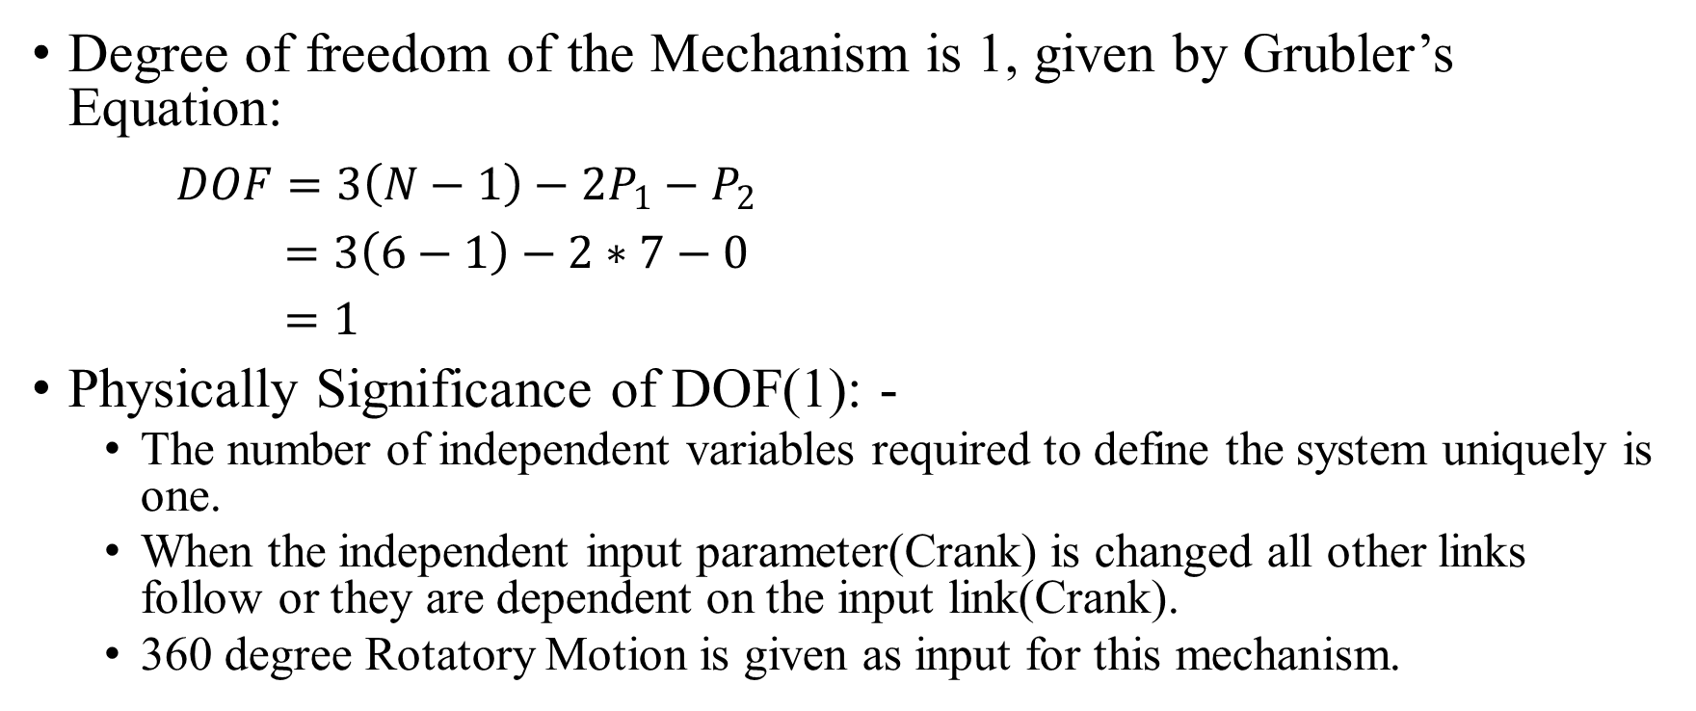
Description of the Mechanism
Degree of freedom of the Mechanism is 1, given by Grubler’s Equation:
$DOF=3\left(N−1\right)−2P_{1}−P_{2}$
$=3\left(6−1\right)−2∗7−0$
$=1$
Physically Significance of DOF(1): -
The number of independent variables required to define the system uniquely is one.
When the independent input parameter(Crank) is changed all other links follow or they are dependent on the input link(Crank).
360 degree Rotatory Motion is given as input for this mechanism.

Slide 5
Position Analysis of Koppelrastgetriebe Mechanism :
Gif : Website Animation of Koppelrastgetriebe Mechanism
Gif : MATLAB animation of Koppelrastgetriebe Mechanism

Slide 6
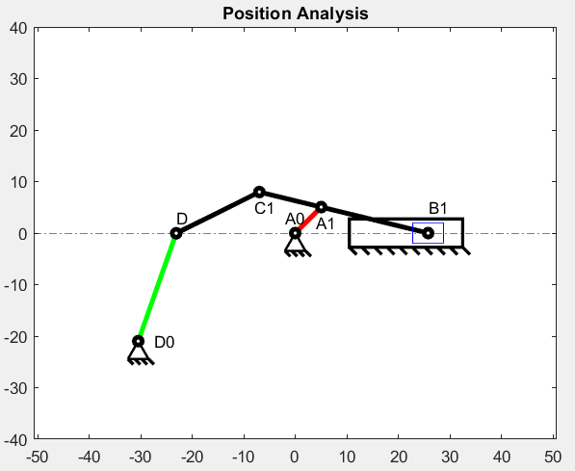
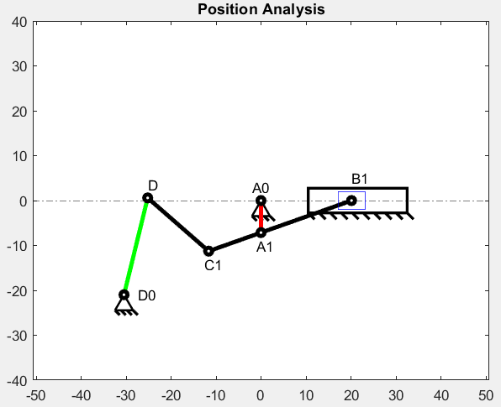
Positional Analysis – Usage of Intersection Algorithms
Line-Circle Intersection:
To get point of the slider, we provided Point A1 coordinates, Sliding path and Length of the Follower.
Circle-Circle Intersection:
To get Point D, we provided Point C1, length of Link #5(C1D), Point D0 and length of Link #6(D0D).
Fig : Crank angle 45 degree
Fig : Crank angle 270 degree

Slide 7
Positional Analysis – MATLAB Code Explanation and Demostration

Slide 8
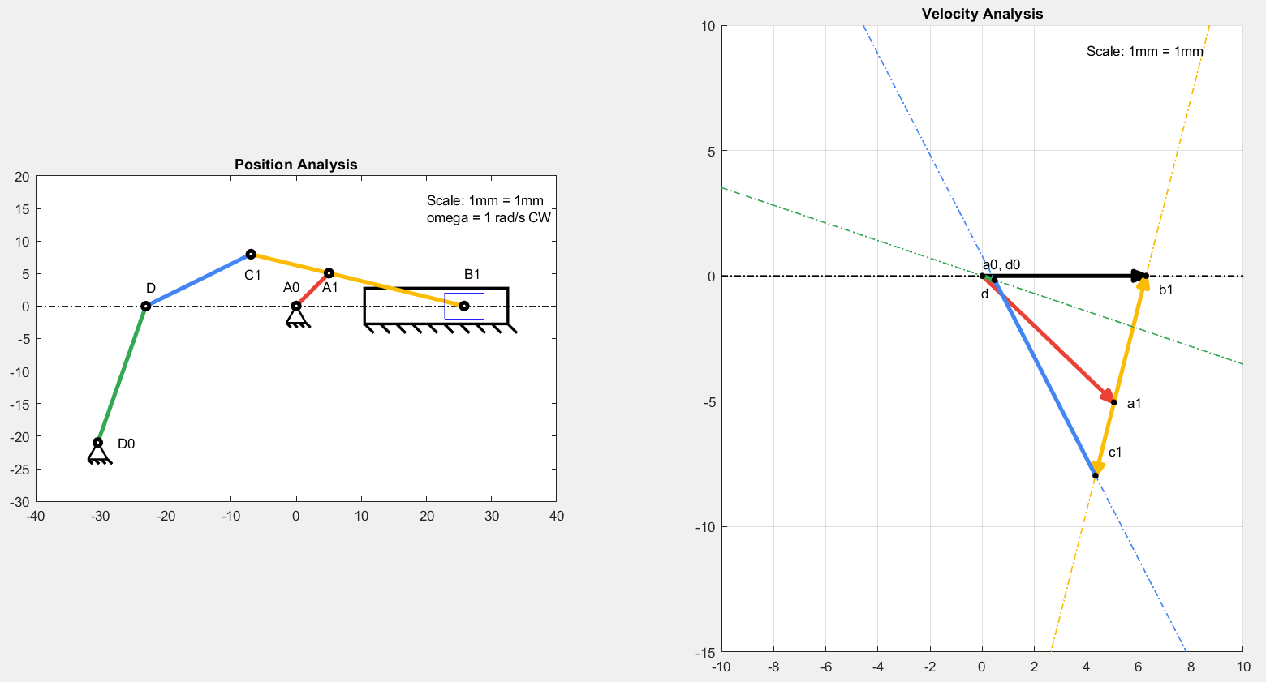
Velocity Analysis of Koppelrastgetriebe Mechanism:
Fig : Crank angle 45 degree
Fig : MATLAB Velocity Analysis output of Koppelrastgetriebe Mechanism

Slide 9
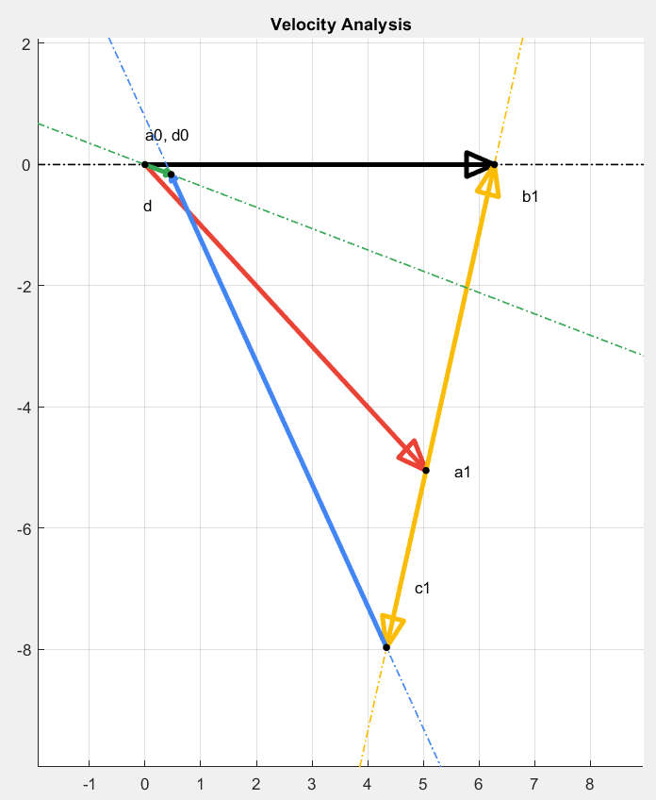
Velocity Analysis – Usage of Intersection Algorithms
Line-Line Intersection:
To get point b1 in velocity polygon, we provided a construction line perpendicular to link A1B1 and passing through A1; a construction line parallel to x-axis and passing through A0.
To get point d in velocity polygon, we provided a construction line perpendicular to link C1D and passing through C1; a construction line perpendicular to link D0D and passing through D0.
Fig : MATLAB Velocity Analysis output (Crank angle 45 degree)

Slide 10
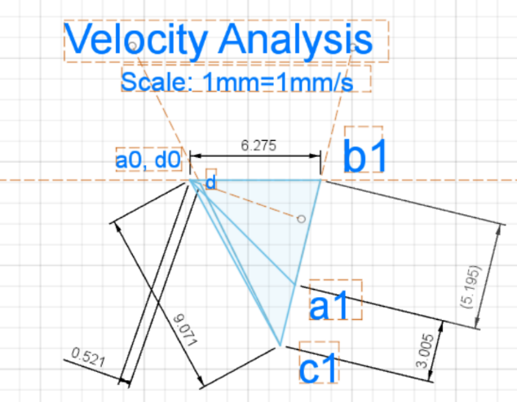
Velocity Analysis- Validation of Results using Fusion Model: For input crank angle = 45 degrees
Result Obtained from MATLAB: | Result Obtained from Fusion Model:
Absolute Velocities: Velocity of a1 wrt a0 = 7.1380 mm/s Velocity of b1 wrt a0 = 6.2751 mm/s Velocity of c1 wrt a0 = 9.0713 mm/s Velocity of d wrt a0 = 0.4964 mm/s Relative Velocities: Velocity of b1 wrt a1 = 5.1945 mm/s Velocity of c1 wrt a1 = 3.0052 mm/s Velocity of d wrt c1 = 8.7090 mm/s | Absolute Velocities: Velocity of a1 wrt a0 = 7.138 mm/s Velocity of b1 wrt a0 = 6.275 mm/s Velocity of c1 wrt a0 = 9.071 mm/s Velocity of d wrt a0 = 0.521 mm/s Relative Velocities: Velocity of b1 wrt a1 =5.195 mm/s Velocity of c1 wrt a1 = 3.005 mm/s Velocity of d wrt c1 = 8.692 mm/s
Table : Comparison with MATLAB and Fusion Velocity Analysis values.
Fig : Fusion Velocity Analysis output (Crank angle 45 degree)

Slide 11
Velocity Analysis – MATLAB Code Explanation and Demostration

Slide 12
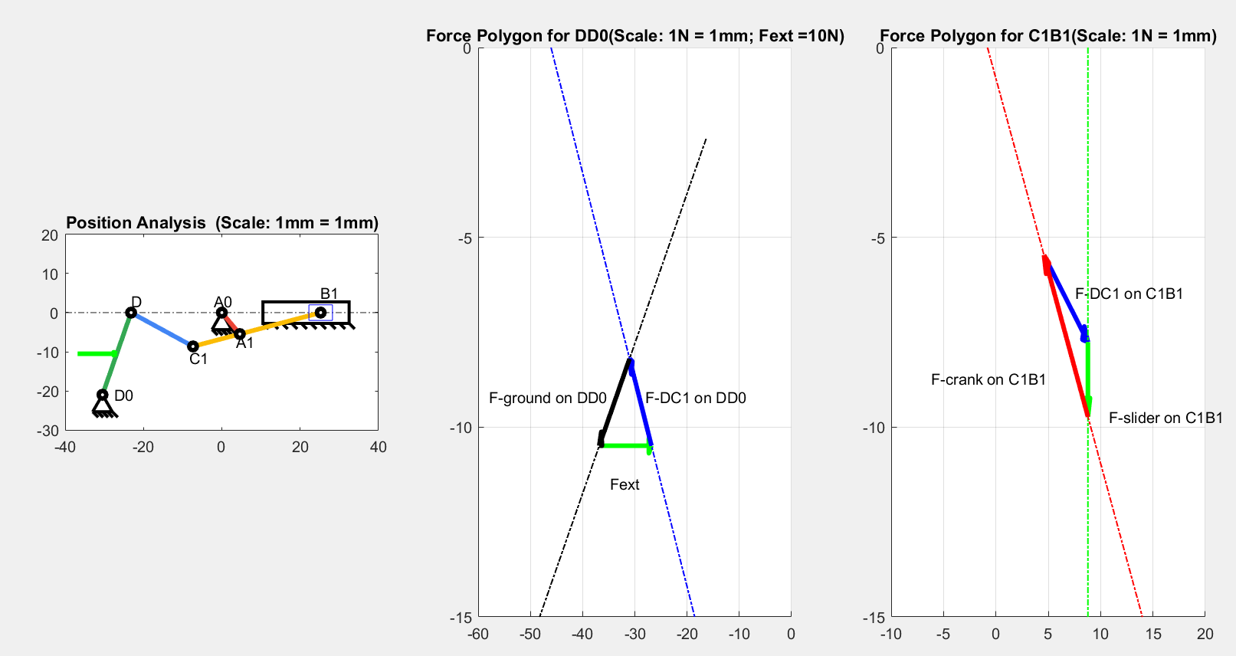
Static Force Analysis of Koppelrastgetriebe Mechanism :

Slide 13
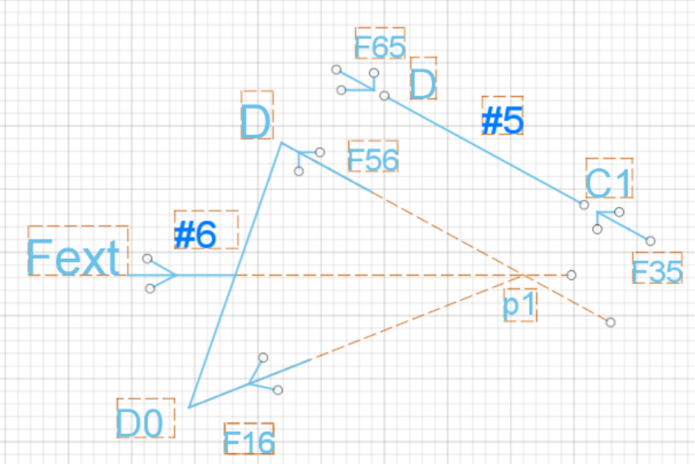
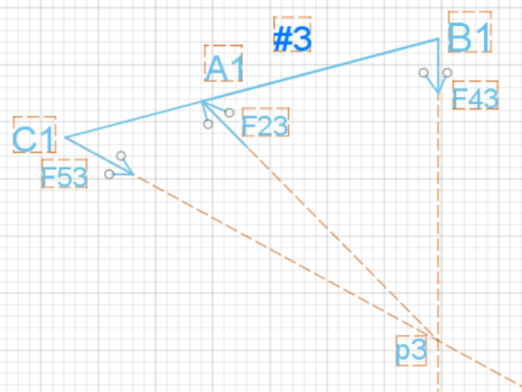
Free body Diagram of Links:
Fext force = 10N; direction = +ve X-axis

Slide 14
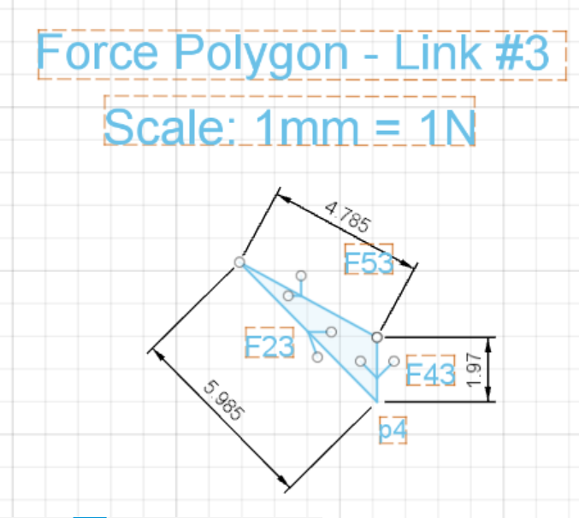
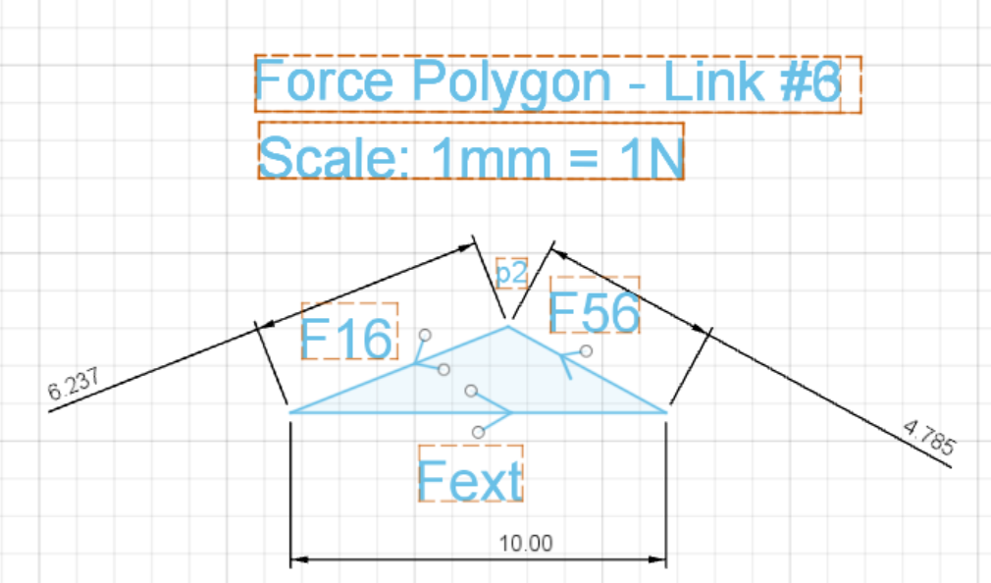
Static Force Analysis of Koppelrastgetriebe Mechanism : Force Polygons Obtained

Slide 15
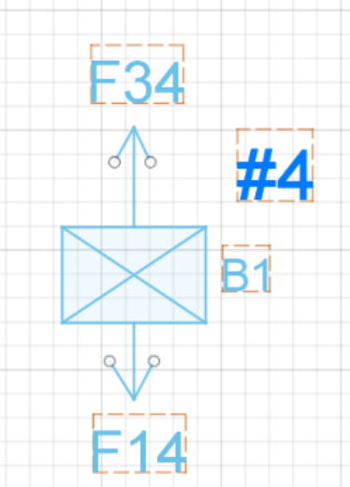
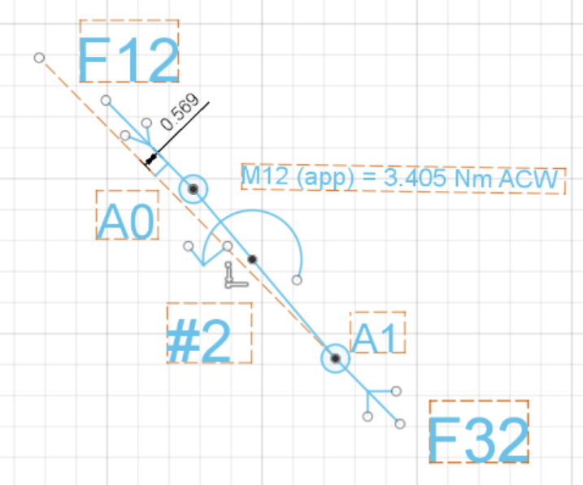
Free body Diagram of Links:
Fext force = 10N; direction = +ve X-axis

Slide 16
Static Force Analysis of Koppelrastgetriebe Mechanism : Verification of result obtained
Result Obtained from MATLAB: | Result Obtained from Fusion Model:
The applied external force on DD0 is: 10.00 N The reaction force of C1D on DD0 is: 4.7865 N The reaction force of ground on DD0 is: 6.2343 N The reaction force of C1D on C1B1 is: 4.7865 N The reaction force of slider on C1B1 is: 1.9699 N The reaction force of A0A1 on C1B1 is: 5.9850 N The reaction force of C1B1 on A0A1 is: 5.9850 N The moment acting on A0A1 is: -3.424596 Nm in Clockwise sense. We need to apply a moment of 3.424596 Nm in Anti-Clockwise sense on A0A1 to keep the mechanism in Static Equilibrium | The applied external force on DD0 is: 10.00 N The reaction force of C1D on DD0 is: 4.785 N The reaction force of ground on DD0 is: 6.237 N The reaction force of C1D on C1B1 is: 4.785 N The reaction force of slider on C1B1 is: 1.97 N The reaction force of A0A1 on C1B1 is: 5.985 N The reaction force of C1B1 on A0A1 is: 5.985 N The moment acting on A0A1 is: -3.405 Nm in Clockwise sense. We need to apply a moment of 3.405 Nm in Anti-Clockwise sense on A0A1 to keep the mechanism in Static Equilibrium

Slide 17
Static Force Analysis – MATLAB Code Explanation and Demostration

Slide 18
Conclusion
We have performed Position, Velocity and Static Force Analysis of Koppelrastgetriebe Mechanism in MATLAB and verified the results using geometric drawings in Fusion360
Through the course of developing the project we have gained a basic understanding on how a mechanism can be analysed to know its working.
Also, we have developed skills to design and animate a given mechanism's position, velocity and static force analysis.

