Slide 1
Browsersync
For multi-system development

Slide 2
Browser Combinations to Support
Chrome
IE & Edge
Safari
Windows 10
Windows 8
Windows 7
Android
Chromebook
OS X
Linux (Ubuntu)
Windows 10
Windows 8
Windows 7
Windows Phone
OS X
iOS
Other
Firefox
OS X
Windows
Linux (Ubuntu)

Slide 3
Resolutions and Orientations
No orientation
Portrait
Landscape
Mac Mini (Safari 1920x1080)
MacBook Pro (Safari 1280x800)
Ubuntu 16.04 LTS (Firefox 1366x768)
Windows 10 (IE & Edge 1024x768)
iPhone 5 (Safari 320x568)
iPhone 5S (Safari 320x568)
iPad II (Safari 768x1024)
Alcatel onetouch Evolve 2 (Android – Chrome 320x534)
Nokia Lumia 635 (Windows Phone – Edge 357x595)
iPhone 5 (Safari 568x320)
iPhone 5S (Safari 568x320)
iPad II (Safari 1024x768)
Alcatel onetouch Evolve 2 (Android – Chrome 534x320)
Nokia Lumia 635 (Windows Phone – Edge 595x357)

Slide 4
Easiest way to play: install an existing project with it
$ brew install yarn
$ yarn --version
$ git clone -o react-starter-kit -b master --single-branch https://github.com/kriasoft/react-starter-kit.git MyApp
$ cd MyApp
$ yarn install
$ yarn start

Slide 5
CSS @media queries made simpler with Browsersync
/* iPhone 5 and 5S in Portrait orientation */
@media only screen
and (min-device-width : 320px)
and (max-device-width : 568px)
and (orientation : portrait) {
/* STYLES GO HERE */
}

Slide 6
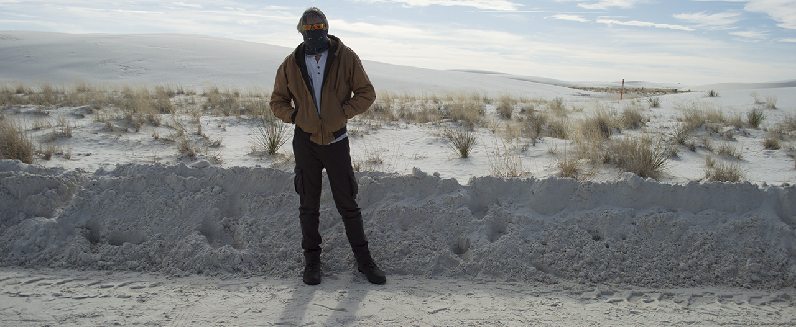
https://github.com/OutsourcedGuru/browserSync-Talk
See also the Browsersync-enabled example at https://github.com/kriasoft/react-starter-kit

