Slide 1
Controlling Thermostats in JavaScript
JavaScript => Ecobee digital thermostats

Slide 2

developer.ecobee.com
1+ Ecobee thermostats, registered
User registered as a developer
Node.js server
Web-based client (like a smartphone)

Slide 3
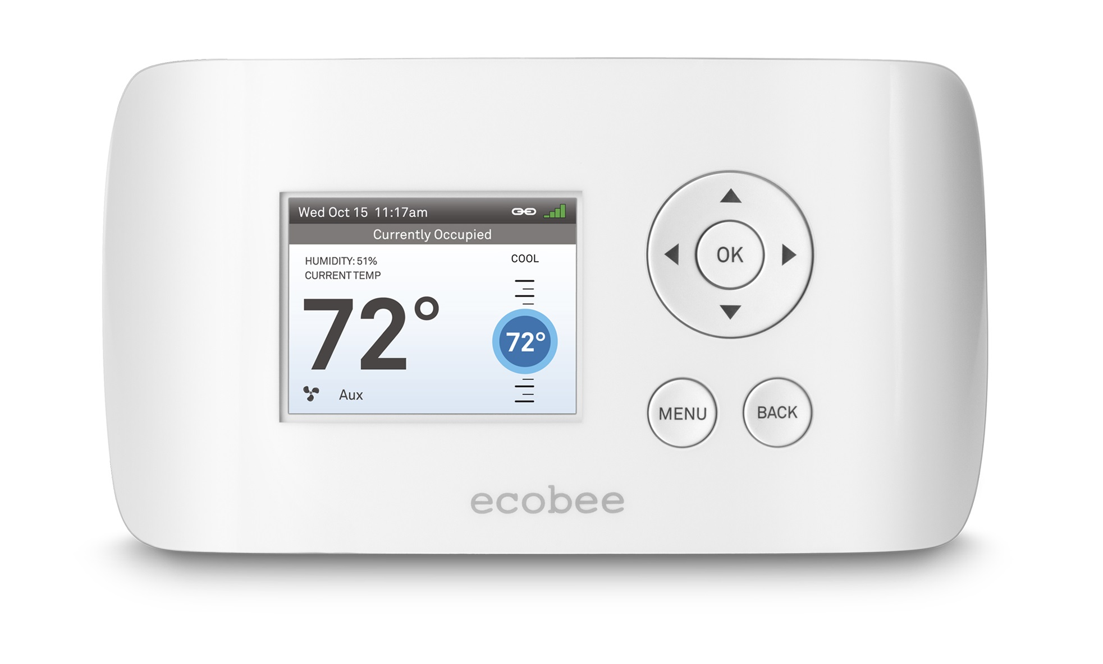

Slide 4
Installation (+/- aFewDetails)
c:\sites\> git clone https://github.com/OutsourcedGuru/ecobee-app.git
c:\sites\> cd ecobee-app & npm install
# Edit /config.js (see README.md)
c:\sites\ecobee-app> npm start
c:\sites\ecobee-app> open http://localhost:3000
# Note the PIN request and authorize it here
c:\sites\ecobee-app> open http://www.ecobee.com
# Back in app’s website, click Complete Link

Slide 5
modules
express
http
should
ejs
expect.js

Slide 6

Copyleft Notice
2017 myJS.io
http://ecobee.com
Allowed Actions:
You are free to use for school, personal or business presentations. Your mileage may vary. This product is meant for educating porpoises only. Any resemblance to real or imaginary pollinators, living or lying moribund in a pool of honey, is purely coincidental. Void where prohibited, especially in Utah. Some assembly required. Batteries not included. Contents may settle during shipment. Use only as directed. All models over 18 years of age. If condition persists, consult your doctor. Wash hands after handling. This product contains chemicals known to the State of California to cause cancer and birth defects or other reproductive harm.
https://github.com/OutsourcedGuru
Sage-Fox.com Free PowerPoint Templates

