Slide 1
A Synesthetic Method of Teaching Music using JavaScript
Client-side JavaScript => colorized musical notation

Slide 2

github.com/OutsourcedGuru/vexflow-syn
Client-side JavaScript
Rendered to HTML5 canvas
Vexflow as the underlying renderer
Synesthesia-like experience for us

Slide 3
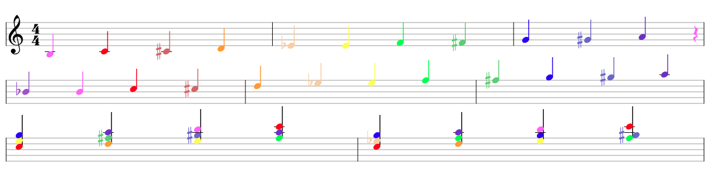
Chromatic scale from B -> A, major chords C, D, E & F followed by minor chord versions of same

Slide 4
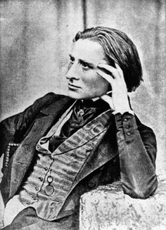
Synesthesia
“Synesthesia is a neurological phenomenon in which stimulation of one sensory or cognitive pathway leads to automatic, involuntary experiences in a second sensory or cognitive pathway.”
Franz Liszt, 19th-century composer and synesthete to the orchestra: “O please, gentlemen, a little bluer, if you please!” and “That is a deep violet, please, depend upon it! Not so rose!”

Slide 5
Installation
c:\sites\> git clone https://github.com/OutsourcedGuru/vexflow-syn.git
c:\sites\> cd vexflow-syn
c:\sites\vexflow-syn> open index.html
# or in Windows: “start index.html”

Slide 6

Copyleft Notice
2017 myJS.io
https://github.com/OutsourcedGuru/vexflow-syn
Allowed Actions:
You are free to use for school, personal or business presentations. Your mileage may vary. This product is meant for educating porpoises only. Any resemblance to real or imaginary music instructors, living or found in a pool of musical notation ink in the back room, is purely coincidental. Void where prohibited, especially in Utah. Some assembly required. Batteries not included. Contents may settle during shipment. Use only as directed. All models over 18 years of age. If condition persists, consult your doctor. Wash hands after handling. This product contains chemicals known to the State of California to cause cancer and birth defects or other reproductive harm.
https://github.com/OutsourcedGuru
Sage-Fox.com Free PowerPoint Templates

