Slide 1
Learning in Cooperative and Non-Cooperative Games: Electricity Market and Utilities

Slide 2
Main Concepts
SFE Model
Equilibrium
Utility Function
Model
What we intend to do?

Slide 3

SFE Model
Adapt better to the uncertain environment
Relates quantity to price
Price-quantity pairs
$λ_{i}=a_{i}q_{i}+β_{i}$

Slide 4
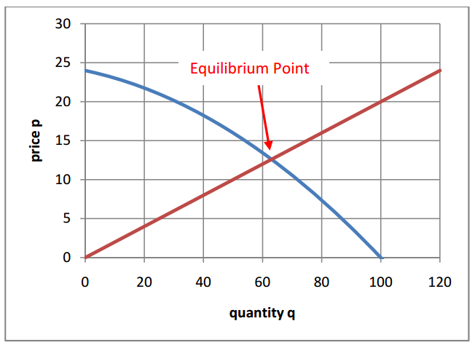
Equilibrium

Slide 5
Utility Function
For Customers:
Cost of Energy
Benefit of consuming energy
Several models have been developed
Based on electrical components
Based on generating a product

Slide 6
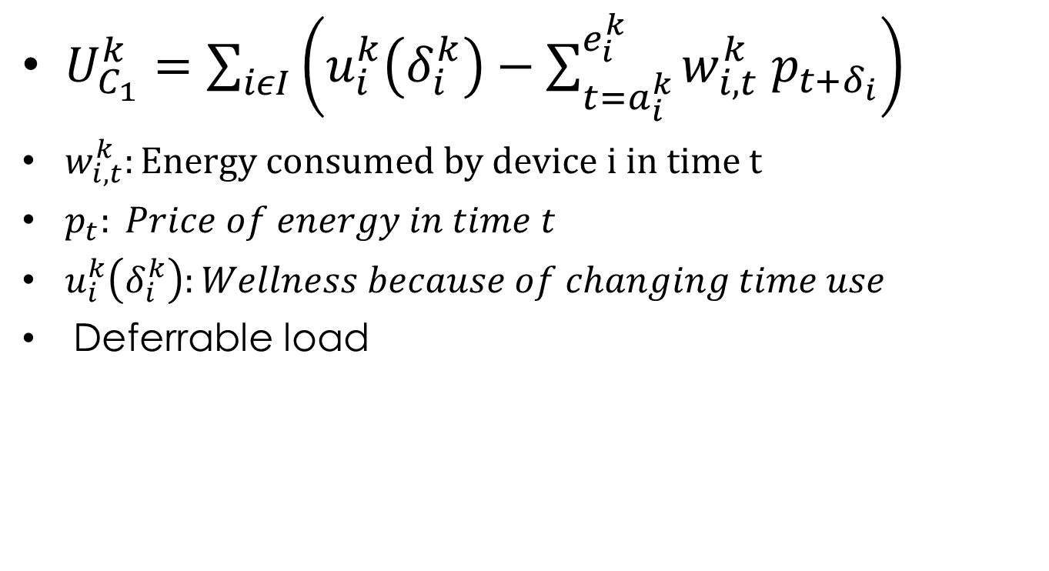
Utility Function
$U_{C_{1}}^{k}=\sum_{iεI}{\left(u_{i}^{k}\left(δ_{i}^{k}\right)−\sum_{t=a_{i}^{k}}^{e_{i}^{k}}{w_{i,t}^{k} p_{t+δ_{i}}}\right)}$
$w_{i,t}^{k}:Energy consumed by device i in time t$
$p_{t}: Price of energy in time t$
$u_{i}^{k}\left(δ_{i}^{k}\right):Wellness because of changing time use$
Deferrable load

Slide 7
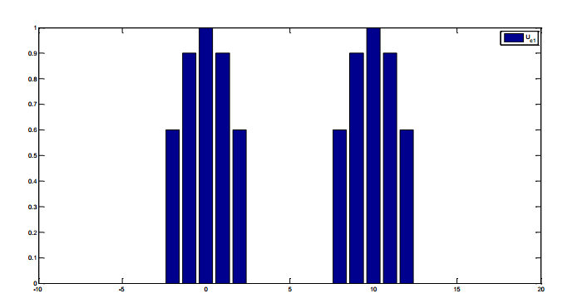
Utility Function

Slide 8
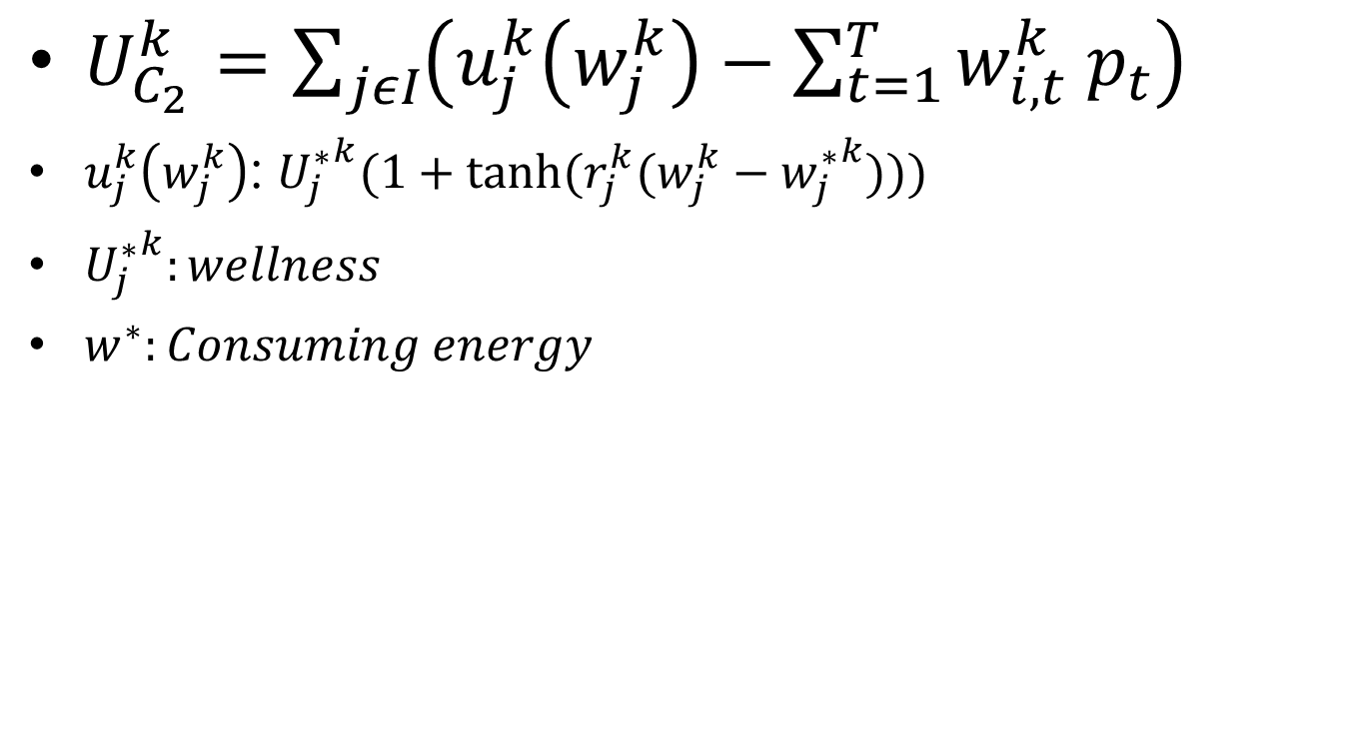
Utility Function
$U_{C_{2}}^{k}=\sum_{jεI}{\left(u_{j}^{k}\left(w_{j}^{k}\right)−\sum_{t=1}^{T}{w_{i,t}^{k} p_{t}}\right)}$
$u_{j}^{k}\left(w_{j}^{k}\right)$: ${U_{j}^{∗}}^{k}(1+tanh⁡(r_{j}^{k}(w_{j}^{k}−{w_{j}^{∗}}^{k})))$
${U_{j}^{∗}}^{k}:wellness$
$w^{∗}:Consuming energy$

Slide 9
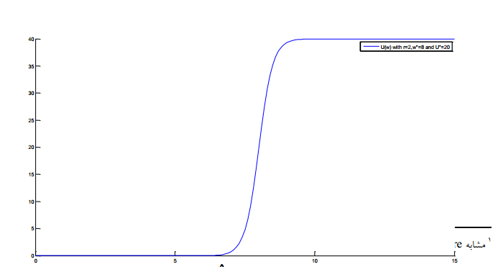
Utility Function

Slide 10
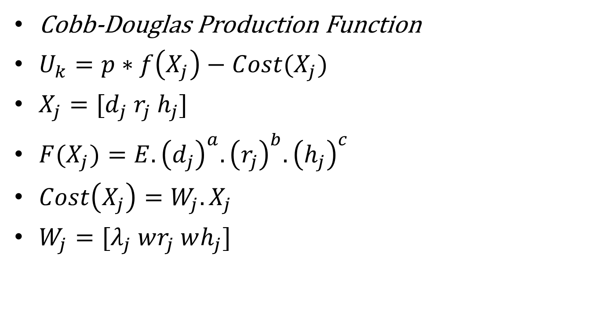
Utility Function
Cobb-Douglas Production Function
$U_{k}=p∗f\left(X_{j}\right)−Cost(X_{j})$
$X_{j}=[d_{j} r_{j} h_{j}]$
$F(X_{j})=E.{\left(d_{j}\right)}^{a}.{\left(r_{j}\right)}^{b}.{\left(h_{j}\right)}^{c}$
$Cost\left(X_{j}\right)=W_{j}.X_{j}$
$W_{j}=[λ_{j} wr_{j} wh_{j}]$

Slide 11
Model
Two distribution company
Two generation company
Each dist co. has two customers
Model of distribution co. & generation co. is SFE
Players do a cournot game with limited demand, also distribution company must get a benefit

Slide 12
Model
Gen Co. 1
Gen Co. 2
ISO
Dist Co. 1
Dist Co. 2

Slide 13
Model
Dist Co.i
Price
Demand
U1
U2
Utility Function
Utility Function

Slide 14
What we intend to do?
Game is non-cooperative:
Dist co. and Gen co. should propose SFE models
Utilities should propose demand
How does learning (Q-learning or SARSA)work?
Purposes:
Calculating NE
Learning optimal solution
Comparison between learning solution and NE
Game is cooperative
Utilities do a cooperative game
Calculating NBS
Do players get more benefit?
How does learning work here?
Comparison between learning solution and NE

Slide 15
Learning
Dist co. and Gen co.:
States?
MCP
Other players actions(needs more learning time)
Actions?
SFE model
Utilities:
States?
Opponent demands
Price
Both!
Actions:
Demand

Slide 16
Thanks for your attention

