Slide 1
Exploratory Data Analysis of Superstore Dataset
Insights for a New Business Venture in New York City
Olatula Adedamola Victoria
13/08/2025

Slide 2
Project Overview
• Objective To analyze Superstore sales data and extract actionable insights for launching a new business in New York City.
• Key Goals - Identify top-selling product categories and products - Analyze customer demographics and buying patterns - Examine seasonal trends and promotion effectiveness

Slide 3
Dataset Summary
•Time Period Covered: January 2016 – December 2019
• Number of Rows: 9,994
• Number of Columns: 21

Slide 4
Geographic Scope Analysis
• Number of countries: 1
• Number of states: 49
• Number of cities: 531

Slide 5
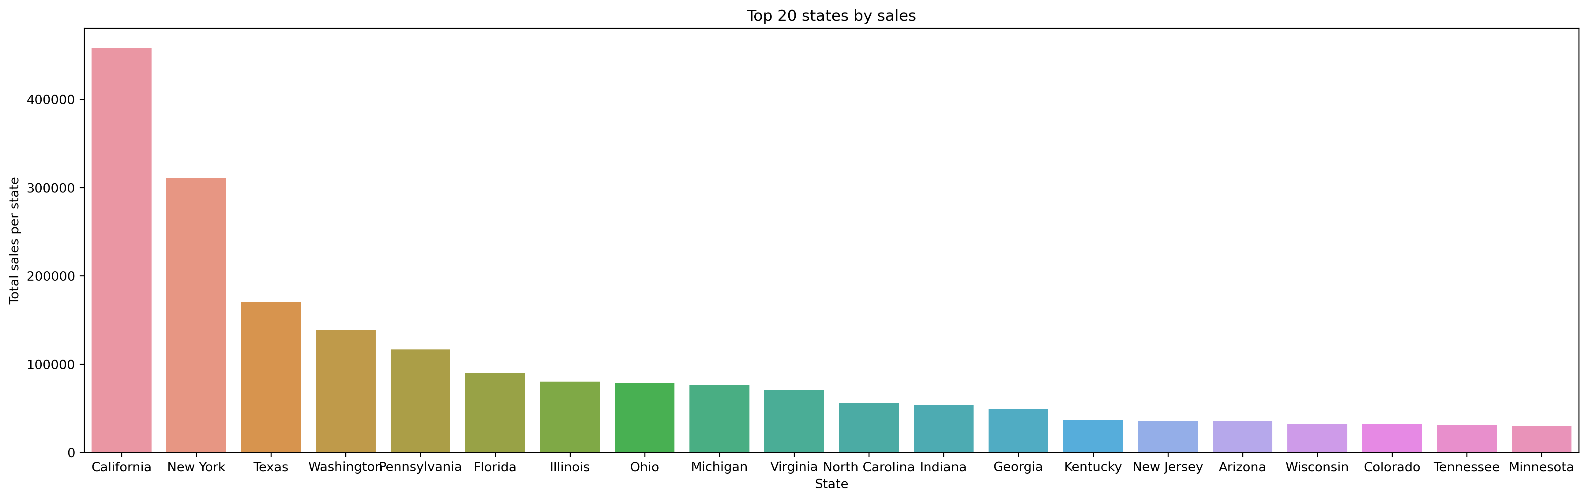
Top 20 States by Total Sales

Slide 6
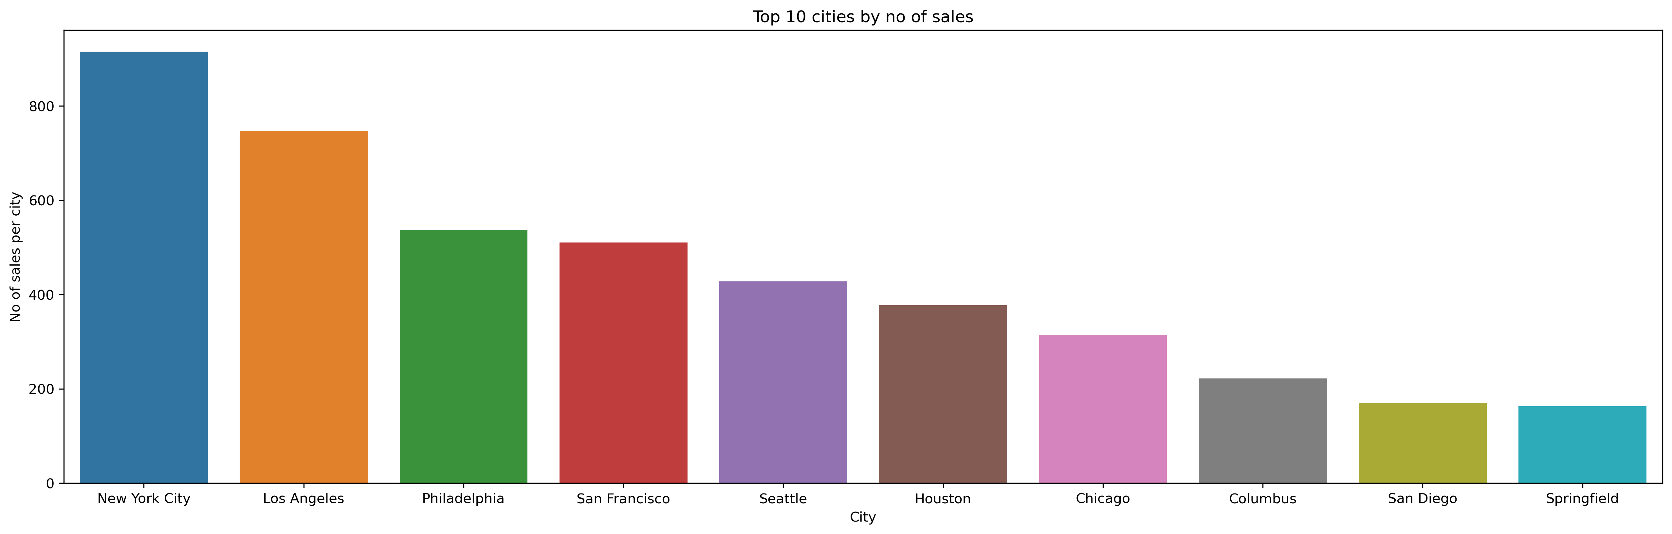
Top 10 Cities by Number of Sales

Slide 7
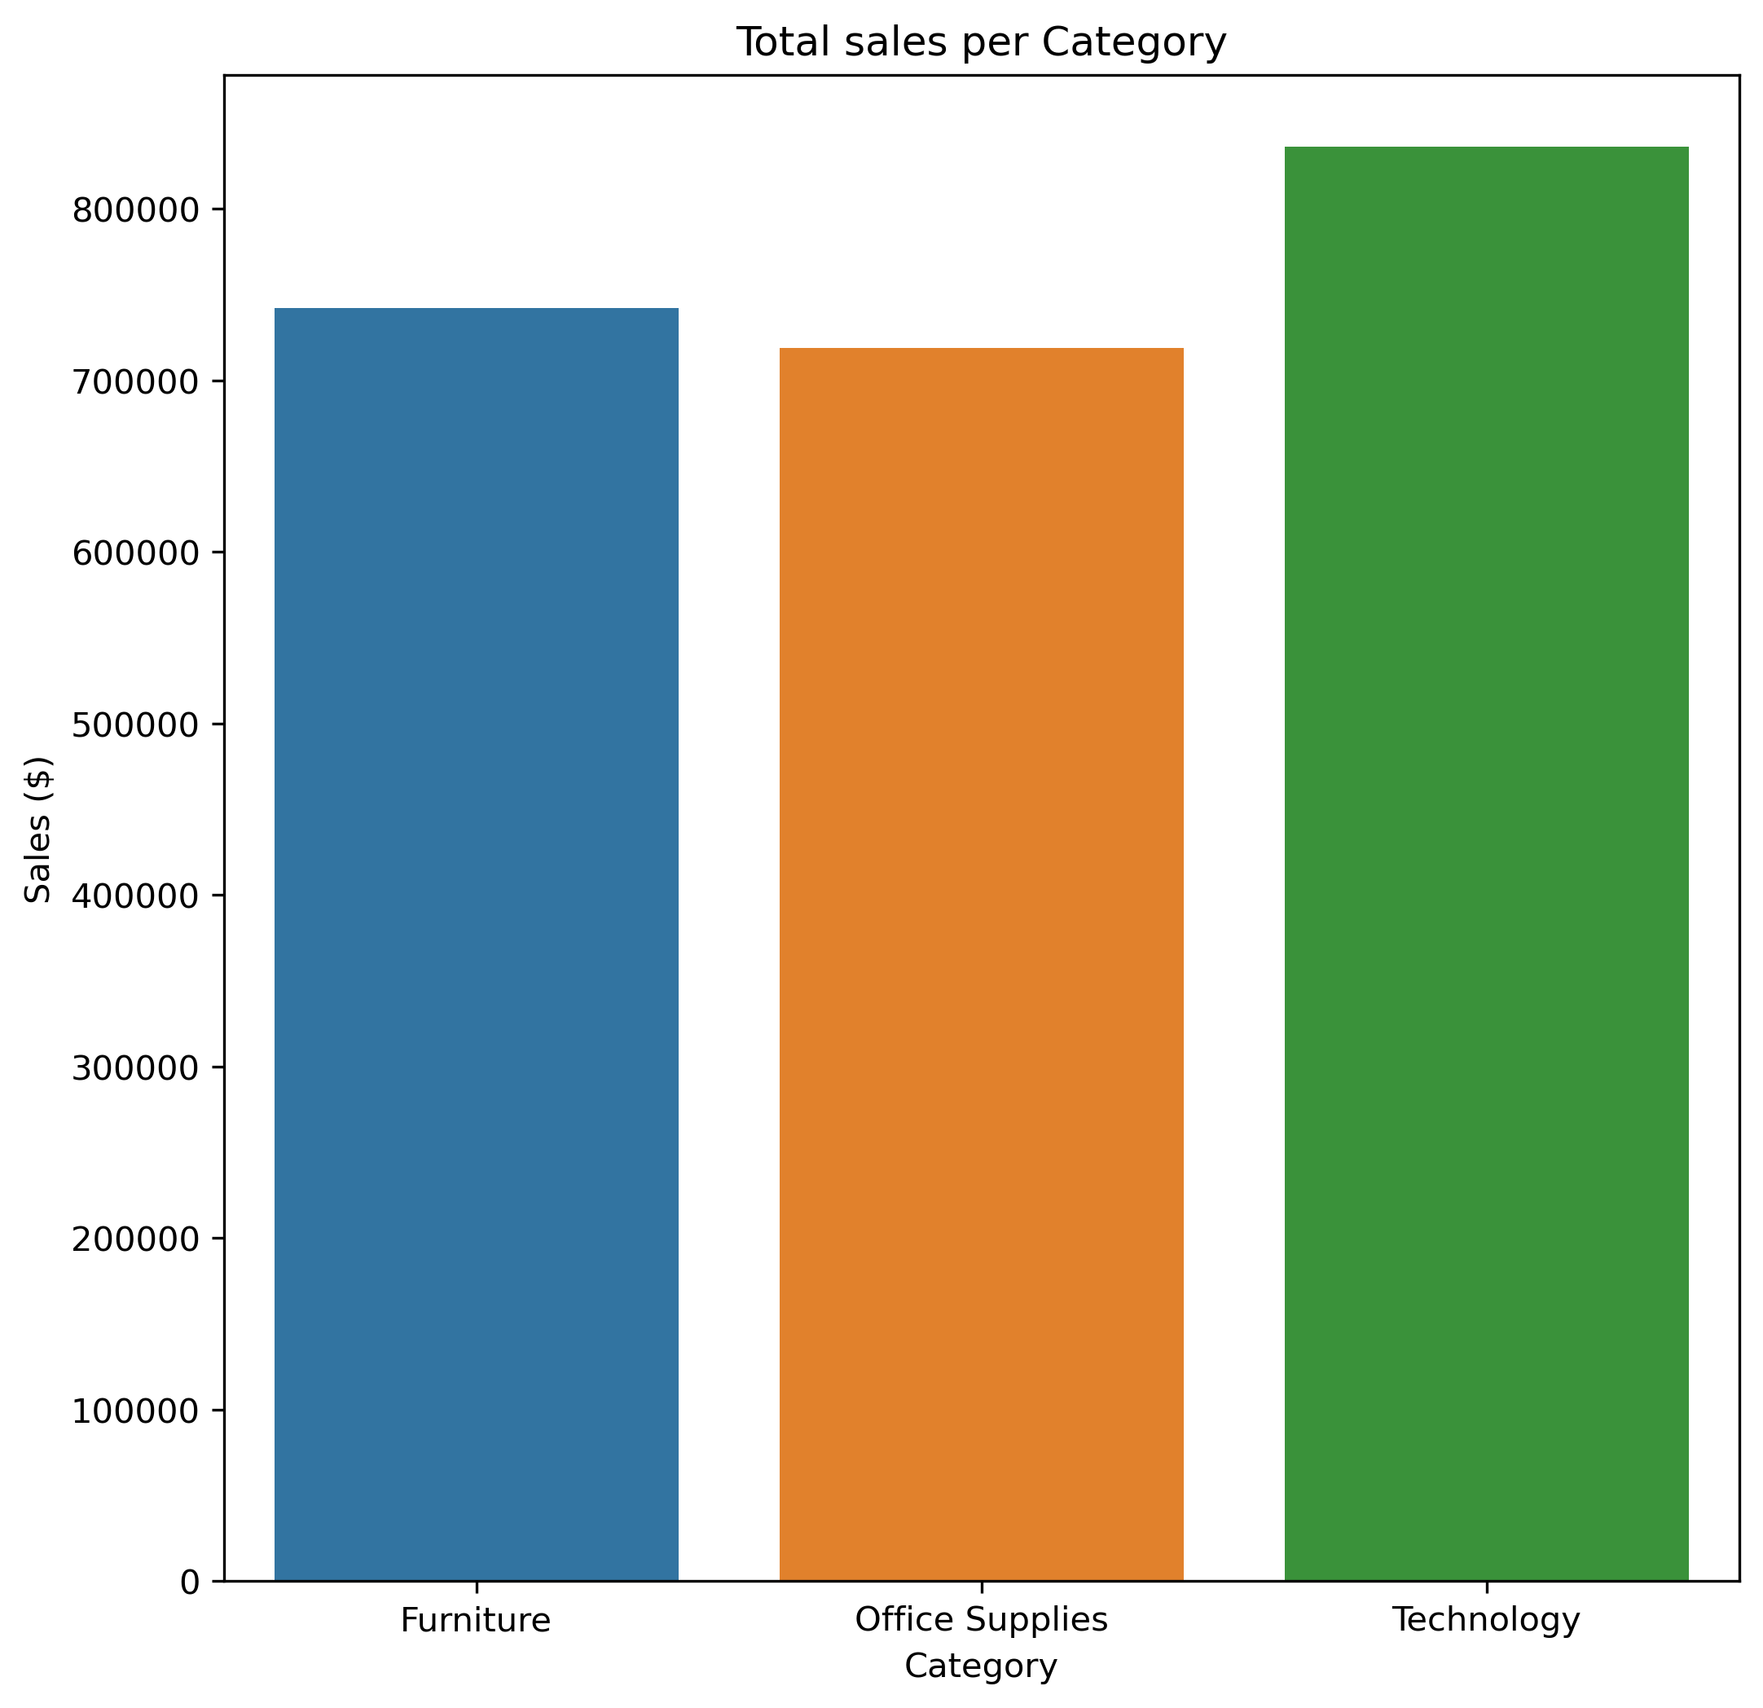
Top Product Categories

Slide 8
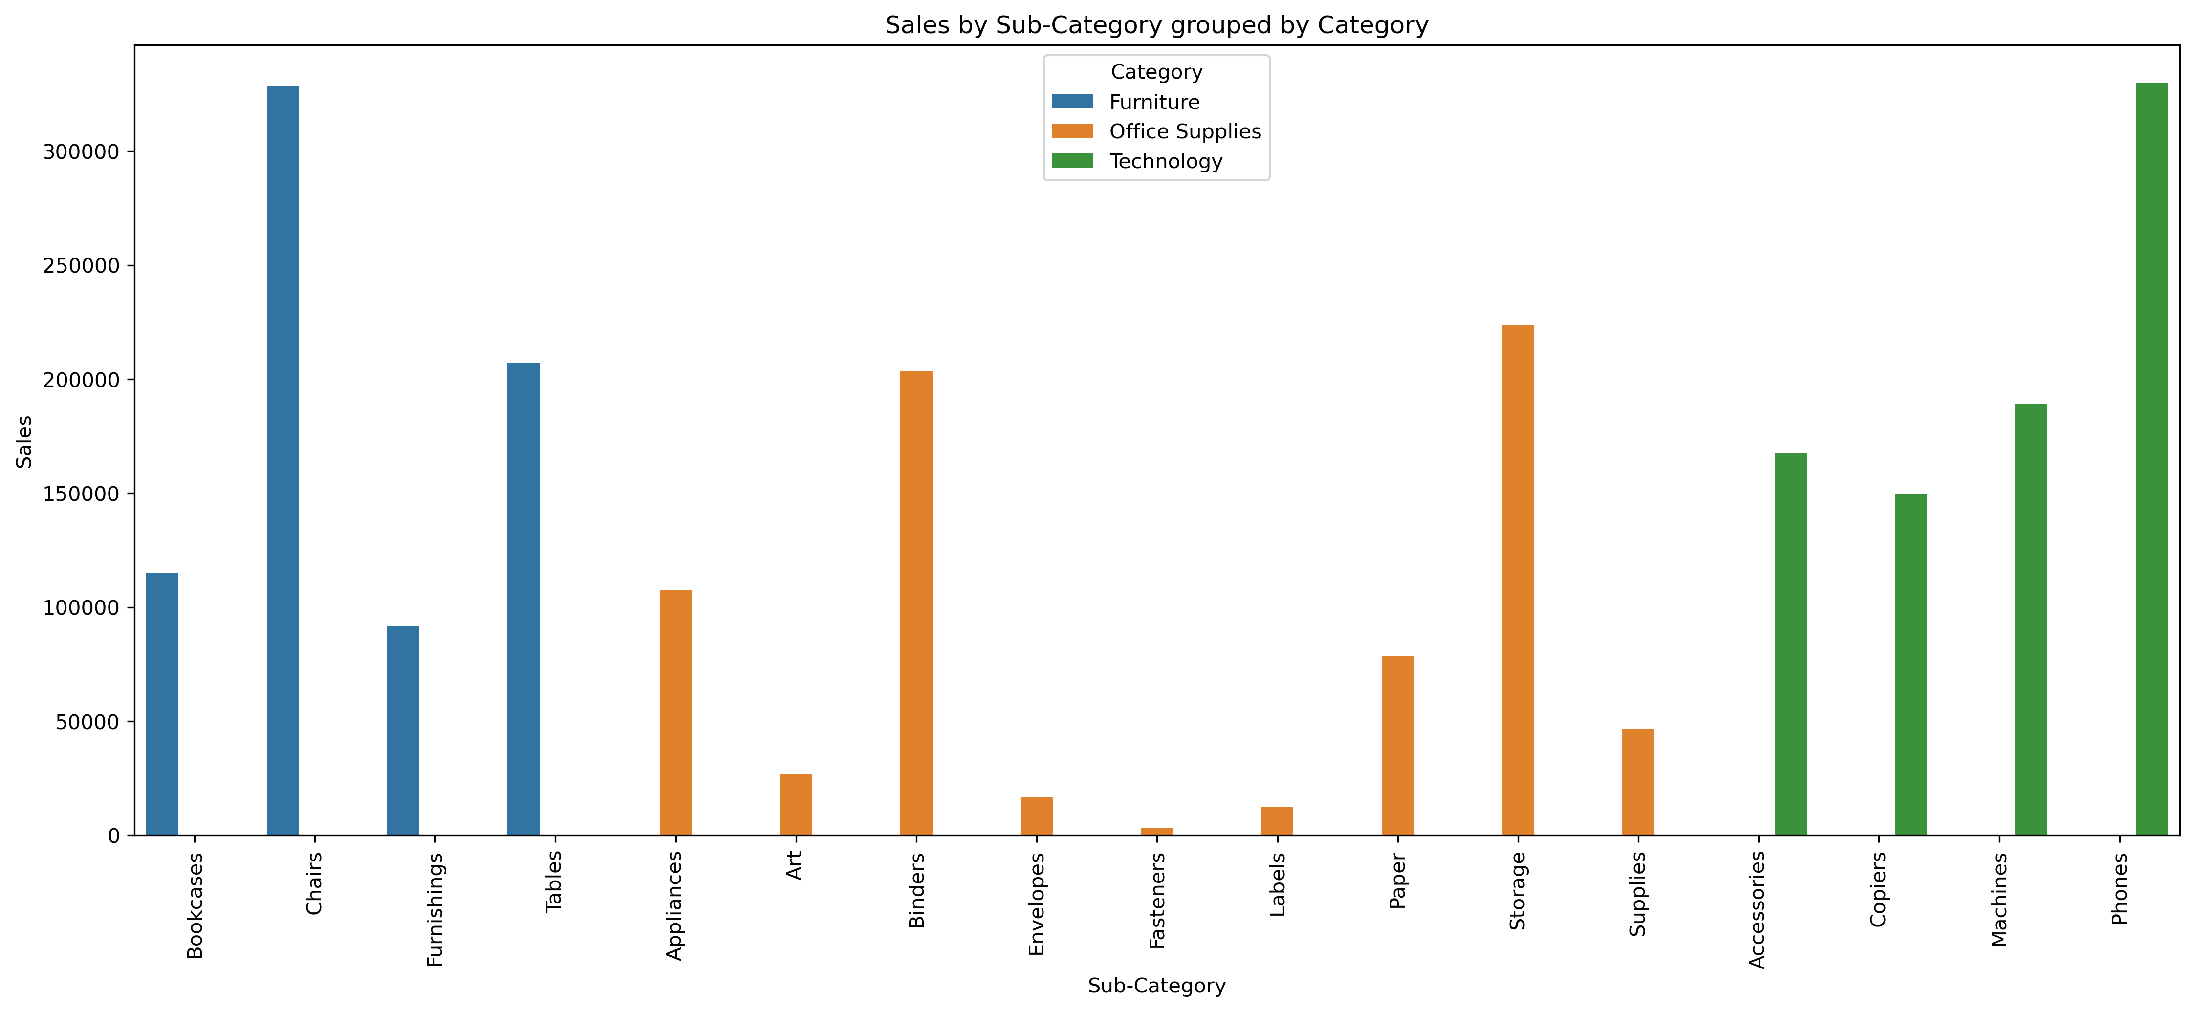
Top Sub-Categories

Slide 9
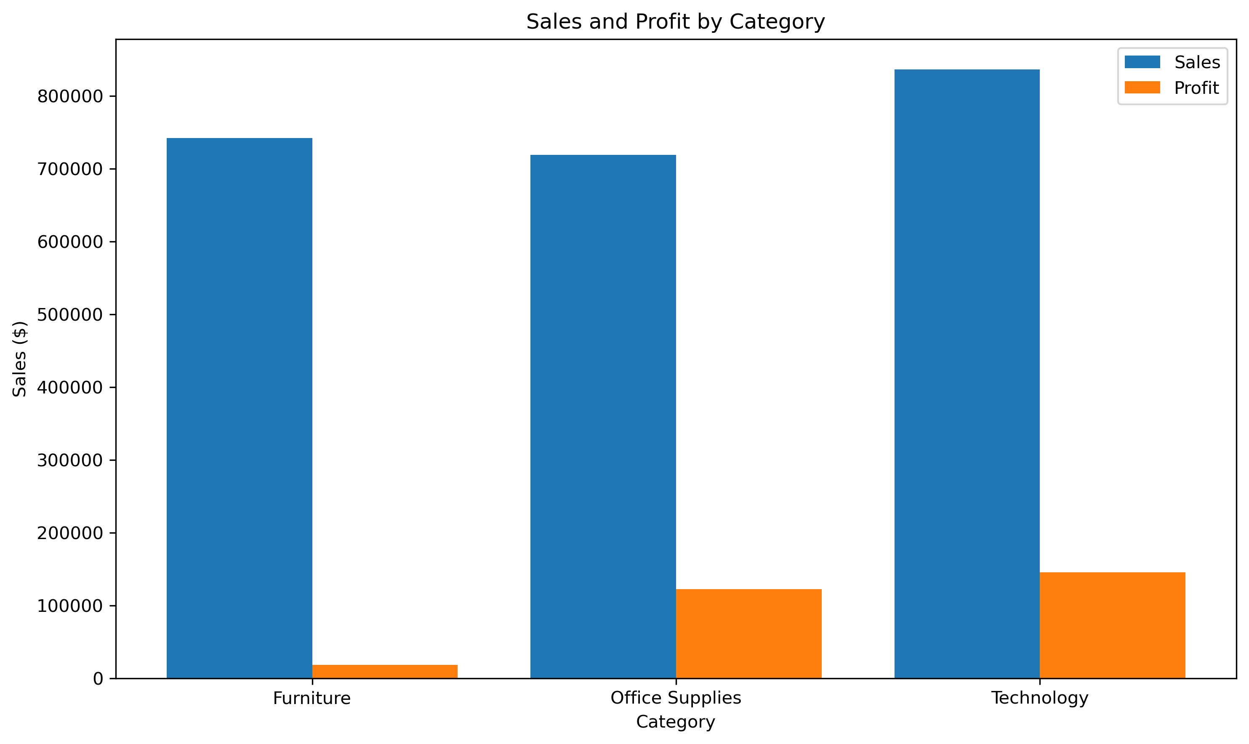
Profitability by Category

Slide 10
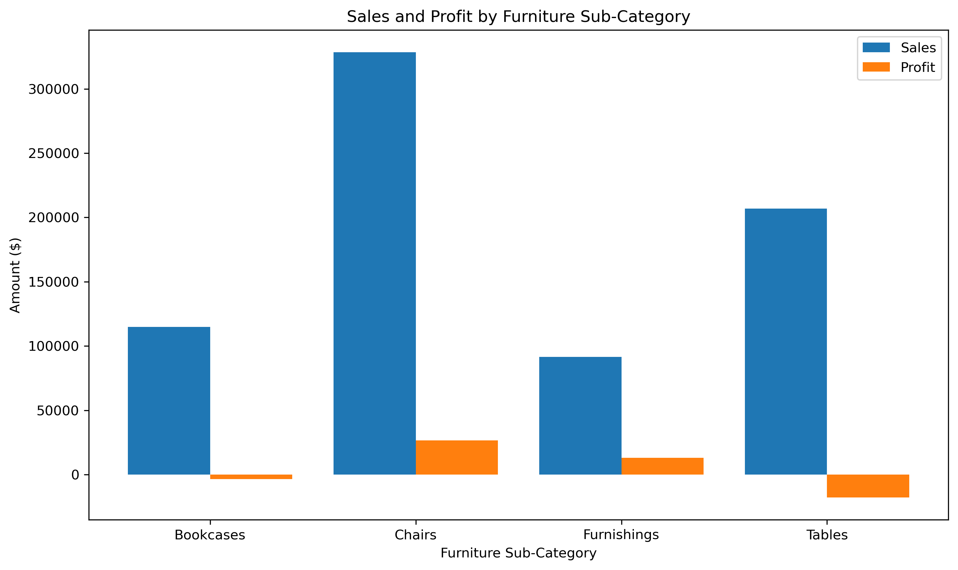
Category Drilldown: Furniture

Slide 11
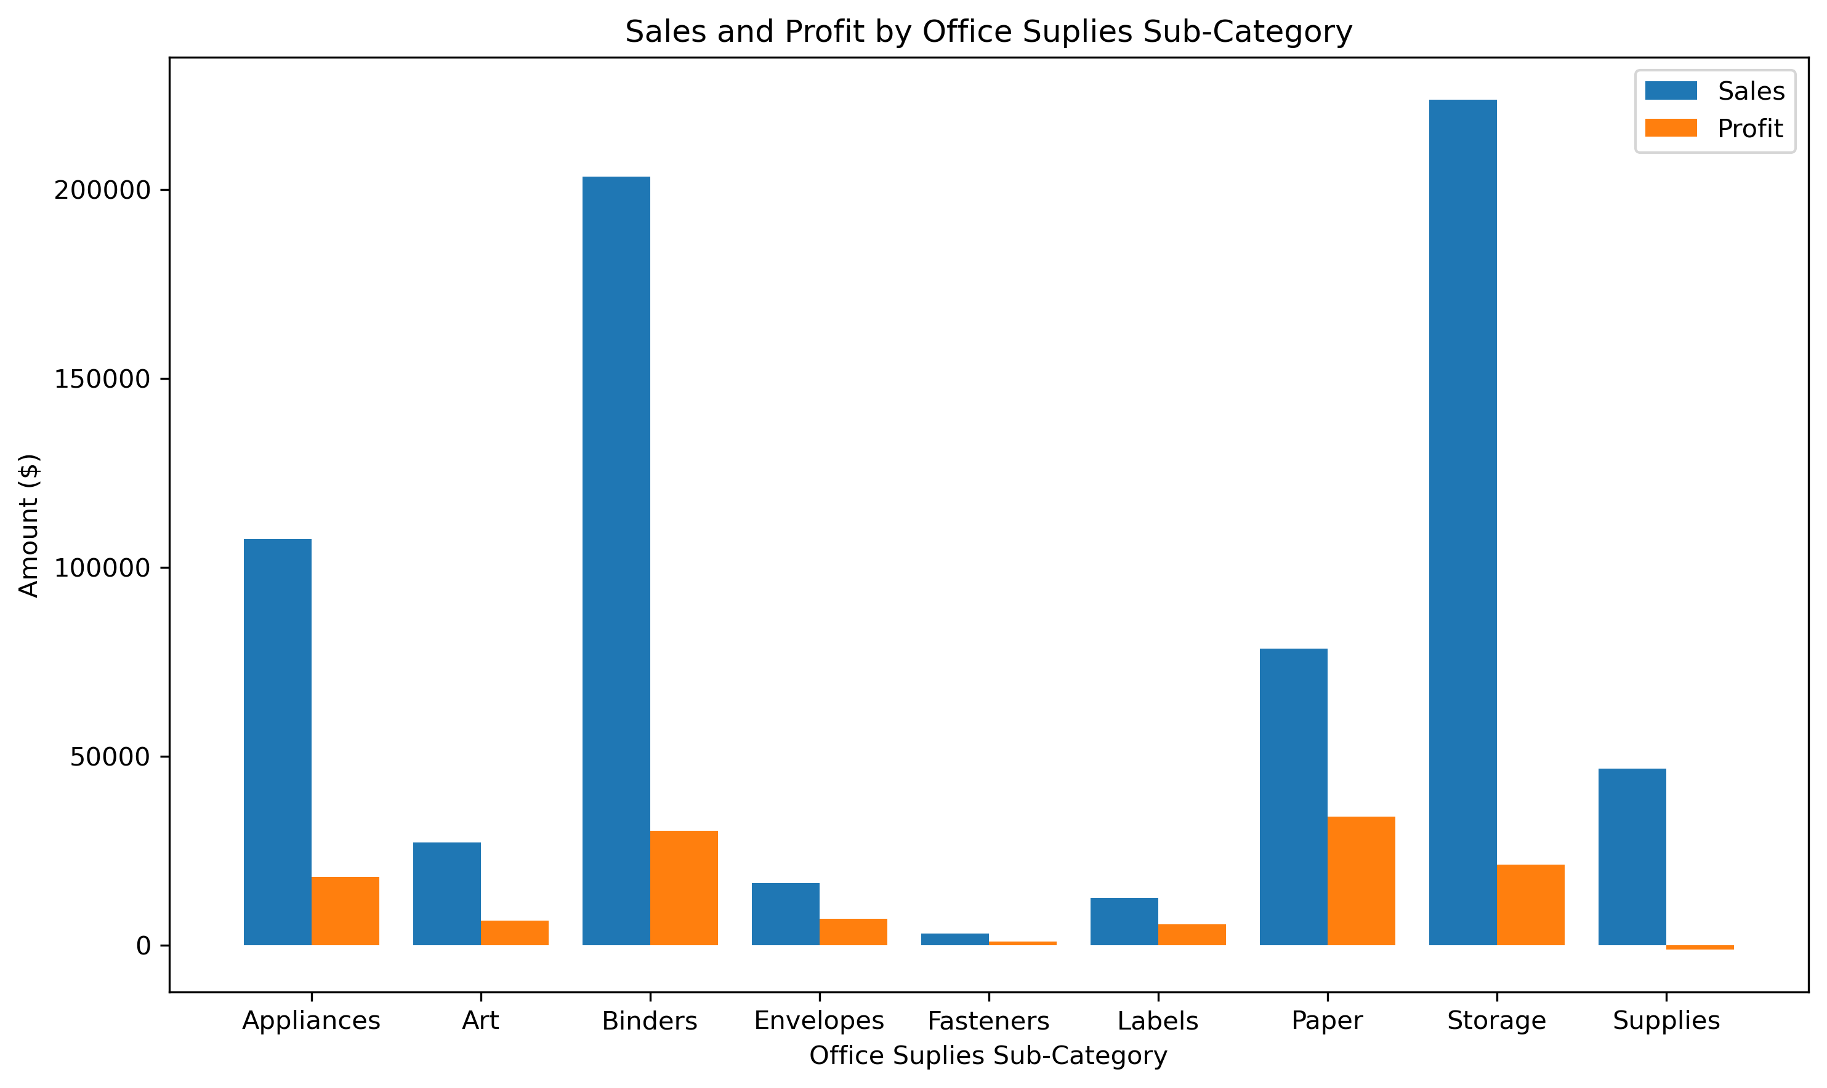
Category Drilldown: Office Supplies

Slide 12
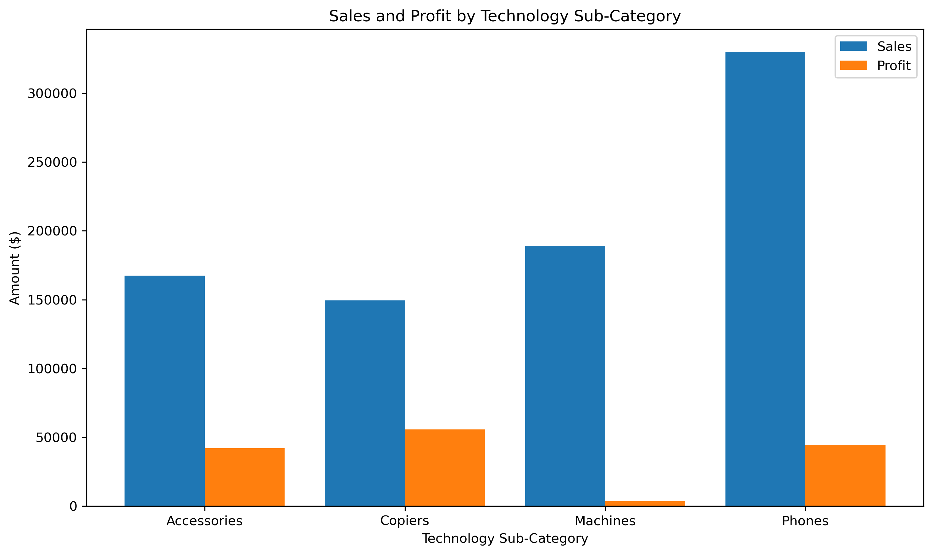
Category Drilldown: Technology

Slide 13
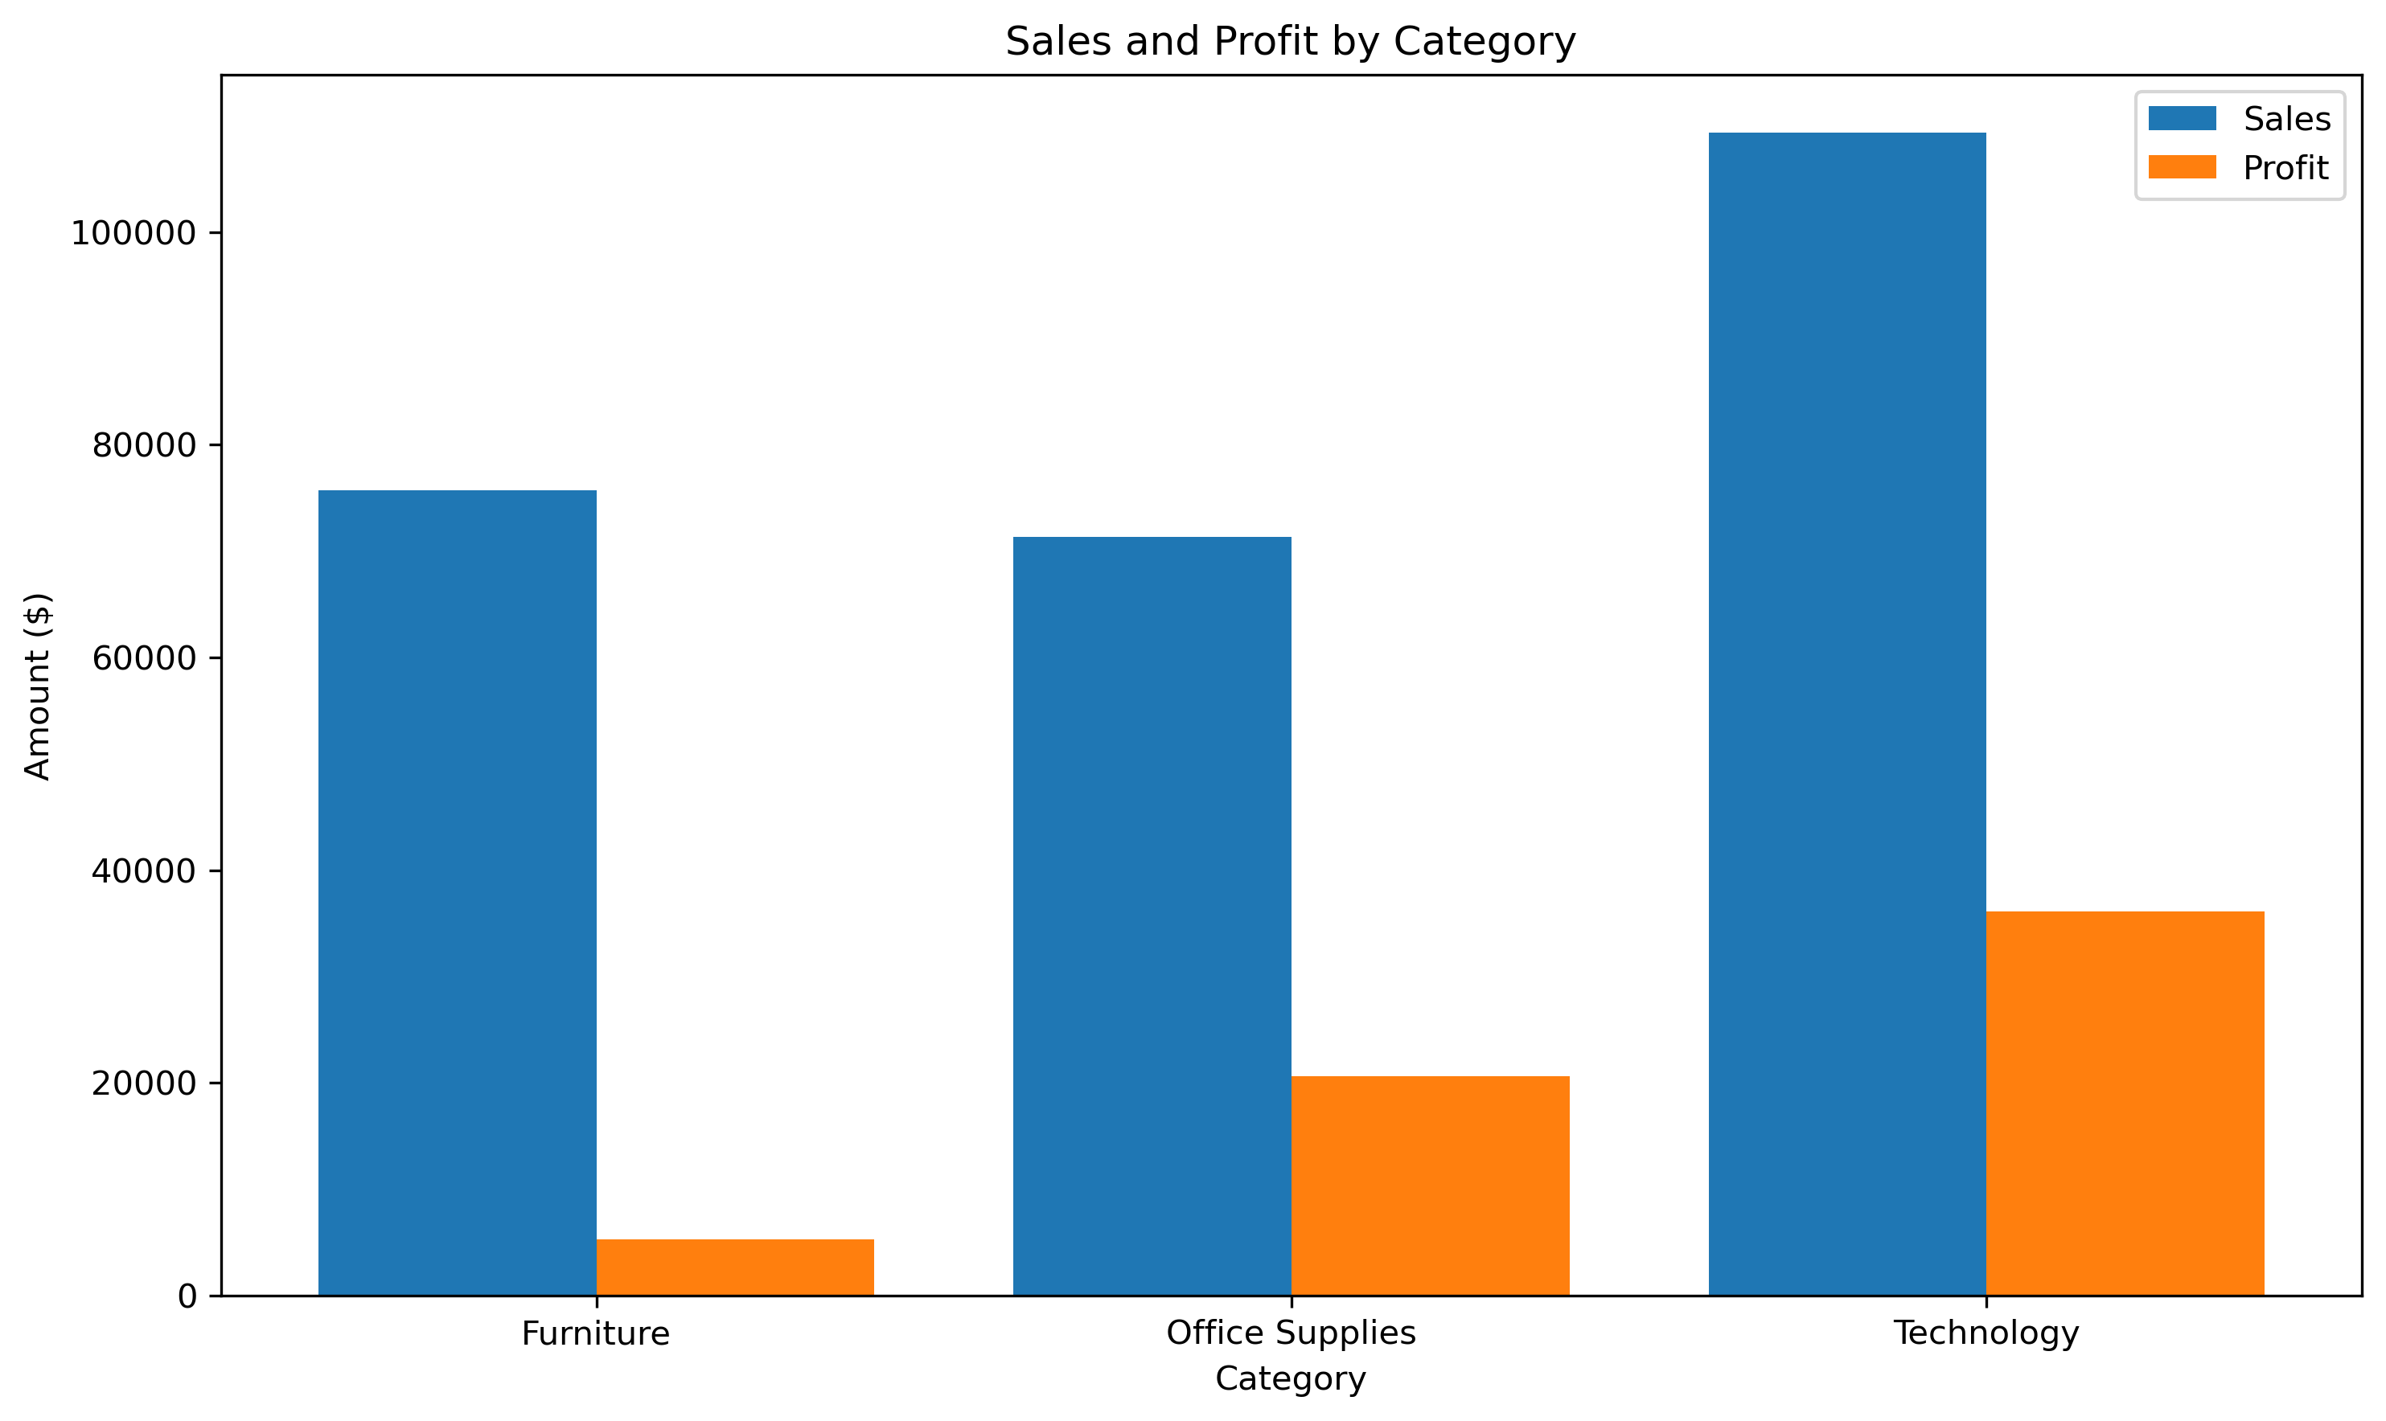
Profitability by Category In NYC

Slide 14
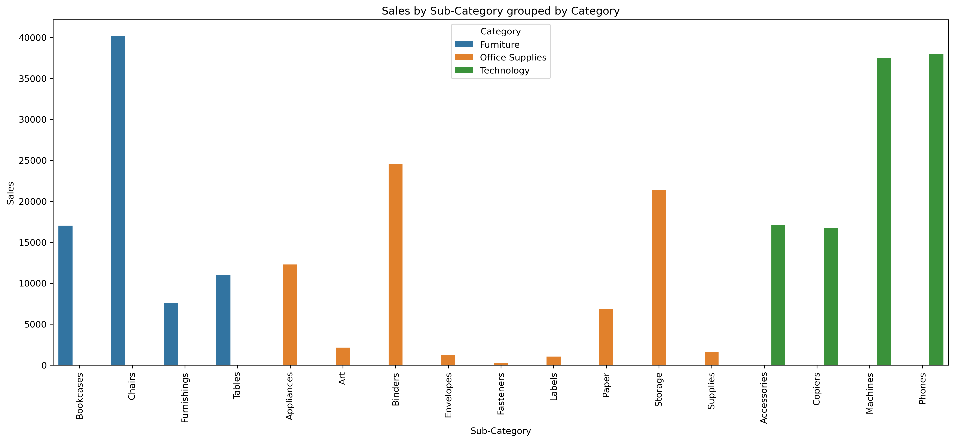
New York City Focus: Top Sub-Category

Slide 15
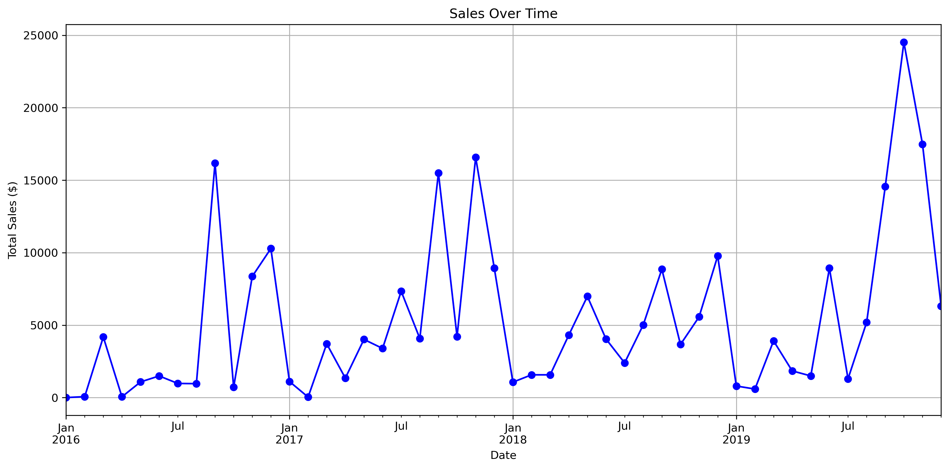
Sales Over Time In NYC

Slide 16
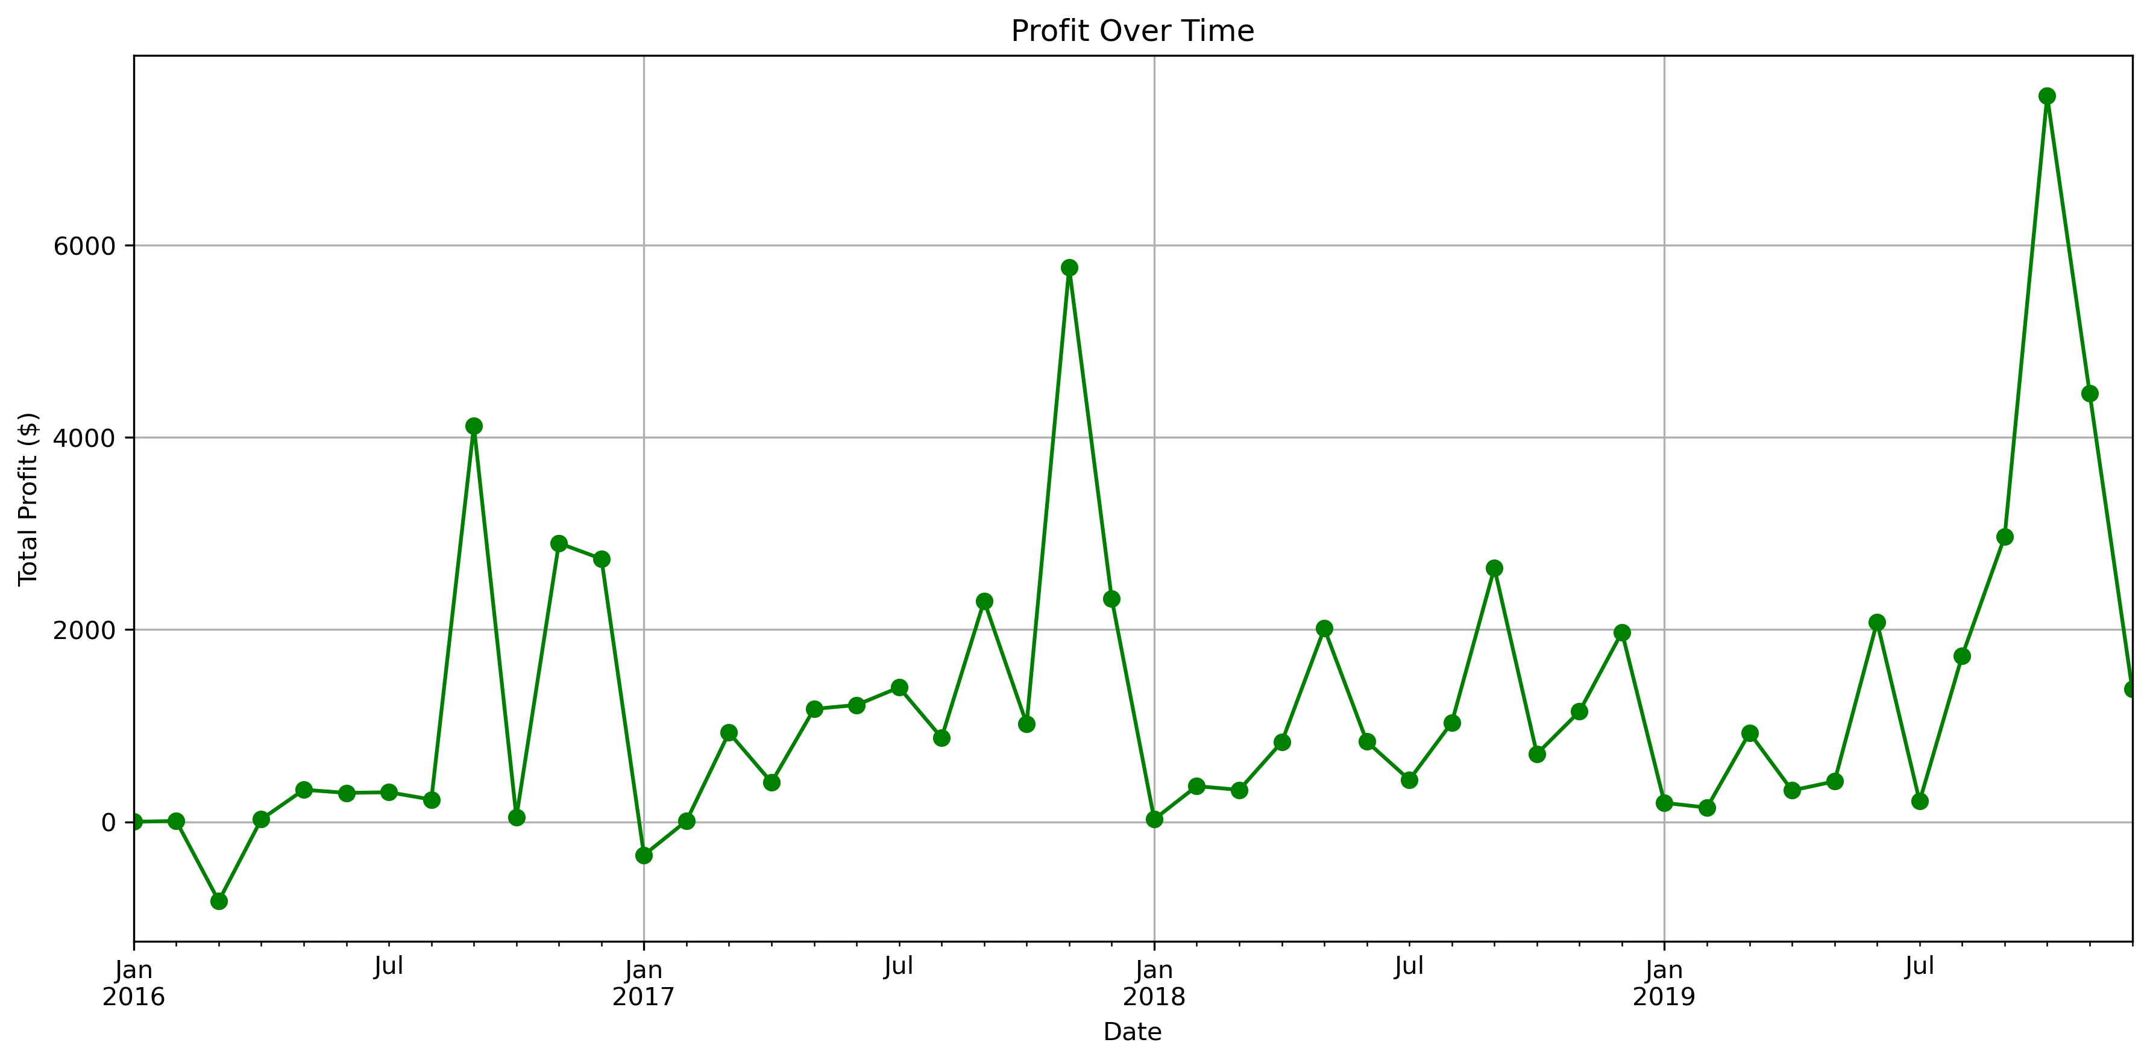
Profit Over Time In NYC

Slide 17
Key Business Insights
Dimension | Key Observations from Existing Competitors
Top Category by Sales | Technology sells the most, followed by Furniture and Office Supplies.
Top Category by Profit | Technology makes the most profit, followed by Office Supplies; Furniture makes the least profit.
Notable Sub-Category Insights | Furniture: Chairs sell the most and make good profit; Tables & Bookcases often lose money. Office Supplies: Binders & Storage sell well, but Paper makes the most profit; Appliances also make good profit. Technology: Phones sell the most; Copiers make the most profit; Accessories also make good profit; Machines make very little profit.
Seasonality | Demand is highest in September and again in Nov–Dec.

Slide 18
Recommendations
• Start Strong with Technology
Make Phones your main product since they sell very well.
Add Copiers and Accessories in smaller numbers to take advantage of their high profit.
• Pick the Right Furniture
Focus on selling Chairs and Furnishings, which sell well and make profit.
Avoid putting too much money into Tables and Bookcases since they don’t make good profit.
• Use Profitable Office Supplies
Sell Binders and Storage for steady sales.
Add Paper products and Appliances early because they make good profit.
• Launch at the Right Time
Plan big promotions in September and Nov–Dec when sales are highest.
• Sell Products Together
Offer product bundles (Phones + Accessories, Chairs + Desks) to get customers to spend more.

Slide 19
Conclusion
• Key Points
Technology leads NYC sales & profit; Phones are top sellers.
Furniture sells well but profit is in Chairs & Furnishings only.
Office Supplies bring steady profit, especially Paper & Binders.
Peak demand in September and November–December.
• Strategy in Brief
Start with Phones & select Copiers and Accessories.
Focus Furniture on Chairs & Furnishings; avoid low-profit items.
Use Paper, Appliances, Binders & Storage for steady income.
Launch big in peak months; use bundles to boost spend.

