Slide 1
Tutored Project
Gilles Coulais
Sebastien Piquemal
Icham Sirat

Slide 2
Property management offered by an estate agent
Start of project: (Test with php, C++, database model…)
Design: (ACSI, UML)
Development: (Engine classes, QT)

Slide 3
I) Start of project
Test of two programming anguages:
PHP, Html et CSS
QT/C++

Slide 4

PHP
The php works primarily with HTML (Hypertext Markup Language) => The Web Language
From our point of view:
Avantages of php:
Integration into the same page of raw code php and html code
Available on most hosts public
Use to make dynamic sites
Much documentation on it, which promotes the learning curve
Great portability without changing source code

Slide 5

PHP
From our point of view:
Disadvantages of php:
The fact that everything is on the same page may give the impression of a complex and difficult to understand code
Gives the impression of being a language that is not professional
Unless agreed naming conventions
All meant that a large program you can have the impression of not really knowing where you will

Slide 6
QT/C++
This is the language we have finally chosen for several reasons :
It is the language with which we started
We did not even work on graphical interfaces in C ++
QT is a free software that has a large community
The coupling between C ++ and QT allows a powerful application development platform
It's a multiplatform software (windows, UNIX, MAC...)

Slide 7

Database
PostgreSQL : it's a management system of relational database
This choice was motivated by:
The urge to try something else
This is a very well known that implements the SQL standards
This system is close to Oracle, which is widely used in business
It's multiplatform

Slide 8
Other tools
GIT: It is a software version control. It's free.
  It allowed us to work in parallel on different files of the same project
  It monitors the source files and keeps old versions of each
  It holds that performed each modification of each file and why. It is therefore able to tell who wrote each line of code in each file and for what purpose
  If two people working simultaneously on a single file, it is capable of assembling (merging) the changes and ensure that the work of one of these people are trapped

Slide 9
II) Design
ACSI (Analyse and conception of information system)
Pencil (Firefox extension)
UML (Unified Modeling Language)

Slide 10
ACSI
Realization of a chart actor flow (GAF):
Objectives :
Identify internal and external actors
Identify trade flows between them
Flows between external actors outside the study area, don't represent

Slide 11
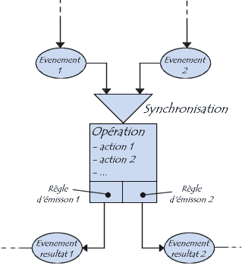
ACSI
MCT
Realization of a Conceptual Model of Treatment (MCT)
The conceptual model of treatment can schematically represent the management of events

Slide 12

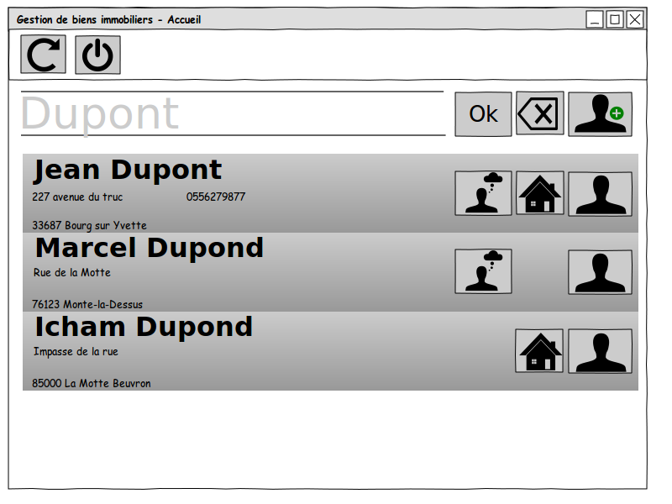
Pencil
Pencil :
It's used to create diagrams and models GUI software. It is available as an extension for the Firefox web browser or standalone version

Slide 13
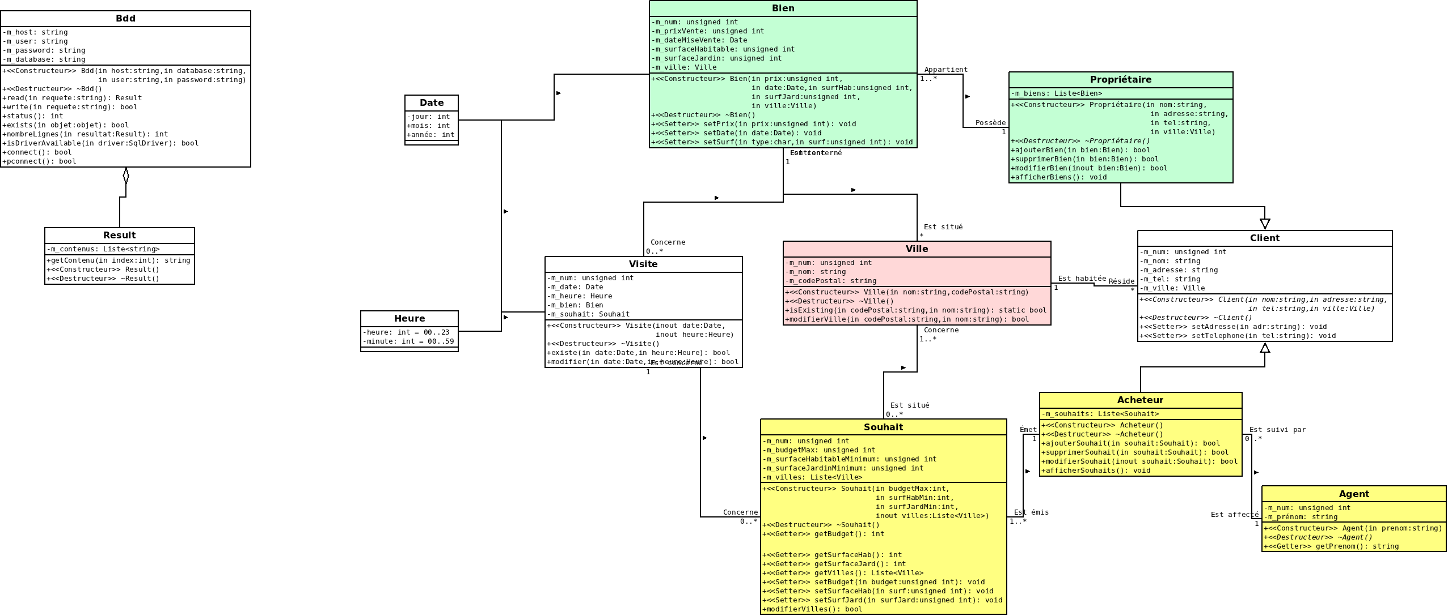
UML
Engines Classes : program architecture

Slide 14
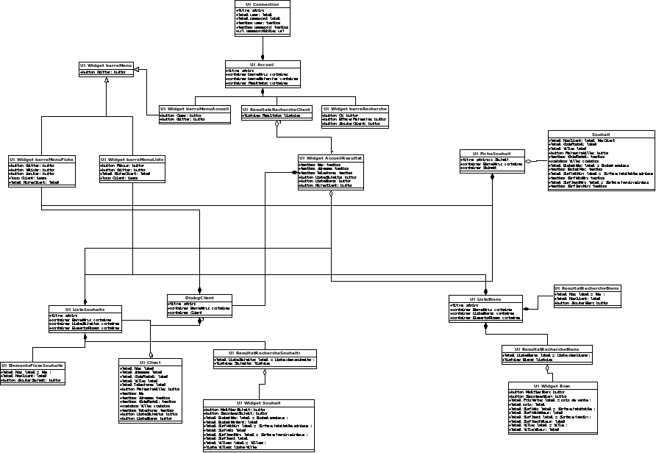
UML
Graphics Classes : interactions of the various interfaces between them

Slide 15
III) Development
Creation of database
Directed graphical windows with QT designer
Achieving classes motors (interaction with the database, Signal, Slot with buttons...)
Some examples

Slide 16
Creation of database
The installation is done from the command line
We first create a username and password
It creates the database by giving it a name
It runs the scripts to create tables (the architecture of the Db) => these are SQL script files
PostgreSQL III is installed graphically to administer the database, write queries...

Slide 17
QT
  Qt is an IDE (Intregrated development environement) for developing C ++, optimized for building projects using Qt (no tedious configuration)
  Qt is a set of libraries
  Everything is so huge that also speaks rather of framework: it means you have at your disposal a set of tools for developing your programs more effectively

Slide 18
QT Creator
This is the main program comes with Qt
  Here we create our class engines
  The program automatically generates a makefile from these files
  We integrate our graphics windows and treated interactions between classes and class graphics engine with: SIGNAL and SLOT

Slide 19
QT Designer
This is a program bundled with Qt
  It allows you to draw your windows visually
  It can also change the properties of widgets, using layouts (to arrange the components on windows)
  It allows the connection between signals and slots => ie the correspondence between classes and class graphics engines

Slide 20
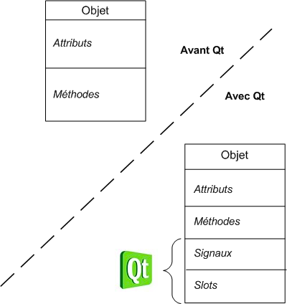
Fonctionnement SIGNAUX et SLOTS
On étend les caractéristiques de l'objet

Slide 21
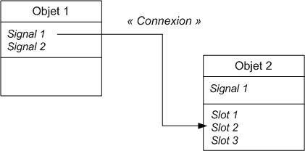
SIGNALS and SLOTS operation
In this diagram we connect the signal of an object with a slot 2 of object 2

Slide 22
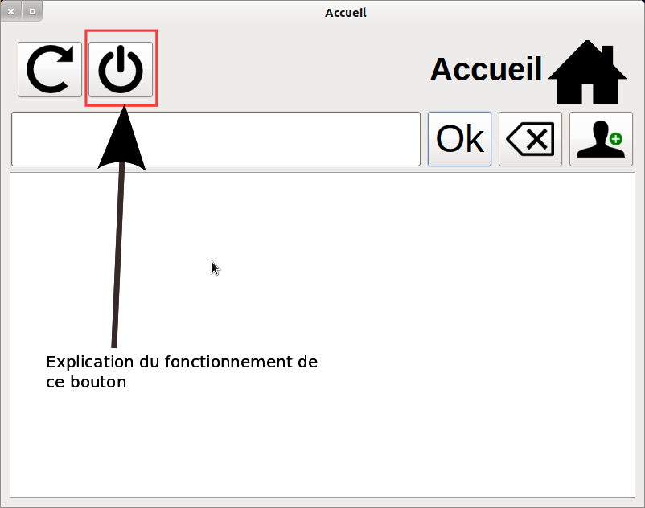
Some Examples
Main window of our program
Made entirely with QT

Slide 23

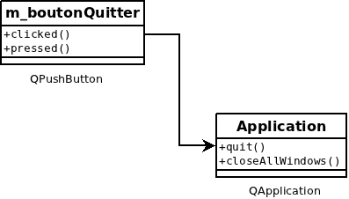
Some Examples
Operation Button: Quit the application

Slide 24
Some Examples
The code associated
//Quit button
//icon's button
m_menu.pushButton_2->setIcon(QIcon(":/app/quitter96"));
//Text display when you move the mouse button
m_menu.pushButton_2->setToolTip("Quitter l'application");
//In a line is generated action to exit the application
QObject::connect(m_menu.pushButton_2, SIGNAL(clicked()), qApp, SLOT(quit()));

