Slide 1


Team Details
  Team name: Samurai
  Team leader: pending portal confirmation
  Problem: founder work loses context and evidence
DRAFT • Future of Work & Enterprise Productivity • Local evidence
Notes:
Draft for Future of Work & Enterprise Productivity. Source template: https://docs.google.com/presentation/d/13rg7vW43mEH6DkpuusAE6fdoEylSFz8waNpE4RLzoUg/edit (download 2026-10-16, SHA256 fac56448966ecac0bea3975b7c9c61bf578679ccf4bd252a5f281ed4db90ce77). Local implementation evidence: docs/local-acceptance.md; production/test commit 7b731d6942e113e671d5ce0110d694deea19193e; acceptance docs da69bbfa6fef32abb01d789efde21eed4f550782. See docs/architecture.md, docs/readiness-costs.md, docs/gcp-deployment.md, docs/competition/template-checklist.md. Slide 1. No cloud/provider/publication/submission acceptance implied. Slide 11 image: accepted Task20 browser-fix.png, synthetic local data; source tree continuity documented in Task20 acceptance receipt.

Slide 2

Note: Please download this template to make your edits and submit the final version.
To download, go to File > Download > Microsoft PowerPoint (.PPTX). Kindly refrain from sending edit requests.
Notes:
Draft for Future of Work & Enterprise Productivity. Source template: https://docs.google.com/presentation/d/13rg7vW43mEH6DkpuusAE6fdoEylSFz8waNpE4RLzoUg/edit (download 2026-10-16, SHA256 fac56448966ecac0bea3975b7c9c61bf578679ccf4bd252a5f281ed4db90ce77). Local implementation evidence: docs/local-acceptance.md; production/test commit 7b731d6942e113e671d5ce0110d694deea19193e; acceptance docs da69bbfa6fef32abb01d789efde21eed4f550782. See docs/architecture.md, docs/readiness-costs.md, docs/gcp-deployment.md, docs/competition/template-checklist.md. Slide 2. No cloud/provider/publication/submission acceptance implied. Slide 11 image: accepted Task20 browser-fix.png, synthetic local data; source tree continuity documented in Task20 acceptance receipt.

Slide 3
Brief about the idea
One founder workspace for turning an idea into research, a reviewable offer, and a delivery plan.
Samurai retains company context, sources, decisions, and artifacts across stages.
The founder reviews the next decision. Missing or conflicting evidence remains visible.
Notes:
Draft for Future of Work & Enterprise Productivity. Source template: https://docs.google.com/presentation/d/13rg7vW43mEH6DkpuusAE6fdoEylSFz8waNpE4RLzoUg/edit (download 2026-10-16, SHA256 fac56448966ecac0bea3975b7c9c61bf578679ccf4bd252a5f281ed4db90ce77). Local implementation evidence: docs/local-acceptance.md; production/test commit 7b731d6942e113e671d5ce0110d694deea19193e; acceptance docs da69bbfa6fef32abb01d789efde21eed4f550782. See docs/architecture.md, docs/readiness-costs.md, docs/gcp-deployment.md, docs/competition/template-checklist.md. Slide 3. No cloud/provider/publication/submission acceptance implied. Slide 11 image: accepted Task20 browser-fix.png, synthetic local data; source tree continuity documented in Task20 acceptance receipt.

Slide 4
Opportunities
A connected workflow: specialists share revisioned company context instead of producing isolated answers.
Evidence before confidence: source adjudication checks cited content; unsupported claims stay unverified.
Founder control: accepted stages persist, and consequential external actions require approval.
Notes:
Draft for Future of Work & Enterprise Productivity. Source template: https://docs.google.com/presentation/d/13rg7vW43mEH6DkpuusAE6fdoEylSFz8waNpE4RLzoUg/edit (download 2026-10-16, SHA256 fac56448966ecac0bea3975b7c9c61bf578679ccf4bd252a5f281ed4db90ce77). Local implementation evidence: docs/local-acceptance.md; production/test commit 7b731d6942e113e671d5ce0110d694deea19193e; acceptance docs da69bbfa6fef32abb01d789efde21eed4f550782. See docs/architecture.md, docs/readiness-costs.md, docs/gcp-deployment.md, docs/competition/template-checklist.md. Slide 4. No cloud/provider/publication/submission acceptance implied. Slide 11 image: accepted Task20 browser-fix.png, synthetic local data; source tree continuity documented in Task20 acceptance receipt.

Slide 5
List of features offered by the solution
Locally accepted
Workspace membership • company revision fencing • quotas and files
Founder context • offer diagnostics • scoped knowledge
Explicit learning • bounded schedules • synthetic scenarios
Reliability
One automatic retry • duplicate-write protection • cancellation
These local results do not establish current cloud deployment.
Notes:
Draft for Future of Work & Enterprise Productivity. Source template: https://docs.google.com/presentation/d/13rg7vW43mEH6DkpuusAE6fdoEylSFz8waNpE4RLzoUg/edit (download 2026-10-16, SHA256 fac56448966ecac0bea3975b7c9c61bf578679ccf4bd252a5f281ed4db90ce77). Local implementation evidence: docs/local-acceptance.md; production/test commit 7b731d6942e113e671d5ce0110d694deea19193e; acceptance docs da69bbfa6fef32abb01d789efde21eed4f550782. See docs/architecture.md, docs/readiness-costs.md, docs/gcp-deployment.md, docs/competition/template-checklist.md. Slide 5. No cloud/provider/publication/submission acceptance implied. Slide 11 image: accepted Task20 browser-fix.png, synthetic local data; source tree continuity documented in Task20 acceptance receipt.

Slide 6
Process flow diagram or Use-case diagram
Founder brief → Research → Source adjudication
↓
Verifier and founder decision
↓ ↓
Evidence sufficient Missing / conflicting
↓ ↓
Strategy and plan Rework / clarify
Accepted stages and their provenance persist; interrupted work resumes under revision and attempt fences.
Notes:
Draft for Future of Work & Enterprise Productivity. Source template: https://docs.google.com/presentation/d/13rg7vW43mEH6DkpuusAE6fdoEylSFz8waNpE4RLzoUg/edit (download 2026-10-16, SHA256 fac56448966ecac0bea3975b7c9c61bf578679ccf4bd252a5f281ed4db90ce77). Local implementation evidence: docs/local-acceptance.md; production/test commit 7b731d6942e113e671d5ce0110d694deea19193e; acceptance docs da69bbfa6fef32abb01d789efde21eed4f550782. See docs/architecture.md, docs/readiness-costs.md, docs/gcp-deployment.md, docs/competition/template-checklist.md. Slide 6. No cloud/provider/publication/submission acceptance implied. Slide 11 image: accepted Task20 browser-fix.png, synthetic local data; source tree continuity documented in Task20 acceptance receipt.

Slide 7
Wireframes/Mock diagrams of the proposed solution (optional)
The implemented founder workspace is shown on slide 11.
It combines conversation, company context, and typed business panels. Views distinguish assumptions, supported claims, and synthetic calculations.
This draft uses an accepted local fixture capture, not a live customer or cloud demonstration.
Notes:
Draft for Future of Work & Enterprise Productivity. Source template: https://docs.google.com/presentation/d/13rg7vW43mEH6DkpuusAE6fdoEylSFz8waNpE4RLzoUg/edit (download 2026-10-16, SHA256 fac56448966ecac0bea3975b7c9c61bf578679ccf4bd252a5f281ed4db90ce77). Local implementation evidence: docs/local-acceptance.md; production/test commit 7b731d6942e113e671d5ce0110d694deea19193e; acceptance docs da69bbfa6fef32abb01d789efde21eed4f550782. See docs/architecture.md, docs/readiness-costs.md, docs/gcp-deployment.md, docs/competition/template-checklist.md. Slide 7. No cloud/provider/publication/submission acceptance implied. Slide 11 image: accepted Task20 browser-fix.png, synthetic local data; source tree continuity documented in Task20 acceptance receipt.

Slide 8
Architecture diagram of the proposed solution
Founder UI (React/Vite)
↓
Server proxy: identity and allowlisted routes
↓
Agno AgentOS: parent + explicit workflows + verifier
↓ ↓
PostgreSQL Gemini reasoning
company state, jobs Researcher-only Search
Agno ↔ Redis: events and cancellation
Local files today. Shared cloud coordination rollout is deferred; Cloud Storage is a future adapter.
Notes:
Draft for Future of Work & Enterprise Productivity. Source template: https://docs.google.com/presentation/d/13rg7vW43mEH6DkpuusAE6fdoEylSFz8waNpE4RLzoUg/edit (download 2026-10-16, SHA256 fac56448966ecac0bea3975b7c9c61bf578679ccf4bd252a5f281ed4db90ce77). Local implementation evidence: docs/local-acceptance.md; production/test commit 7b731d6942e113e671d5ce0110d694deea19193e; acceptance docs da69bbfa6fef32abb01d789efde21eed4f550782. See docs/architecture.md, docs/readiness-costs.md, docs/gcp-deployment.md, docs/competition/template-checklist.md. Slide 8. No cloud/provider/publication/submission acceptance implied. Slide 11 image: accepted Task20 browser-fix.png, synthetic local data; source tree continuity documented in Task20 acceptance receipt.

Slide 9
Technologies to be used in the solution
Python + Agno AgentOS: explicit staged workflows and persistence
Gemini: bounded reasoning; native Search for Researcher only
PostgreSQL: canonical company state, artifacts, and durable jobs
Redis: local coordination for recovery and cancellation
React/Vite + TypeScript: typed founder views and server proxy
Historical Google deployment: Cloud Run, Cloud SQL, and IAP.
The current local candidate has not been deployed.
Notes:
Draft for Future of Work & Enterprise Productivity. Source template: https://docs.google.com/presentation/d/13rg7vW43mEH6DkpuusAE6fdoEylSFz8waNpE4RLzoUg/edit (download 2026-10-16, SHA256 fac56448966ecac0bea3975b7c9c61bf578679ccf4bd252a5f281ed4db90ce77). Local implementation evidence: docs/local-acceptance.md; production/test commit 7b731d6942e113e671d5ce0110d694deea19193e; acceptance docs da69bbfa6fef32abb01d789efde21eed4f550782. See docs/architecture.md, docs/readiness-costs.md, docs/gcp-deployment.md, docs/competition/template-checklist.md. Slide 9. No cloud/provider/publication/submission acceptance implied. Slide 11 image: accepted Task20 browser-fix.png, synthetic local data; source tree continuity documented in Task20 acceptance receipt.

Slide 10
Estimated implementation cost (optional)
Cost controls
Bounded attempts, company admission, quotas, and test fixtures
Provider-free local acceptance; no new Gemini spend in these checks
Paid cloud recovery upgrade: deferred by the founder
Current spend and an approved recurring budget: not established
Hosting estimates require a refreshed inventory and authorization.
No claim of zero-cost hosting or a guaranteed spending cap.
Notes:
Draft for Future of Work & Enterprise Productivity. Source template: https://docs.google.com/presentation/d/13rg7vW43mEH6DkpuusAE6fdoEylSFz8waNpE4RLzoUg/edit (download 2026-10-16, SHA256 fac56448966ecac0bea3975b7c9c61bf578679ccf4bd252a5f281ed4db90ce77). Local implementation evidence: docs/local-acceptance.md; production/test commit 7b731d6942e113e671d5ce0110d694deea19193e; acceptance docs da69bbfa6fef32abb01d789efde21eed4f550782. See docs/architecture.md, docs/readiness-costs.md, docs/gcp-deployment.md, docs/competition/template-checklist.md. Slide 10. No cloud/provider/publication/submission acceptance implied. Slide 11 image: accepted Task20 browser-fix.png, synthetic local data; source tree continuity documented in Task20 acceptance receipt.

Slide 11
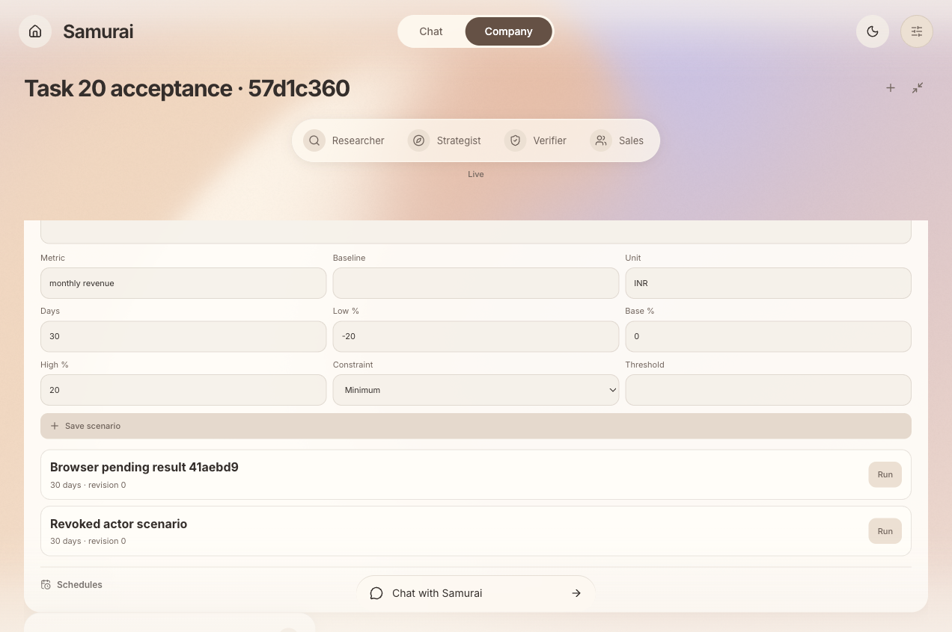
Snapshots of the prototype
Accepted Task 20 local fixture capture; visible “Live” is the UI mode, not cloud deployment or real business data.
Notes:
Draft for Future of Work & Enterprise Productivity. Source template: https://docs.google.com/presentation/d/13rg7vW43mEH6DkpuusAE6fdoEylSFz8waNpE4RLzoUg/edit (download 2026-10-16, SHA256 fac56448966ecac0bea3975b7c9c61bf578679ccf4bd252a5f281ed4db90ce77). Local implementation evidence: docs/local-acceptance.md; production/test commit 7b731d6942e113e671d5ce0110d694deea19193e; acceptance docs da69bbfa6fef32abb01d789efde21eed4f550782. See docs/architecture.md, docs/readiness-costs.md, docs/gcp-deployment.md, docs/competition/template-checklist.md. Slide 11. No cloud/provider/publication/submission acceptance implied. Slide 11 image: accepted Task20 browser-fix.png, synthetic local data; source tree continuity documented in Task20 acceptance receipt.

Slide 12
Prototype Performance report/Benchmarking
Correctness checks at the accepted local production tree
554 backend tests • 150 frontend tests
60 server tests • 4 Sites tests • 40 provider-free evaluations
Observed recovery
One scheduled result; no duplicate receipt on replay
Stable company and result hashes after backend restart and reload
Latency, throughput, cost per task, and business impact: unmeasured.
Notes:
Draft for Future of Work & Enterprise Productivity. Source template: https://docs.google.com/presentation/d/13rg7vW43mEH6DkpuusAE6fdoEylSFz8waNpE4RLzoUg/edit (download 2026-10-16, SHA256 fac56448966ecac0bea3975b7c9c61bf578679ccf4bd252a5f281ed4db90ce77). Local implementation evidence: docs/local-acceptance.md; production/test commit 7b731d6942e113e671d5ce0110d694deea19193e; acceptance docs da69bbfa6fef32abb01d789efde21eed4f550782. See docs/architecture.md, docs/readiness-costs.md, docs/gcp-deployment.md, docs/competition/template-checklist.md. Slide 12. No cloud/provider/publication/submission acceptance implied. Slide 11 image: accepted Task20 browser-fix.png, synthetic local data; source tree continuity documented in Task20 acceptance receipt.

Slide 13
Additional Details/Future Development (if any)
Before a production-readiness claim
Complete final integrated manual QA and local integration
Authorize and verify cloud queue rollout and isolated restore drill
Run bounded live source-supported business acceptance
Future work
Cloud Storage adapter and connected business measurements
No outreach, publishing, spending, or demand validation is implied.
Notes:
Draft for Future of Work & Enterprise Productivity. Source template: https://docs.google.com/presentation/d/13rg7vW43mEH6DkpuusAE6fdoEylSFz8waNpE4RLzoUg/edit (download 2026-10-16, SHA256 fac56448966ecac0bea3975b7c9c61bf578679ccf4bd252a5f281ed4db90ce77). Local implementation evidence: docs/local-acceptance.md; production/test commit 7b731d6942e113e671d5ce0110d694deea19193e; acceptance docs da69bbfa6fef32abb01d789efde21eed4f550782. See docs/architecture.md, docs/readiness-costs.md, docs/gcp-deployment.md, docs/competition/template-checklist.md. Slide 13. No cloud/provider/publication/submission acceptance implied. Slide 11 image: accepted Task20 browser-fix.png, synthetic local data; source tree continuity documented in Task20 acceptance receipt.

Slide 14
Prototype and submission links
Repository: OveRide-Phoenix/team-samurai
Public visibility and final all-ref review: pending authorization
Demo video: not yet recorded or published
Product: restricted Google sign-in; evaluator access pending
Current deployment revision and public links require verification
DRAFT — not ready to submit
Notes:
Draft for Future of Work & Enterprise Productivity. Source template: https://docs.google.com/presentation/d/13rg7vW43mEH6DkpuusAE6fdoEylSFz8waNpE4RLzoUg/edit (download 2026-10-16, SHA256 fac56448966ecac0bea3975b7c9c61bf578679ccf4bd252a5f281ed4db90ce77). Local implementation evidence: docs/local-acceptance.md; production/test commit 7b731d6942e113e671d5ce0110d694deea19193e; acceptance docs da69bbfa6fef32abb01d789efde21eed4f550782. See docs/architecture.md, docs/readiness-costs.md, docs/gcp-deployment.md, docs/competition/template-checklist.md. Slide 14. No cloud/provider/publication/submission acceptance implied. Slide 11 image: accepted Task20 browser-fix.png, synthetic local data; source tree continuity documented in Task20 acceptance receipt.

Slide 15
Notes:
Draft for Future of Work & Enterprise Productivity. Source template: https://docs.google.com/presentation/d/13rg7vW43mEH6DkpuusAE6fdoEylSFz8waNpE4RLzoUg/edit (download 2026-10-16, SHA256 fac56448966ecac0bea3975b7c9c61bf578679ccf4bd252a5f281ed4db90ce77). Local implementation evidence: docs/local-acceptance.md; production/test commit 7b731d6942e113e671d5ce0110d694deea19193e; acceptance docs da69bbfa6fef32abb01d789efde21eed4f550782. See docs/architecture.md, docs/readiness-costs.md, docs/gcp-deployment.md, docs/competition/template-checklist.md. Slide 15. No cloud/provider/publication/submission acceptance implied. Slide 11 image: accepted Task20 browser-fix.png, synthetic local data; source tree continuity documented in Task20 acceptance receipt.

Slide 16

Notes:
Draft for Future of Work & Enterprise Productivity. Source template: https://docs.google.com/presentation/d/13rg7vW43mEH6DkpuusAE6fdoEylSFz8waNpE4RLzoUg/edit (download 2026-10-16, SHA256 fac56448966ecac0bea3975b7c9c61bf578679ccf4bd252a5f281ed4db90ce77). Local implementation evidence: docs/local-acceptance.md; production/test commit 7b731d6942e113e671d5ce0110d694deea19193e; acceptance docs da69bbfa6fef32abb01d789efde21eed4f550782. See docs/architecture.md, docs/readiness-costs.md, docs/gcp-deployment.md, docs/competition/template-checklist.md. Slide 16. No cloud/provider/publication/submission acceptance implied. Slide 11 image: accepted Task20 browser-fix.png, synthetic local data; source tree continuity documented in Task20 acceptance receipt.

