Slide 1
Improving Black Carbon Measurements in Ethiopian Aerosols
Ahmad Jalil
Dr. Ann M. Dillner - Dr. Hossein Kazemian
FTIR Group Seminar - June 30, 2025

Slide 2
Research Motivation
Black Carbon measurement uncertainty:
Different methods can give vastly different results
Lack of standardized MAC values:
10 m²/g is widely used but may not be universally appropriate
Ethiopian context:
Unique aerosol composition (dust, biomass burning) challenges standard approaches
Climate relevance:
BC is the second strongest climate forcer after CO₂
Core Problem:
How do we reconcile different BC measurement techniques and derive reliable, site-specific calibrations?
Why This Work Matters

Slide 3
Research Questions
Method Agreement:
How do raw aethalometer, HIPS (10 m²/g MAC), and FTIR-EC measurements compare at Ethiopian sites?
Optimal MAC Values:
What seasonal and wavelength-dependent MAC values minimize bias for HIPS and aethalometer when referenced to FTIR-EC?
Drivers of Variability:
How do EC composition, PM₂.₅ composition, and meteorological factors explain day-to-day MAC variations?
Transferability:
Under what conditions can site-specific MAC values be applied elsewhere without significant bias?

Slide 4
Three Measurement Approaches
FTIR-EC:
Principle: Direct measurement of carbon bonds via IR spectroscopy
Advantage: Established reference method for elemental carbon
Sampling: 24-hour integrated
HIPS
Principle: Light absorption at 633nm + MAC conversion
Advantage: Direct optical measurement
Sampling: 24-hour integrated
Challenge: MAC variability
Aethalometer
Principle: Multi-wavelength light attenuation
Advantage: Real-time, source discrimination
Sampling: 1-minute resolution
Challenge: Filter loading effects

Slide 5
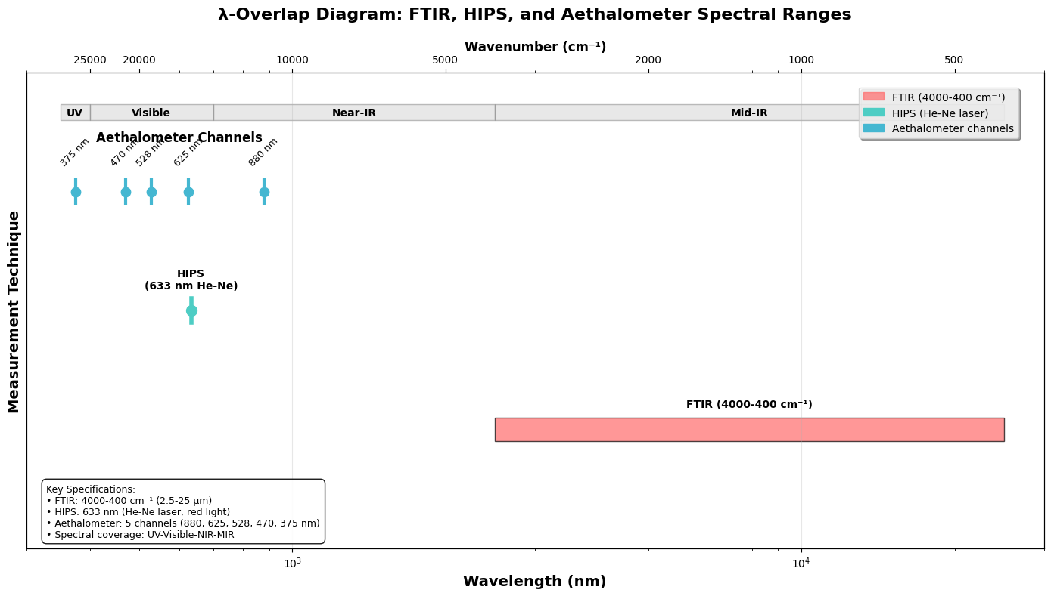

Slide 6
The MAC Problem - Four Different Calculation Methods
Method 1 - Mean of Ratios:
$$MAC=mean\left(\frac{F_{abs}}{EC}\right)=11.15 \frac{m^{2}}{g}$$
𝑀𝐴𝐶=𝑚𝑒𝑎𝑛(𝐹_𝑎𝑏𝑠/𝐸𝐶)=11.15" " 𝑚^2/𝑔
Method 2 - Ratio of Means:
$$MAC=\frac{{mean(F}_{abs})}{mean(EC)}=10.\text{09} \frac{m^{2}}{g}$$
𝑀𝐴𝐶=(〖𝑚𝑒𝑎𝑛(𝐹〗_𝑎𝑏𝑠))/(𝑚𝑒𝑎𝑛(𝐸𝐶))=10."09 " 𝑚^2/𝑔
Method 3 - Standard Regression:
$$F_{abs}=m∗EC+b→MAC=4.20 \frac{m^{2}}{g}$$
𝐹_𝑎𝑏𝑠=𝑚∗𝐸𝐶+𝑏→𝑀𝐴𝐶=4.20" " 𝑚^2/𝑔
Method 4 - Origin Regression:
$$F_{abs}=m∗EC→MAC=9.\text{18 }\frac{m^{2}}{g}$$
𝐹_𝑎𝑏𝑠=𝑚∗𝐸𝐶→𝑀𝐴𝐶=9."18 " 𝑚^2/𝑔
Statistical Performance vs Physical Reality:
Method 3 has the best R² (0.754) but predicts negative BC when F_{abs} = 0
This violates the fundamental physical constraint that zero absorption should equal zero BC.

Slide 7
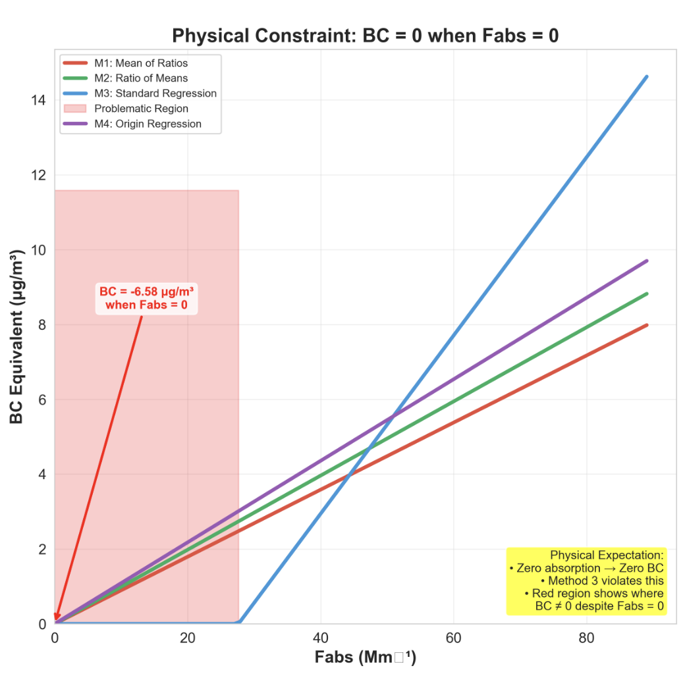

Slide 8
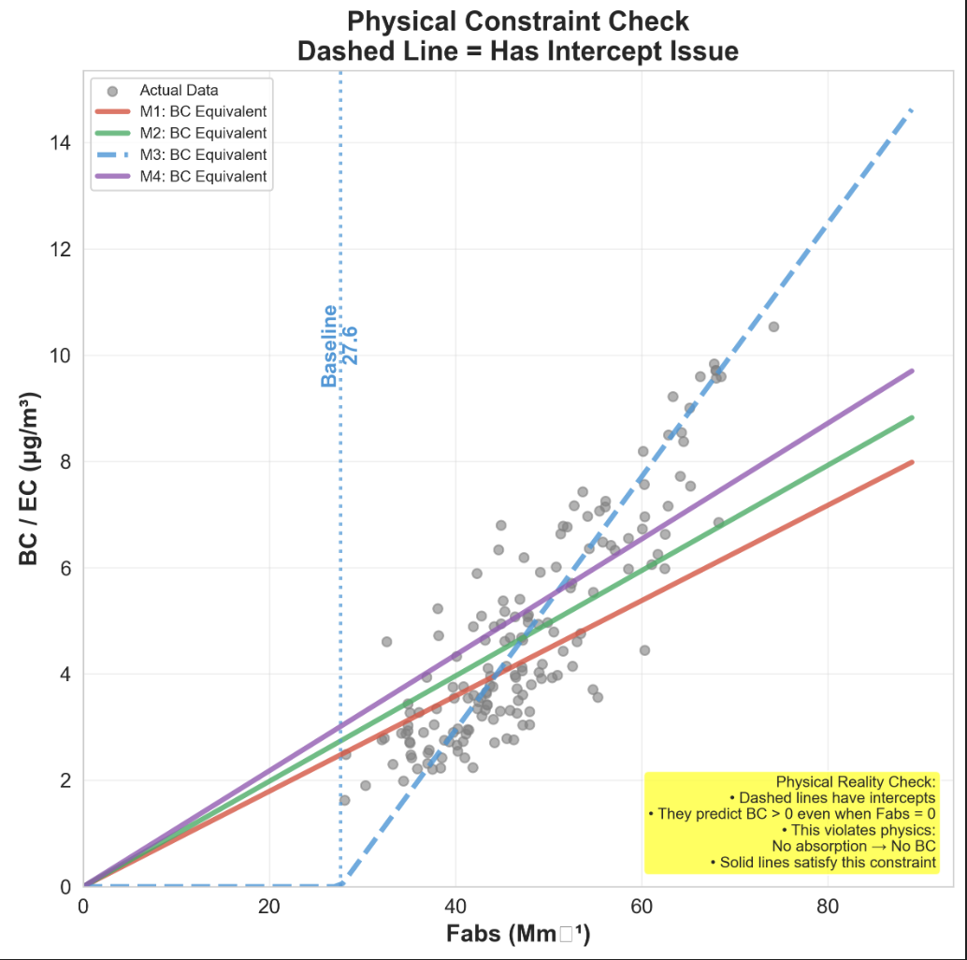

Slide 9
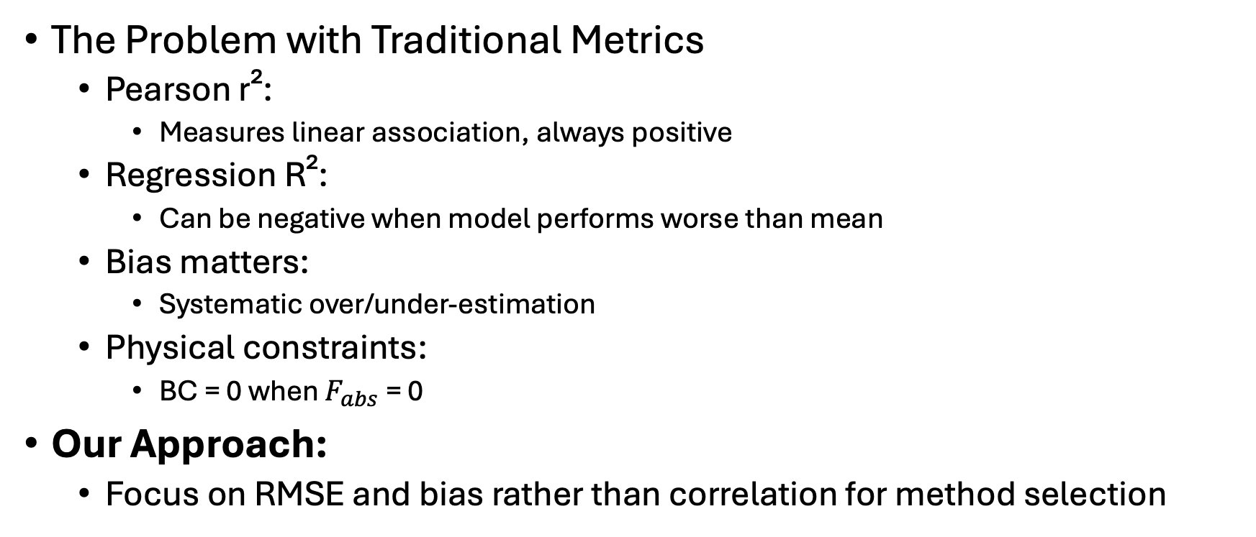
Why R² Alone Isn't Enough
The Problem with Traditional Metrics
Pearson r²:
Measures linear association, always positive
Regression R²:
Can be negative when model performs worse than mean
Bias matters:
Systematic over/under-estimation
Physical constraints:
BC = 0 when $F_{abs}$= 0
Our Approach:
Focus on RMSE and bias rather than correlation for method selection

Slide 10
Iron Interference Investigation
Why Iron Matters
Iron absorbs light at 633nm (HIPS wavelength)
Ethiopia has significant dust sources
Could create "false" BC signal
Average Fe concentration: ~300 ng/m³
Extinction Coefficients:
Iron (Fe³⁺): 2,220 M⁻¹ cm⁻¹
Manganese: 50-500 M⁻¹ cm⁻¹
Iron is 5-10× stronger absorber

Slide 11
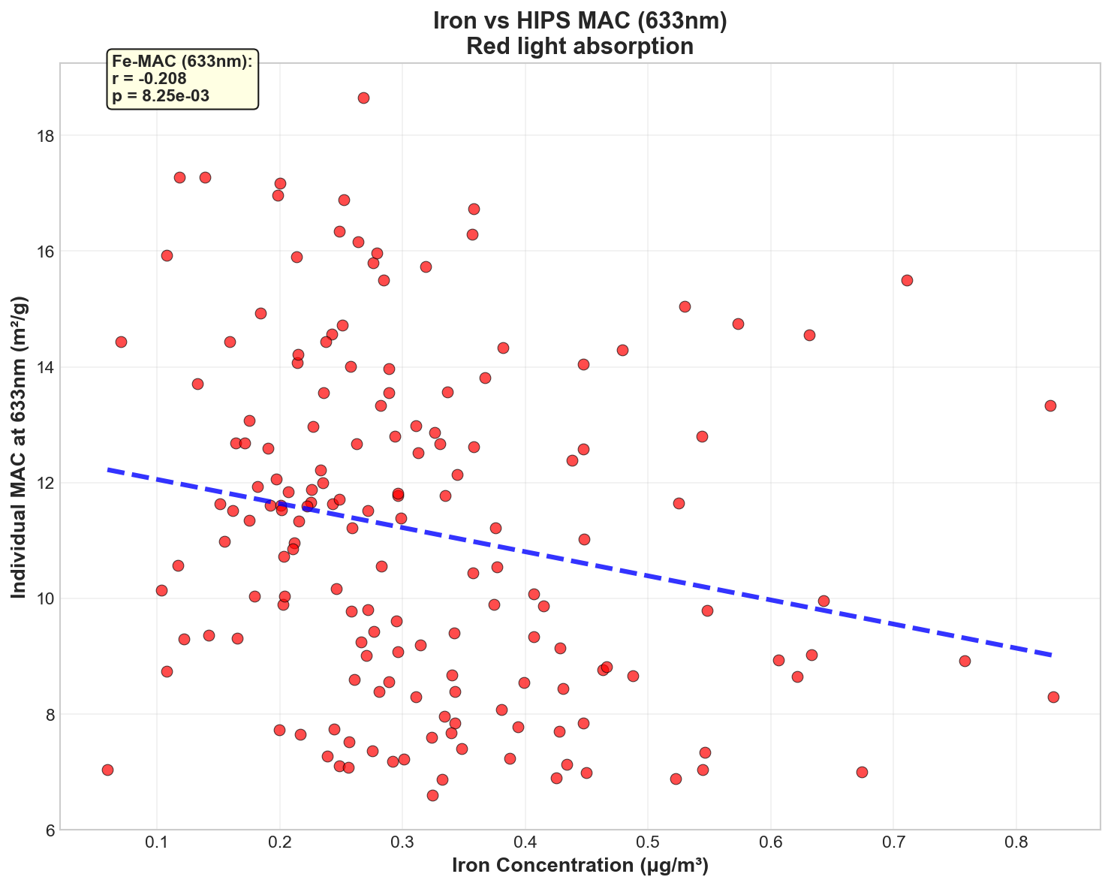

Slide 12
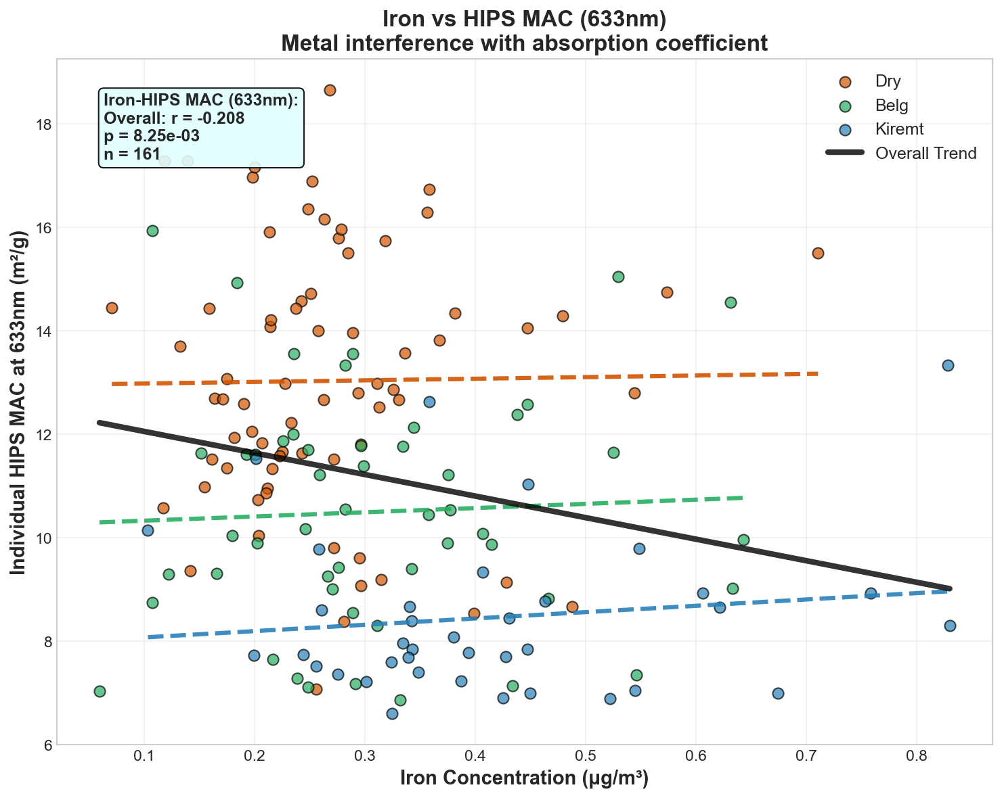

Slide 13
Maybe Iron isn't that bad?
Overall trend: Weak downward relationship between iron concentration and HIPS MAC
r = -0.208, suggesting minimal direct iron effect
Critical insight: When data is separated by Ethiopian seasons (static definition), trends within each season flatten
Dry season: MAC values consistently higher (~13 m²/g), regardless of iron levels
Belg season: Intermediate MAC values (~10.5 m²/g), weak iron dependence
Kiremt season: Lower MAC values (~8.5 m²/g), minimal iron trend

Slide 14
Cross-Method Validation
FTIR-EC vs Aethalometer
Correlation: r² = 0.608
Systematic offset: Aethalometer consistently higher
Bias: ~2× overestimation by aethalometer
HIPS vs Aethalometer
Correlation: r² = 0.558
Similar bias pattern: Aethalometer systematically high
Temporal consistency: All methods track same events
Key Finding: Systematic Aethalometer Bias
Magnitude: Aethalometer mean = 7.7 μg/m³
FTIR/HIPS: Both ~4.6 μg/m³
Implication: Default aethalometer corrections inappropriate for this site
Possible causes: Filter loading, MAC assumptions, baseline corrections
Critical Insight:
Underlying factor causing systematic aethalometer overestimation needs investigation

Slide 15
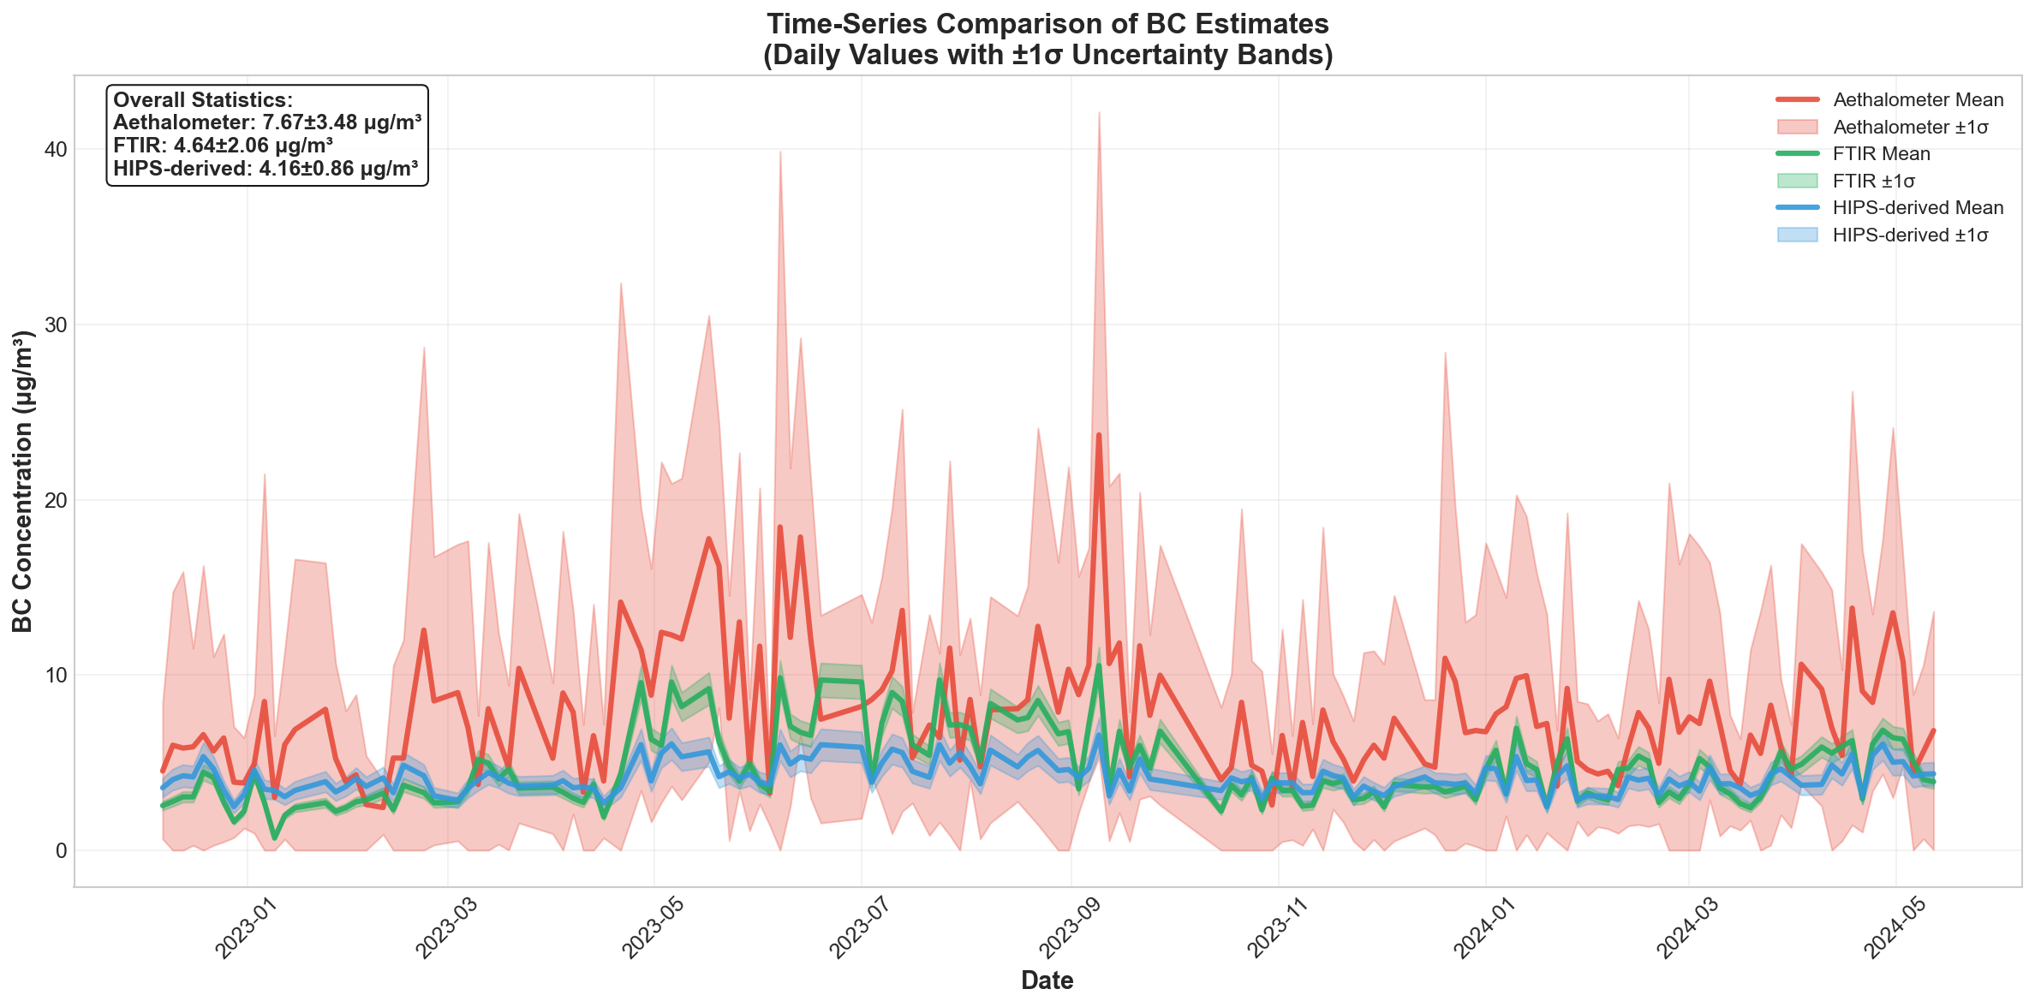

Slide 16
Key Takeaways
Method Selection Matters
Statistical performance (R²) can be misleading. Physical constraints and bias are more important for operational measurements.
Seasonality is Real
MAC values vary by >50% between dry and wet seasons.
Aethalometer Systematic Bias
Aethalometer consistently overestimates BC by ~2× compared to FTIR-EC and HIPS. This suggests default corrections are inappropriate for Ethiopian aerosols.
Site-specific Calibration Required
Universal MAC values (10 m²/g) and default instrument corrections are insufficient for accurate BC measurements in diverse environments.

Slide 17
Next Steps
Immediate Priorities
Dynamic season definitions: Use rainfall data instead of calendar months
All wavelength analysis: Complete aethalometer multi-λ comparison
Validation with raw attenuation: Compare τ vs corrected BC
Future Directions
Pasadena comparison: Test transferability to different environment
Humidity corrections: Account for RH effects on optical measurements
Dynamic MAC: Develop dynamic MAC based on composition

Slide 18

Acknowledgment
Supervision & Guidance
Dr. Ann Marie Dillner (UC Davis)
Dr. Hossein Kazemian (UNBC)
Collaborators
SPARTAN Network Team
NASA JPL
Addis Ababa University

