Slide 2
Greene Thesis Proposal
Nov 9, 2015

Slide 3
Outline
Introduction
Completed Aims
Ongoing Aims
Organization & Time Frame

Slide 4
Purpose
Preparedness
Sufficiency
Additional Steps
General Discussion
Future Plans

Slide 6
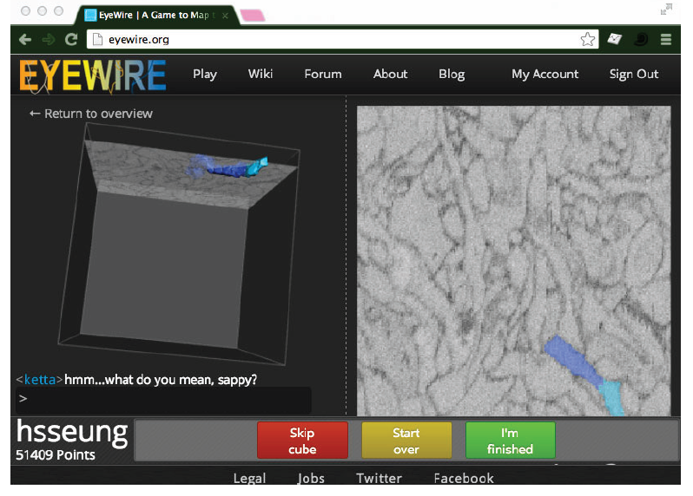
e2198 Dataset

Slide 7
Completed Aims

Slide 8
Aim 1: BC classification
We aim to create an objective classification scheme for bipolar cells in the mouse retina using only morphological features available to both LM and EM methodologies.

Slide 9
Aim 1: Purpose
BC classification is subjective, error-prone
Consistency across imaging techniques
Required for understanding downstream circuitry
Confirm a “complete” catalog of BC types

Slide 10
Aim 1: Background
Early BC subdivision
  Receptive field polarity (On-center or Off-center)
  “flat” or “invaginating” synapses with photoreceptors
Later focus on depth of axonal arbor stratification and immunostaining

Slide 11
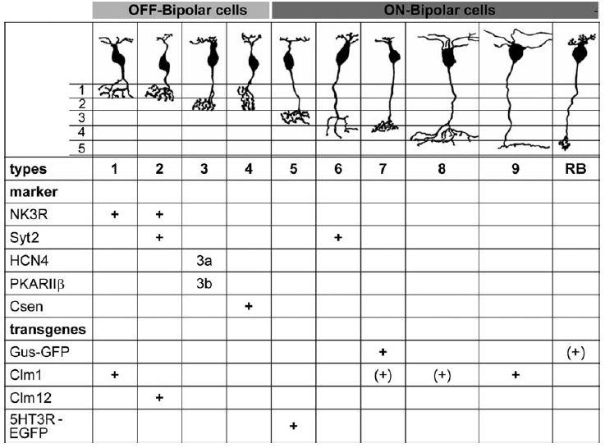
Aim 1: Background
Wässle et al (2009)

Slide 12
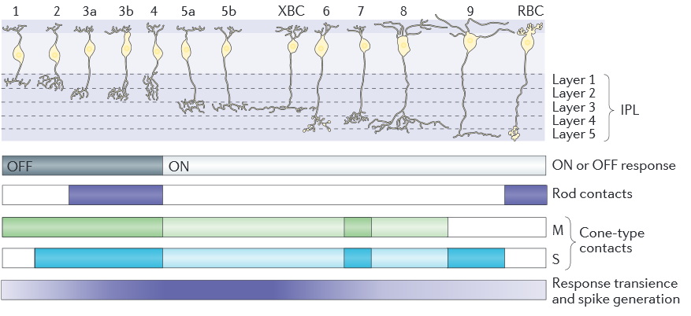
Aim 1: Background
Euler et al (2014)

Slide 13
Aim 1: Methods
Helmstaedter et al (2013)

Slide 14
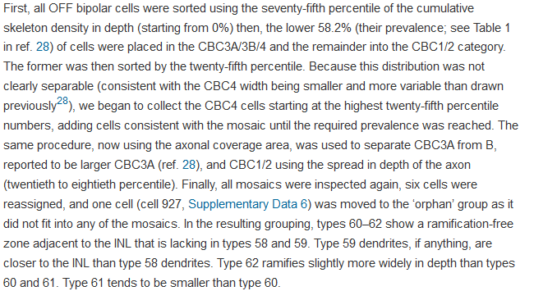
Aim 1: Methods
Helmstaedter et al (2013)

Slide 15
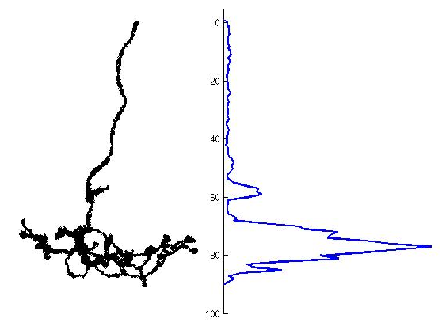
Aim 1: Methods
Percent IPL Depth

Slide 16
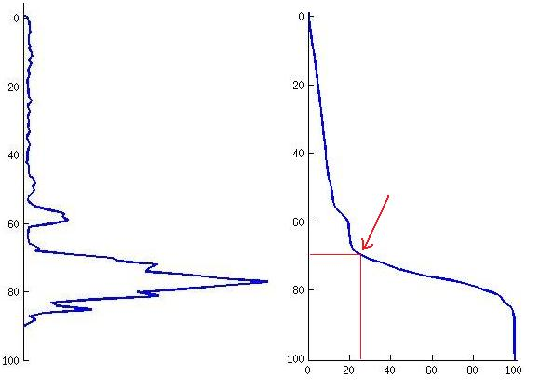
Aim 1: Methods
25th Percentile Depth
Percent IPL Depth
Surface Area Percentile

Slide 17
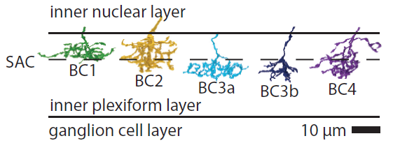
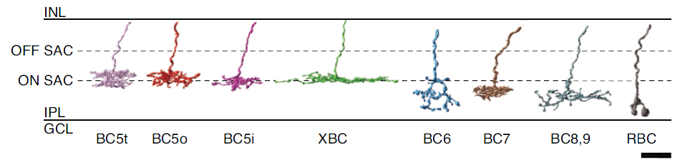
Aim 1: Results

Slide 18
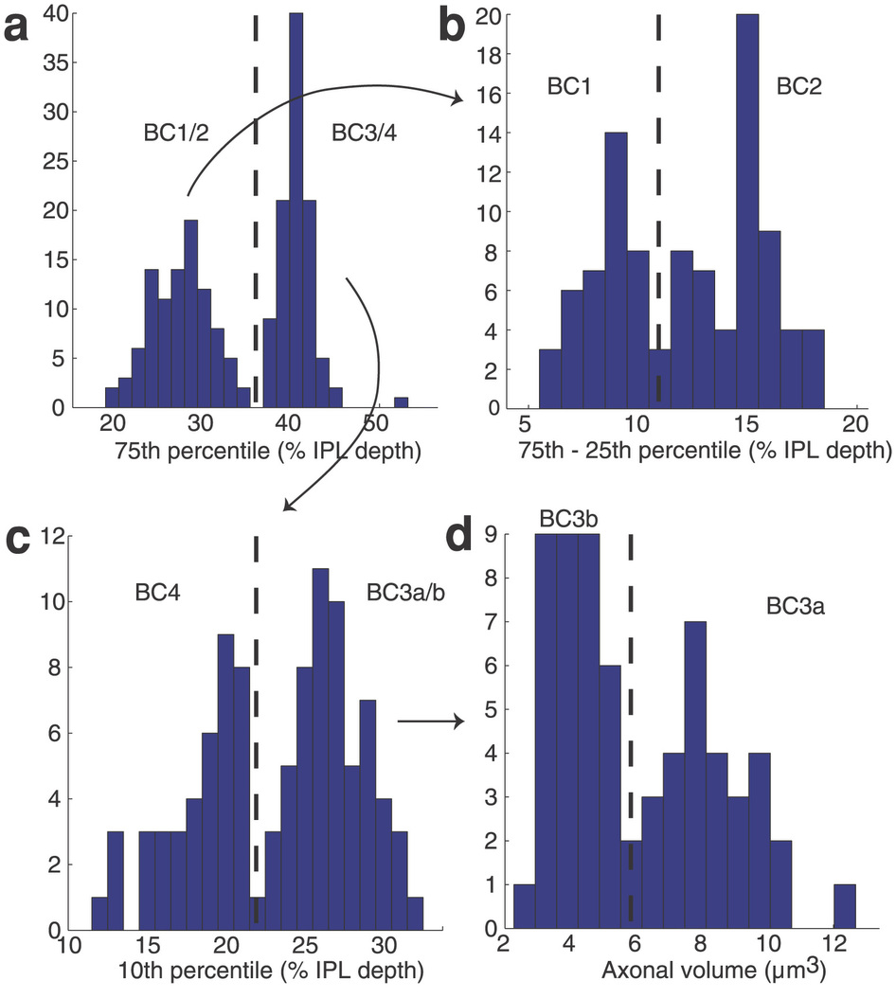
Aim 1: Results

Slide 19
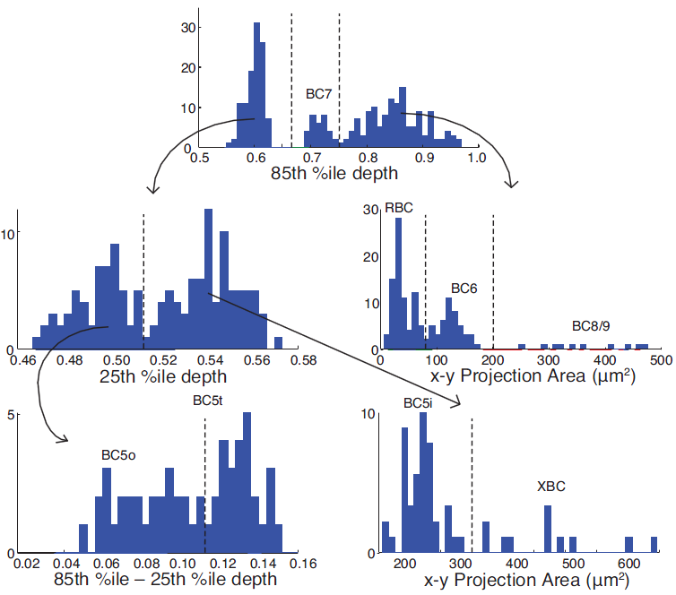
Aim 1: Results

Slide 20
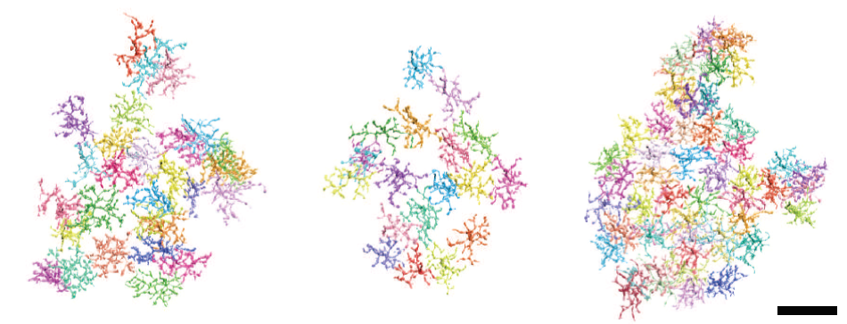
Aim 1: Results
BC5t
BC5o
BC5i

Slide 21
Aim 2: DS in the Off-SAC
We aim to confirm a hypothesis that Off-SAC directional selectivity may arise through presynaptic mechanisms.

Slide 22
Aim 2: Purpose
Prior hypotheses rely on post-synaptic mechanisms
Novel model may be applicable to other circuits
Explains observed “tilt” in Off-SAC arborization

Slide 23
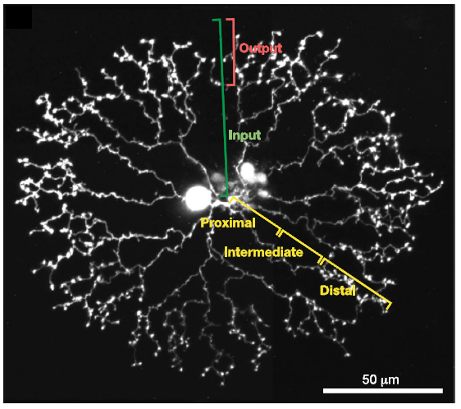
Aim 2: Background
Euler et al (2002)

Slide 24
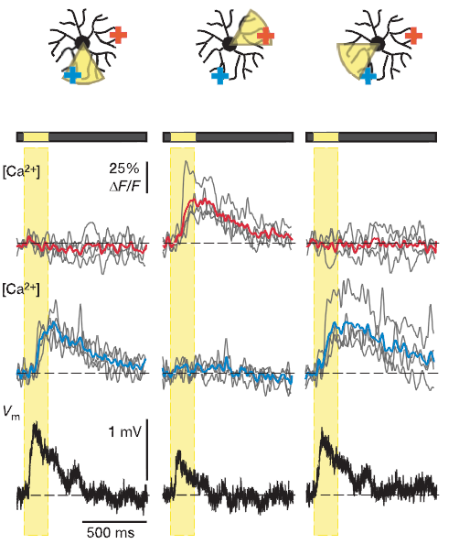
Aim 2: Background
Euler et al (2002)

Slide 25
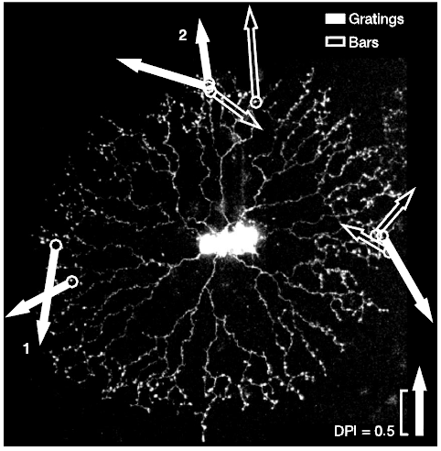
Aim 2: Background
Euler et al (2002)

Slide 26
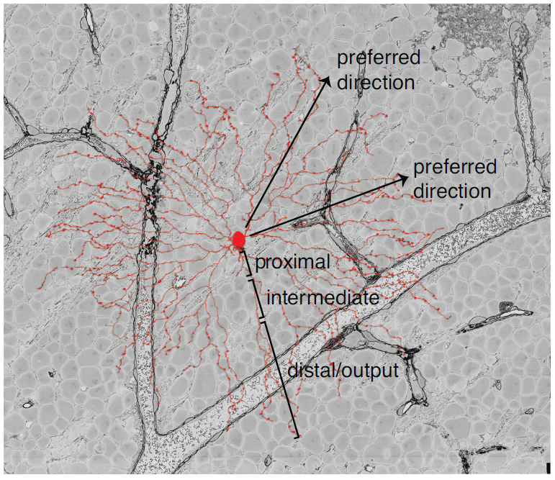
Aim 2: Background

Slide 27
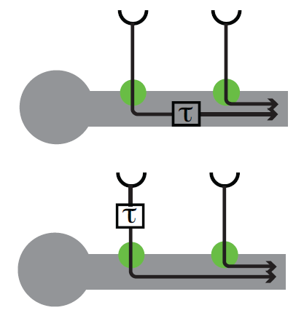
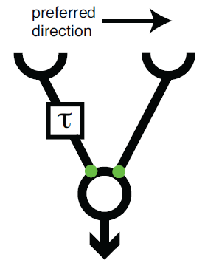
Aim 2: Background

Slide 28
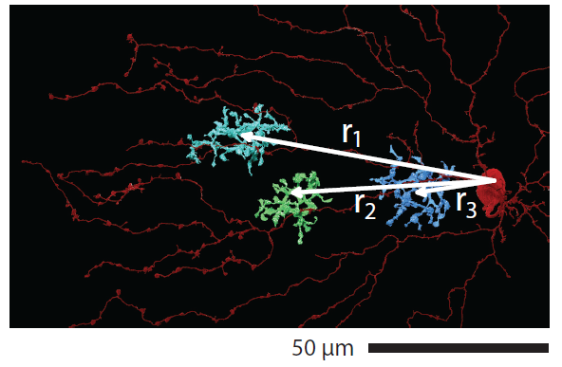
Aim 2: Methods

Slide 29
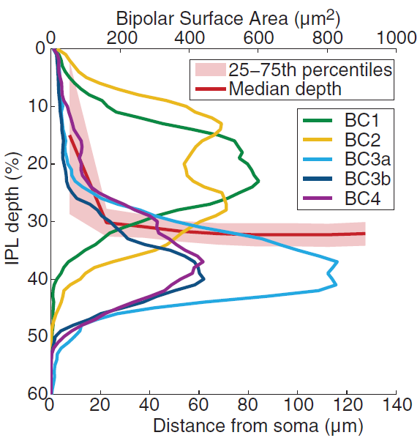
Aim 2: Results

Slide 30
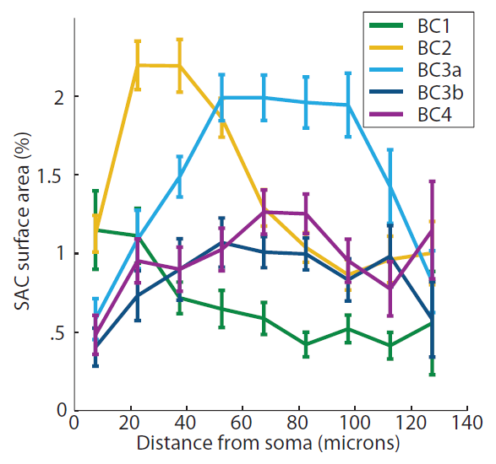
Aim 2: Results

Slide 31
Ongoing Aims

Slide 32
Aim 3: Parallelism in the On-SAC
We aim to show that the On-SAC shows similar space-time wiring specificity.

Slide 33
Aim 3: Purpose
Original work is only in the On SAC (Euler et al 2002)
Some evidence of differences between On and Off SACs

Slide 34
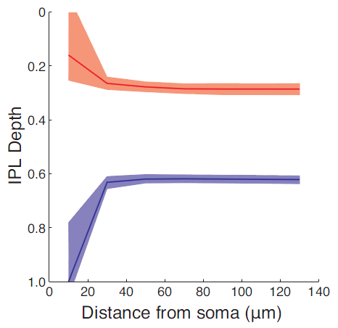
Aim 3: Preliminary Results

Slide 35
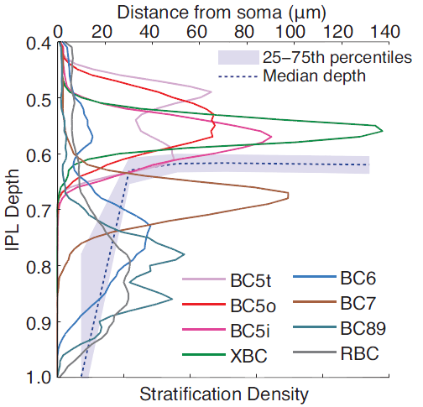
Aim 3: Preliminary Results

Slide 36
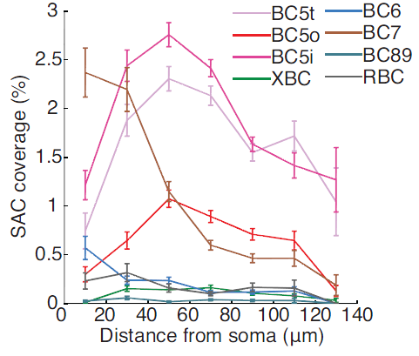
Aim 3: Preliminary Results

Slide 37
Aim 4: SAC to GC connectivity
We aim to explore the complete circuitry of the On-Off DSGC and the On DSGC, to confirm the observation that DS in these arises from biased SAC input, and to investigate a possible excitatory pathway

Slide 38
Aim 4: Background
Barlow & Levick first identified these units in 1964
Hypothesized an inhibitory mechanism of DS
Discovery of SACs led to the theory that they provide inhibition to the On-Off DSGC
Confirmed by Briggman et al (2011)

Slide 39
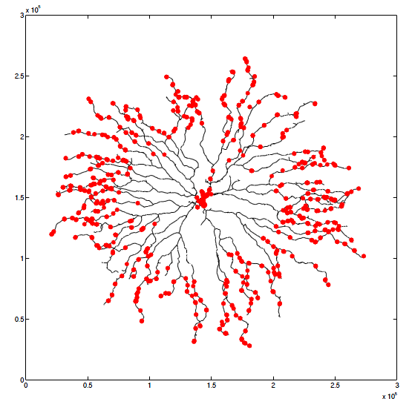
Aim 4: Methods

Slide 40
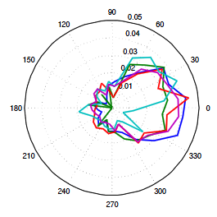
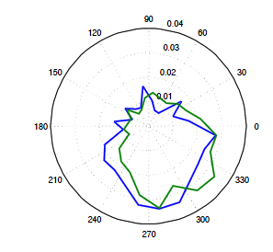
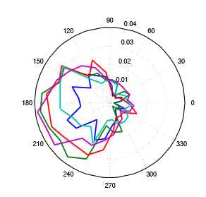
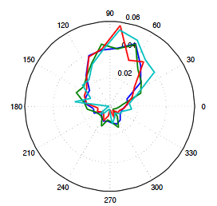
Aim 4: Results

Slide 41
Organization/Conclusion
Written Component
Documentation
New member
Scheduling

