Slide 1
Retinal Circuitry for Direction Selectivity of the Starburst Amacrine Cell
Matthew Greene
11/24/2013

Slide 2
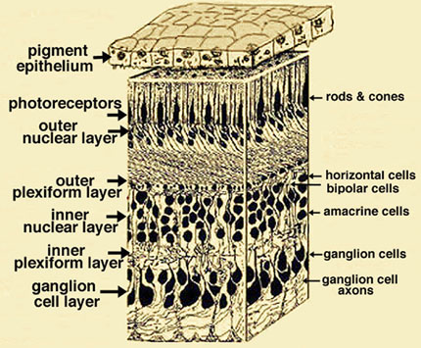
The Mammalian Retina

Slide 3
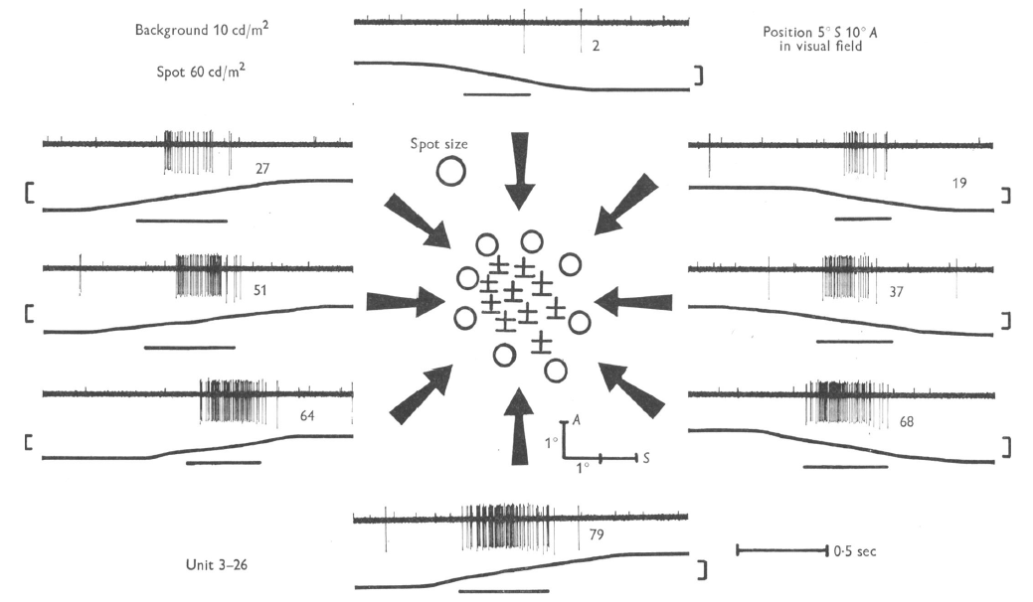
Direction Selectivity (DS)
Barlow et al (1964)

Slide 4
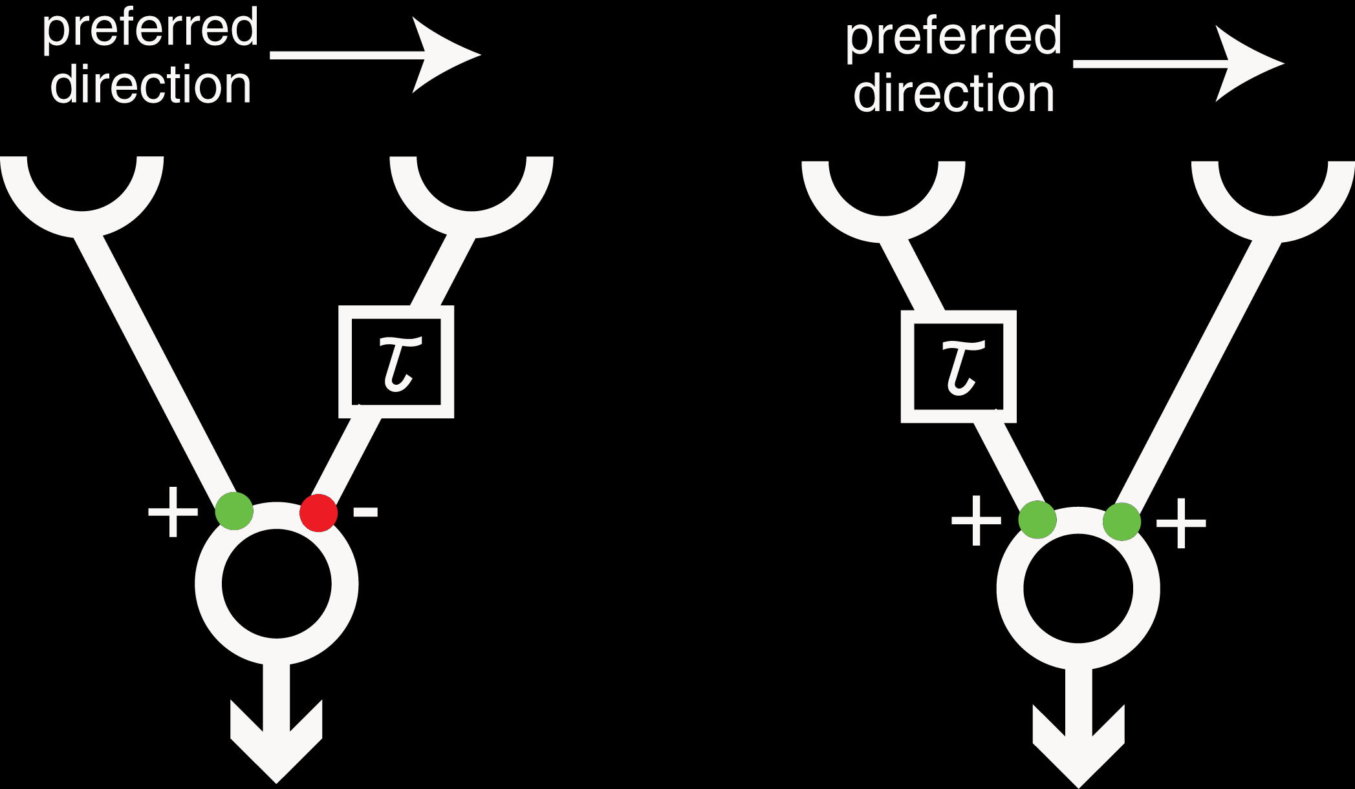
Models for Direction Selectivity
Barlow-Levick model -1965
Hassenstein-Reichardt model -1956

Slide 5
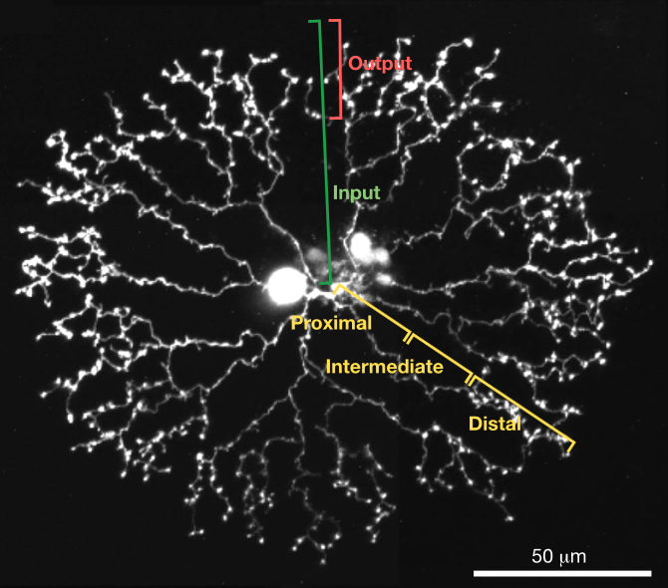
Starburst Amacrine Cells (SACs)
Euler et al (2002)

Slide 6
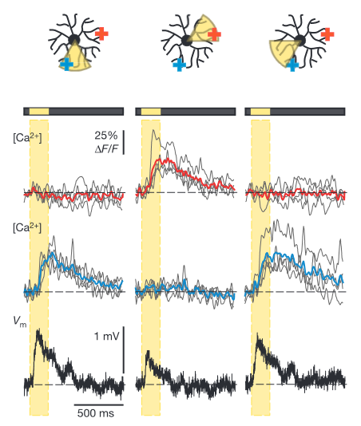
Starburst Amacrine Cells (SACs)
Euler et al (2002)

Slide 7
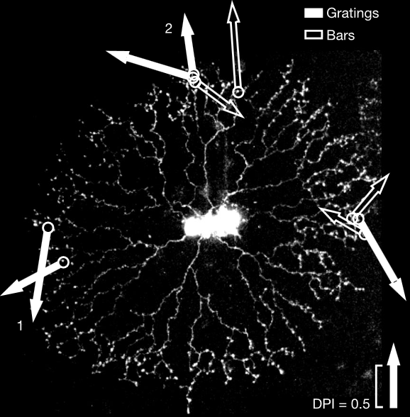
DS in the SAC
Euler et al (2002)

Slide 8
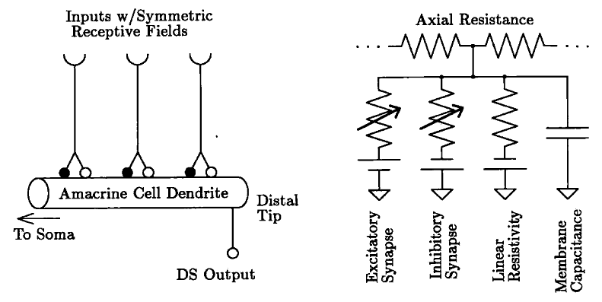
Post-synaptic Hypothesis
Borg-Graham and Grzywacz (2002)

Slide 9
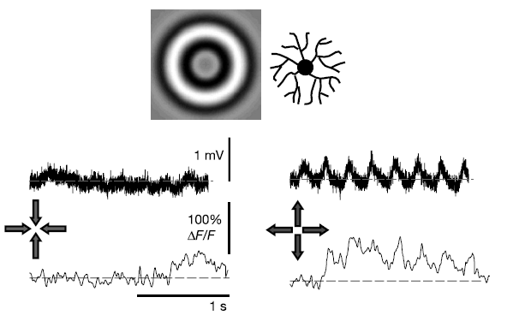
Post-synaptic Hypothesis
Euler et al (2002)

Slide 10
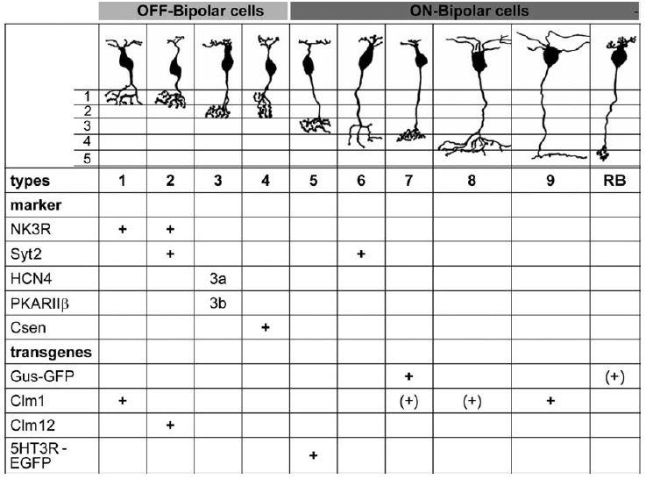
Pre-synaptic Hypothesis
Wässle et al (2009)

Slide 11
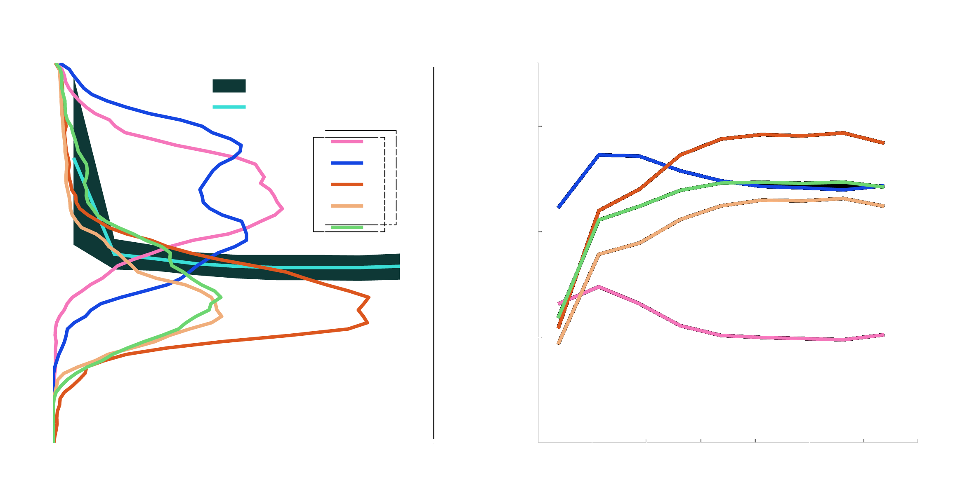
Spatial Separation

Slide 12
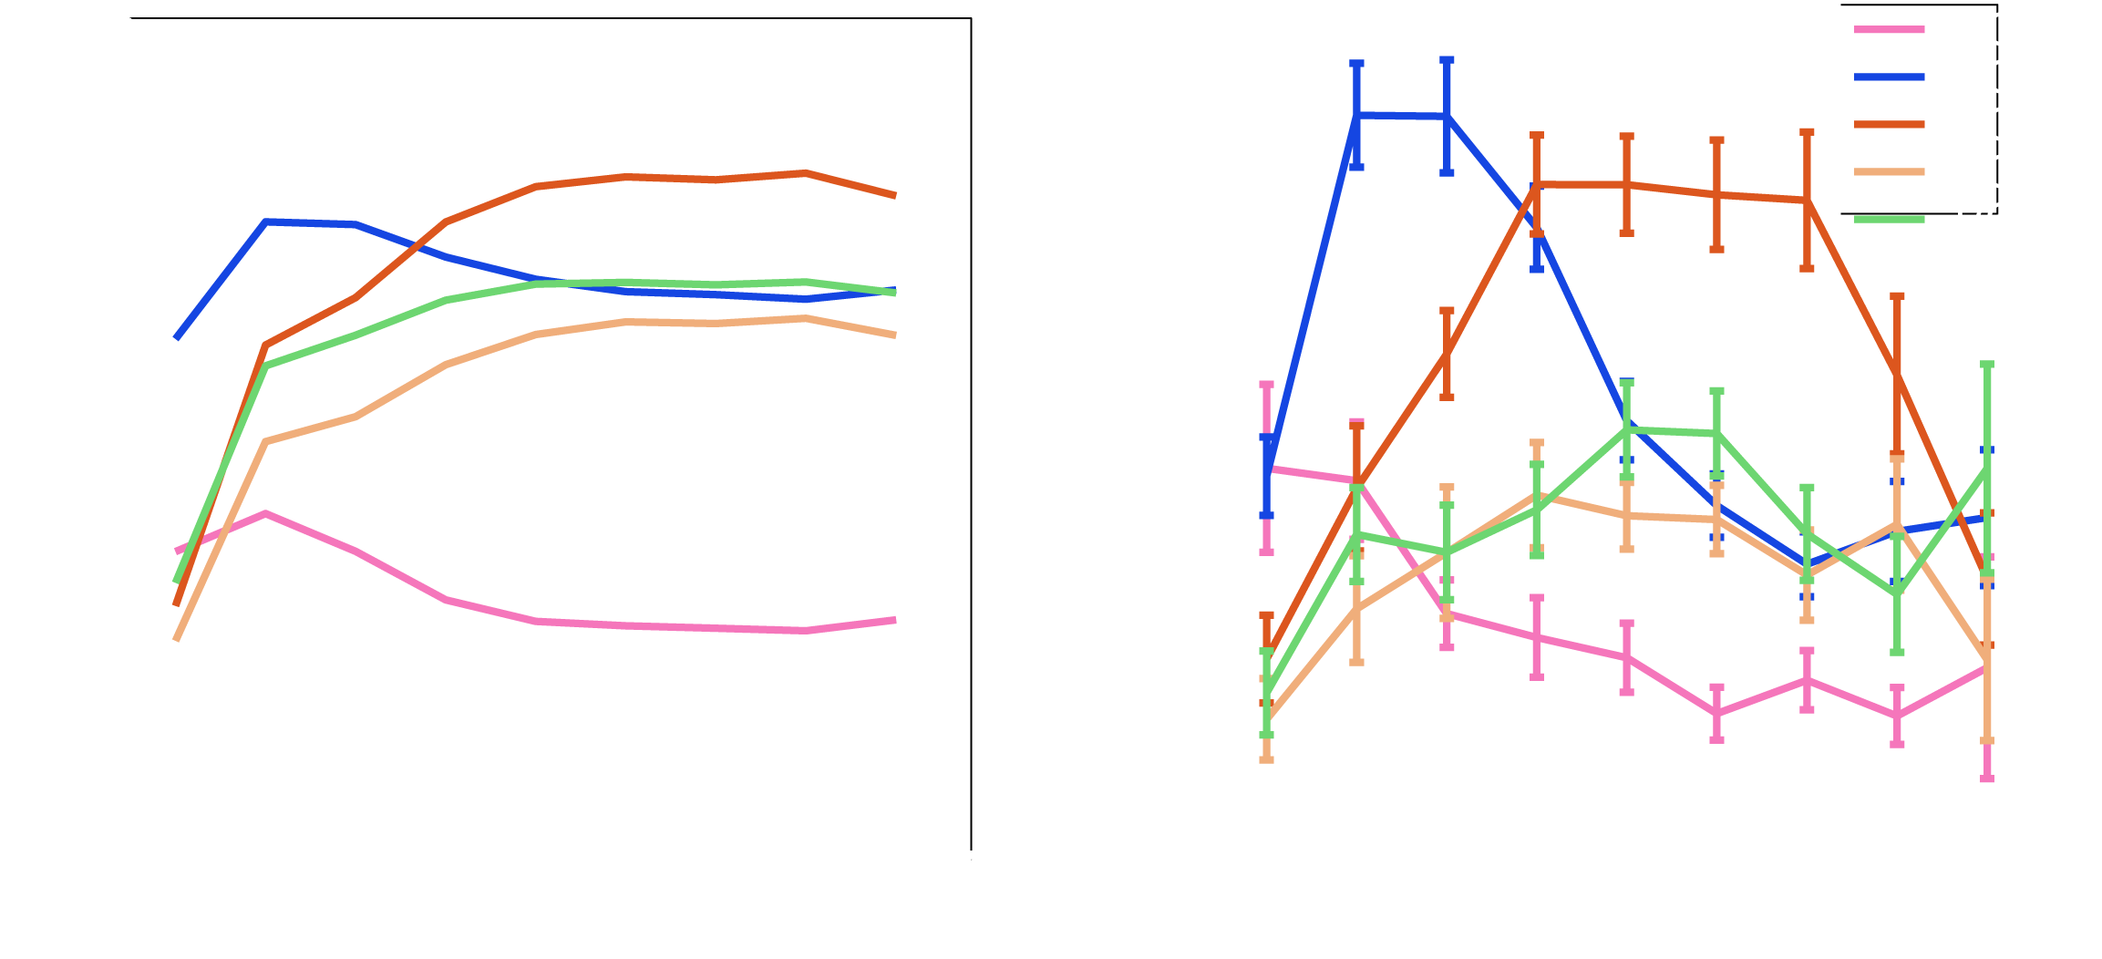
Spatial Separation

Slide 13
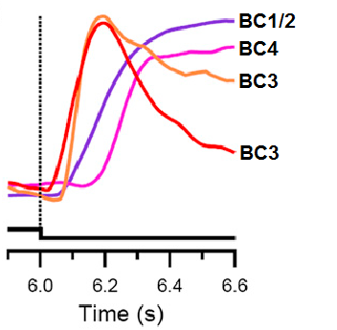
Temporal Separation
Baden et al (2012)

Slide 14
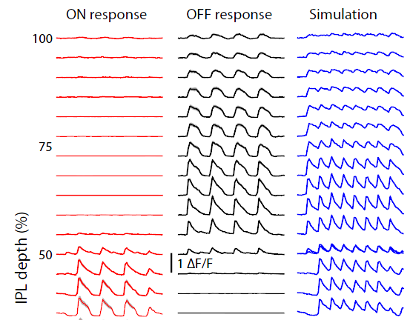
Temporal Separation
Borghuis et al (2013)

Slide 15
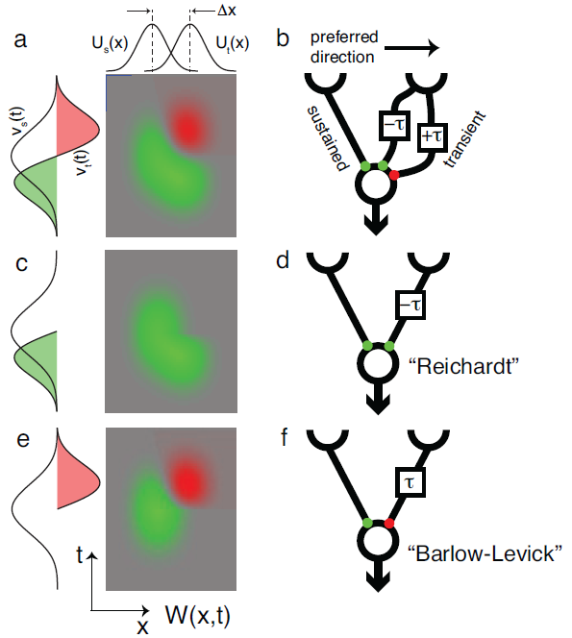
Putative Model

Slide 16
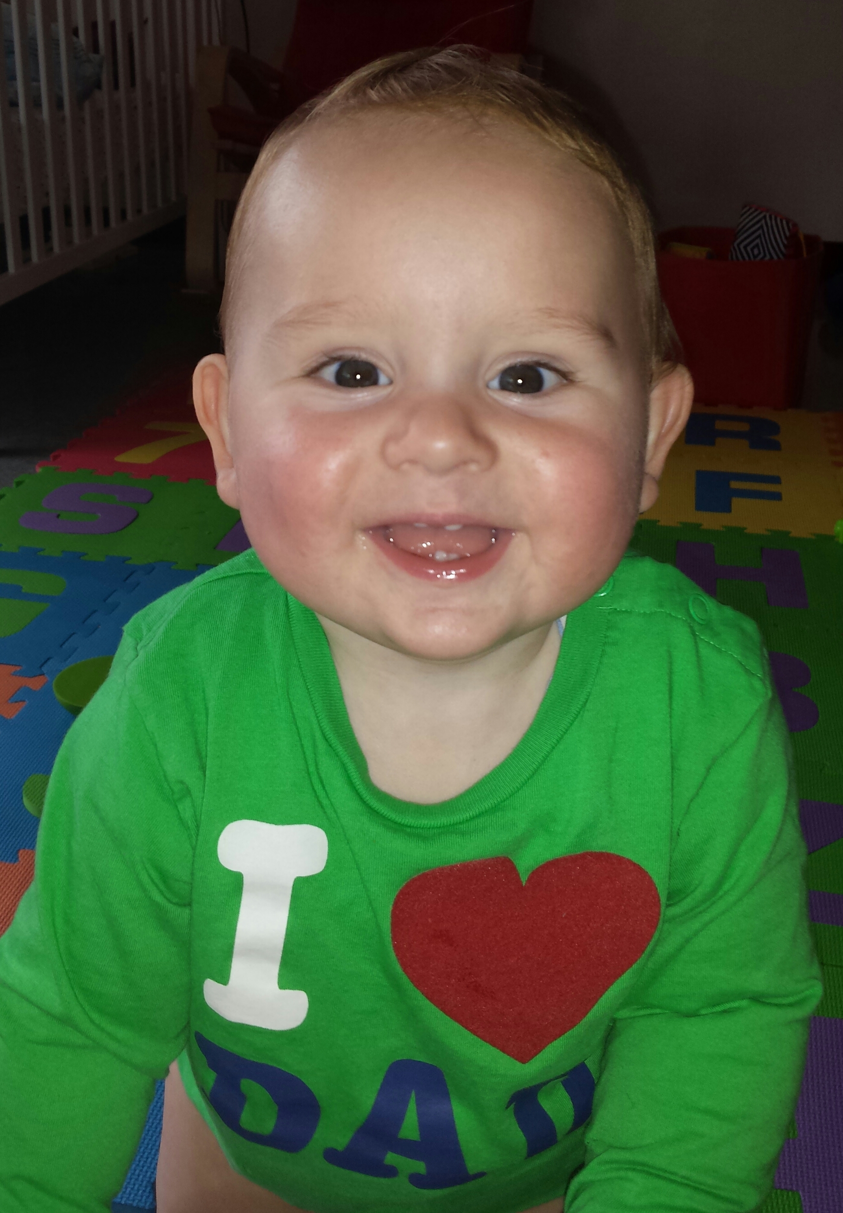
Thank you!

Slide 17
Extras and Deleted Scenes

Slide 18
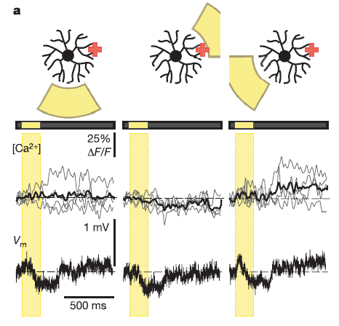
SAC surround is inhibitory
Euler et al (2002)

Slide 19
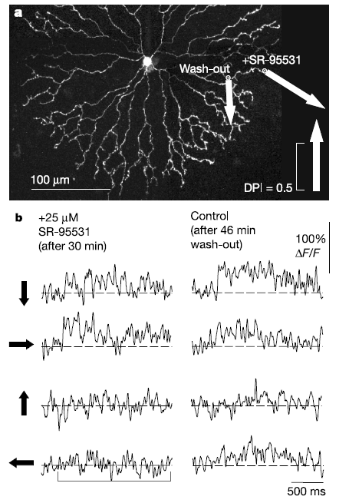
DS in SAC with GABA blocking
Jimmy Zhou also shows this
Euler et al (2002)

Slide 20
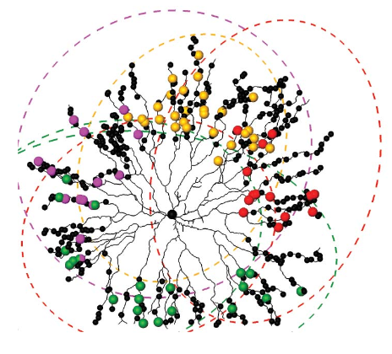
SAC to DSGC connections
Briggman et al (2011)

Slide 21

Possible Arbor-based organization
Briggman et al (2011)

Slide 22
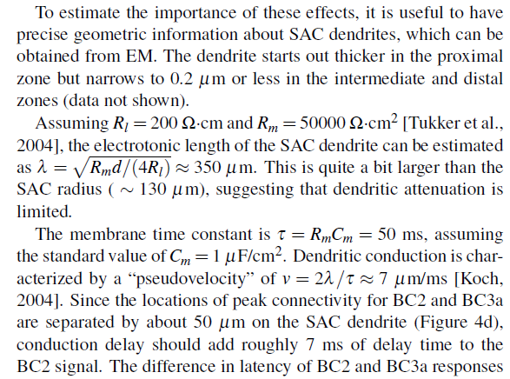
Electrotonic Length and Velocity Estimate

