Slide 1
Tutorial 5: JavaScript I
IT1152 / IT1352 / IT1552 / IT1652 / IT1852 / IT1952
Web Development

Slide 2
Experience usage of JavaScript in the web environment
Using JavaScript in console & web page
Concept of variables, global vs local
Pop up boxes
Built-in object: String
Calling a function and define function

Slide 3
Question 1: Writing JavaScript in web page (15 Mins)
Prompting and Displaying
Using Atom or Notepad++, create a web page with JavaScript which prompt and remember the name of user
greet the person
e.g. Hi Jerry, nice to meet you !
Prompt the person for age
Prompt the person how many friends he/she would like to make in a year
Calculate and show the user that in 5 years time how many friends he/she will have.
You may pair up to do this question

Slide 4
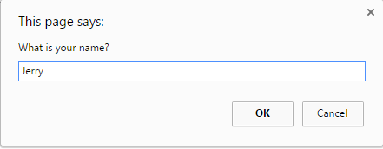
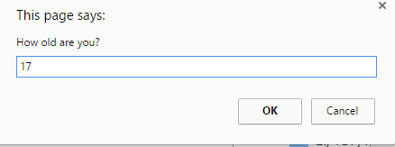
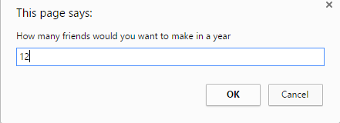
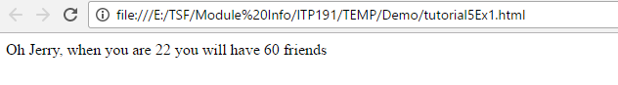

Slide 5
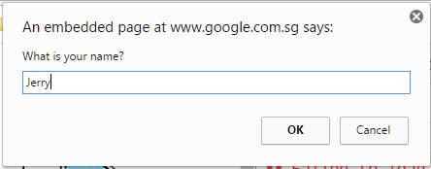
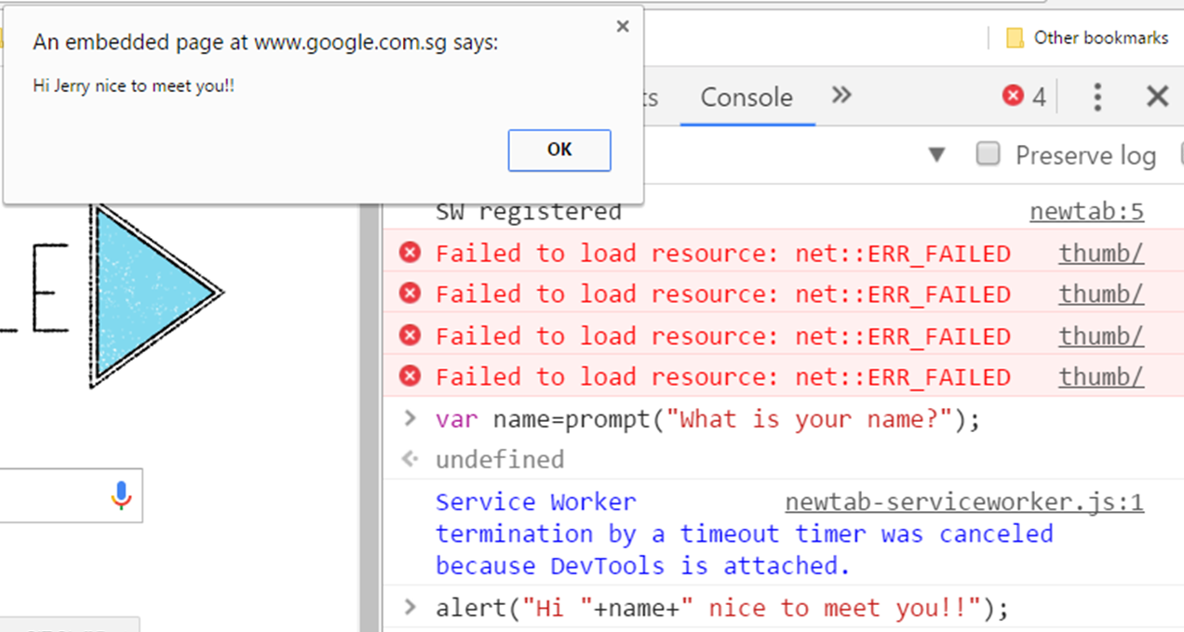

Slide 6
Question 2: Functions (15 Mins)
Functions, If/Else, Operators
Write a JavaScript program called sumTriple. This function will compute the sum of the two given integers. If the two values are same, then returns triple their sum.
The function will take in 2 numbers as integers. Use if/else to check if the numbers are the same, if yes, return sum *3, otherwise return the sum only.

Slide 7
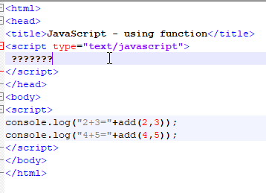
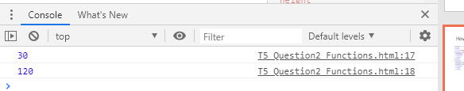
How should you write your function?
Your output at console:

Slide 8

Question 3 : Built in Functions (15 Mins Optional)
Built in Functions, Formatting
Write a JavaScript program to get the current date. Expected Output : dd-mm-yyyy, dd/mm/yyyy
Use getDate(), getMonth() and getFullYear()
Your output at console:

Slide 9

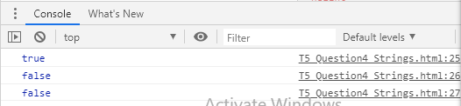
Question 4 : Strings Manipulation (15 Mins Optional)
Strings, Boolean
Write a JavaScript program to check whether a string starts with 'Super' and false otherwise. Test Data:
Your output at console:

