Slide 1

Building PowerWorld Cases from the EIA 860 Data
(Requires PowerWorld Simulator Version 23 or Later with a Build Date after March 21, 2023)
Prof. Tom Overbye
Dept. of Electrical and Computer Engineering
Texas A&M University
overbye@tamu.edu March 2023

Slide 2
Goal
The goal of these slides is to show how public, US Energy Information Administration (EIA) Form EIA-860 generator data can be used to create a PowerWorld power flow case
The purpose for doing this is to allow the visualization of this generation information using the power of PowerWorld Simulator
The associated case can then be used with other information, such as weather
While a power flow case is created, there is no transmission grid; rather, all the generators are connected to a slack bus through low impedance lines
Since only public data is used, these cases can be freely shared
There is great flexibility in how these cases could be created; these slides just provide one approach; time to create a case should be at most several hours (and less with practice)
2

Slide 3
Form EIA-860 Data
Form EIA-860 is used to collect generator specific information about existing and planned generators in the U.S. with a capacity of 1 MW or greater
This data is provided annually, with early release data for the prior year usually available in June and the final release in September
The website is https://www.eia.gov/electricity/data/eia860/
Data is provided in several Schedules (Excel spreadsheets)
Schedule 1 provides utility information, Schedule 2 provides plant information, Schedule 3, which has several parts, provides generator information
These slides assume the EIA-860 data from 2021; some modifications may be needed for other years if the format has changed
3

Slide 4
Form EIA-860 PowerWorld Data Structures
Areas are used to represent the Schedule 1 (utility) data
A fictional slack area is also created; a single super area is also provided which includes all the areas except for the slack area
Substations and buses are used to represent the Schedule 2 (plant) data, with one bus per substation; a fictional “slack bus” bus and substation is also created
Generators are used to represent the Schedule 3 (generator) data with one generator per Schedule 3 line; a fictional slack bus generator is also created; cases may optionally include planned generators
Zones are used to summarize the information by state; a separate slack zone is also created
4

Slide 5
Cookbook Procedure
Obtain the EIA-860 data and extract the files into a directory; the examples provided here are based on the EIA-860 data for 2021 and PowerWorld Simulator Version 23 (beta or later)
The procedure gives one approach and can certainly be customized. For example, building one case with just the currently installed generation, and another also including the proposed generation.
Open Simulator and select File, New Case; close the default “NewOne1” oneline – later slides give an example of how to create a geographic data view (GDV) onelines
5

Slide 6
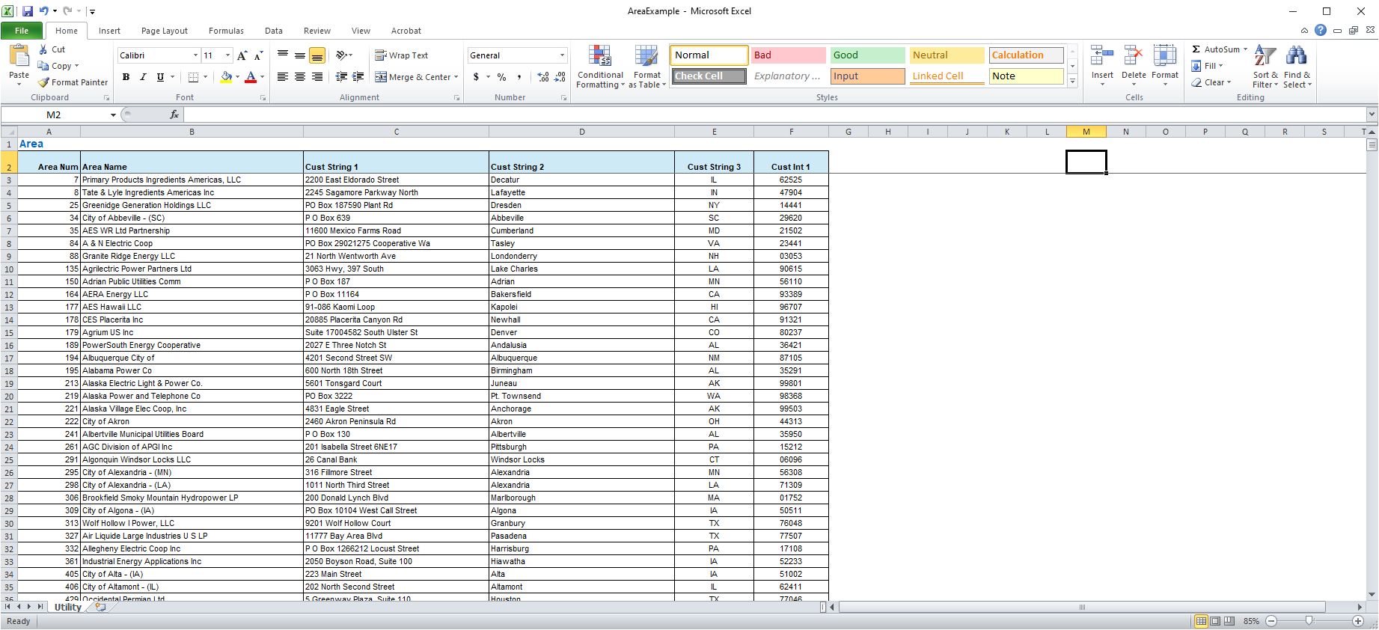
Cookbook: Use Utility Data to Define Areas
Load the Schedule 1 data into Excel, replace the first line with “Area”
Replace the first column, “Utility ID”, with “Area Num”
Replace the second column, “Utility Name”, with “Area Name”
As desired place some of the other columns with custom fields, such as “Street Address” with “Cust String 1”, “City” with “Cust String 2”, Zip with “Cust Int 1”
If desired delete other columns
Select all. In Simulator Edit Mode view Case Information, Aggregation Areas; right-click and select Copy/Paste/Send, Paste to define the utilities as the Simulator case areas
6

Slide 7
Cookbook: Manually Setup a Super Area, Slack Area
Select Aggregation, Super Areas. Right-click and select Insert to enter a super area to hold all the areas. Give it a name say “FullCase”
To add all the areas to the case, in the “New Area #’s” field enter “1-99999”; the click Add New Areas by Number
Select OK to save the new super area and close its dialog
Select Aggregation, Areas to manually enter an area for the slack bus.
Select Insert, and give it a large area number (say 999999); for its name enter “SlackArea”
It is important to have a separate area to the slack bus generation that is not included in the other totals. Also, this area is not in the super area.
7

Slide 8
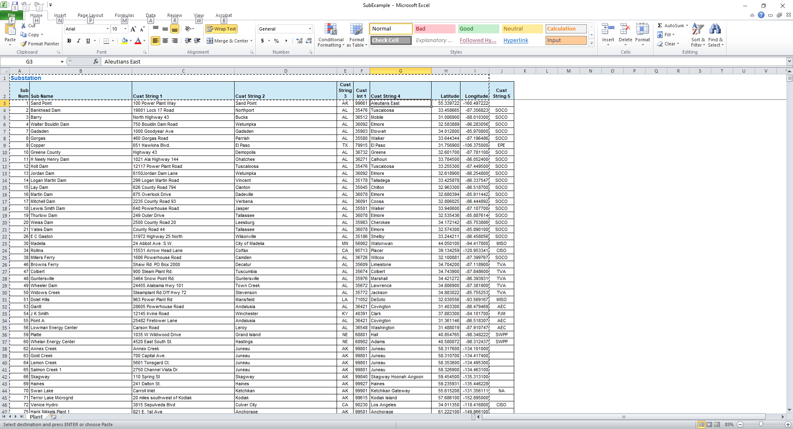
Cookbook: Substations
The substations and buses are used to store the Schedule 2.
Load the Schedule 2 data into Excel; Delete the first two columns (“Utility ID” and “Utility Name”); this information will be stored with the buses
On the first line enter “Substation”
Replace the new first column, “Plant Code”, with “Sub Num”; replace the “Plant Name” column with “Sub Name”; keep the “Latitude” and “Longitude” columns
As desired use custom fields to store the other fields, deleting the rest
Select all. In Simulator Edit Mode view Case Information, Aggregation Substations; paste the data
Manually enter a slack bus substation with a number of 999999 and a name of “SlackSub”; leave its latitude and longitude blank
8

Slide 9
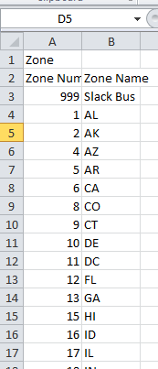
Cookbook: Zones
Zones provide another way to group information. Here the zones are used to group the generators by their US state
If not already available, in a blank Excel page enter “Zone” on the first line; then on the second line name the first column “Zone Num” and the second column “Zone Name”
On subsequent lines enter the state FIPS (Federal Information Processing System) Code as the Zone Num and the Postal abbreviation as the Zone Name (this information is widely available online); usually it is best to include the US territories as well, such as Puerto Rico (PR, 44). Setup a slack bus zone, with a number of 999 and a name of SlackZone
Be sure to save the case often as you are building it
9

Slide 10
Cookbook: Buses
Use the Schedule 2 data to also setup the buses. The difference from the substations is now the utility code is used to set the bus’s area, the State fields are used to set the zone, and the Plant Code is both used as the bus and the substation number.
Load the Schedule 2 data into Excel, change the first line to “Bus”; change the “Utility ID” field to “Area Num”, delete the “Utility Name” column
Change “Plant Code” to “Number”
Change “Plant Name” to “Name”
Change “NERC Region” to Cust String 1
Change “County” to Cust String 2
Change “Zip” to Cust String 3
Change “Balancing Authority Name” to Cust String 4
Change “Name of Water Source” to Cust String 5
Copy the “Number” column and paste in a new column with a name of “Sub Num”
Add a new column with a name of “Nom KV” and give each line an entry of “138” (the nominal kV for the bus does not matter for this case)
10

Slide 11
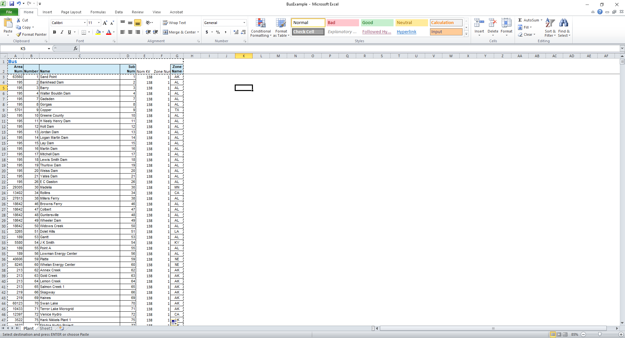
Cookbook: Buses, cont.
Pasting in buses also requires the zone number be specified; since the Schedule 2 data has the state (zone) name but not the number. The easiest way to do this is to first change the “State” column to “Zone Name”
The Zone Num will automatically update in PW – but verify this to be in the case
As desired other columns in Schedule 2 can be added as custom fields or deleted
Manually enter the slack bus with a number of 999999, a name of “SlackBus” and link it to the slack area, zone and substations; on the bus dialog check the “System Slack Bus”
11

Slide 12
Cookbook: Generators
Use the Schedule 3 data to setup the generators. This can include either just the “Operable” page if the desire is to have just the in-service generators at the end of the year, or both the “Operable” and “Proposed” if the desire is to also have the proposed generators
Copy into Excel the Schedule 3 the “Operable” page data, sort it based on the “Synchronized to the Transmission Grid Field”, delete all the generators that have a “N” in this field, then delete this column
If optionally the “Proposed” page data can be copied in; however, when combining the two pages note that some of their columns are different so you first need to align the columns
This is usually done by deleting some columns from the Operable (like the derate columns) and inserting some new columns into the Proposed (like Minimum Load)
When adding a new numeric field, like Minimum Load, make sure all the entries are zero, not blank
12

Slide 13
Cookbook: Generators, cont.
Delete the “Utility ID”,“Utility Name”,”Plant Name”, “State” and “County” columns
Change the “Plant Code” field to “Number of Bus”
Next to the “Generator ID” field add a new column called “ID”, make sure its type of field is general (set in Excel using Format Cells), and leave it empty for now
Sort the data by the “Number of Bus” field
(the order would have gotten changed when sorting on those not synchronized to the grid, and also if combining with the Proposed generators)
Make sure the first row is empty except with the entry “Gen” in the first column
13

Slide 14
Cookbook: Generators, cont.
In the EIA data, the generators are uniquely identified by their “Plant Code” (now changed to “Number of Bus”) and “Generator ID”. However, since Simulator only supports two character IDs, and the EIA IDs are often longer than this, a new unique “Primary Label” field needs to be created that combines the number and Generator ID; also the ID field needs to be set to a unique value for each generator
To add the labels insert a new column next to “ID” called “Primary Label”; make sure the type of field is general; for the field value set them to value of Number of Bus + “_”+Generator ID; the code is =CONCATENATE(A3,”_”,B3); fill the column
This Primary Label field will be used to subsequently uniquely identify the generator when pasting in additional data such as for the wind turbines and solar PV
Set the ID field to a unique two character value for each bus; an easy way to do this is to just make it the MOD 100 of the row number; enter =MOD(ROW(A3),100)
14

Slide 15
Cookbook: Generators, cont.
Change the “Prime Mover” field to “Unit Type Code” (the EIA 860 codes are compatible with Simulator)
Change the “Energy Source 1” to “Fuel Type Code” (the EIA 860 codes are compatible with Simulator)
Change the “Minimum Load (MW) field to “Min MW” The “Status” field is required; what it means in the EIA 860 is different than in Simulator; to have all the generators online in Simulator set this field to “Yes”
To paste in a new generators Simulator requires several other fields that are not used here; enter the following columns:
“Set Volt” and set to 1.0,
“Gen MW set point” and set to 0;
“Max Mvar”, “Min Mvar”, “Gen Mvar set point” and set to 0;
“AGC” and “AVR” and set to No
Add “MVA Base” and set it equal to the nameplate capacity
Add a field called “RegBus Num” and set it to the “Number of Bus” field values
15

Slide 16
Cookbook: Generators, cont.
The last field is the “Max MW.” The EIA 860 has two fields that could be used, either the “Summer Capacity (MW)” or the “Winter Capacity (MW)”; whether to use one or them or there maximum depends on the application. One approach, particularly when studying wind and solar outputs modified by the actual weather is to just pick the largest; for this approach enter a new column titled “Max MW” and set its entries to the maximum of these two fields (e.g.,”=MAX(N3,O3)
Either delete the other columns or store them using custom fields
Select all. In Simulator Edit Mode view Case Information, Network Generators and paste all the data.
Manually enter the slack generator at the slack bus location. Its ID should be “1”
16

Slide 17
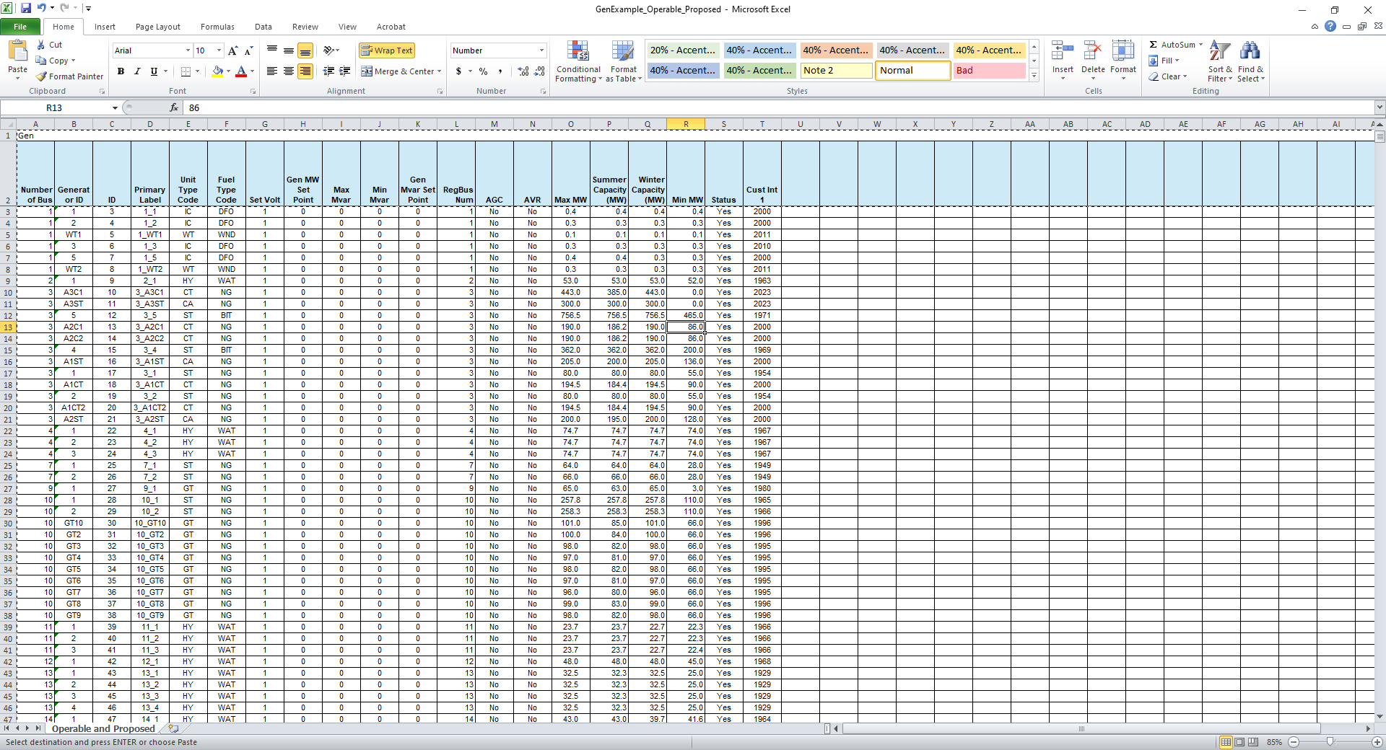
Cookbook: Generators, cont.
When adding additional generator fields for the PFW models (covered soon), the Primary_Label is used to uniquely identify the generator
Example generator spreadsheet input
17

Slide 18
Adding Generator Inservice, Retirement and EIA-860 fields
Starting in March 2023 PowerWorld now has fuller support for the generator operating month and year, retirement (or planned retirement) month and year, the EIA 860 Plant Code, and the Generator ID
With Schedule 3 the Plant Code is in Column C, the Generator ID in Column G, the Operating month and year in columns Z and AA, and the Planned Retirement in columns AB and AC (same with the Retired and Canceled; for Proposed only Operating data is available; use Current Month and Current Year columns (W and X)
For pasting this data into Simulator define a “Labels” column that is again a concatenate of the Plant Code, “_” and the generator ID
The column title for the Plant Code should be “EIA860 Plant Code”; for the Generator ID use “EIA860 Gen ID”
For the Operating fields use “Operating Date Month” and “Operating Date Year”
For the Retired fields using “Retired Date Month” and “Retired Date Year

Slide 19
Adding Generator Inservice, Retirement and EIA-860 fields, cont.
The paste spreadsheet should look like

Slide 20
Cookbook: Entering Lines to Connect the Buses
The last step is to connect all the buses to the slack bus through low impedance lines. This allows for a power flow solution, albeit one with no real transmission grid (i.e., a “copper plate” model)
Open Excel and on the first line enter “Branch” and then on the second line enter the fields “From Number”, “To Number”, “Circuit”, “Status”, “R”, “X”, “Lim MVA A”, “Lim MVA B”, “Lim MVA C”
Paste all the bus numbers except the Slack bus into the “From Number” column; then set the “To Number” for all to the slack bus number, the “Circuit” to 1, “Status” to closed, “R” to 0, “X” to 0.0001, and all the limits to zero
Select all. In Simulator Edit Mode view Case Information, Network, Lines and Transformers and paste all the data.
20

Slide 21
Saving and Solving the Case
Save the case, go to the Run Mode and select Tools, Solve, Solve Power Flow Newton
Initially all the generator outputs are zero; if desired they can be set to any value, such as setting all to their maximum
21

Slide 22
Setting up PFW Models
It is very easy to setup PFW models, with the a slide set describing this process available at
powerworld.com/files/202210OverbyeWeatherPowerWorld.pdf
To setup the PFW models, it is helpful to utilize the information given in the EIA 860 Schedule 3_2_Wind file and/or the 3_3_Solar file
These files only have data for the operable generators, not the proposed ones
To copy data from these files into the Simulator case, you need to add the “Gens” in the first row; then add a “Label” column, and then set it as before. That is, a combination of the Plant Code and Generator ID (e.g., =CONCATENATE(A3,”_”,B3) in the following example)
Paste in the desired fields using the custom fields, but avoid using Cust Int 1 since that was set to the operating year
22

Slide 23
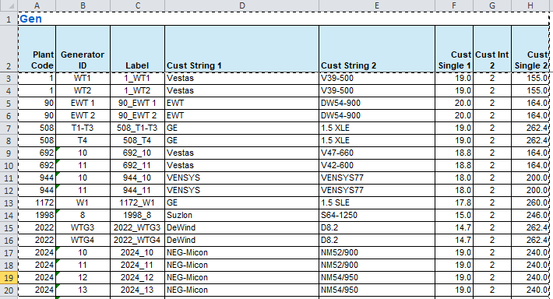
Setting Up PFW Models Example 1
This pastes in the wind data from Schedule 3_2
The wind turbine manufacturer is pasted into Cust String1, the turbine model in Cust String 2, the Design Wind Speed in Cust Float 1, the Wind Quality Class in Cust Int 2 and the Hub Height (ft) in Cust Float 2
When pasting in generator data they can be uniquely identified by the “Label” column header; when assigning a label to a new generator (done earlier) the column header should be “Primary Label”
23

Slide 24
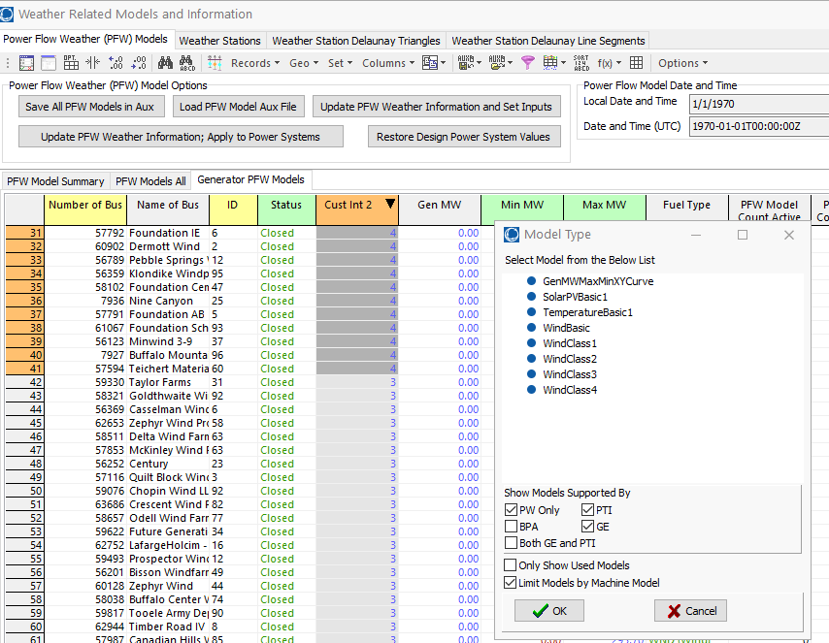
Setting Up PFW Models Example 1, cont
As noted in the slide set mentioned on the previous slide, the PFW models are set by selecting Tools, Other, Weather Models and Information, and going to the Generator PFW Models page
Since the Cust Int 2 field is only used with wind turbines (to indicate their wind quality class), sort on this field, select all of the type, right-click and select Insert New PFW Models to insert the appropriate model for the class (e.g., the “WindClass4” model for all the “4” entries, “WindClass3 model for all the “3” entries, etc).
24

Slide 25
Setting Up PFW Models Example 2
To enter the solar models, open the Schedule 3_3 and set it up similar to the wind
Setup a Cust Int 3 column to indicate the type of tracking, which is a combination of the “Single-Axis Tracking” and “Dual-Axis Tracking” columns; the value should be “0” for no tracking, “1” for single-axis tracking fixed tilt, “2” for single-axis tracking fixed azimuth, and “3” for dual-axis
This can be done using several nested IFs in Excel (e.g., =IF(E3="Y",3,IF(AND(D3="Y",F3="Y"),1,IF(D3="Y",2,0)))
Setup “Azimuth Angle” as Cust Single 1 and “Tilt Angle” as Cust Single 2
Use the same display to insert the models but first sort on the Fuel Type and only enter models for the “Sun (Solar)” type; for the PFW model select SolarPVBasic2
the SolarPVBasic2 is identical to SolarPVBasic1 except the tilt angle is specified in absolute degrees rather than an offset from the latitude
25

Slide 26
Setting Up PFW Models Example 2, cont.
An easy way to set the SolarPVBasic2 model fields to have the correct tracking, tilt and azimuth fields is as follows
On the Generator PFW Models display filter on just the “Active PFW Model(s)” field being “SolarPVBasic2” and show the Cust Int 3, Cust Float 1 and Cust Float 2 fields; copy this into Excel
In Excel change the Cust Int 3 to “Tracking”, Cust Float 1 to “AzimuthDeg” and Cust Float 2 to “TiltAngleDeg”
Also change the entry in the top left cell to be GenMWMax_SolarPVBasic2
The “Label” field is used to identify the associated generator
Select all in Excel, in PowerWorld show the display that contains all the SolarPVBasic2 modes and paste into
An easy way to show this display is to go to the Tools, Other, Weather Models and Information and display the PWF Model Summary display; right-click on the SolarPVBasic2 row.
26

Slide 27
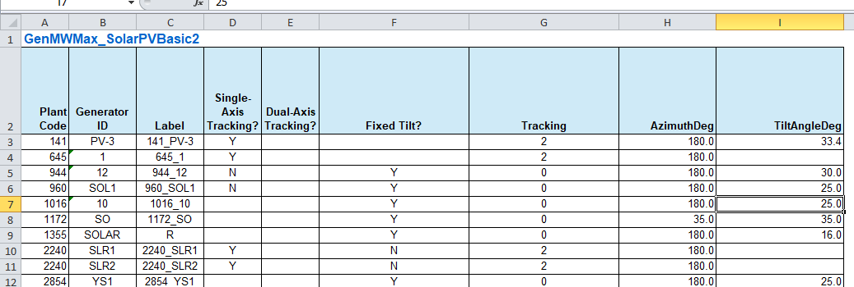
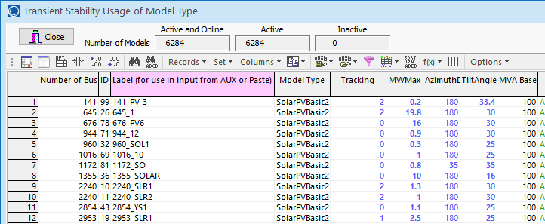
Setting Up PFW Models Example 2, cont.
27

Slide 28
Visualizing the Results with GDVs
Since everything is geo-mapped, the results can be easily visualized using geographic data views (GDVs)
Whenever you use a GDV in a paper be sure to reference
T. J. Overbye, E. M. Rantanen and S. Judd, “Electric power control center visualization using Geographic Data Views,” 2007 iREP Symposium – Bulk Power System Dynamics and Control – VII. Revitalizing Operational Reliability, Charleston, SC, Aug. 2007
The PFW models can also be visualized using GDVs
The image on the next slide shows groups the generators by substation, with the size based on the substation “Generators\MW Max” field and the fill color based on the “Generators Type Unit Fuel\Primary Generic Fuel Type\Integer (by capacity)”
For a color mapping use “IntegerA 16 Color (1-16) for Fuel Type”
28

Slide 29
Example Substation Generation GDV
29

Slide 30
Example GDVs for SolarPVBasic2
The PFW models also have GDV support.
For example, go to Tools, Weather Models and Information; go to the Power Flow Weather (PFW) Models page, PFW Model Summary tab, and view the SolarPVBasic2 model type
Right-click, select Geographic Data View, to show the Geographic Data View Customization Dialog
Customize as desired. The PFW fields are available in the Model Parameters\... group. The oneline on the next page shows all the SolarPVBasic2 models in Texas with a MW rating above 200 MW; the top line shows the MW rating, and the second line the type of tracking
Layout was used to avoid overlap, sacrificing some geographic accuracy
30

Slide 31
Example GDVs for SolarPVBasic2
31

