Slide 1
QAM Transmitter

Slide 2
Index
Parameters
Bit Resolution / Sampling Frequency
Sample Per Symbol / Filter Length
Symbol Mapper of VSA
Block Diagram
Top Module
Filter
Root Raised Cosine Filter Coefficient Generator
Results observed via VSA

Slide 3
Parameters

Slide 4
Constraints
Bit Resolution
DAC Bit Resolution : Unsigned 14 Bits
Sampling Frequency
Maximum Clock in FPGA Board : 50 MHz

Slide 5
Sample per Symbol / SPAN
SPS
한 심볼이 차지하는 시간 구간에서 취해지는 샘플의 개수
SPS가 클수록, 신호의 시간 해상도가 높아지고, 스펙트럼 표현이 더욱 정확해질 수 있음
SPAN
필터의 임펄스 응답 길이에 영향을 주는 요소
SPAN이 클수록, 필터의 임펄스 응답을 완전하게 표현할 수 있음

Slide 6
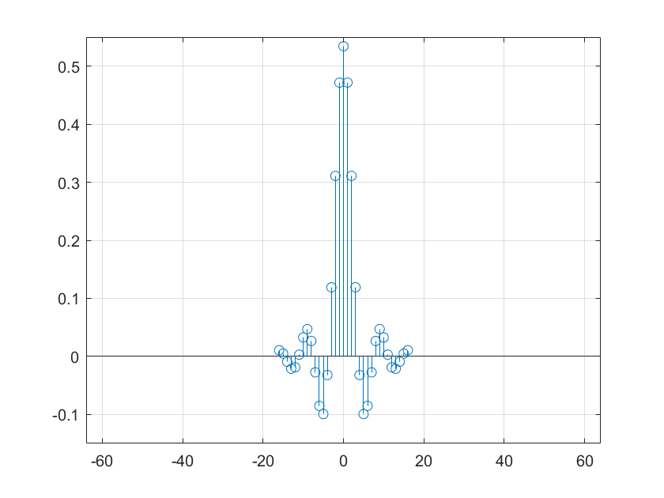
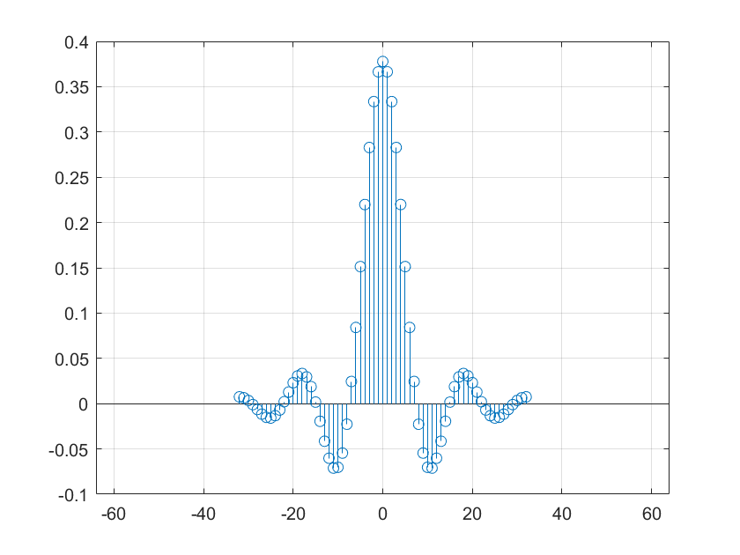
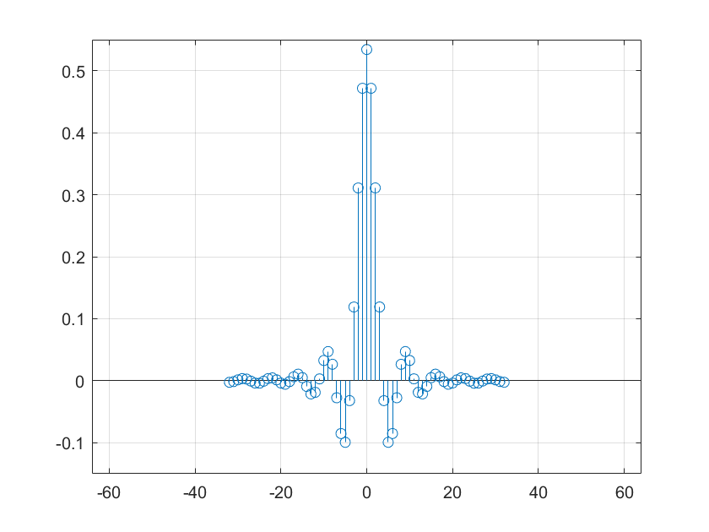
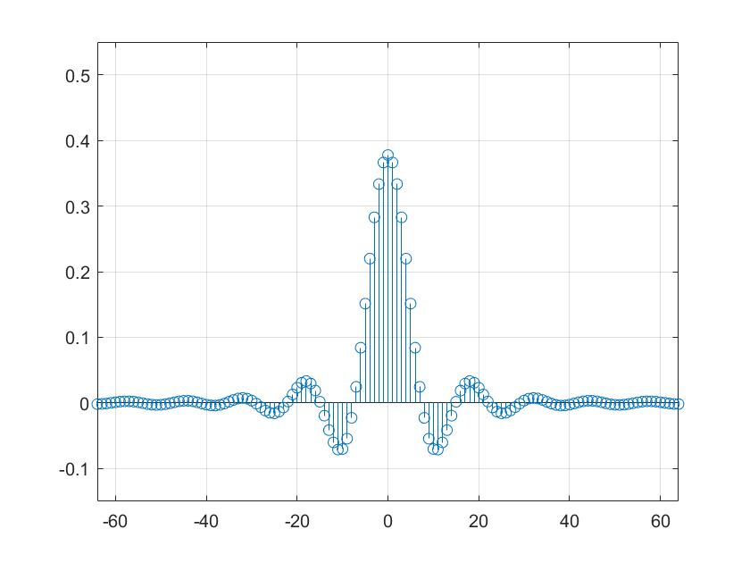
Sample per Symbol / SPAN
 | SPS = 4 | SPS = 8
SPAN = 8
SPAN = 16

Slide 7
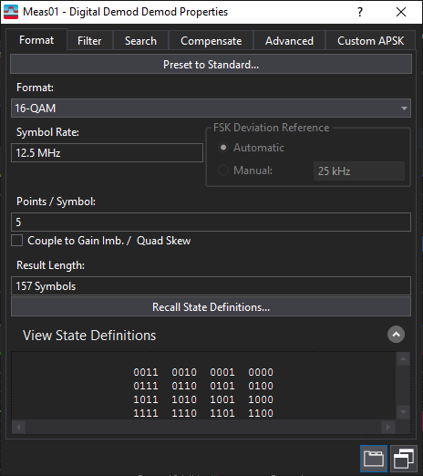
16-QAM Mapping
Q
+3
00
+1
01
-3
-1
+1
+3
I
11
10
01
00
-1
10
-3
11

Slide 8
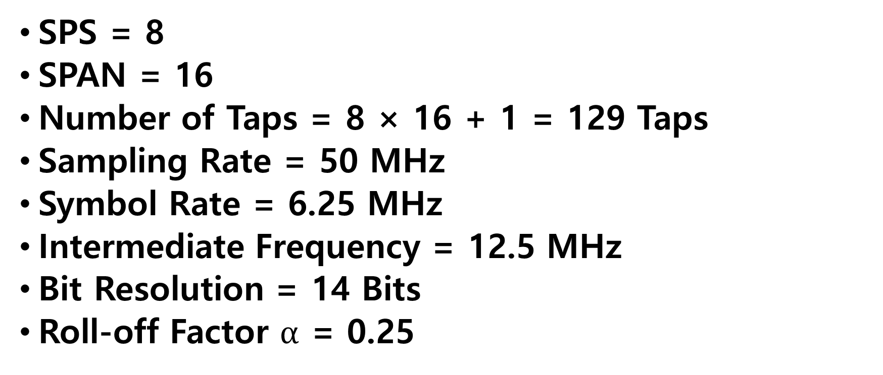
Filter Parameter
SPS = 8
SPAN = 16
Number of Taps = 8 × 16 + 1 = 129 Taps
Sampling Rate = 50 MHz
Symbol Rate = 6.25 MHz
Intermediate Frequency = 12.5 MHz
Bit Resolution = 14 Bits
Roll-off Factor $α$ = 0.25

Slide 9
Block Diagram

Slide 10
Block Diagram
- Top Module
50MHz CLOCK
PLL_OUT_DA
Clock Generator
DA_WRTA
[2:0] count
clock_6.25MHz
1’b1
DA_MODE
clock_25MHz
Filter
PN Generator
clock
Register
[13:0] dac_out
[13:0] DAC_OUT
reset
pn_out
clock
[3:0] reg_out
reset
clock
[2:0] count
in
clock_symbol
reset
clock_sample
[3:0] symbol
RESET
reset

Slide 11
Filter (1)
TDL_I0
[16:0] out
CLOCK_SYMBOL
clock
reset
MUX
RESET
SYMBOL [0]
in
TDL_I1
[16:0] state_0
[16:0] out
[16:0] state_1
clock
reset
[16:0] state_i0
SYMBOL [1]
in
TDL_Q0
[16:0] state_i1
[16:0] state_q0
[16:0] out
[16:0] state_q0
clock
reset
sel
SYMBOL [2]
in
TDL_Q1
[16:0] out
clock
reset
COUNT [0]
SYMBOL [3]
in

Slide 12
Filter (2)
ROM[0][0]
ROM[0][1]
ROM[0][2]
ROM[0][3]
Multiplier
[13:0] rom
rom [14:0]
rom [14:0]
rom [14:0]
always @(posedge clock_sample)
begin
for(k=0 ; k<=SPAN ; k=k+1)
begin
case ({ state_1[k] , state_0 [k] })
2’b00 : product [k] = 3 * rom[k];
2’b01 : product [k] = 1 * rom[k];
2’b10 : product [k] = -1 * rom[k];
2’b11 : product [k] = -3 * rom[k];
endcase
end
end
FNAME
FNAME
FNAME
FNAME
[2:0] address
address [2:0]
address [2:0]
address [2:0]
·
·
·
·
·
·
·
·
·
·
·
·
[2:0] COUNT
ROM[16][0]
ROM[16][1]
ROM[16][2]
ROM[16][3]
[16:0] STATE_0
[13:0] rom
rom [14:0]
rom [14:0]
rom [14:0]
[16:0] STATE_1
FNAME
FNAME
FNAME
FNAME
[2:0] address
address [2:0]
address [2:0]
address [2:0]
ADDER
IF
DAC
CLOCK_SAMPLE
always @(posedge clock_sample)
begin
sum = 1'sb0;
for(k=0 ; k<=SPAN ; k=k+1)
begin
sum = sum + product [k];
end
end
assign
if_out = ( count[1] ) ?
- sum[14:1] : sum[14:1] ;
assign dac_out = {~if_out[13], if_out[12:0]};
[13:0] DAC_OUT
PRODUCT [0:16]

Slide 13
Filter (2)
ROM[0][0]
ROM[0][1]
ROM[0][2]
ROM[0][3]
[14:0] rom
[14:0] rom
[14:0] rom
[14:0] rom
FNAME
FNAME
FNAME
FNAME
[2:0] address
[2:0] address
[2:0] address
[2:0] address
·
·
·
·
·
·
·
·
·
·
·
·
[2:0] COUNT
ROM[16][0]
ROM[16][1]
ROM[16][2]
ROM[16][3]
[14:0] rom
[14:0] rom
[14:0] rom
[14:0] rom
FNAME
FNAME
FNAME
FNAME
[2:0] address
[2:0] address
[2:0] address
[2:0] address
ADDER
DAC
CLOCK_SAMPLE
always @(posedge clock_sample)
begin
sum = 1'sb0;
for(k=0 ; k<=SPAN ; k=k+1)
begin
sum = sum + rom[k][{state_1[k],state_0[k]}];
end
end
[16:0] STATE_0
assign dac_out = { ~sum[14] ,
sum[13:1] };
DAC_OUT [13:0]
[16:0] STATE_1
ROM [0:16][0:3]

Slide 14
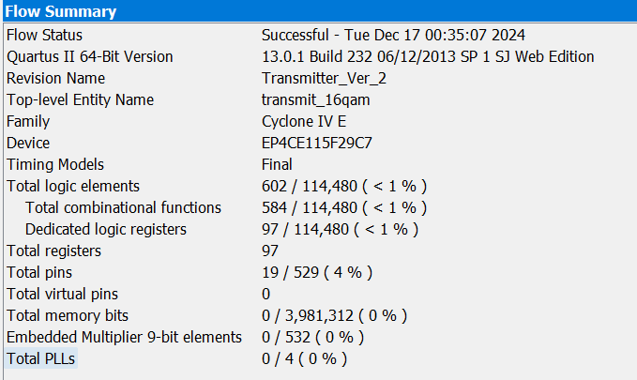
Total Logic Element
 | Total Logic Element
Before Remove the Multiplier Module | 797
After Remove the Multiplier Module | 602
Reduction Rate | 24.47 %
Notes:
797 – 602 / 797

Slide 15
RRCF Coefficient Generator

Slide 16
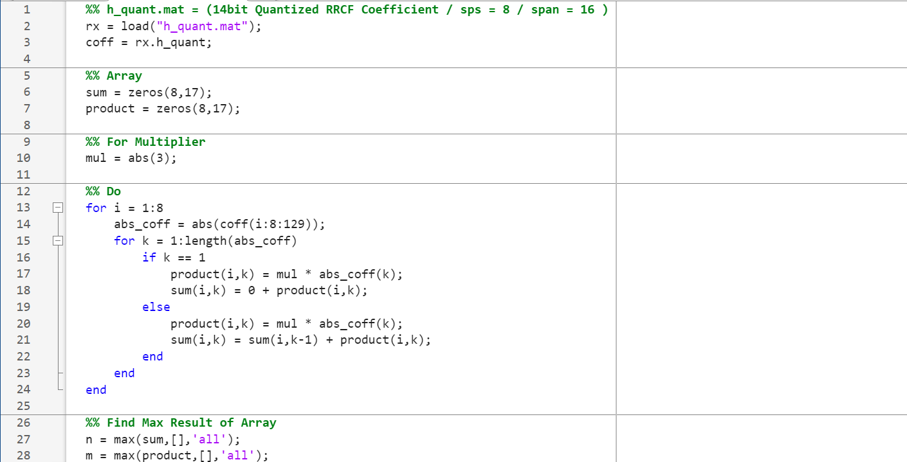
Analyzing Maximum Values in Multiplication and Addition Processes
 | mul = 1 | mul = 3
max(sum) | 0.6350 | 1.1331
max(product) | 0.3777 | 1.9050
1 bit Overflow
→ Set 15 bits

Slide 17
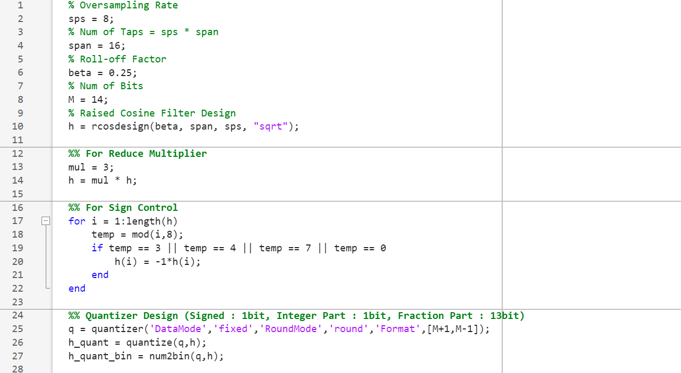
RRCF Coefficient Generator

Slide 18
Results observed via VSA

Slide 19
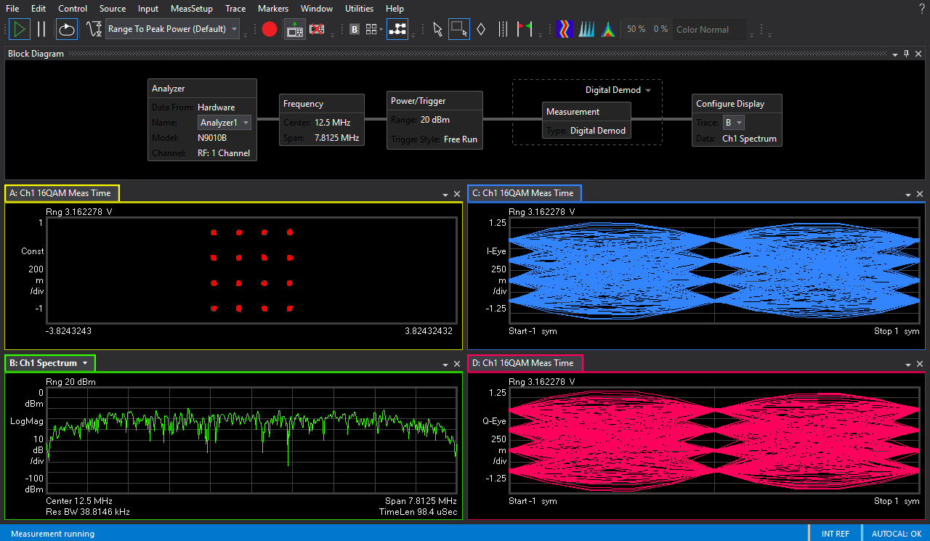
Results observed via VSA

Slide 20
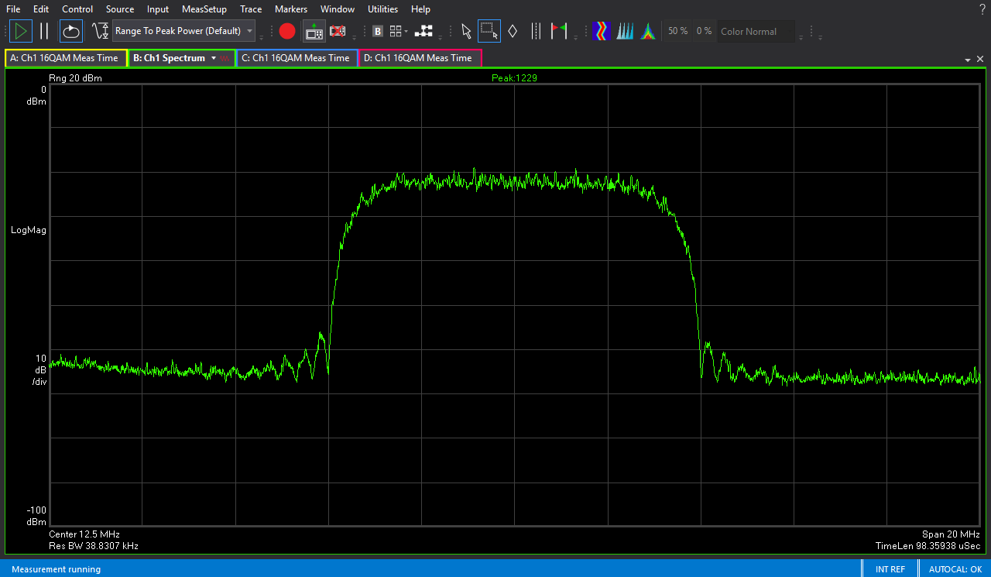
Spectrum
8 MHz

Slide 21
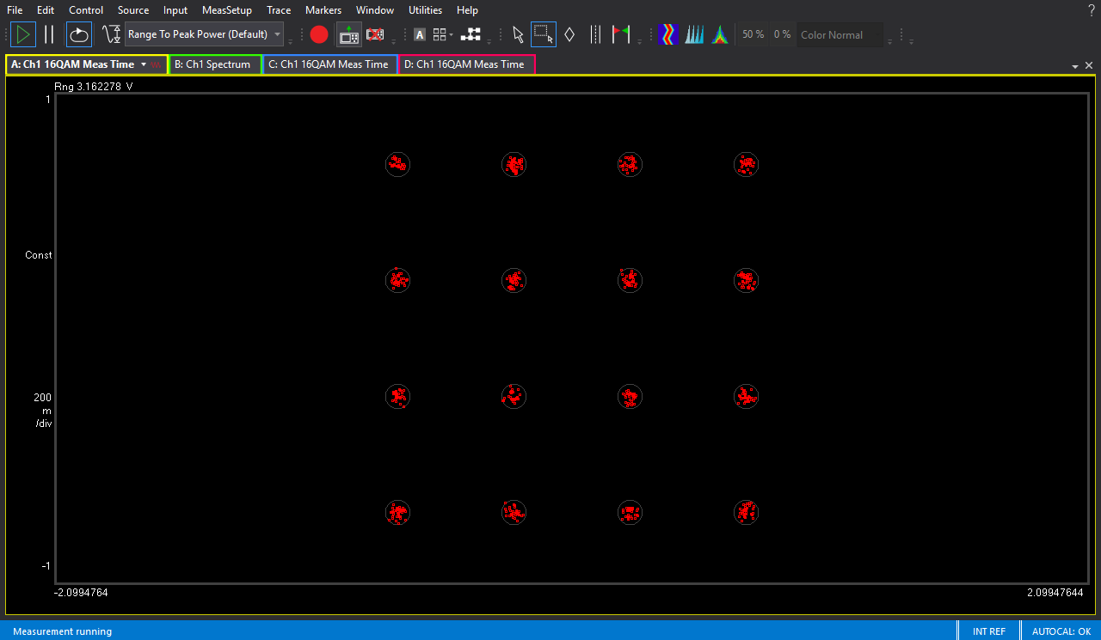
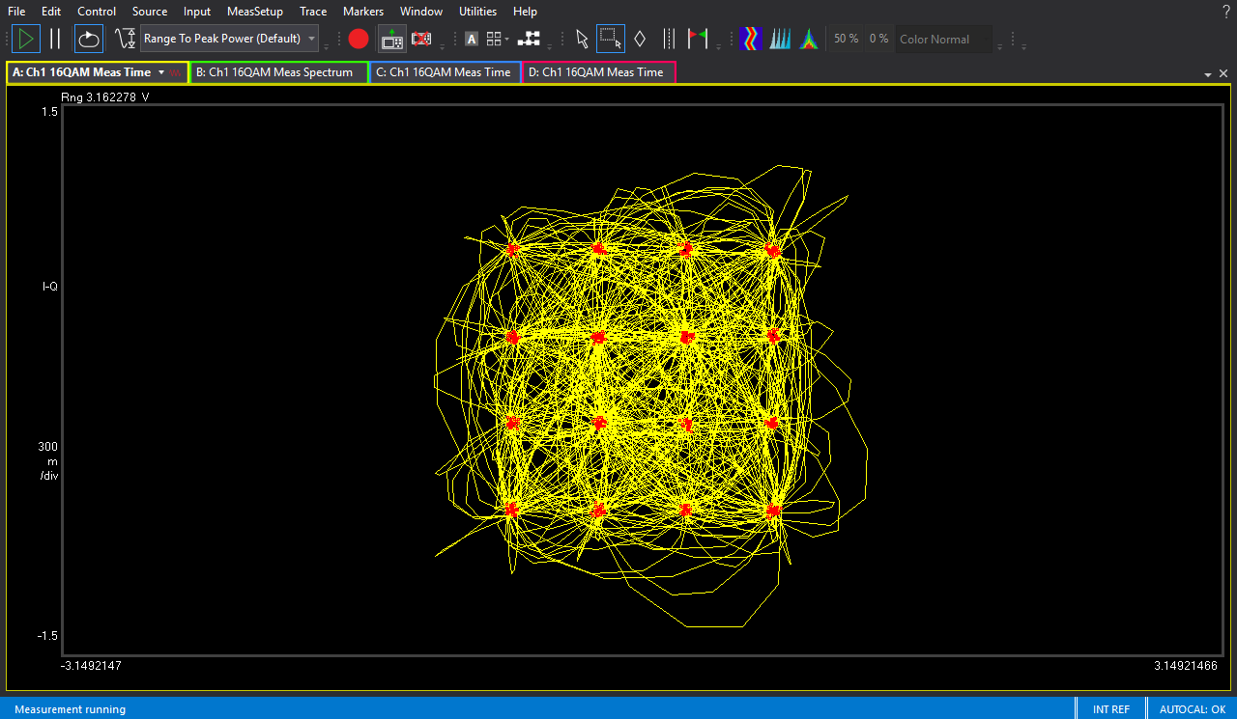
Constellation & Trajectory Diagram

Slide 22
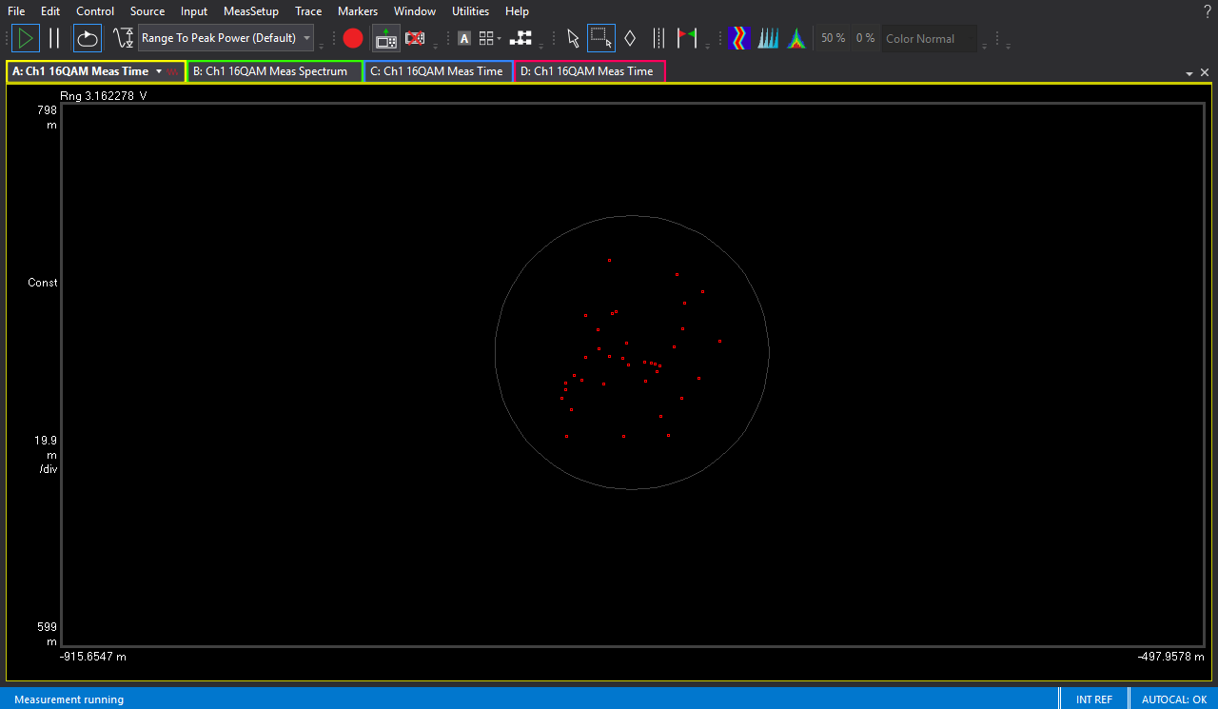
Constellation

Slide 23
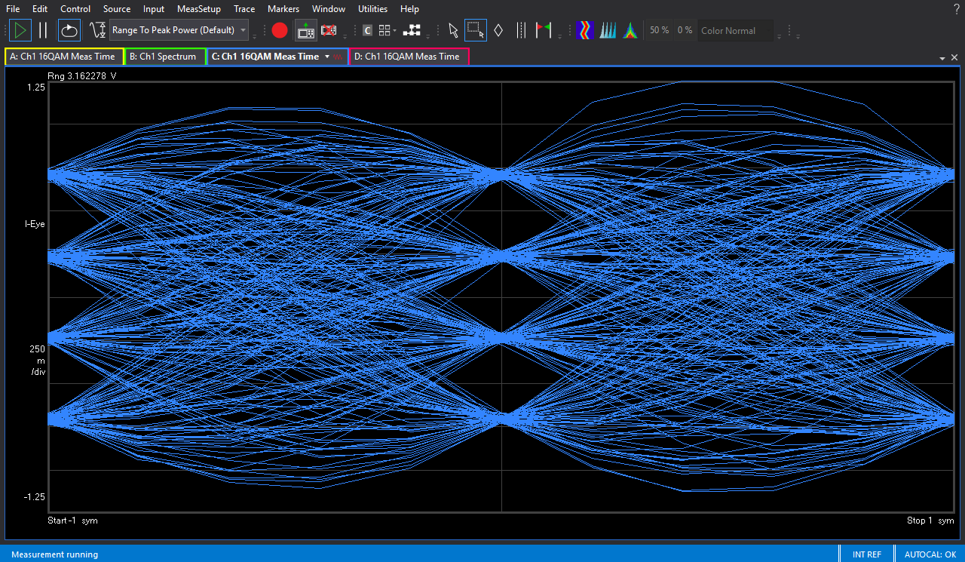
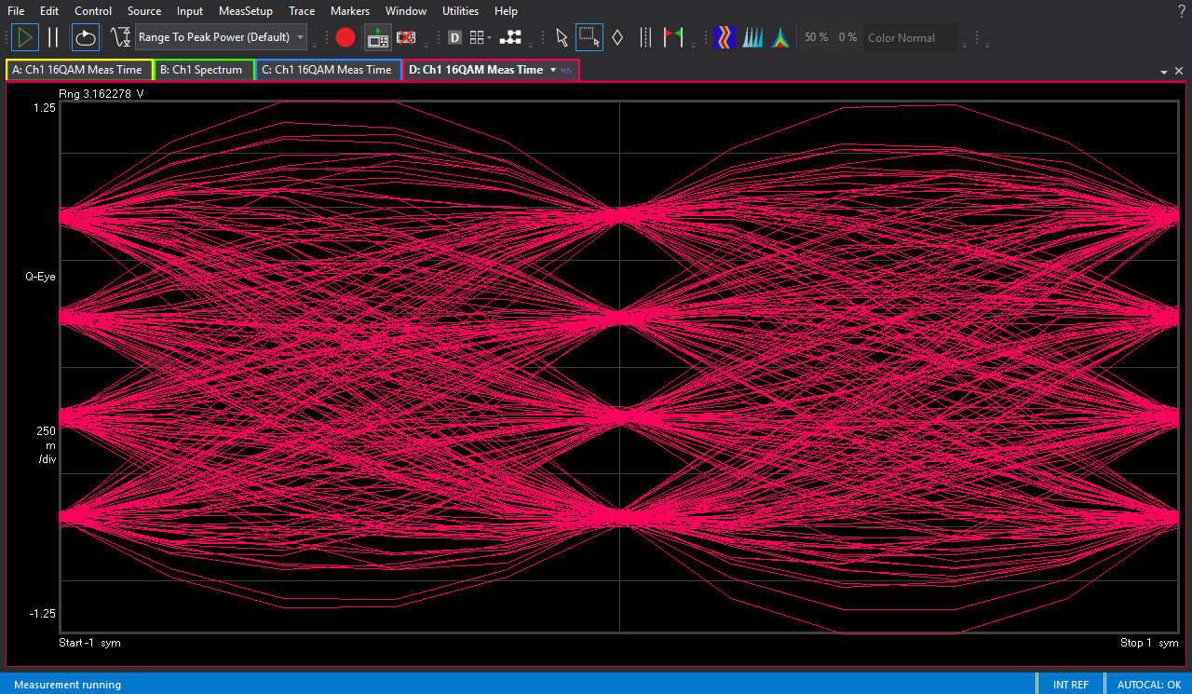
Eye Diagram
I - Eye
Q - Eye

Slide 24
- THE END -

