Slide 1
EXCAVATE Team_ExMachina Detailed Submission Report

Slide 2
HELLO!
Name | Campus | Roll No. | Mobile No. | Email Id
Jitendra Jangid | IIT Kharagpur | 14CE10023 | 9933915716 | jitujangid38@gmail.com
Arpit Bansal | IIT Kharagpur | 14EE30006 | 9933964106
Ritwika Chowdhury | IIT Kharagpur | 14EC30027 | 8373066145

Slide 3
Our Objectives and description about dataset
To handle the missing values in the training data provided to us
To make an effective multi-classification predictive model which can predict the type of glass in terms of F1 Score
To find out the importance or influence of independent variables in the data towards predicting type of glass
Number of independent variables in training dataset: 9 excluding SN
Number of response variables: 1 (categorical variable) – ‘ID of Glass’
Total no. of instances in the dataset: 200

Slide 4
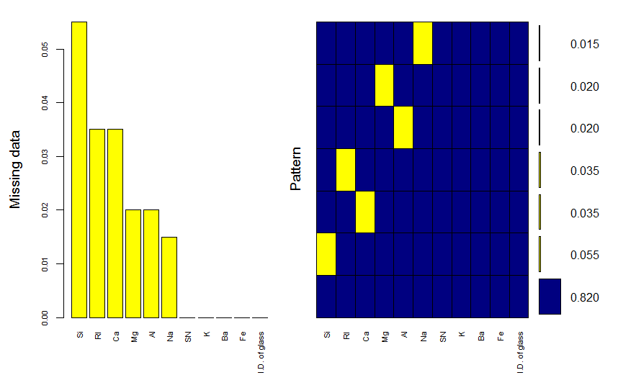
MISSING Data Prediction
library(VIM)
mice_plot <- aggr(train, col=c('navyblue','yellow'),numbers=TRUE, sortVars=TRUE, labels=names(train), cex.axis=.7,gap=3, ylab=c("Missing data,"Pattern"))
library(mice)
imputed_train <- mice(train, m=5, maxit = 50, method = 'pmm', seed = 500)
Variable sorted by number of Missings
Variable Count
Si 0.055
RI 0.035
Ca 0.035
Mg 0.020
Al 0.020
Na 0.015

Slide 5
Feature Engineering
Created a new feature inverse_RI which is inverse of numerical RI variable:
Inverse_RI = 1/RI
completeData <- complete(imputed_train,2)
target <- completeData$`I.D. of glass`
#converting into factor
target <- as.factor(target)
completeData$target <- target
completeData$inverse_RI <- 1/completeData$RI
completeData$`I.D. of glass` <- NULL
completeData$SN <- NULL
rm(target)

Slide 6
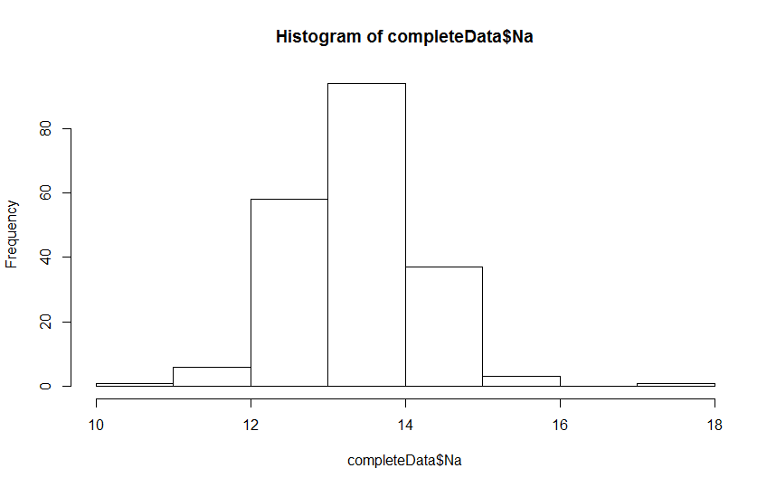
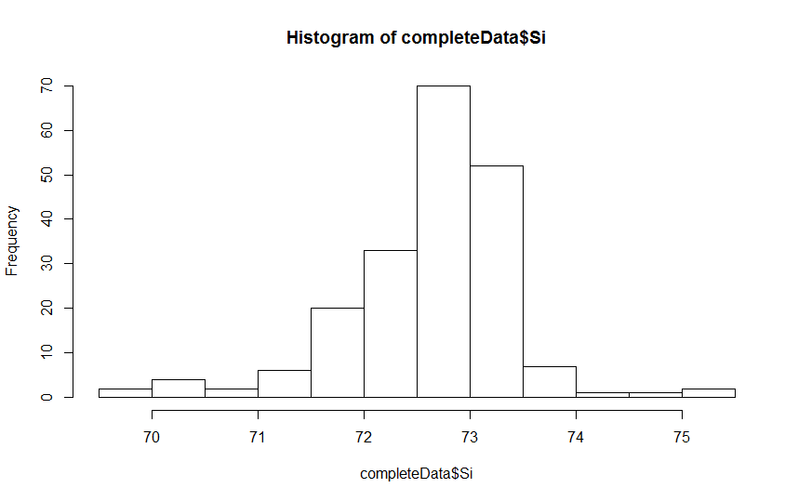
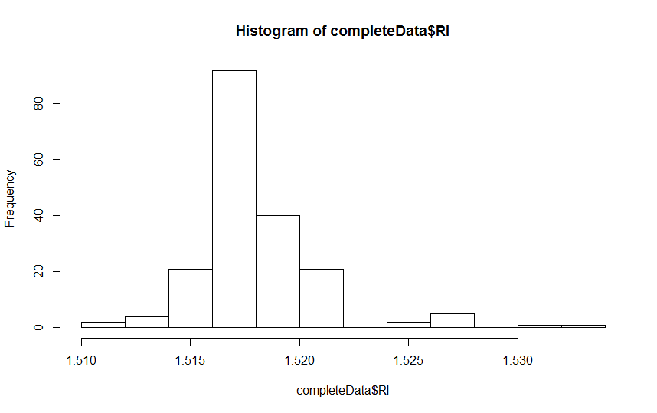
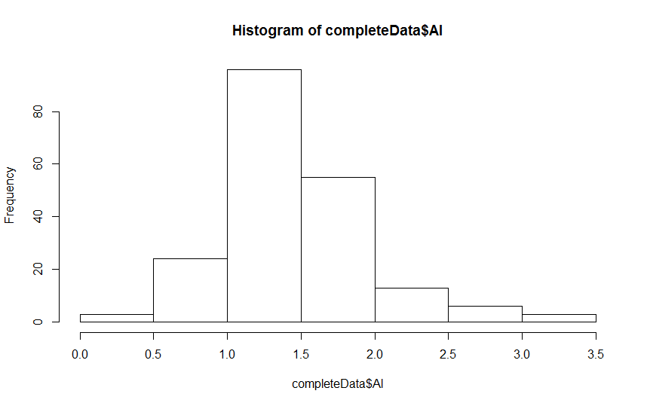
Visualization

Slide 7
Equation to identify ID of Glass
LIST OF FEATURES/VARIABLES USED :
Final model is a Xgboost machine learning algorithms :
Model : Xgboost (Xtreme Gradient Boosting)
ID_of_Glass ~ Si + RI + Ca + Mg + Al + Na + K + Ba + Fe + inverse_RI
**features in bold, italic, represent engineered features

Slide 8
Estimation Technique Used
Modeling Technique:
Xgboost Model
The model was built using an ensemble of 3 different parametric values of our boosting parameters eta, colsample_bytree and subsample
By Hyper parameter tuning using MLR package we tuned eta(0.1,0.05,0.01), colsample_bytree(0.2,0.4,0.6) and subsample(0.4,0.8,1) which decided our learning rate and control the overfitting
We kept the number of rounds(nrounds) to 100 and max_depth to 8

Slide 9
Final Prediction on Test Data
Using sapply function we accounted for our final prediction by taking the Median for that particular class for a particular data point
Further after getting our predictions for both training and testing data set by Xgboost algorithm we generated the confusion matrix table for this multi-classification problem
Several different parameters were estimated such as accuracy of model (95-98 %), precision and recall of our predictions and finally the F1 score for each class which on an average turned out to be around 95%

Slide 10
Features Importance

Slide 11
Reasons for Technique(s) Used
Why do you think this is the best technique(s) for this particular problem?
XGBoost is an implementation of gradient boosted decision trees designed for speed and performance
XGBoost dominates structured or tabular datasets on classification and regression predictive modeling problems
Xgboost readily take care of the low relative influenced variable amongst the data given, and deals with higher correlation variables without over-fitting
It is called gradient boosting because it uses a gradient descent algorithm to minimize the loss when adding new models

Slide 12
Other Estimation Technique Tried
GBM (Generalized Boosted Regression Model)
Accuracy – 80 % and avg. F1 score – 78%
Random Forest
Accuracy – 78% and avg. F1 score – 75%

Slide 13
THANKS!
Any questions?

