Slide 1
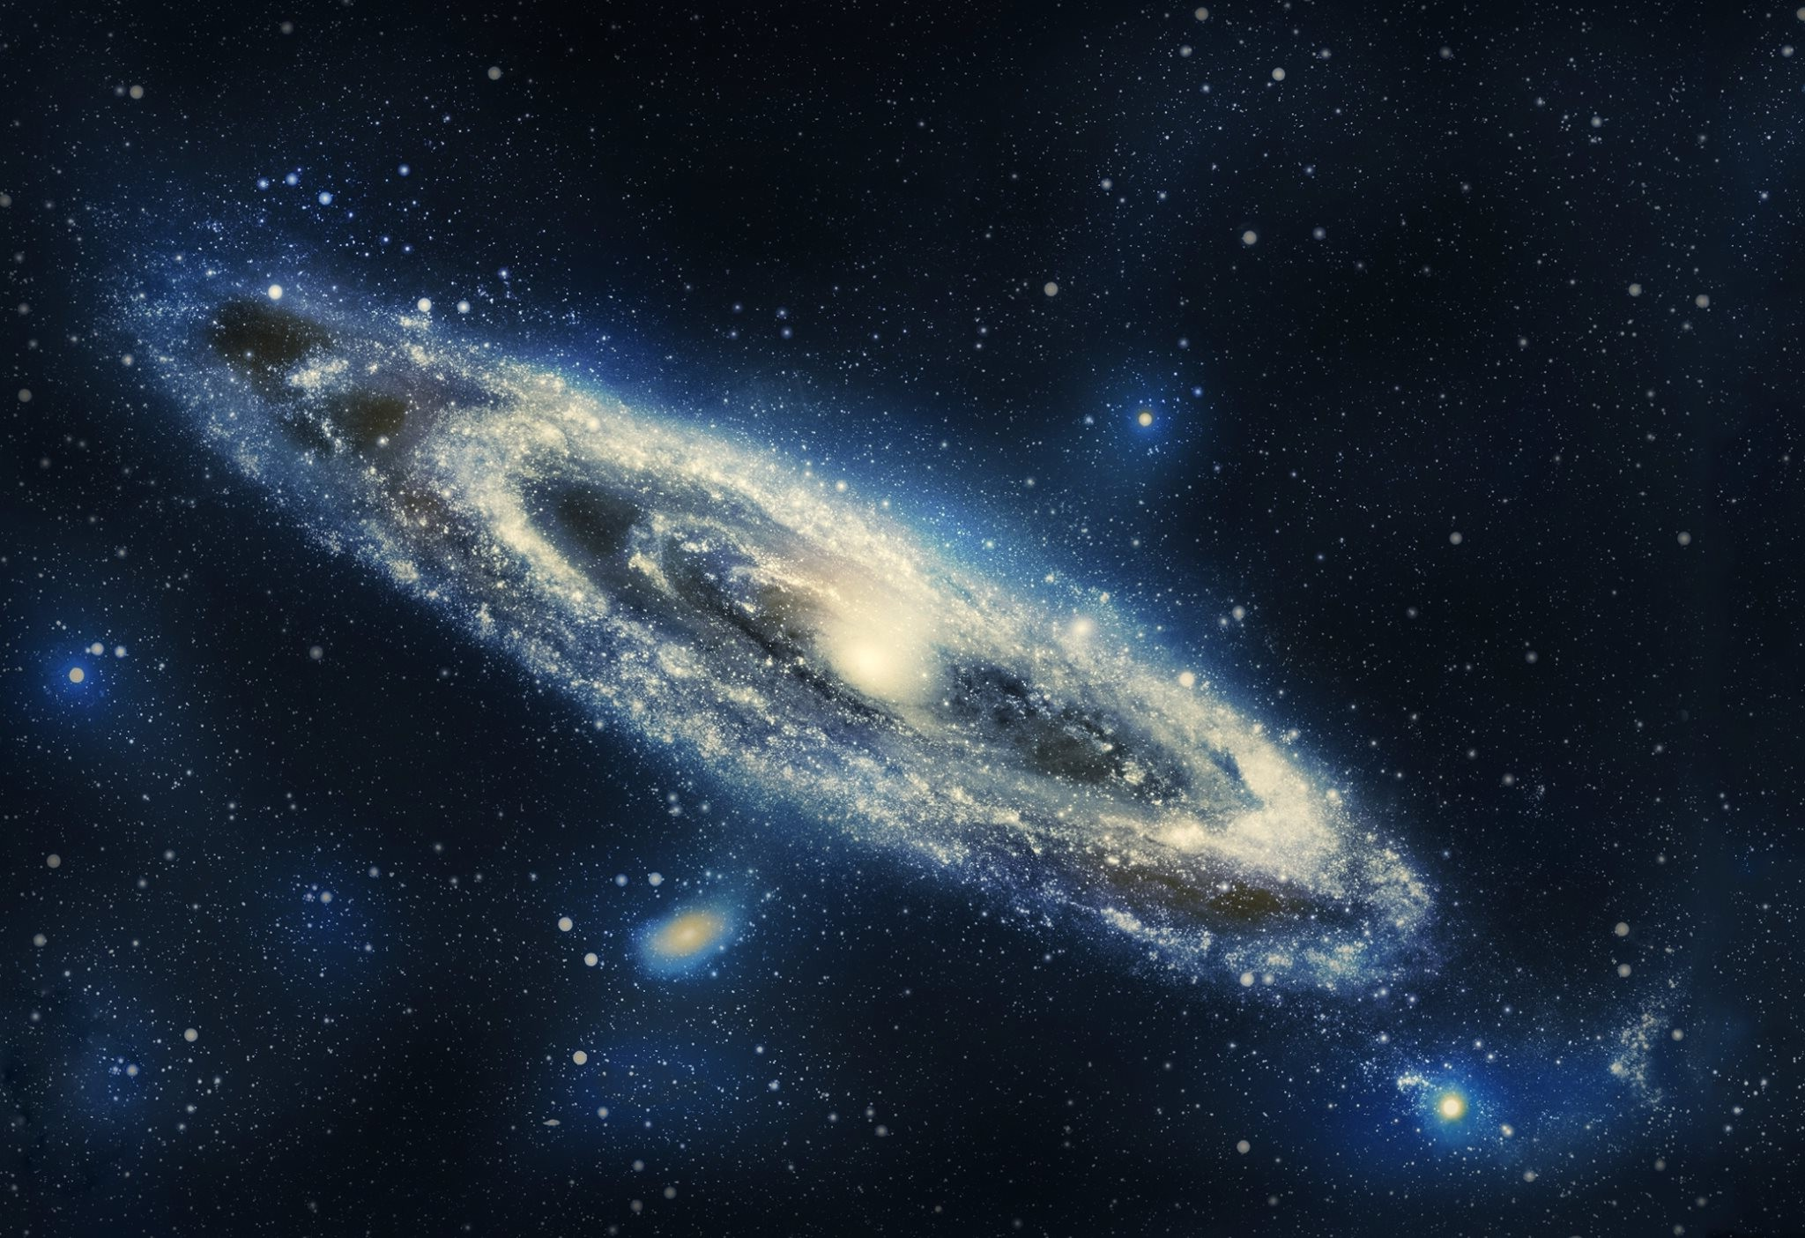
Nbody project
Optimization of the gravitational effects on a large number of celestial bodies
Marco de rosso, Matteo rigamonti, marco scarpelli

Slide 2
summary
Introduction
Code
Performace results
Conclusion

Slide 3
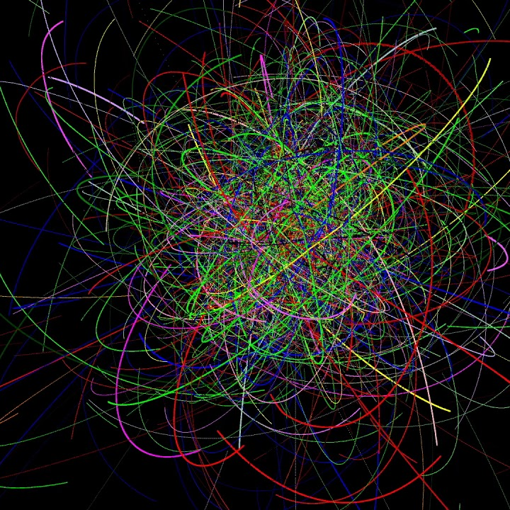
Introduction
The problem of calculating the interactions between particles in a very large system is known for having no close solution. Hence it has to be simulated.
In the code provided we write a C++ implementation of said problem where we employ various techniques of parallelization to allow it to be run in a multithreaded environment.

Slide 4
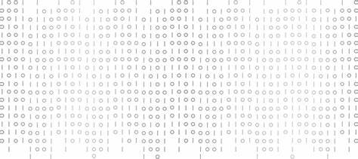
Code

Slide 5
Structure of the program
We have created a template class Vector with template functions depending on a parameter «dim» which represents the dimension of the system we’re in (e.g. 2D,3D). This allows us to change the dimension of the problem with very little effort. Our vector class has optimized functions for simple linear algebra that we coded by overloading some operators.

Slide 6
Structure of the program
We wrote a class Particle that represents the generic body that we consider, and we have given it attributes like mass, velocity, acceleration. It also has it’s own member functions that compute distances and interactions between particles. The methods are parallelized using OpenMP.

Slide 7
Structure of the program
In our first implementation we wanted to avoid repeated calculations of interactions, so we created a «force matrix», with its own class, that stored the forces at every iteration. We then noticed that this technique slowed down the process, due to the eccessive amount of memory accesses. So we decided to remove the class and let every particle calculate its interactions (mathematical operations are much faster than memory accesses).

Slide 8
Structure of the program
We have also built a JSON parser to be able to simply change our constants along he way, and a binary file that stores the status of a simulation to be able to load it and/or save the current state.
We built a 3D graphics engine with OpenGL that is able to effectively plot our system and simulate its behaviour.

Slide 9

Performance

Slide 10
Server – no omp, no graphics
NBody profiling
--- SIMULATION INFO ---
Problem dimension: 3D
Particle amount: 1000
Number of iterations: 1000
Simulation time resolution: 10 ticks per second
Simulation elapsed time: 10000 seconds
Graphics refresh time: 1000 milliseconds
Screen resolution: 2048x 2048
--- TIMING AND THREADS INFO ---
Total duration: 909933 ms
Iteration mean duration: 909908 us

Slide 11
Server – yes omp, no graphics
NBody profiling
--- SIMULATION INFO ---
Problem dimension: 3D
Particle amount: 1000
Number of iterations: 1000
Simulation time resolution: 10 ticks per second
Simulation elapsed time: 10000 seconds
Graphics refresh time: 200 milliseconds
Screen resolution: 2048x 2048
--- TIMING AND THREADS INFO ---
Total duration: 220875 ms
Iteration mean duration: 220788 us

Slide 12
Server – no omp, no graphics, 2000 bodies
NBody profiling
--- SIMULATION INFO ---
Problem dimension: 3D
Particle amount: 2000
Number of iterations: 1000
Simulation time resolution: 10 ticks per second
Simulation elapsed time: 10000 seconds
Graphics refresh time: 1000 milliseconds
Screen resolution: 2048x 2048
--- TIMING AND THREADS INFO ---
Total duration: 3651476 ms
Iteration mean duration: 3651433 us

Slide 13
Server – yes omp, no graphics optimized
NBody profiling
--- SIMULATION INFO ---
Problem dimension: 3D
Particle amount: 1000
Number of iterations: 1000
Simulation time resolution: 10 ticks per second
Simulation elapsed time: 10000 seconds
Graphics refresh time: 1000 milliseconds
Screen resolution: 2048x 2048
--- TIMING AND THREADS INFO ---
Total duration: 37667 ms
Iteration mean duration: 37578 us

Slide 14
pc – no omp, no graphics
NBody profiling
--- SIMULATION INFO ---
Problem dimension: 3D
Particle amount: 1000
Number of iterations: 1000
Simulation time resolution: 10 ticks per second
Simulation elapsed time: 10000 seconds
Graphics refresh time: 200 milliseconds
Screen resolution: 2048x 2048
--- TIMING AND THREADS INFO ---
Total duration: 616221 ms
Iteration mean duration: 616186 us

Slide 15
pc – yes omp, no graphics
NBody profiling
--- SIMULATION INFO ---
Problem dimension: 3D
Particle amount: 1000
Number of iterations: 1000
Simulation time resolution: 10 ticks per second
Simulation elapsed time: 10000 seconds
Graphics refresh time: 200 milliseconds
Screen resolution: 2048x 2048
--- TIMING AND THREADS INFO ---
Total duration: 56731 ms
Iteration mean duration: 56552 us

Slide 16

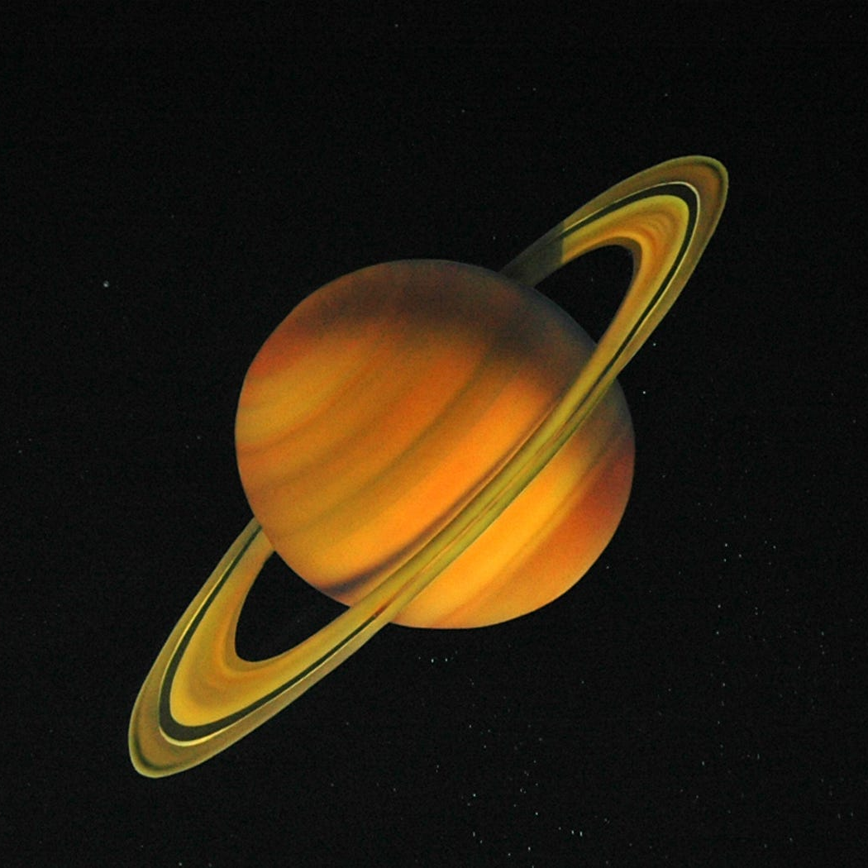
Thank you for the attention
Marco de rosso, matteo rigamonti, marco scarpelli

