Slide 1
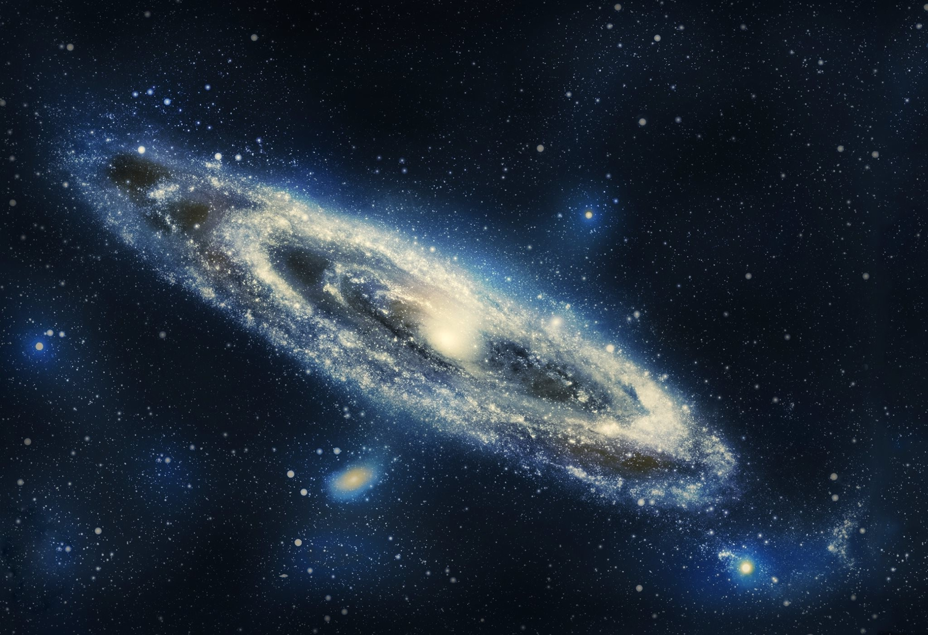
Nbody project
Optimization of the gravitational effects on a large number of celestial bodies
With the Barnes-Hut clustering algorithm
Matteo rigamonti

Slide 2
summary
Introduction
Code
Performace results
Conclusion

Slide 3
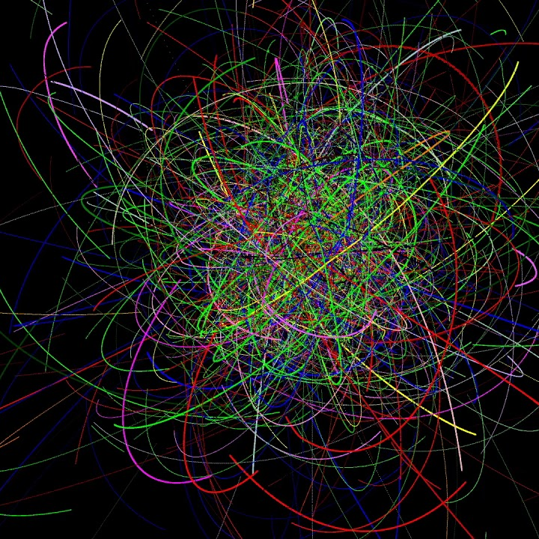
Introduction
The problem of calculating the interactions between particles in a very large system is known for having no close solution. Hence it has to be simulated.
In the code provided we write a C++ implementation of said problem where we employ various techniques of parallelization to allow it to be run in a multithreaded environment.

Slide 4
The barnes-hut algorithm
The Barnes-Hut algorithm aims to optimize the number of interactions to calculate between the bodies by approximating far away clusters with their center of mass. The code works on a particular data structure called Octree, which is a tree in which every node has 8 children. Every level of the Octree subdivides the space in 8 octants, and proceeds to refine the ones full of particles while leaving the empty ones large. For every octant (and so every node) the center of mass and the resulting effect is calculated. This way, in the optimal case, the complexity of the algorithm goes from O(n^2) to O(nlogn)

Slide 5

Code

Slide 6
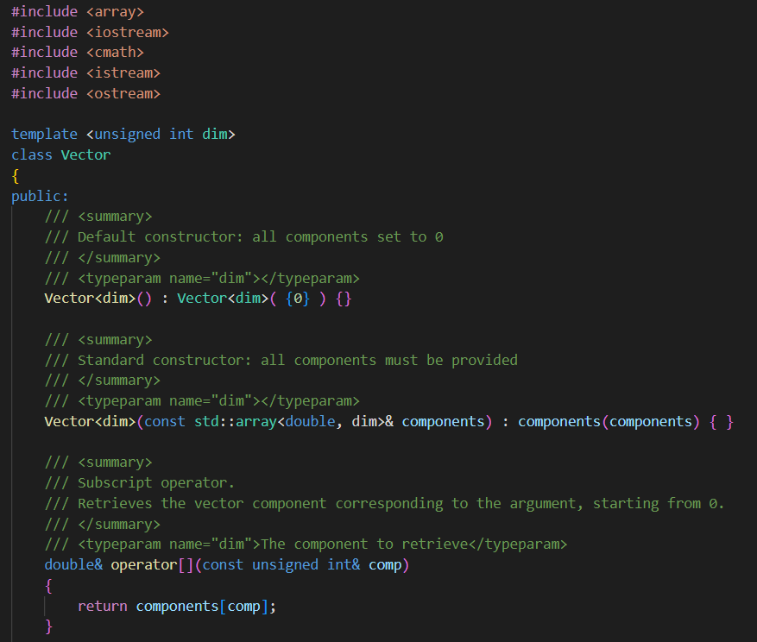
Structure of the program
We have created a template class Vector with template functions depending on a parameter «dim» which represents the dimension of the system we’re in (e.g. 2D,3D). This allows us to change the dimension of the problem with very little effort. Our vector class has optimized functions for simple linear algebra that we coded by overloading some operators.

Slide 7
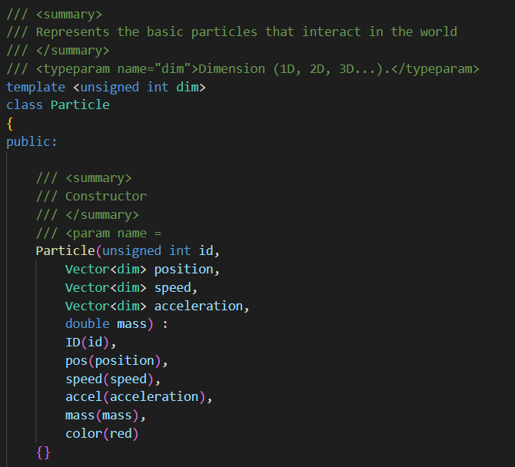
Structure of the program
We wrote a class Particle that represents the generic body that we consider, and we have given it attributes like mass, velocity, acceleration. It also has it’s own member functions that compute distances and interactions between particles. The methods are parallelized using OpenMP.

Slide 8
Structure of the program
In our first implementation we wanted to avoid repeated calculations of interactions, so we created a «force matrix», with its own class, that stored the forces at every iteration. We then noticed that this technique slowed down the process, due to the eccessive amount of memory accesses. So we decided to remove the class and let every particle calculate its interactions (mathematical operations are much faster than memory accesses).

Slide 9
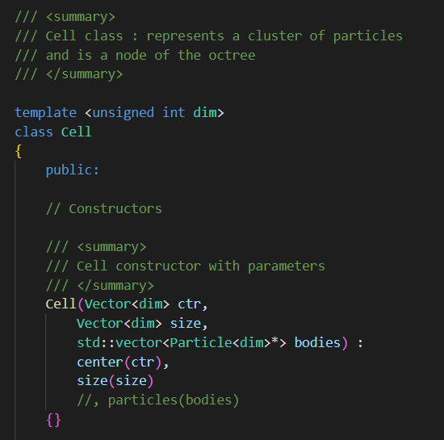
Structure of the program
Differently from before, I have implemented a class Cell, which represents a node the Octree, and has the methods buildTree and updateForces. Every Cell contains a vector of pointers to particles, that represent the particles inside, an information about its center of mass and its center in physical space, and an information about the size of the octant.

Slide 10
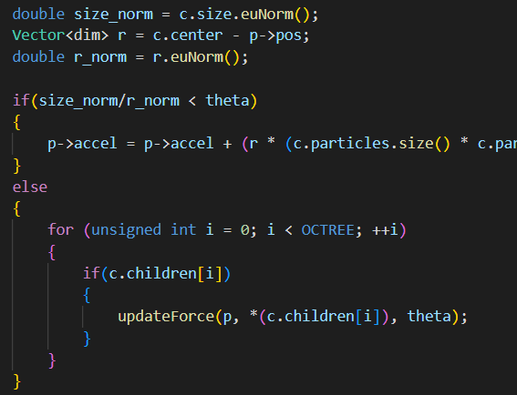
Structure of the program
In particular, the Barnes-Hut algorithm approximates the computation of far-away bodies with a parameter THETA in this way : if the ratio between the distance of the particles and the size of the cell is smaller than THETA, the force is calculated, otherwise it’s not (and we rely on the approximation of the center of mass of the cell). Clearly, if THETA = 1 every interaction in an octant is calculated, worsening the performance.

Slide 11
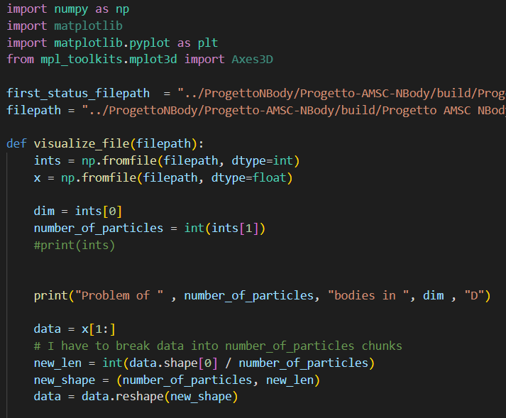
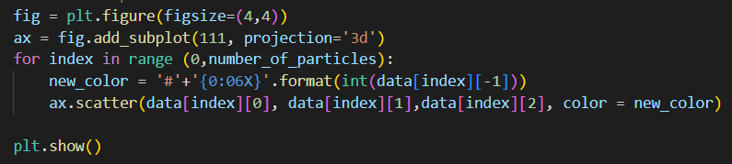
Structure of the program
A python visualizer has been implemented that reads the binary file in output and plots the bodies in 3D with matplotlib. This was done to avoid slowing performance with the graphics, and to check correctness of the algorithm.

Slide 12
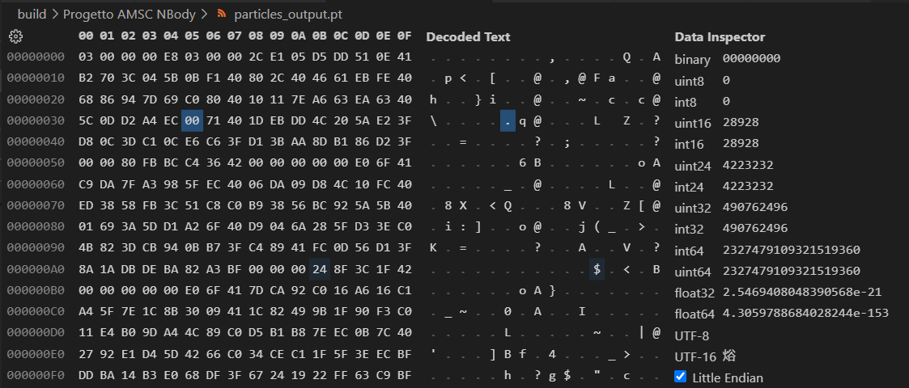
Structure of the program
A close look to the binary file:

Slide 13
Structure of the program
We have also built a JSON parser to be able to simply change our constants along he way, and a binary file that stores the status of a simulation to be able to load it and/or save the current state.
We built a 3D graphics engine with OpenGL that is able to effectively plot our system and simulate its behaviour.

Slide 14

Performance

Slide 15
Server – no omp, no graphics
NBody profiling
--- SIMULATION INFO ---
Problem dimension: 3D
Particle amount: 1000
Number of iterations: 1000
Simulation time resolution: 10 ticks per second
Simulation elapsed time: 10000 seconds
Graphics refresh time: 1000 milliseconds
Screen resolution: 2048x 2048
--- TIMING AND THREADS INFO ---
Total duration: 909933 ms
Iteration mean duration: 909908 us

Slide 16
Server – yes omp, no graphics
NBody profiling
--- SIMULATION INFO ---
Problem dimension: 3D
Particle amount: 1000
Number of iterations: 1000
Simulation time resolution: 10 ticks per second
Simulation elapsed time: 10000 seconds
Graphics refresh time: 200 milliseconds
Screen resolution: 2048x 2048
--- TIMING AND THREADS INFO ---
Total duration: 220875 ms
Iteration mean duration: 220788 us

Slide 17
Server – no omp, no graphics, 2000 bodies
NBody profiling
--- SIMULATION INFO ---
Problem dimension: 3D
Particle amount: 2000
Number of iterations: 1000
Simulation time resolution: 10 ticks per second
Simulation elapsed time: 10000 seconds
Graphics refresh time: 1000 milliseconds
Screen resolution: 2048x 2048
--- TIMING AND THREADS INFO ---
Total duration: 3651476 ms
Iteration mean duration: 3651433 us

Slide 18
Server – yes omp, no graphics optimized
NBody profiling
--- SIMULATION INFO ---
Problem dimension: 3D
Particle amount: 1000
Number of iterations: 1000
Simulation time resolution: 10 ticks per second
Simulation elapsed time: 10000 seconds
Graphics refresh time: 1000 milliseconds
Screen resolution: 2048x 2048
--- TIMING AND THREADS INFO ---
Total duration: 37667 ms
Iteration mean duration: 37578 us

Slide 19
pc – no omp, no graphics
NBody profiling
--- SIMULATION INFO ---
Problem dimension: 3D
Particle amount: 1000
Number of iterations: 1000
Simulation time resolution: 10 ticks per second
Simulation elapsed time: 10000 seconds
Graphics refresh time: 200 milliseconds
Screen resolution: 2048x 2048
--- TIMING AND THREADS INFO ---
Total duration: 616221 ms
Iteration mean duration: 616186 us

Slide 20
pc – yes omp, no graphics
NBody profiling
--- SIMULATION INFO ---
Problem dimension: 3D
Particle amount: 1000
Number of iterations: 1000
Simulation time resolution: 10 ticks per second
Simulation elapsed time: 10000 seconds
Graphics refresh time: 200 milliseconds
Screen resolution: 2048x 2048
--- TIMING AND THREADS INFO ---
Total duration: 56731 ms
Iteration mean duration: 56552 us

Slide 21
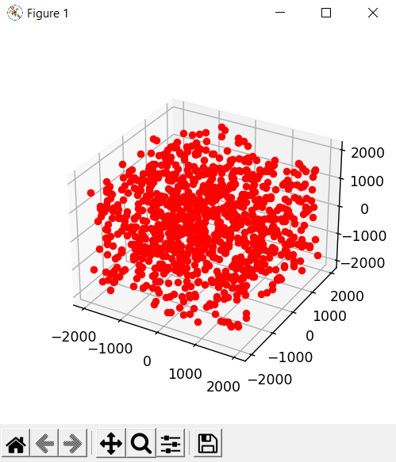
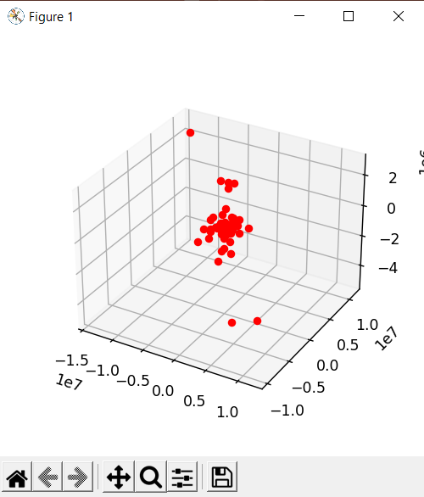
pc – barnes-hut
We see that we a significant speedup with a large number of bodies

Slide 22
pc – barnes-hut and omp
In this case, the tree is built and updated with omp parallel tasks.
With only 1000 bodies we cannot appreciate significant speedup

Slide 23

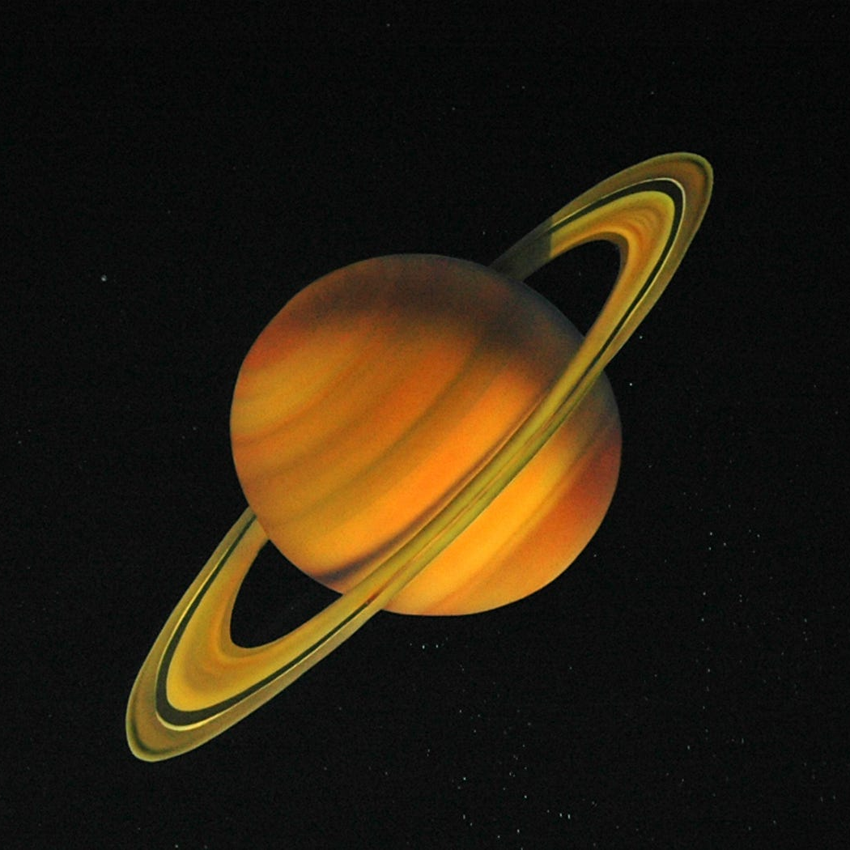
Thank you for the attention
matteo rigamonti

