Slide 1
CSE 3812 · AI Lab
Predator & Prey
Grid-based tactical AI simulation — predators hunt, prey forage, win by elimination or resource control.
Search
Behavior
Core
Vision
BFS · A*
FSM · Intents · Fcost
Turns · Combat · Occupancy
Full awareness (v1)

Slide 2
Problem
PREDATORS
PREY
Eliminate ≥ 70% of prey
Consume ≥ 65% of food
Tiger (one-shot) · Wolves (damage + cooldown)
Deer herds · shared goals · flee under threat
Alternating team turns · Predators first each round · 20×20 map

Slide 3
Architecture
config/*.json → data/loader → core (rules) → ai (decisions) → rendering
core/
ai/
rendering/
Grid · Agents · Combat · Simulation · Scenario
No Pygame — headless + tested
BFS · A* · Fcost · FSM · FoV (ready) · Influence (stub)
Pygame view only — never mutates simulation

Slide 4
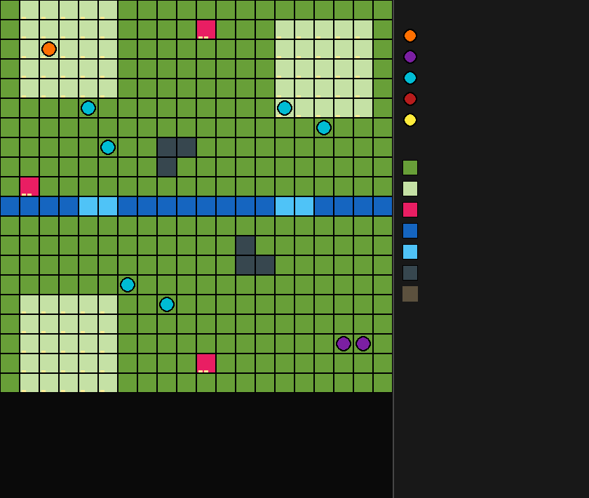
Map & Units (live render)
• River + 2 chokepoints
• 3 feeding grounds · resource nodes
• Rocks block movement
• T Tiger · W Wolves
• D 6 deer · 3 herds

Slide 5
Core Workflow — One Round
Predator turn → move + attack → Prey turn → move + feed → Win check
HARD RULES
DYNAMIC EACH TURN
• No shared tiles (occupancy)
• Moves sequential · adjacent only
• Predators attack from next tile — never stack on prey
• Positions · HP · food stock
• Prey state · wolf cooldown
• Flock food goal · events · winner

Slide 6
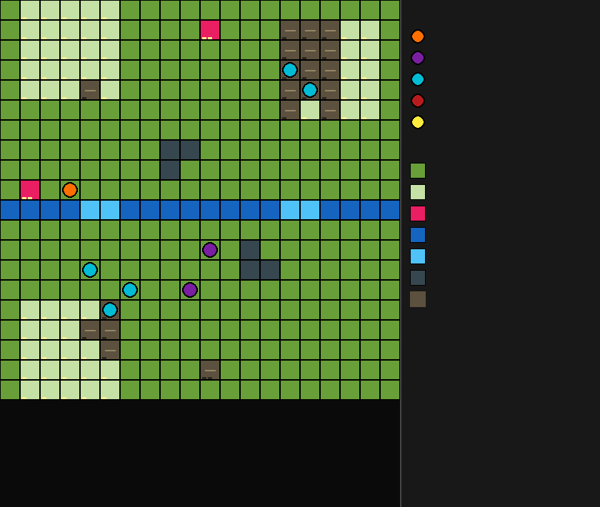
Mid-Game State
• Herds split across feeding areas
• Brown tiles = depleted food
• Same rules in Fast & Detailed playback
• Screenshot from real Renderer + Simulation

Slide 7
Algorithms — Search
Algo
Where
Does
BFS
Nearest food · flock goal
Unweighted shortest reach
A*
Prey NORMAL · predator intents
Path with Chebyshev heuristic
Chebyshev
Everywhere
8-dir distance · adjacency
A*: f = g + h | h = max(|Δr|, |Δc|)
Take only the next step each turn — replan next round.

Slide 8
Predator Intents (rolled once)
Chase
Ambush
Camp
A* toward closest prey
A* to midpoint(prey, prey's food)
Wait opposite side of river
Also after tiger's first kill
Wolf bias
If prey < 3 tiles → close in · Tiger bias
Target = closest living prey · recomputed every move

Slide 9
Prey FSM
NORMAL → PANIC → DESPAIR → NORMAL if predator > 3
NORMAL
PANIC
DESPAIR
Shared flock food goal · A* · eat underfoot if safe
Flee + still prefer food (fcost)
Flee + regroup flock · no food term
Despair triggers on kill · Panic scoring implemented · spotting trigger = Phase 2

Slide 10
Fcost ≠ A*'s f
WHAT IT IS
FORMULAS
Local rank score over ≤8 neighbors (+ stay)
Panic: away from predator + toward food
best gets N … worst gets 1
fcost = sum of ranks
Despair: away from predator + toward mate (unless already ≤2)
A* = global path to a goal · Fcost = one emergency step under fear

Slide 11
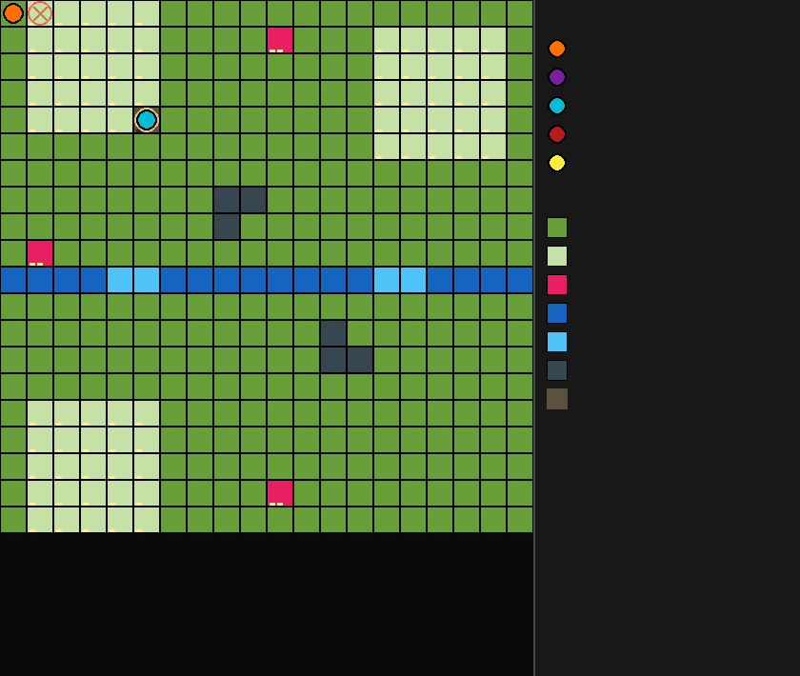
Combat & Events
• Adjacent after move → attack
• Tiger one-shots · Wolf 60 dmg
• Wolf skips attacks 1 full turn after kill
• KILL / EMPTY FX + sidebar log

Slide 12
Vision
v1 = Full awareness — whole map known
No fog of war in the live turn loop
READY, NOT WIRED
DEFEND
• src/ai/fov.py
• Rocks block Bresenham LoS
• Tall grass hides past 3 tiles
Deterministic chase & tests first. LoS is an optional harder mode per GDD.

Slide 13
CSP?
Not used — current AI = search + FSM + local scoring
WHERE CSP COULD FIT
WHAT WE DO INSTEAD
• Legal spawn layouts
• Simultaneous herd next-tiles
• Wolf pack spacing assignment
Sequential moves + hard occupancy checks = constraints enforced, not a CSP solver.

Slide 14
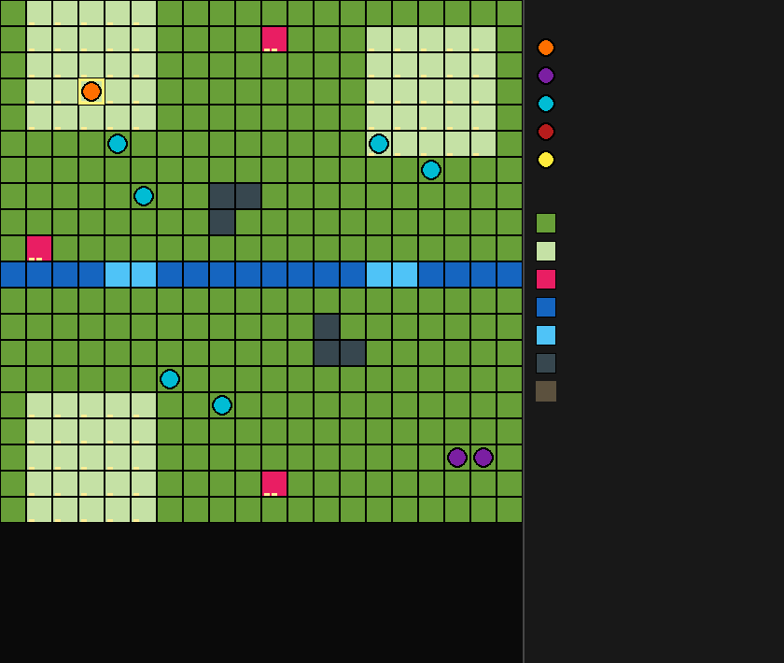
Detailed Playback
• One unit action per tick
• Active unit highlighted
• Fast mode = full round / tick
• Identical outcomes (tested)

Slide 15
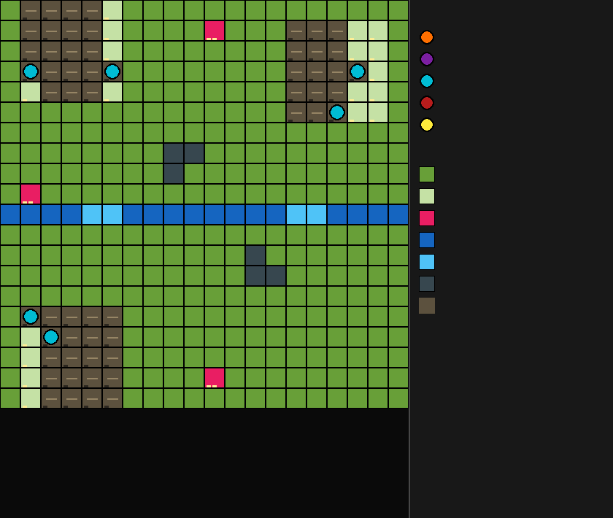
Foraging & Depletion
• Eat underfoot when safe
• Blocked goal → BFS other food
• Depleted = brown · still passable
• Prey win at 65% pool eaten

Slide 16
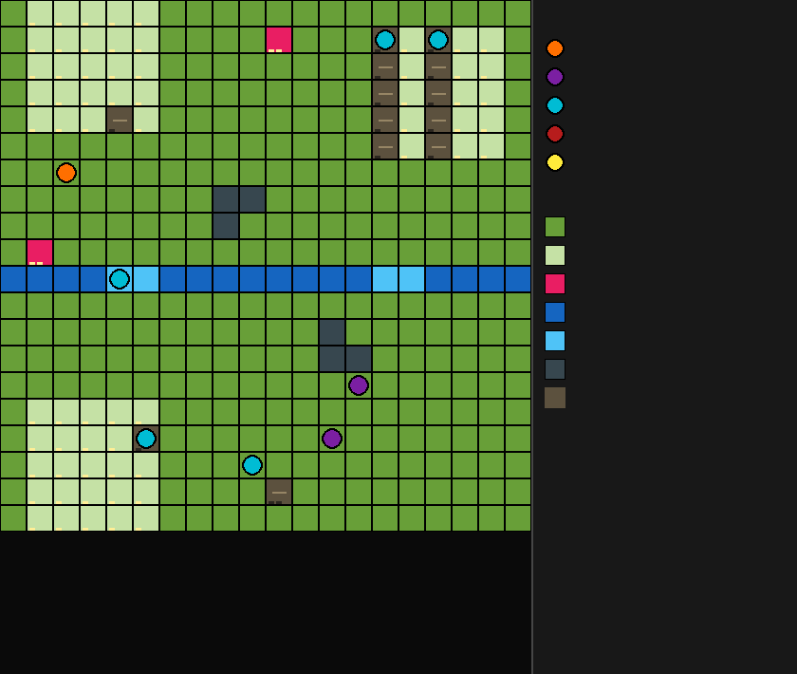
Debug Overlay
• F1 — intents + prey states
• Shows Chase / Ambush / Camp
• Shows N / P / D state letter

Slide 17
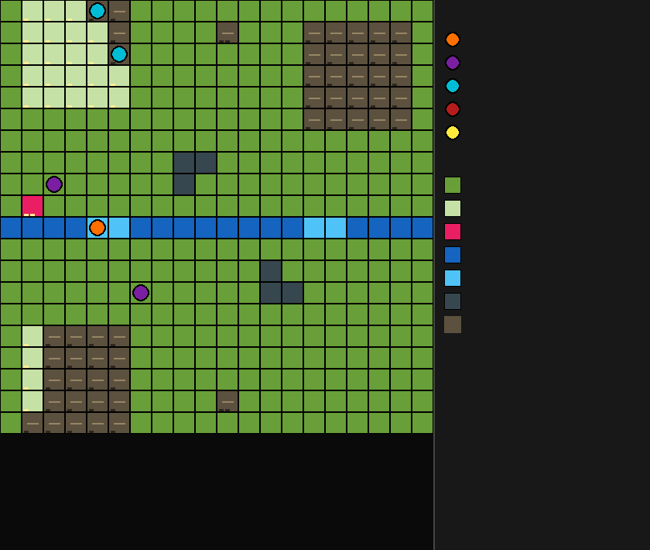
End State
• Winner set when threshold hit
• Sample balance ~55% prey / 45% pred (seeds 0–99)
• History logged each round

Slide 18
Gaps & Defense
Panic spotting
Wolf pack AI
LoS / influence / CSP
Fcost ready · trigger not wired
Coded · default uses solo A*
Optional / deferred
Phase 2 — despair already on kill
Next: assign pack_id + call pack step
Not required for core demo
DONE: Core loop · occupancy · BFS/A* · intents · despair · fcost · combat · wins · playback · tests

Slide 19
Demo Controls
Space
Pause / resume
T
Detailed ↔ Fast
N
Next action / round
+ / −
Speed
R
New scenario
F1
Debug overlay
python -m src.main · pytest tests/ -v

Slide 20
Summary
• Headless core owns rules; AI chooses moves; render only shows
• Search: BFS + A* · Fear: ranked fcost · Behavior: FSM + intents
• Vision: full map in v1 · FoV module ready for later
• Honest Phase-1 complete · Phase-2 wires identified
Questions?

