Slide 1
Alumni TrackEr
Created By:-
Omkar Kawale(20)
Aryan Nagbanshi(31)
Sahil Nikshe(32)
Sahil Suryawanshi(49)

Slide 2
Introduction:-
The Alumni Tracking System is a web-based application that aims to improve the current tracking procedure of college graduates by providing an optimized solution for collecting and managing alumni data. It provides an easy-to-use platform for alumni to update their current status and information by simply filling out forms and uploading files.
The system also benefits college faculties by giving them access to alumni data and enabling communication with graduates. Alumni forums can be managed through the platform, and events can be posted automatically without requiring any maintenance effort from alumni or admins.
Overall, the Alumni Tracking System provides a great flexible solution to keep track of alumni data and to facilitate communication between the institution and graduates. It streamlines the process for both parties and helps colleges stay connected with their alumni community.

Slide 3
Literature survey:-
Title | Author | Year of Publication | Description
Alumni Tracking Using Google Map API and Social Media based on GPS and LBS:This work was carried out in 2016 | by Nikita Mittapelli, SnehalChavan, JyotiKumari. | May 2016 | Android, an open source platform has become popular in smart phones and used more by people. Aim of our project is to develop an android application which will be useful to track all the alumni by their social media account information using web API's.

Slide 4
Title | Author | Year of Publication | Description
Gathering Alumni Information from a Web Social Network | It was carried in 2016 Rashmi Chaudhary; Vighnesh Sawant; Priya Prajapati. | Feb 2018 | Thus, this work proposes a novel method to help teaching staffs of undergraduate programs to gather information on the desired population of alumni, semi automatically, on the Web. Overall, by using a few alumni pages as an initial set of sample pages, the proposed method was capable of gathering information concerning a number of alumni twice as bigger than adopted conventional methods

Slide 5
Motivation and challenges
In any University or Institution, every year more than 2000 students pass every year. It is very difficult for the University to manage everyone and there is no way for them to keep track of them.
Our Project allows these Universities to keep track of their Alumni. We also allow them to get in contact with the alumni for future events.

Slide 6
Problem statement:-
As number of students graduating each year is more than 10000, there is no way for the Higher Education Directorate to manage them. To develop a web application to track the alumni of Higher Education Directorate.

Slide 7
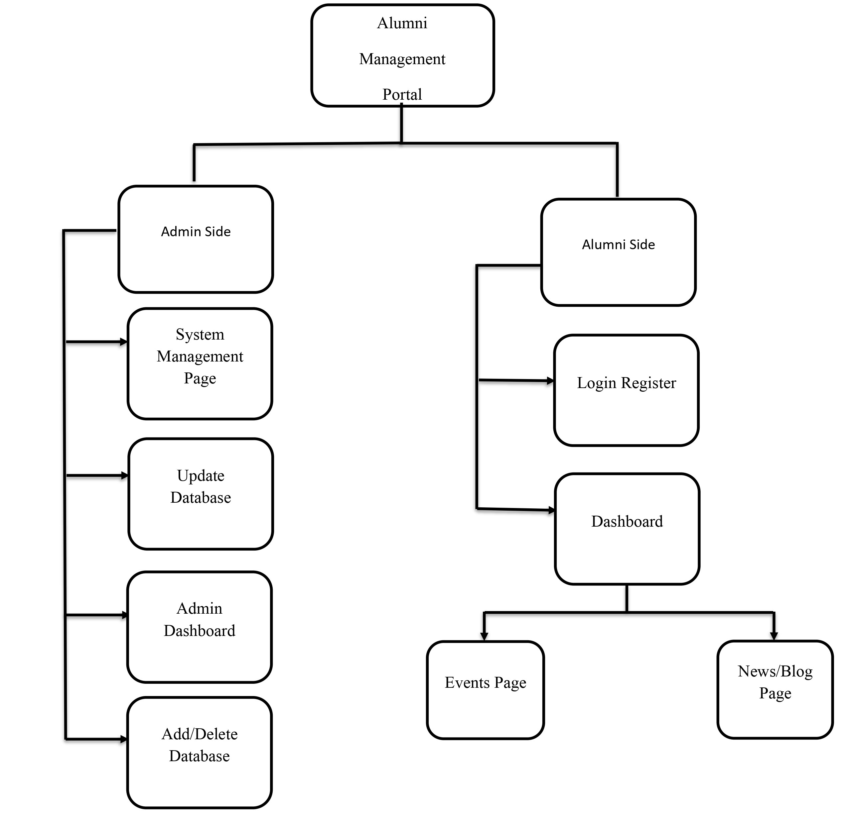

Slide 8
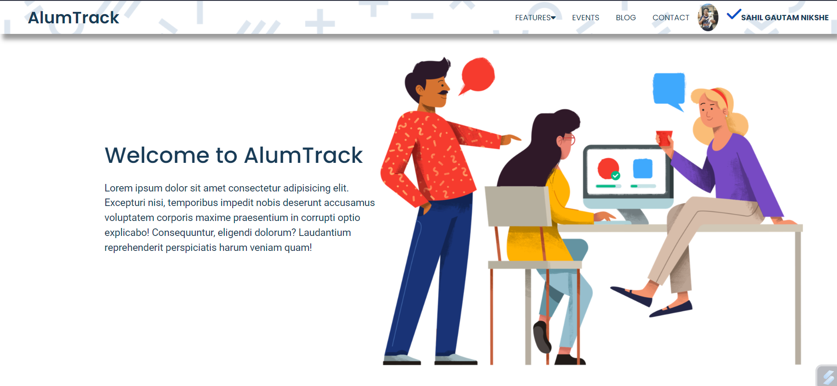
Output:-

Slide 9

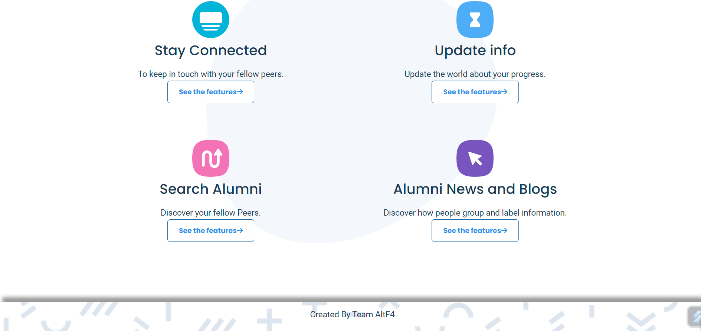

Slide 10
Conclusion:-
The "Alumni Management System" website is a fully functional website which time saving, easy to use, efficient way of managing relatable data, making it for the institution to connect with them easily and updating them about the ongoings of the institution.
In the future, we can even sell this project to different colleges and universities to help them manage their alumni better.

Slide 11
References:-
[1] B. Carter, "HTML Educational Node.js System (HENS): An Applied System for Web Development," 2014 Annual Global Online Conference on Information and Computer Technology, 2014, pp. 27-31, doi: 10.1109/GOCICT.2014.25.
[2] Tarun Kumar, Yeeshu Prateek, Prajwal Atharga, Dr. Rajashekarappa, Prof. V. K. Parvati, 2019, Alumni Database Management System, INTERNATIONAL JOURNAL OF ENGINEERING RESEARCH & TECHNOLOGY (IJERT) NCRACES – 2019 (Volume 7, Issue 10),
[3] L. Meng, "College Student Management System Design Using Computer Aided System," 2015 International Conference on Intelligent Transportation, Big Data and Smart City, 2015, pp. 212-215, doi: 10.1109/ICITBS.2015.59.
[4] A. Mukherjee, A. Roy, M. K. Lath, A. Ghosal and D. Sengupta, "Centralized Alumni Management System (CAMS) - A Prototype Proposal," 2019 Amity International Conference on Artificial Intelligence (AICAI), 2019, pp. 967-971, doi: 10.1109/AICAI.2019.8701383.

