Slide 1
Electrical Impedance Tomography (EIT)
Introduction of EIT, Comparing methods and brief look at Deep D-bar method

Slide 2
What is tomography?
The term ‘Tomography’ refers to a general technique of using penetrating signals to image a solid object from outside.
It’s used in many fields of study bit here we want to use it in medicine purposes.
We use it for imaging the human body.

Slide 3
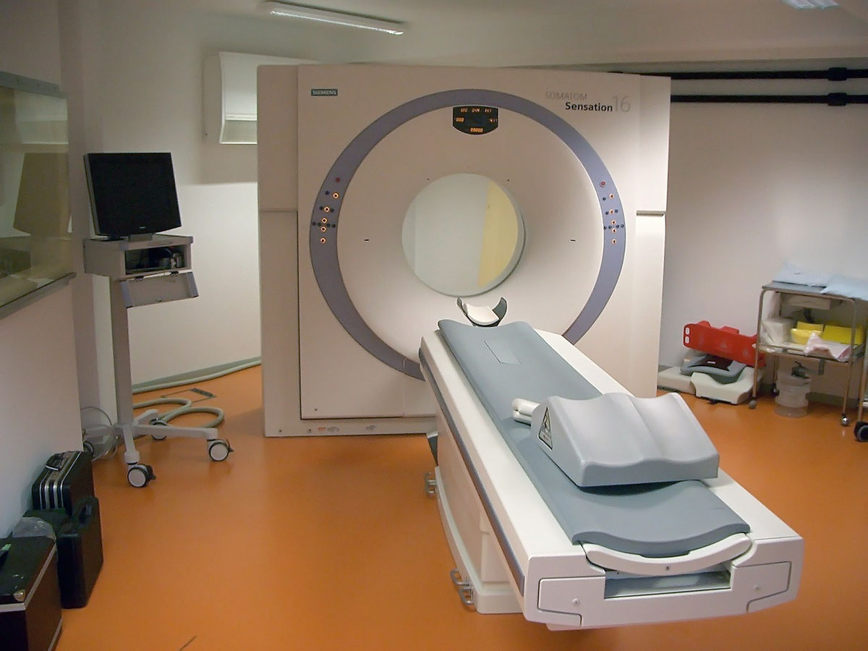
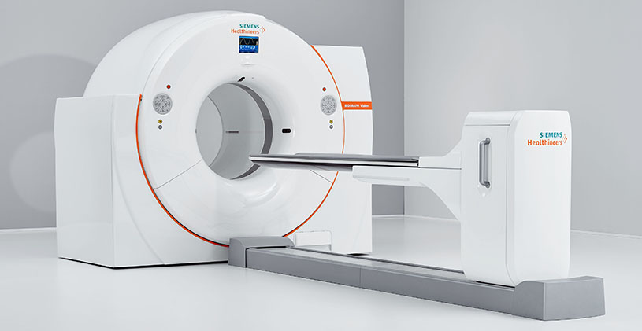
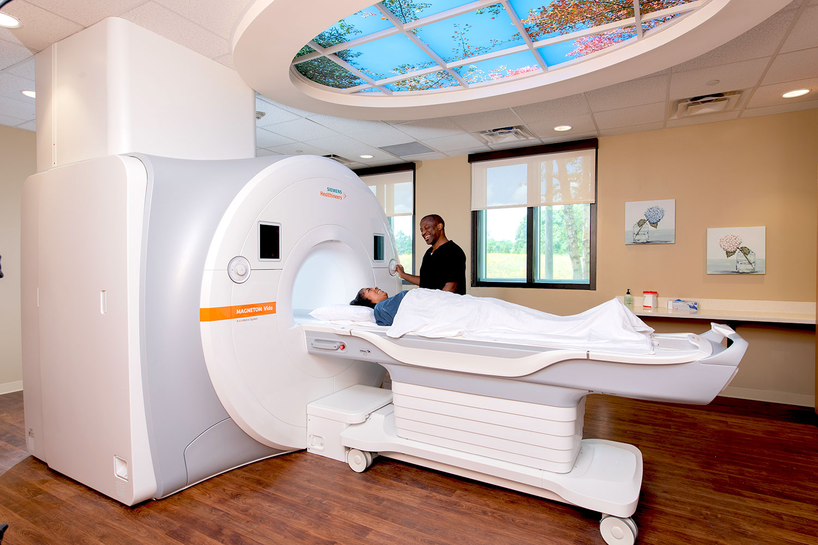
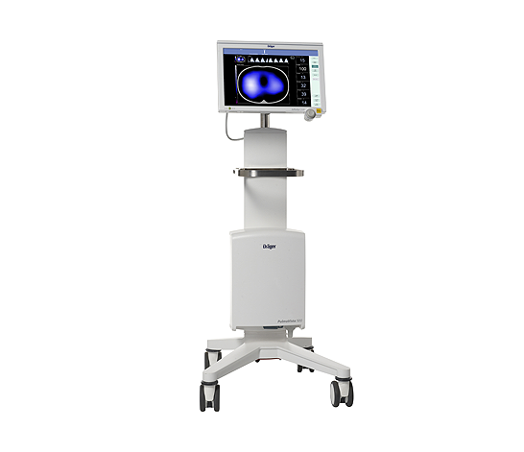
Different tomography methods
Fig.1.¹
CT
X-rays
Fig.3.³
PET Gamma rays
Fig.2.²
MRI
Magnets
Fig.4.⁴
EIT
Electricity

Slide 4
Historical example
Changes in the resistivity of lung tissue during respiration have been measured by placing electrodes directly in contact with lung tissue
(Geddes and Baker 1967, Witsoe and Kinnen 1967, Denniston and Baker 1975) .⁵

Slide 5
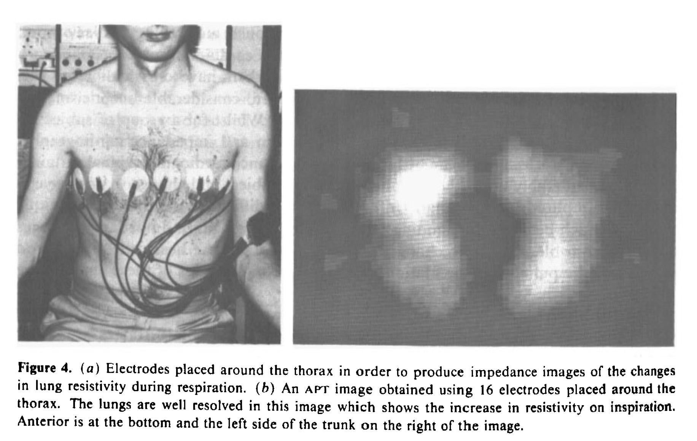
Fig.5.⁵ Electrodes placed around the thorax
An EIT image obtained using 16 electrodes placed around the thorax.

Slide 6
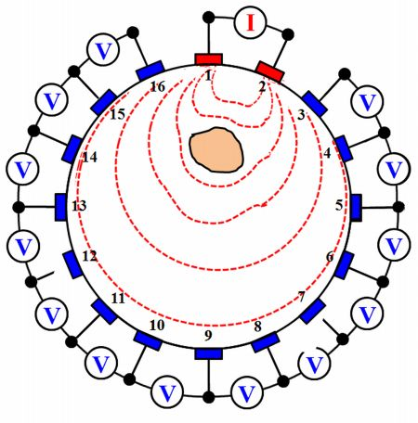
What is EIT?
Electrical impedance tomography
-EIT uses electrical currents to visualize the conductivity
distribution within the body from voltage measurements
of its surface. ⁶
For the input we use alternative current
For the output we measure the voltage

Slide 7
Pros
Real-time Imaging: EIT can provide real-time or near real-time imaging, allowing for continuous monitoring and dynamic imaging
Low Cost: EIT is relatively inexpensive compared to other imaging modalities like CT or MRI.
Portable and Bedside Application: EIT systems can be compact and portable. This mobility makes it suitable for monitoring patients in intensive care units, emergency departments.
Safety: EIT uses low electrical currents that are generally safe for patients, even for long-term monitoring.
Potential for Specific Applications: EIT shows promise in specific applications, such as lung imaging, breast cancer detection, monitoring of blood flow, and assessing tissue viability during surgery.

Slide 8
Cons
Spatial Resolution: EIT typically provides lower spatial resolution compared to other medical imaging techniques
Inverse Problem: EIT is an ill-posed inverse problem, meaning that multiple different conductivity distributions can give rise to the same measured voltage changes.
Sensitivity to Noise: EIT measurements are sensitive to noise interference.
Limited Tissue Differentiation: EIT primarily measures electrical conductivity and may have difficulty in differentiating between different types of tissues with similar conductivities.

Slide 9
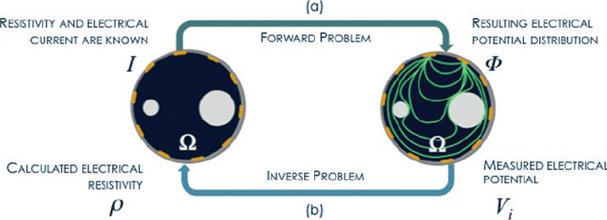
Forward and Inverse problem
Fig.6.⁸ Forward and inverse problem of EIT

Slide 10
Different parameters in EIT
Number of electrodes
Position of electrodes
Injection pattern
Image reconstruction method
Current level and frequency
Based on this Parameters we have some experiments

Slide 11
D-bar
The image recovery process of EIT image from the current/voltage measurement data is an ill-posed nonlinear inverse problem.⁹
The D-bar method is a non-iterative reconstruction method based on low-pass filtering a nonlinear Fourier of the measured surface current/voltage data.⁹
The D-bar approach is to transform the physical conductivity equation into a nonphysical Schrödinger equation, solve that problem and then transform back to the physical setting
The ‘D-bar method’, provides real-time noise-robust image recovery by using a low- pass filter of the associated nonlinear Fourier data.⁹

Slide 12
Deep D-bar
Unfortunately, this results in images that suffer a loss of sharp features often important in medical imaging applications.⁹
D-bar method is robust to incorrect or incomplete knowledge of electrode locations as well as errors in boundary shape.⁹
D-bar algorithm with subsequent processing by a CNN.⁹

Slide 13
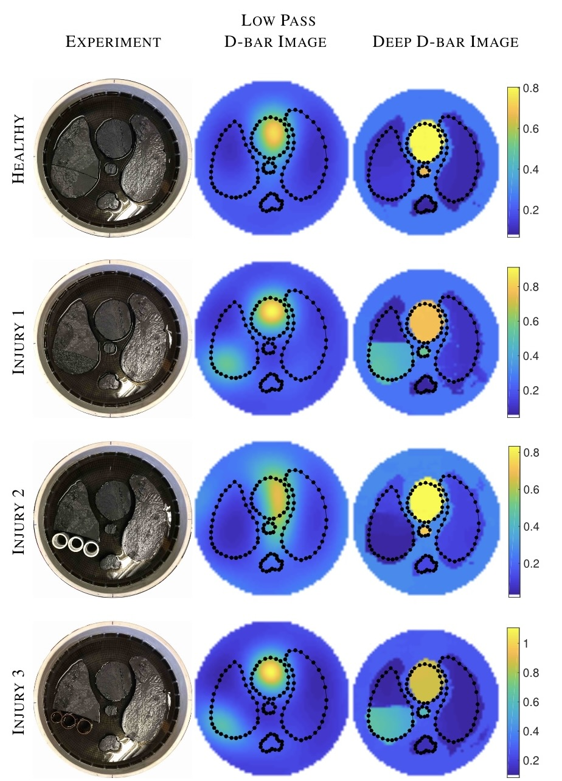
Fig.7.⁹ Healthy,Injuries1-3
The initial D-bar image is compared to the Deep D-bar image.

Slide 14
Future Work
Improved Image Reconstruction Algorithms: Developing more sophisticated and robust image reconstruction algorithms
Hardware Advances: Continual advancements in electrode technology, including flexible and high-density electrode arrays, can enhance the quality of EIT measurements.
Deep Learning and Artificial Intelligence: The application of deep learning and artificial intelligence techniques can assist in image reconstruction, noise reduction, and interpretation of EIT images.
Integration with Interventional Procedures: Integrating EIT with interventional procedures, such as guiding needle placements or monitoring treatment responses in real-time, for example anesthesiologists.

Slide 15
Conclusion
Use of EIT help us with costs and time and in compare of other tomography methods is safer and healthier.
Despite all these benefits, it’s not mature yet and suffers from ill-posed nonlinear inverse problem. The D-bar method provides reliable reconstructions of the conductivity but suffers from a blurring.
Sharp improvements in absolute EIT image quality can be achieved by coupling the D-bar reconstruction method with a convolutional neural network.⁹
We demonstrated that a CNN can effectively learn the deblurring using only simulated data without including any experimental data in the training itself.⁹

Slide 16
Electrical impedance tomography
Oveys Javanmardtilaki oveys.javanmardtilaki@uni-rostock.de
Prof. Dr.-Ing. Sascha Spors. sascha.spors@uni-rostock.de
Dr.-Ing. Frank Schultz frank.schultz@uni-rostock.de
M.Sc. Jacob Thönes. jacob.thoenes@uni-rostock.de

Slide 17
resources
1.https://de.wikipedia.org/wiki/Computertomographie#/media/Datei:Computertomograph_Sensation16.JPG
2.https://www.nghs.com/mri
3.https://www.siemens-healthineers.com/molecular-imaging/pet-ct
4.https://www.omnia-health.com/product/dräger-pulmovista®-500-electrical-impedance-tomography-eit
5. B H Brown et al 1985 Clin. Phys. Physiol. Meas. 6 109
6. Yang Zhang, Robert Xiao, Chris Harrison ’’Advancing Hand Gesture Recognition with High Resolution Electrical Impedance Tomography’’
7. https://web.yonsei.ac.kr/seoj/eit.htm
8. R.Silva, M.G.Rasteiro, F.A.P. Garcia, A.R:Ferreira, M.J.Santos,J.B.Santos & A.P.Coimbra , 18 Jun 2012
maging Particulate Two-Phase Flow in Liquid Suspensions with Electric Impedance Tomography,Pages 329-342
9. S. J. Hamilton and A. Hauptmann, Deep D-Bar: Real-Time Electrical Impedance Tomography Imaging With Deep Neural Networks, Doi:10.1109/TMI.2018.2828303

