Slide 1

2025 Sales Performance Report
EMMA N. VENTURES
Home of Phones and Accessories

Slide 2
Executive Summary
Strong Revenue
Branch Performance
Data Limitations
Business achieved strong total revenue with positive growth momentum across 2025.
Growth driven mainly by a few high-performing branches with revenue concentration.
Lack of transaction-level tracking and branch closures limit strategic planning.
The interactive dashboard provides management with real-time insights into performance, trends, and operational efficiency.

Slide 3

Problem Statement
Current Tracking
Company tracks only daily total sales per branch.
Data Gaps
High customer volume and lack of customer and product-level data prevent accurate assessment of behavior, performance, and efficiency.
Strategic Impact
Restricts forecasting, inventory planning, and growth strategy development.

Slide 4
Objectives
01
02
03
Evaluate Performance
Compare Branches
Identify Trends
Assess overall 2025 sales performance
Analyze branch contributions
Detect seasonal patterns
04
05
06
Measure Consistency
Calculate Growth
Assess Risk
Evaluate operational performance
Determine sales growth rate
Identify revenue concentration
07
Provide Insights
Deliver data-driven recommendations

Slide 5

Dashboard Overview
Total Revenue
Average Sales
Aggregate sales across all branches
Average dails sales across branches
Monthly Trends
Branch Performance
Seasonal performance patterns
Individual location metrics
Operating Rate
Revenue Contribution
Days open vs. total working days
Branch-level revenue share
Filters enable analysis by month and branch for targeted insights.

Slide 6

Key Findings
Revenue Concentration
Revenue is highly concentrated among top-performing branches, creating concentration risk.
Seasonal Trends
Certain months consistently outperform others, indicating clear seasonality patterns.
Positive Growth
Sales show positive overall growth but experience significant monthly fluctuations.
Volatility
Daily sales volatility remains high across all locations.

Slide 7
Recommendations
Staff Feedback System
Management can implement a structured staff feedback mechanism
Management Reviews
Use dashboard in regular management reviews
Optimize Inventory Based on Branch Strength
Optimize inventory distribution by prioritizing high-demand products in branches where they sell the most
Deploy POS
Install point-of-sale system for transaction-level data
Centralize Data
Centralize database for unified reporting
Automate Reporting
Automate reporting processes
Forecast Models
Implement forecasting models for better planning

Slide 8

Conclusion
EMMA N. VENTURES has built a strong revenue foundation in 2025. With improved data systems, operational discipline, and strategic investment in high-performing branches, the business can achieve sustainable long-term growth.
The interactive dashboard provides management with real-time insights into performance, trends, and operational efficiency.

Slide 9

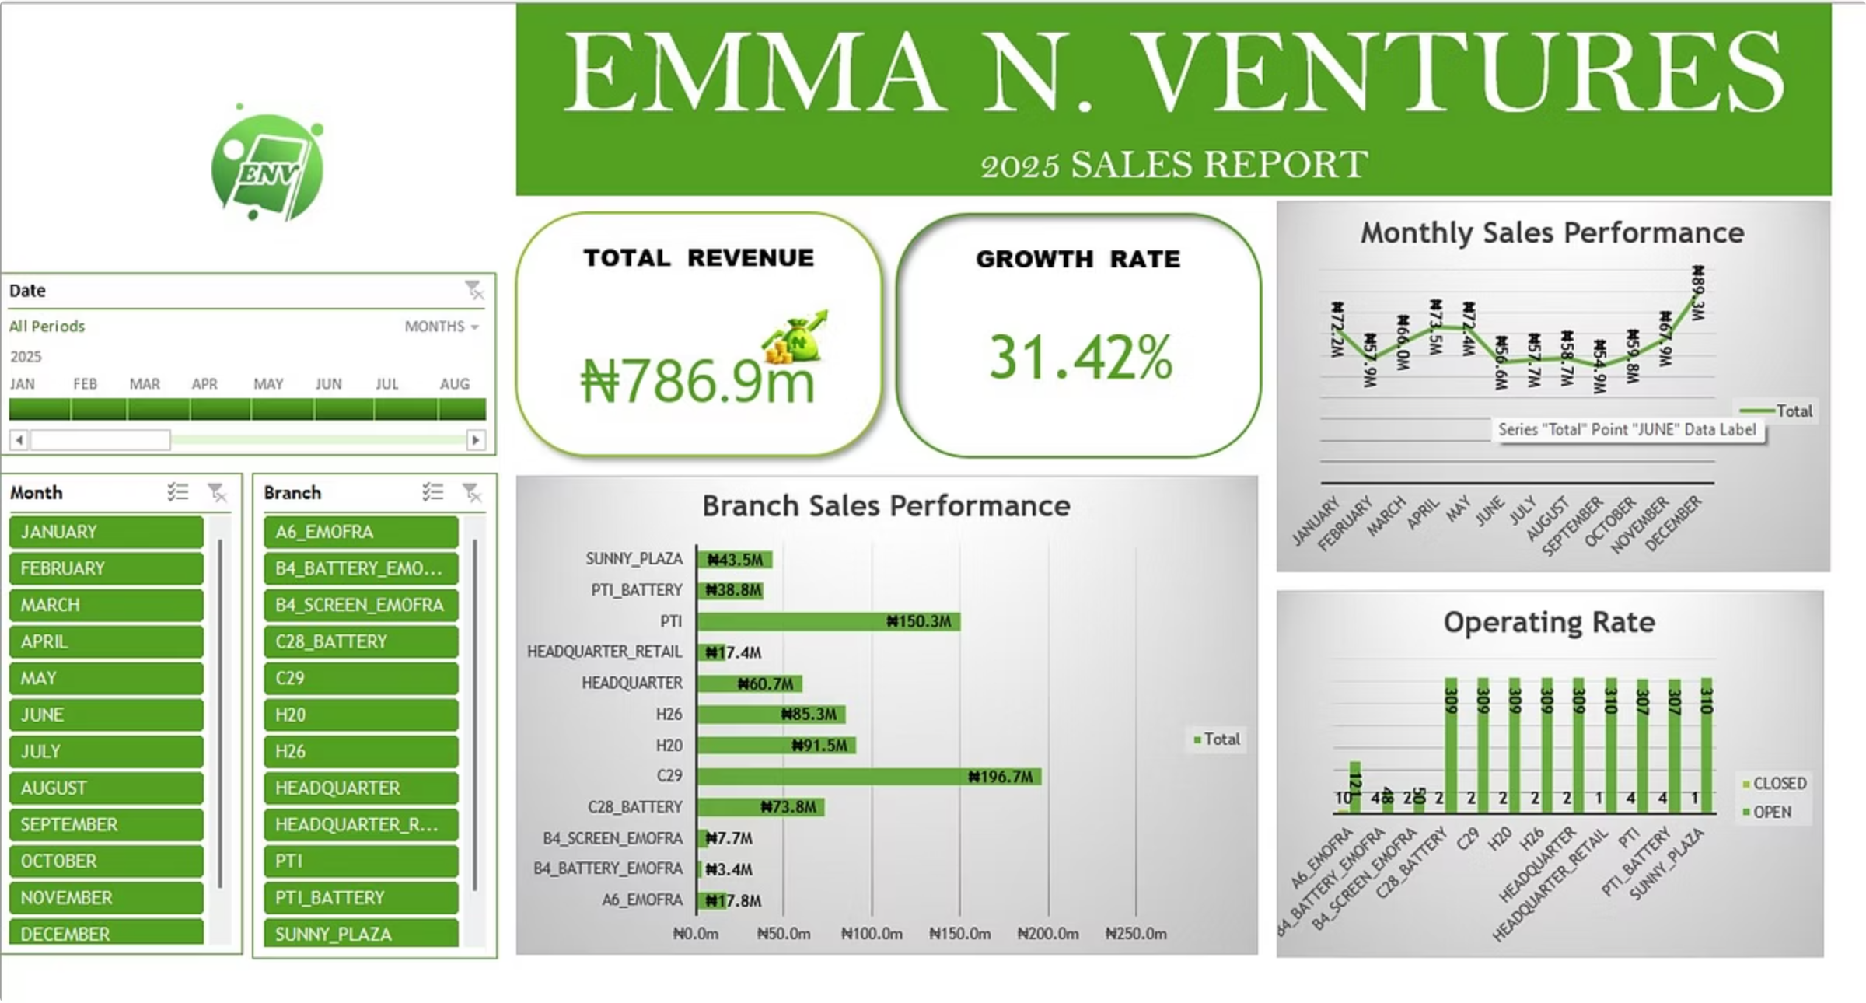
Interactive Sales Dashboard
The dashboard presents Total Revenue, Sales Growth Rate, Monthly Sales Trend, Branch Performance, Operating Rate, and Revenue Contribution by Branch. Filters allow analysis by month and branch.

