Slide 1


Final Dashboard & Strategic Insights Report
AI Data Insights Team 15 • Week 04 • March 09, 2026

Slide 2

Agenda
Title Slide
Agenda
Introduction
Executive Summary
Dataset Overview
Historical Application Analysis
Model Development and Performance
Feature Important Analysis
Prediction Forecast Analysis
Integrated Dashboard Overview
Strategic Recommendations
Conclusion and Learning Journey

Slide 3

Executive Summary
Historical learner application data analyzed to identify engagement patterns
Exploratory analysis revealed imbalance between success and non-success outcomes
Random forest model built to predict learner success probability
Predictions indicate high risk of non-success outcomes
Insights integrated into an interactive analytics dashboard

Slide 4



Dataset Overview
Application Records
Analytical Objectives
Status Description, Opportunity Category, Age Group, Country, Institution Name, Application timing
Examine historical participation trends
Identify structural outcome patterns
Develop predictive model for learner success
Translate results into strategic recommendations

Slide 5






Data Preparation & Cleaning
Data Preparation Process
Purpose of Data Preparation
Removed incomplete and ongoing application records to ensure reliable analysis
Standardized categorical values such as Status Description and Opportunity Category
Cleaned and filtered data to retain only relevant variables for analysis
Target Variable Creation
Improve data quality and reduce noise in the dataset
Enable accurate model training and prediction
Support clear and meaningful dashboard visualizations
Created a binary outcome variable for modeling
Success: Rewards Award
Non-Success: Rejected, Dropped Out, Withdrawn

Slide 6

Historical Application Analysis
20-25
2
99.3%
Primary Age Group
Dominant Categories
Drop-Off Rate
Historical imbalance in outcomes
Accounted for highest application volume
Internship and Course programs
Geographic distribution showed concentration in limited countries, suggesting uneven global engagement patterns.

Slide 7



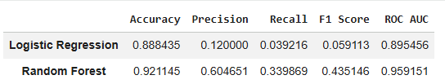
Model Development & Performance
Random Forest Model
Binary Prediction
Model Evaluation
Classification algorithm trained on demographic and opportunity-related features
Success (Rewards Award) vs. Non-Success (Rejected, Dropped Out, Withdrawn)
Confusion matrix analysis confirmed strong alignment with actual outcomes
This table compares the performance of the models tested during the modeling phase.
The Random Forest model achieved higher accuracy, precision, recall, F1 score, and ROC AUC compared to Logistic Regression.
Model Performance Comparison
1
Model Selection
2
Random Forest was selected because it produced the most stable and accurate predictions compared to the other tested models.

Slide 8
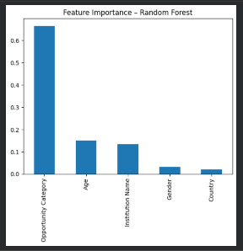
Feature Importance Analysis
Opportunity Category
Program type significantly influences outcome probability
Age Group
Demographic segment drives participation patterns
Institution Name
Organizational context affects engagement levels
Country
Geographic region shapes application success rates

Slide 9


Prediction Forecast Analysis
99.3%
0.7%
Predicted Drop-Off
Predicted Success
Non-success outcomes dominate forecast
Rewards Award probability remains low
Probability distribution analysis indicates concentration of predictions within high-risk zones, suggesting systemic engagement challenges rather than isolated individual cases.

Slide 10
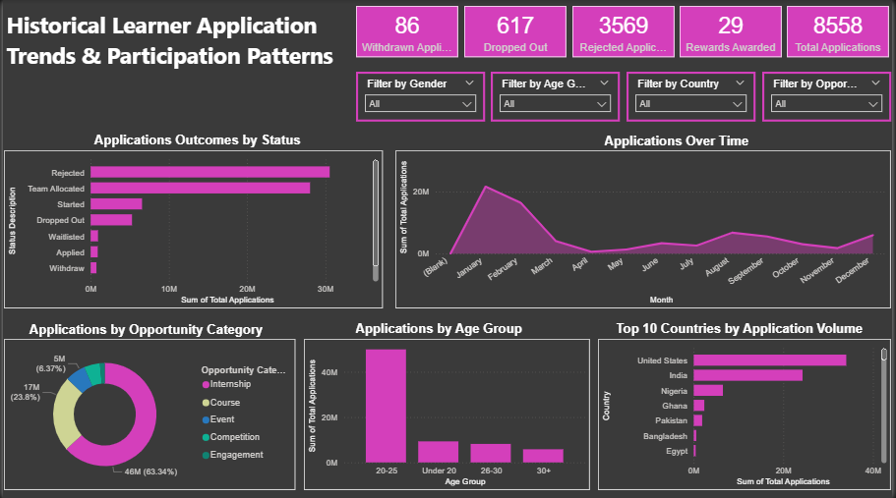
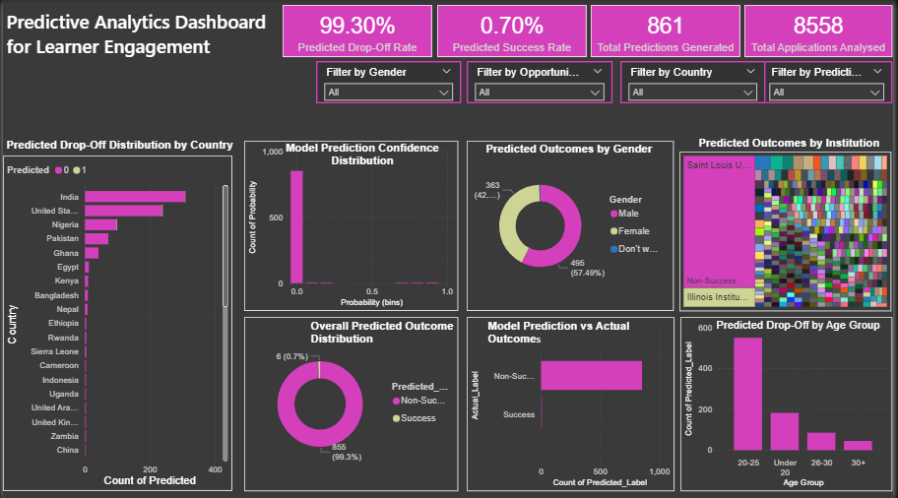
Integrated Dashboard Overview
Historical Learner Trends
1
Demographic filtering, program-level risk exploration, country-level segmentation
Predictive Analytics Insights
2
Confidence-based analysis, probability score visualization, actual vs. predicted comparison
The dashboard transforms static analysis into an interactive planning tool, enabling stakeholders to visualize both historical insights and future forecasts.
Dashboard Link
https://drive.google.com/file/d/1j92bjEFUlUTer9y6KHJBsYJPNgel_5x_/view?usp=sharing

Slide 11
Strategic Recommendations
01
02
03
Early Risk Identification Framework
Program-Level Structural Review
Application Pipeline Optimization
Use prediction probabilities to flag high-risk learners and implement early mentorship interventions
Analyze high-risk opportunity categories and redesign onboarding and support mechanisms
Strengthen screening processes and introduce preparatory workshops for high-risk segments
04
05
Geographic Engagement Expansion
Continuous Data Monitoring and Model Improvement
Increase outreach efforts in underrepresented countries to improve global participation balance.
Regularly monitor application outcomes and retrain predictive models to improve forecasting accuracy.

Slide 12

Conclusion & Learning Journey
Key Achievements
Skills Developed
Integrated exploratory data analysis with predictive modeling
Developed Random Forest classifier with strong performance
Built interactive dashboard for strategic planning
Translated predictions into actionable recommendations
Data cleaning and transformation
Feature engineering
Model evaluation and interpretation
Power BI dashboard design
This analysis demonstrates how data-driven approaches uncover meaningful patterns in learner engagement. By integrating machine learning insights into an interactive dashboard, raw data transforms into strategic intelligence for proactive decision-making.

